Slide 1
State-of-Art: Management of patients with CCS
Arvand Pharmed
Maryam Mehrpooya, M.D.
Imam Khomeini Hospital , Tehran University of Medical Science

Slide 2
TABLE OF CONTENTS
01
02
03
Introduction
Evaluation, Diagnosis, &
Risk Stratification
Treatment
Arvand Pharmed
Epidemiology and Definition
Diagnostic Evaluation for Risk Management
CCD Management & Treatment

Slide 3
01
Introduction
Arvand Pharmed
Epidemiology & Definition

Slide 4
620,000,000
20,500,000
Arvand Pharmed
People living with Heart and Circulatory Diseases, Worldwide in 2021
Deaths due to Heart and Circulatory Diseases, Worldwide in 2021

Slide 5
CCD DEFINITION
Arvand Pharmed
Patients discharged after admission for an ACS event or after coronary revascularization procedure and after stabilization of all acute cardiovascular issues.
Patients with left ventricular systolic dysfunction and known or suspected coronary artery disease or those with established cardiomyopathy deemed to be of ischemic origin.
Patients with stable angina symptoms medically managed with or without positive results of an imaging test.
Patients with angina symptoms and evidence of coronary vasospasm or microvascular angina.
Patients diagnosed with CCD based solely on the results of a screening study and the treating clinician concludes that the patient has coronary disease.

Slide 6
Emphasis is on team-based, patient centered care that considers social determinants of health along with associated costs while incorporating shared decision-making in risk assessment, testing, and treatment.
Arvand Pharmed

Slide 7
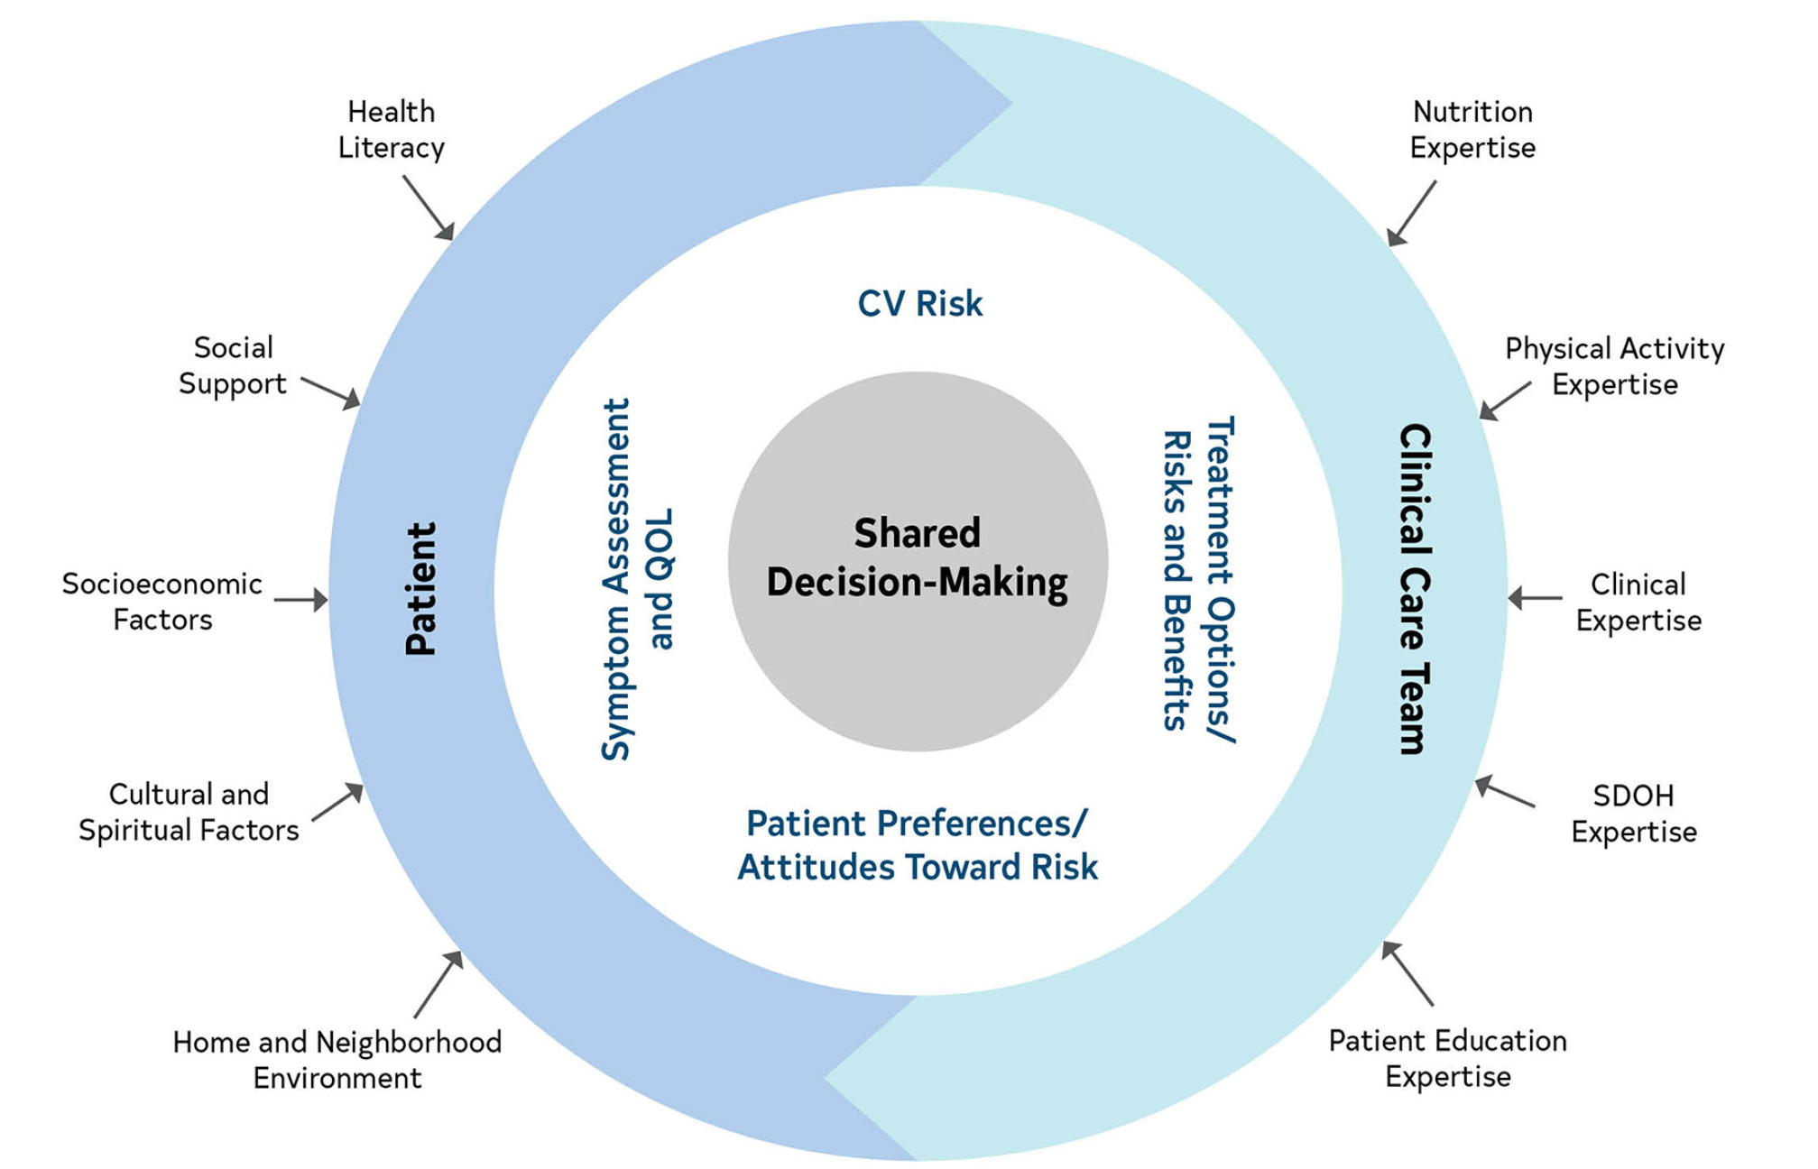
Domains to Consider When Seeing a Patient With CCD
Arvand Pharmed

Slide 8
02
Evaluation, Diagnosis, &
Risk Stratification
Arvand Pharmed
Diagnostic Evaluation for Risk Management

Slide 9
2023 AHA Diagnostic Evaluation
Arvand Pharmed
In patients with CCD, if there is an opportunity to do so, clinicians should first intensify GDMT and defer testing. In patients with CCD, assessing the severity of ischemia may be useful to guide clinical decision-making regarding the use of ICA and for intensification of preventive and anti-ischemic therapy.
invasive coronary angiography
guideline-directed management and therapy

Slide 10
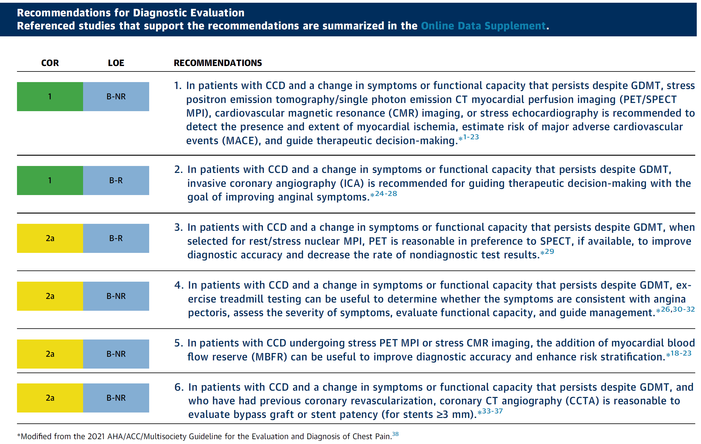
2023 AHA Guideline for Diagnostic Evaluation
Arvand Pharmed

Slide 11

Risk Stratification
Arvand Pharmed
In patients with CCD, the results of non-invasive or invasive testing alone are insufficient to accurately risk stratify an individual’s annual future risk of future cardiovascular death or nonfatal MI. Clinicians should integrate cardiovascular test results with demographic, social, and medical variables and use validated risk prediction models (where available) to estimate the annual cardiovascular risk.

Slide 12

The ultimate goals for treatment of CCD are to prolong survival and improve QOL. To do this, treatments should target a reduction in cardiac death, nonfatal ischemic events, progression of atherosclerosis, & symptoms & functional limitations of CCD while engaging patients in shared decision-making considering their preferences, potential complications of procedures/ medications, and costs to the health care system.
Arvand Pharmed

Slide 13
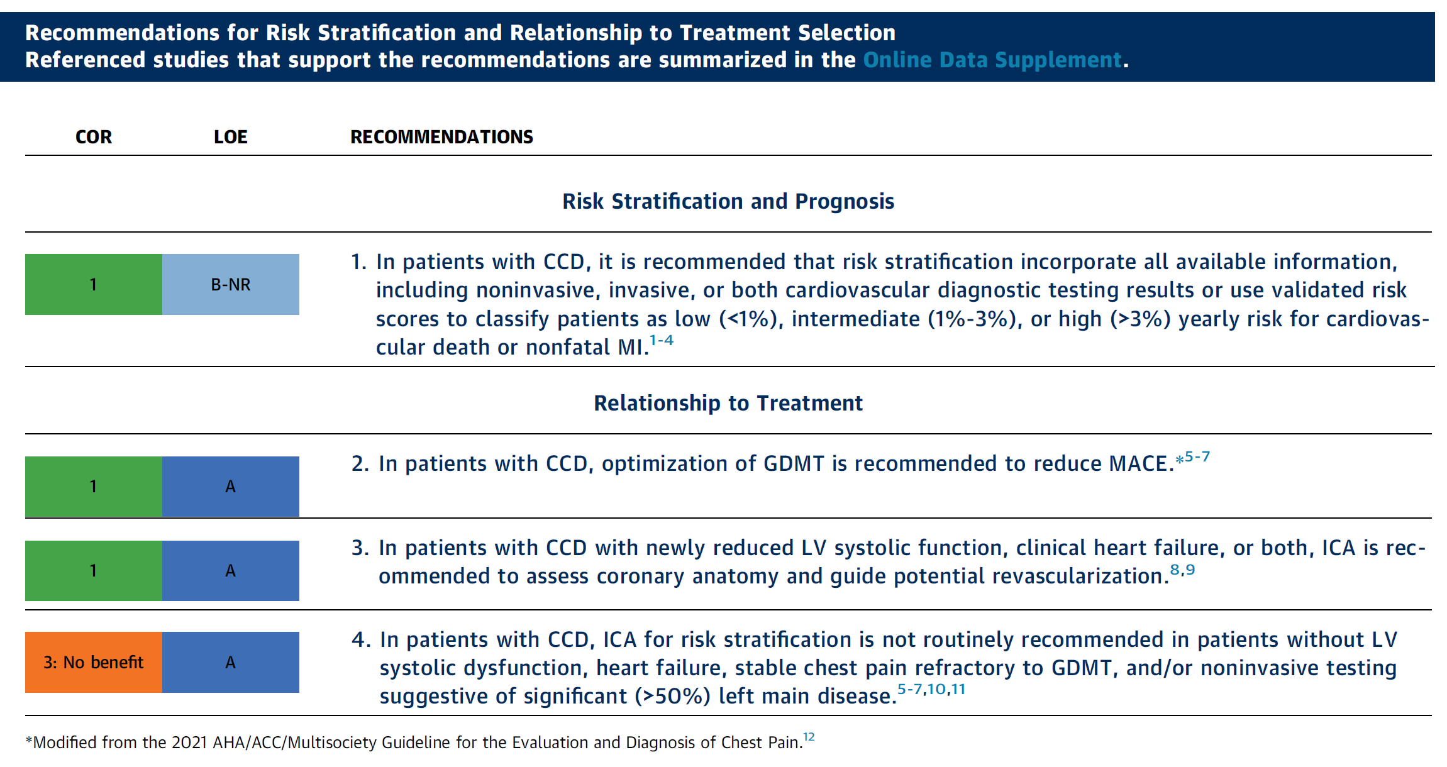
2023 AHA Guideline for Risk Stratification
Arvand Pharmed

Slide 14
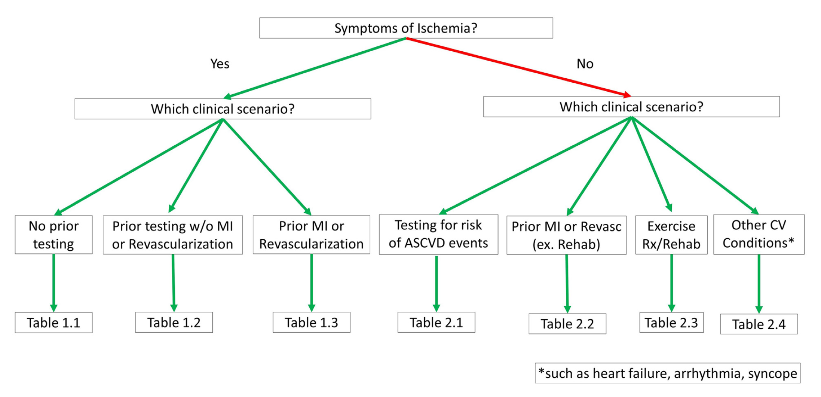
AHA Multimodality Appropriate Use Criteria for the Detection and Risk Assessment of CCD
Arvand Pharmed
Flowchart of appropriateness Tables

Slide 15
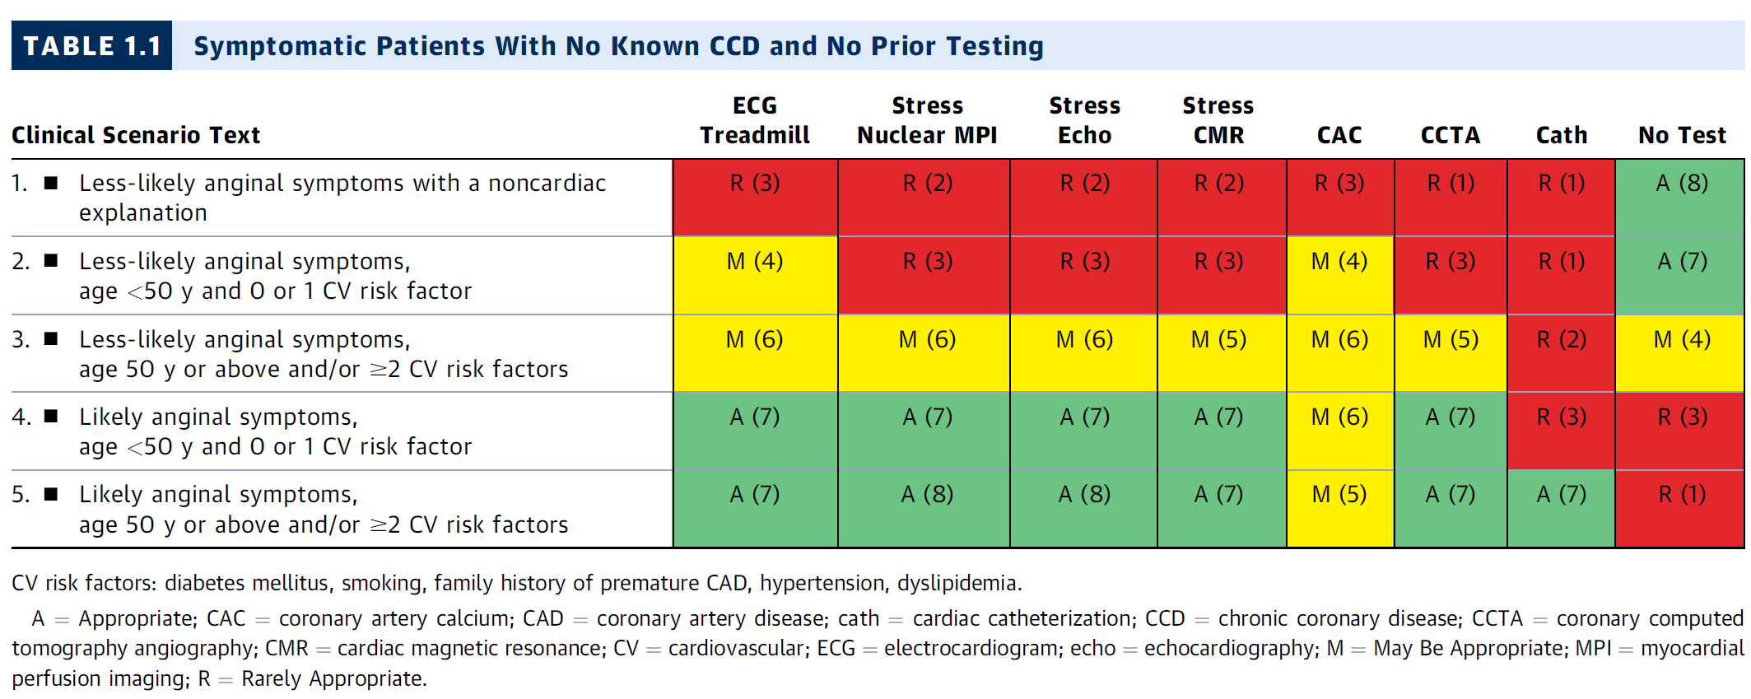
Symptomatic with No Prior Testing
Arvand Pharmed

Slide 16
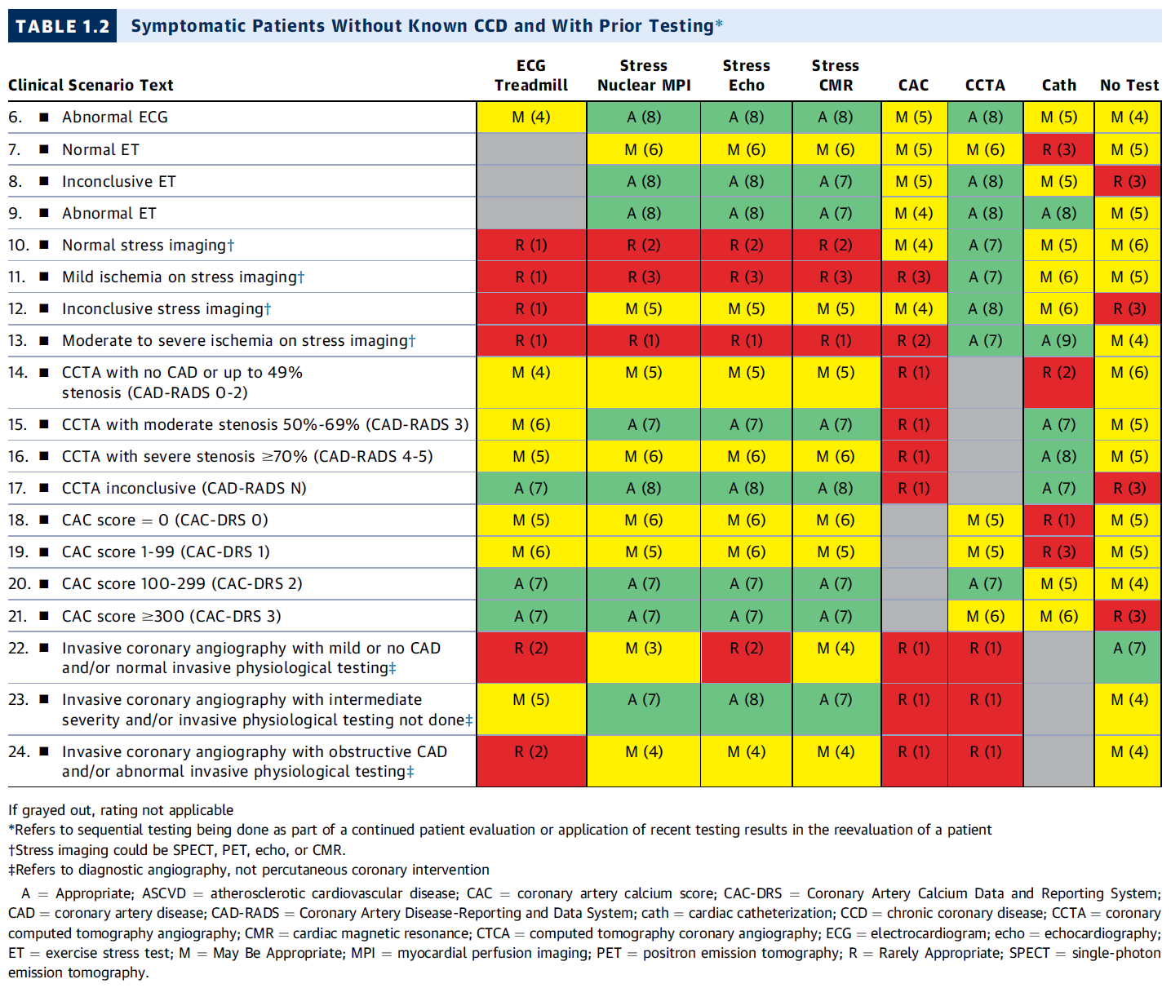
Prior Testing without MI or Revascularization
Arvand Pharmed

Slide 17
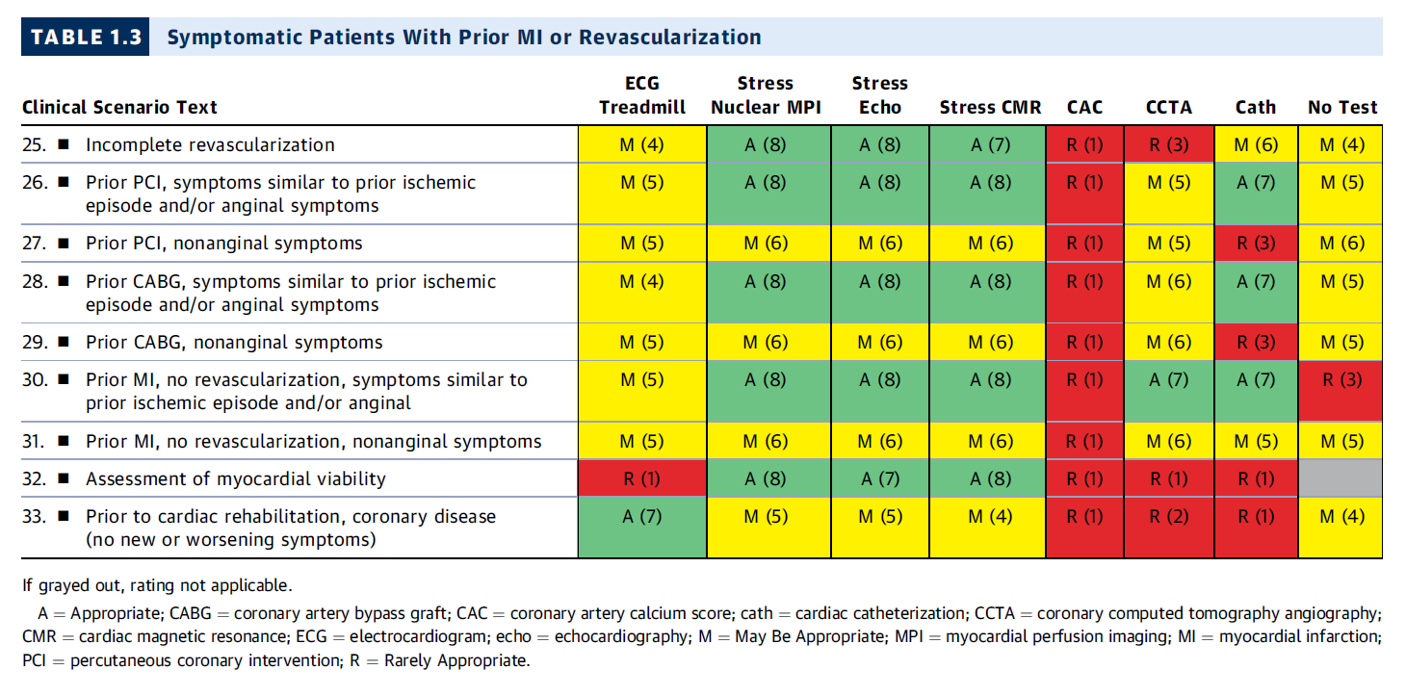
Prior MI or Revascularization
Arvand Pharmed

Slide 18
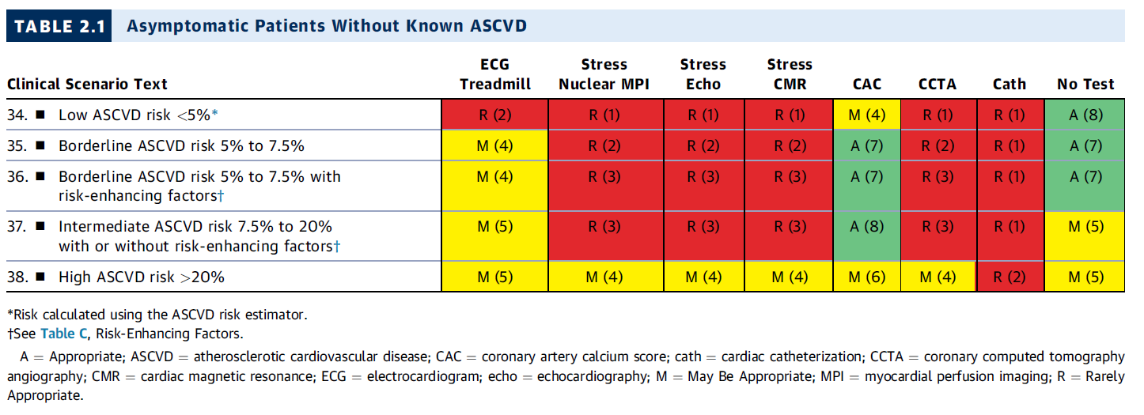
Testing for Risk of ASCVD Events
Arvand Pharmed

Slide 19
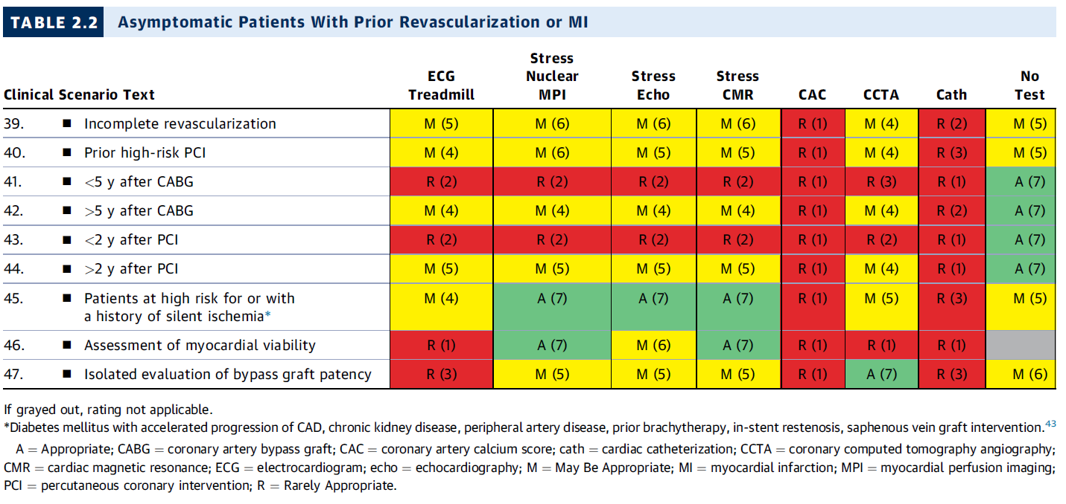
Prior MI or Revascularization
Arvand Pharmed

Slide 20
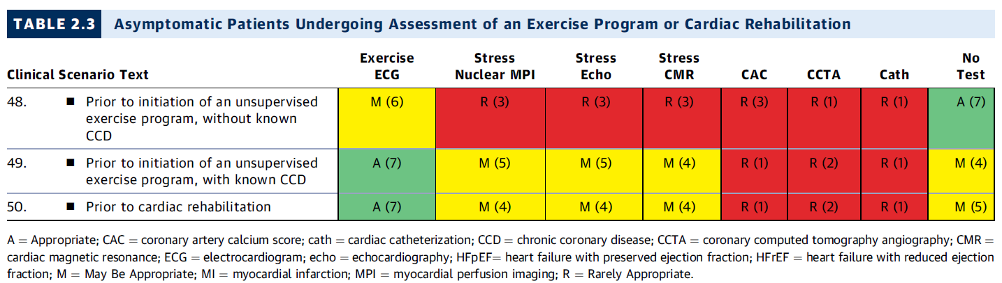
Exercise Program or Cardiac Rehabilitation
Arvand Pharmed

Slide 21
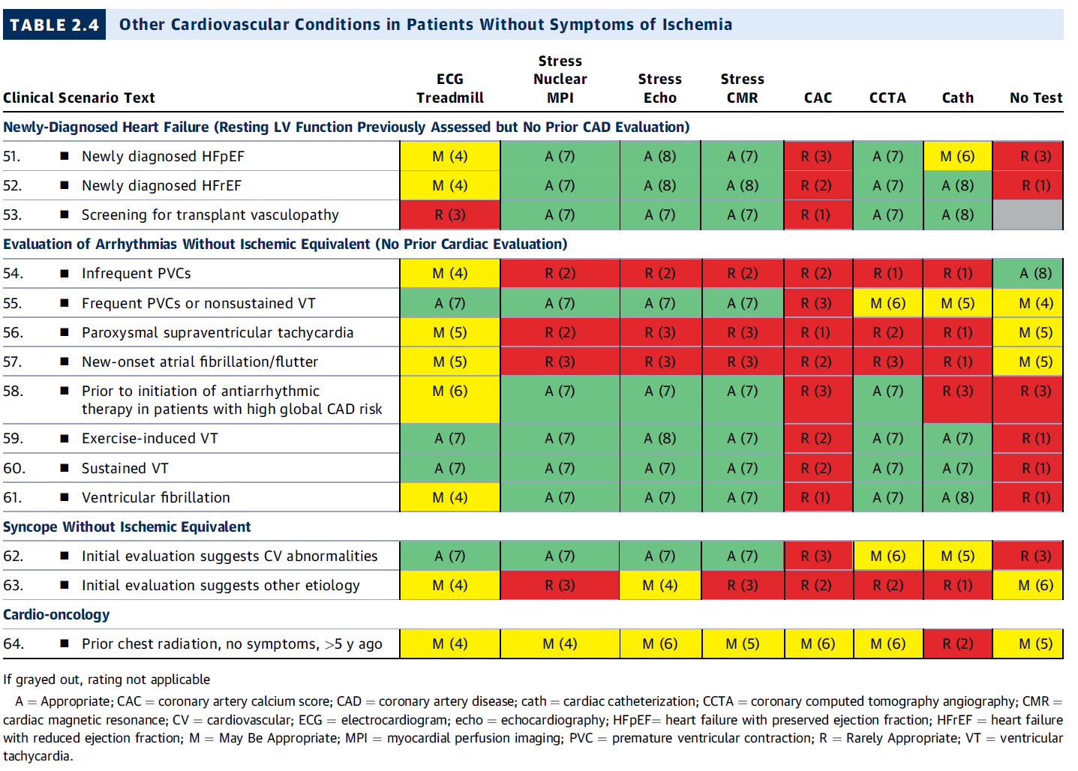
Other Conditions
Arvand Pharmed

Slide 22
03
Treatment
Arvand Pharmed
CCD Management & Treatment

Slide 23
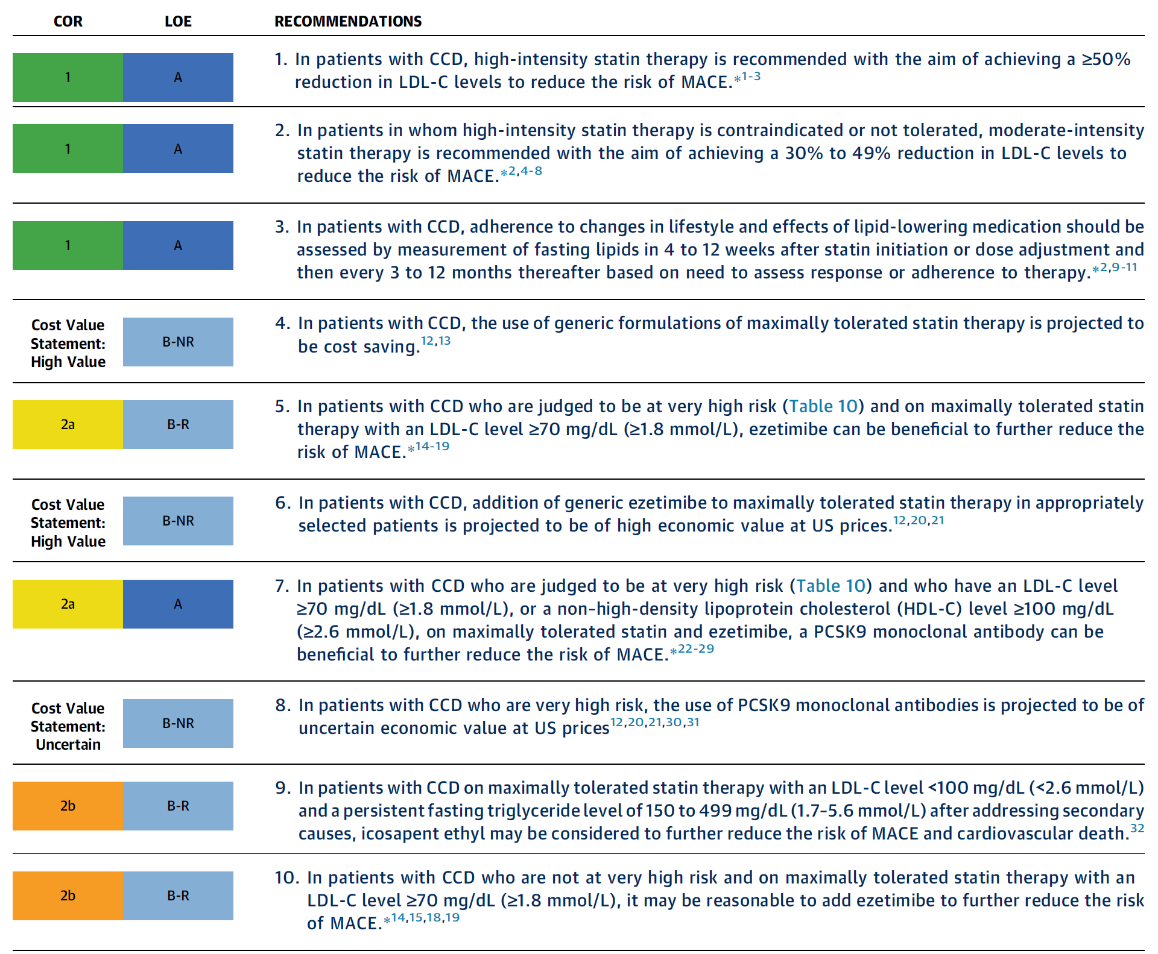
2023 AHA Guideline for Lipid Management
Arvand Pharmed

Slide 24
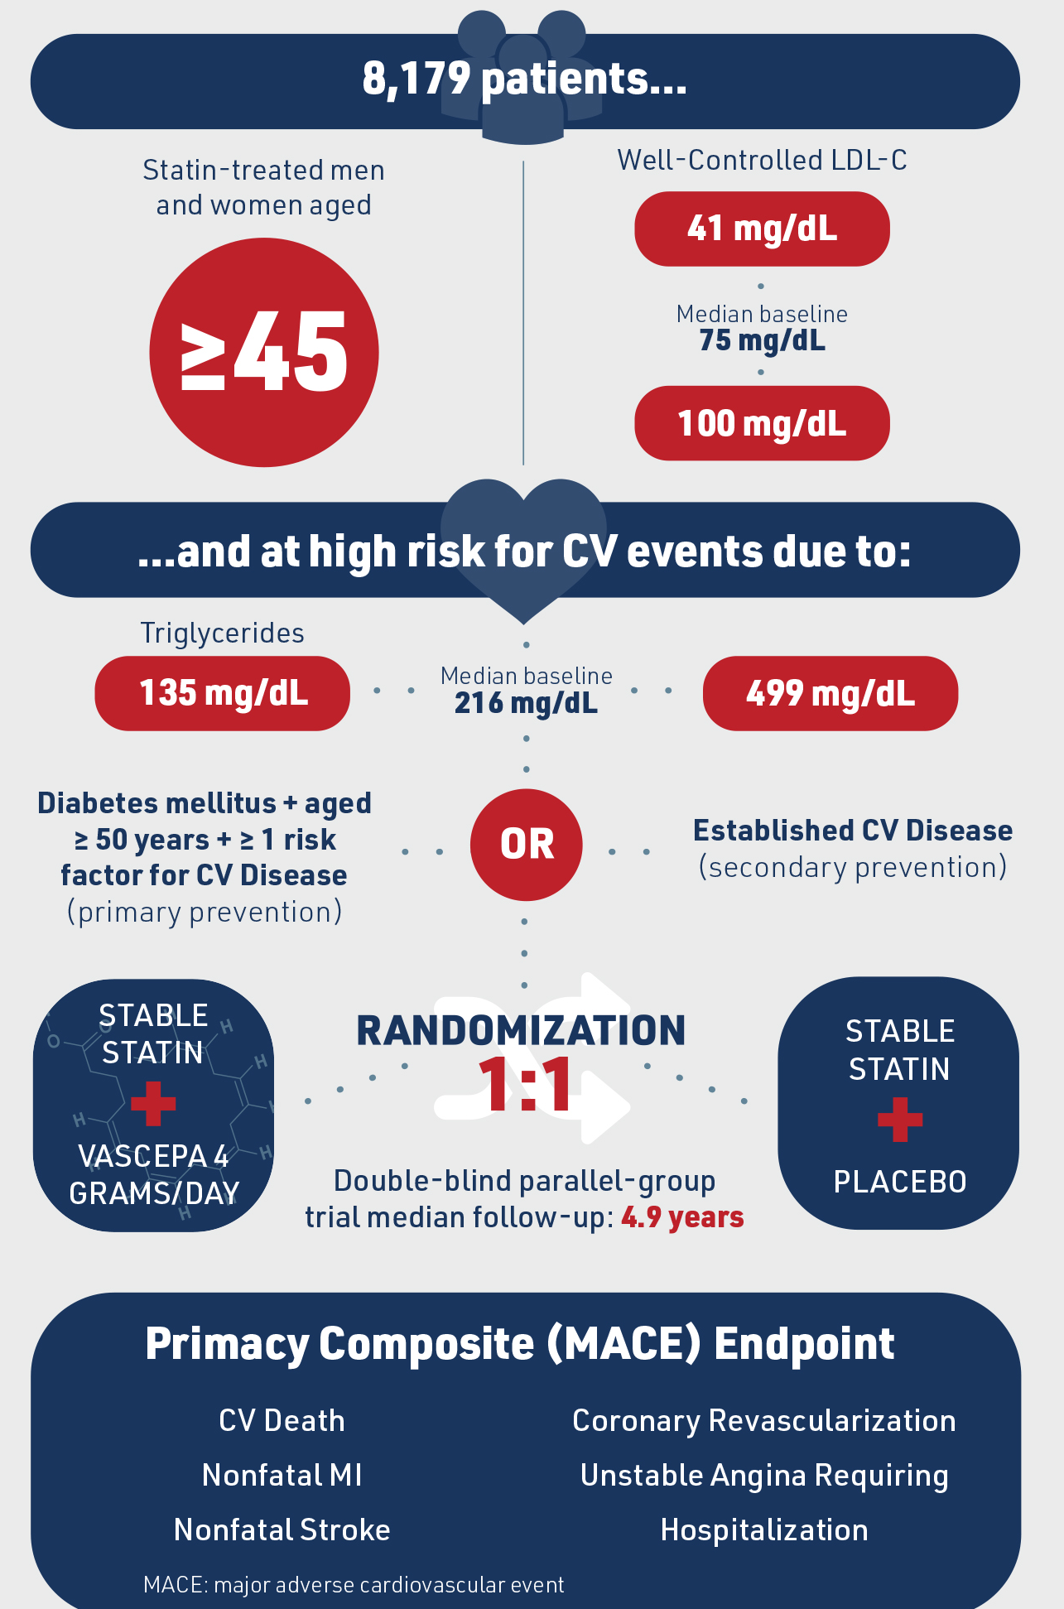
Lipid Management
Arvand Pharmed
REDUCE-IT trial randomized patients with established ASCVD or diabetes plus additional risk factors, triglyceride levels between 150 mg/dL and 499 mg/dL, and an LDL-C level of <100 mg/dL on background statin therapy to either 4 g/day of icosapent ethyl (purified EPA only) or mineral oil placebo.
25%
Decrease in MACE.
20%
Decrease in CV death.

Slide 25
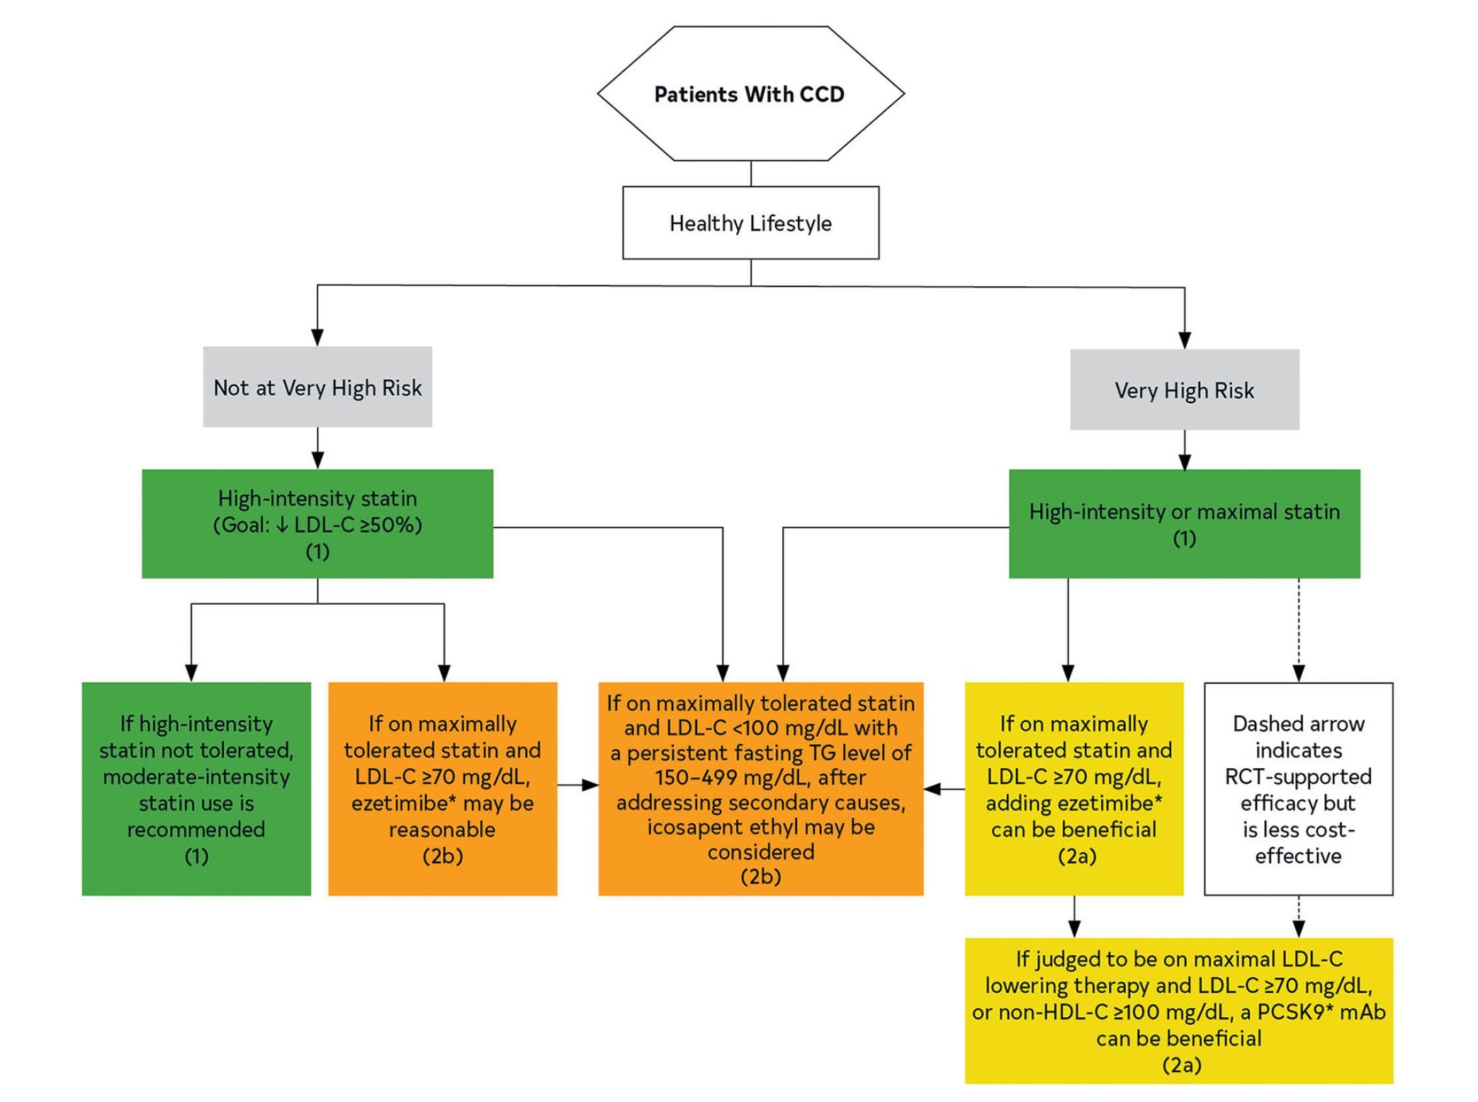
2023 AHA Guideline for Lipid Management
Arvand Pharmed

Slide 26
2023 AHA Guideline for Lipid Management
Arvand Pharmed

Slide 27
Lipid Management
Arvand Pharmed
REDUCE-IT trial randomized patients with established ASCVD or diabetes plus additional risk factors, triglyceride levels between 150 mg/dL and 499 mg/dL, and an LDL-C level of <100 mg/dL on background statin therapy to either 4 g/day of icosapent ethyl (purified EPA only) or mineral oil placebo.
25%
Decrease in MACE.
20%
Decrease in CV death.

Slide 28
Arvand Pharmed
Dietary supplements containing omega-3 fatty acids (ie, fish oil) are widely used for presumed cardioprotective benefits. However, low-dose omega-3 fatty acid supplementation does not reduce MACE in patients with CCD.
The only omega-3 fatty acid formulation that can be recommended in patients with CCD is icosapent ethyl (EPA only).

Slide 29
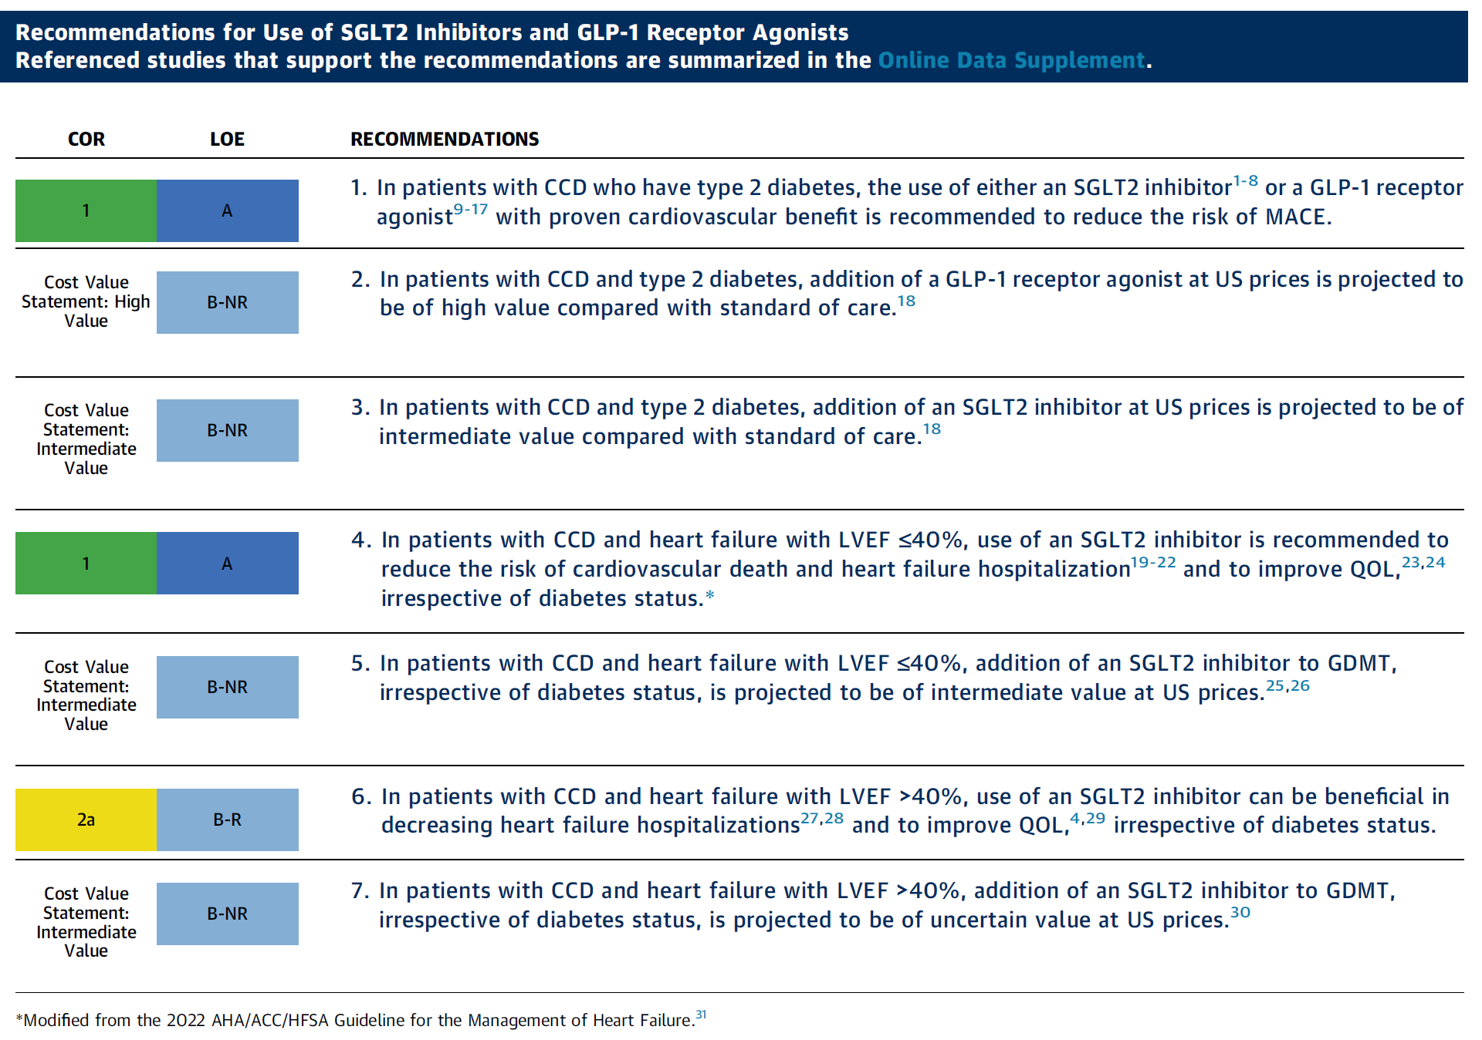
2023 AHA Guideline for SGLT2i Indications
Arvand Pharmed

Slide 30
Arvand Pharmed
In patients with CCD and type 2 diabetes, SGLT2 inhibitors significantly reduce the risk of MACE, with additional benefits in terms of weight loss and progression of kidney disease.

Slide 31
SGLT2i in CCD
Arvand Pharmed
Screening period
(≤28 days)
Screening period
(≤28 days)
Among patients with HF with preserved ejection fraction, SGLT2 inhibitors reduced the risk of HF hospitalization or cardiovascular death in the EMPEROR-PRESERVED trial and the risk of worsening HF or cardiovascular death in the DELIVER trial with the primary endpoints driven by significant reductions in HF hospitalization in both trials.
Randomization
5,988 patients
Randomization
6,100 patients
SGLT2i
Placebo
SGLT2i
Placebo
Follow-up
24 months
Follow-up
33 months
Post-treatment period
(30 days)
Time to 1st occurrence of either CV death, HHF, or urgent visit
EMPEROR-PRESERVED
Trial
DELIVER Trial

Slide 32
2023 AHA Guideline for SGLT2i Indications
Arvand Pharmed

Slide 33
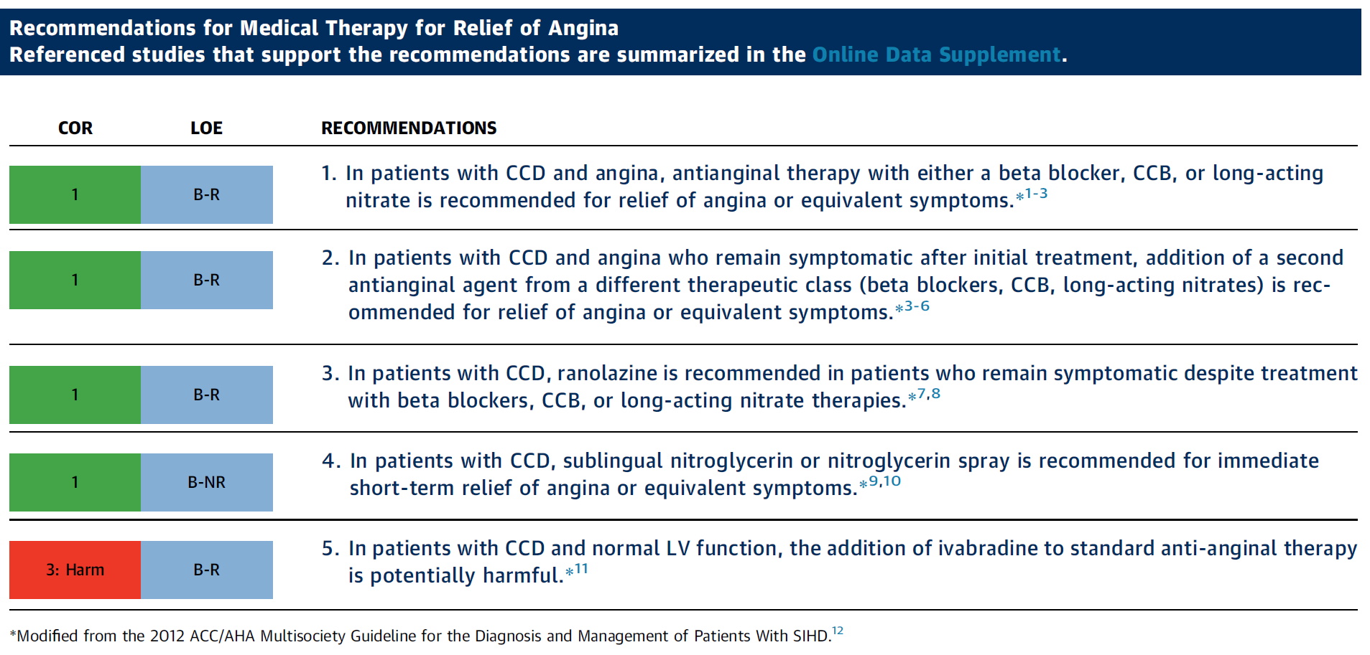
Medical Therapy for Relief of Angina
Arvand Pharmed

Slide 34
Ranolazine in CCD
Arvand Pharmed
MARISA
CARISA
ERICA
TERISA
MERLIN-TIMI 36
Two randomized, placebo-controlled studies showed that the addition of ranolazine on the background of standard anti-anginal therapy improved anginal outcomes.
In the CARISA trial, 823 patients with CCD were randomized to placebo or 1 of 2 doses of ranolazine. After 12 weeks of therapy, ranolazine improved exercise capacity and more effectively relieved angina compared with placebo.
In the ERICA trial, 565 patients with CCD and persistent symptoms despite a maximally tolerated dose of amlodipine were randomized to ranolazine or placebo. After 6 weeks, patients randomized to ranolazine had significantly fewer anginal episodes and less nitroglycerin consumption.

Slide 35
Medical Therapy for Relief of Angina
Arvand Pharmed

Slide 36
THANKS
Arvand Pharmed

