Slide 1
Application of ARNI in cardiovascular field
SOMAYEH MOHAMADI
HF & transplant specialist

Slide 2
Story of ARNI:
Natriuretic peptides (NPs) cause natriuresis, vasodilation, anti proliferative effects, cause vascular remodeling and modulation of renin–angiotensin–aldosterone systems thus benefiting in treatment of HF While exogenous administration is the best possible way to acutely augment NPs action.

Slide 3
The first combined angiotensin converting enzyme inhibitor (ACEI) and neprilysin inhibitor developed was omapatrilat, an orally active, long acting, selective, competitive inhibitor of neutral endopeptidase and angiotensin converting enzyme.
OVERTURE trial , showed omapatrilat-reduced morbidity and mortality but was not more effective than ACE inhibition alone in reducing the
risk of the combined risk of death or hospitalization for HF requiring intravenous treatment.

Slide 4
Angiotensin-converting enzyme inhibitors and angiotensin receptor blockers are the mainstay of therapy for cardiovascular disease and heart failure (HF). The angiotensin receptor II blocker – neprilysin inhibitor (ARNI), sacubitril-valsartan has an established role in treatment of patients with HF with reduced ejection fraction (HFrEF) based on the results of PARADIGM-HF trial Several studies are done using ARNI in various indications such as HFrEF, patients hospitalized with acute decompensated HF, HF with preserved EF, AMI with LVEF reduce .

Slide 5
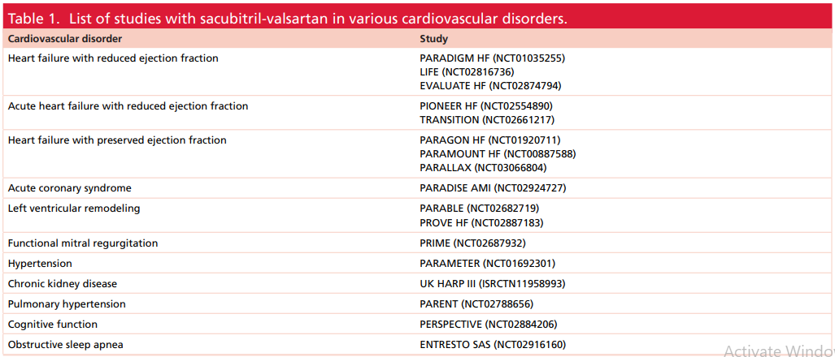

Slide 6
INDICATIONS AND PITFALLS :
Neprilysin degrades these NPs and neprilysin inhibition is associated with augmenting NPs actions. Combining neprilysin inhibition with angiotensin receptor blocker helps to overcome the adverse effect of angioedema.
Sacubitril-valsartan, the first angiotensin receptor II blocker – neprilysin inhibitor agent has shown significant mortality benefit in heart failure with reduced ejection fraction compared with ACE inhibitor, thus paving way for a new class of therapeutics.
Encouraged by the results of PARADIGM-HF study, sacubitril-valsartan is tested in other cardio vascular indications with promising results.
Further understanding of NP and their analogs is likely to change the future of cardiovascular disease therapy.

Slide 7
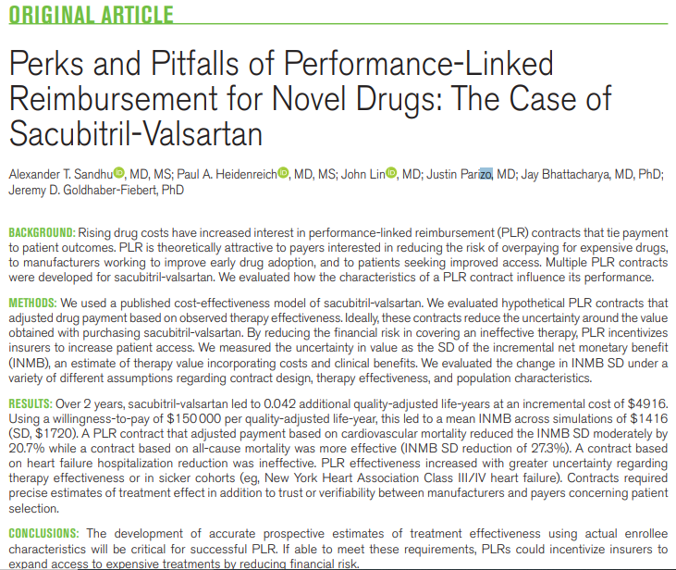

Slide 8
Both guidelines recommend that patients tolerating an ACEi
or ARB be switched to the angiotensin receptor–neprilysin
inhibitor (ARNI) sacubitril/valsartan. The ACC/AHA/HFSA
guidelines put more emphasis on sacubitril/valsartan and give
it a 1A recommendation2 citing studies on acute HF, cardiac
................................................. ................................................
remodelling and aortic stiffness. Conversely, the ESC guidelines give a I B recommendation to sacubitril/valsartan to ‘reduce
the risk of HF hospitalization and death’, and consider only the
PARADIGM-HF trial as evidence

Slide 9
PARADIGM-HF: The PARADIGM-HF trial showed an improvement in subjective symptoms reported by patients as measured and a reduction in hospitalizations and mortality Patients should have been New York Heart Association (NYHA) functional class II or III, clinically stable since their last hospitalization and with left ventricular ejection fraction (LVEF)≤0.35. Patients who had received an implanted cardioverter defibrillator (ICD) at least 3 months prior to admission to study, whether in combination with cardiac resynchronization therapy (CRT-D), were also included. Conversely, refractory HF, impaired glomerular filtration rate (<60 mL/min), severe hepatic dysfunction, sustained hypotension, permanent atrial fibrillation, aortic or mitral stenosis, history of angioedema, hospitalization within the last 3 months due to destabilization, acute coronary syndrome and recent surgery were exclusion criteria.

Slide 10
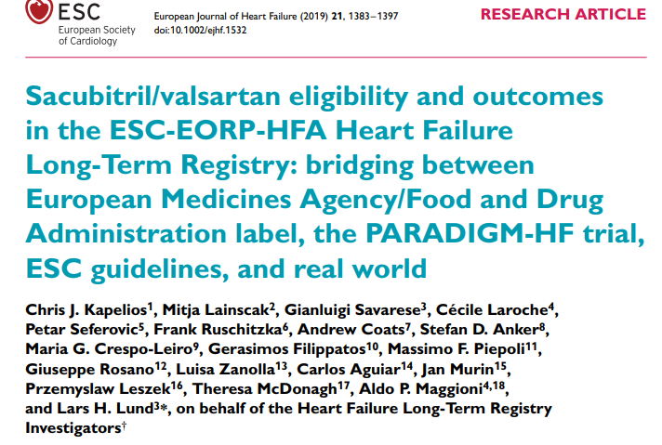

Slide 11
HFrEF:
PARADIGM-HF trial was a ‘game-changer’ for the concept of ARNI in treatment of HFrEF. In this large double-blind trial, 8442 patients with class II, III or IV HF and an ejection fraction of 35% or less were randomly assigned to receive LCZ696 at a dose of 200 mg twice daily (n = 4187) or enalapril at a dose of 10 mg twice daily (n = 4212), in addition to recommended therapy. After a median follow-up of 27 months, the trial was stopped due to overwhelming benefit of LCZ696 over enalapril. The study drug LCZ696 proved superior to enalapril in the primary outcome of composite of death from CV causes or hospitalization for HF (21.8 vs 26.5%; p = 0.001).

Slide 12
The drug also proved to significantly reduce the clinical worsening of patients evidenced by reduction in intensification of medical treatment for HF or an emergency department visit for worsening HF. The beneficial effects were evident as early as 30 days. PARADIGM-HF trial was designed to provide evidence to support the replacement of ACE inhibitors or ARBs with LCZ696 in the management of chronic HF and was successful in the same as the 2017 ACC/AHA/HFSA Heart Failure Focused Update recommends in patients with chronic symptomatic HFrEF New York Heart Association class II or III who tolerate an ACE inhibitor or ARB, replacement with an ARNI to further reduce morbidity and mortality is indicated.

Slide 13
HFpEF:
In contradistinction to successful evidence-based therapy for HFrEF, no therapies have been shown to definitively improve mortality or hospitalization in HFpEF possibly due to the fact that most of the hospitalizations and deaths in patients with HFpEF are likely to be non-CV. Therefore, current practice favors only symptomatic treatment with diuretics in patients with fluid overload and management of risk factors and comorbidities. There is evidence for role for ARB candesartan in symptomatic improvement and reduce HF hospitalizations in patients with HFpEF . Trials of ACEIs, ARBs, β-blockers and mineralocorticoid receptor antagonists (MRAs) have all failed to reduce mortality in patients with HFpEF.

Slide 14
NT-pro BNP is a marker for diagnosis and prognosis of HF. Reduction in NT-pro BNP levels in patients with LV ejection fraction ≥45% with sacubitril-valsartan was studied in PARAMOUNT trial. 301 patients were randomized to sacubitirl-valsartan (n = 149) or valsartan alone (n = 152) and it was found that NT-pro BNP levels significantly decreased in former group ([783 pg/ml at baseline and 605 pg/ml] compared with the latter group [862 pg/ml at baseline and 835 pg/ml] at 12 weeks. There was 7% reduction of LA volume (p = 0.003) indicating reverse left atrial remodeling, 9% improvement in New York Heart Association class (p = 0.051). While PARAMOUNT trial assessed the efficacy of sacubitril-valsartan on the biomarker NT-proBNP, PARAGON HF trial assessed the clinical primary end point of composite of total hospitalizations for HF and death from CV causes in patients with HFpEF. In this study, 4822 patients with HFpEF were randomized to sacubitril-valsartan (n = 2407) and valsartan alone (n = 2389). The study failed to show significant beneficial effect with sacubitril-valsartan.

Slide 15
Sacubitril/valsartan was associated with more hypotension, but less hyperkalemia and less renal dysfunction compared with valsartan, findings similar to those seen in the PARADIGMHF trial. Another ongoing study in 2547 patients with HFpEF sponsored by Novartis is examining the superiority of sacubitril-valsartan therapy over individualized medical therapy for comorbidities in reducing NT-proBNP and improving exercise capacity and HF symptoms over 24 week.

Slide 16
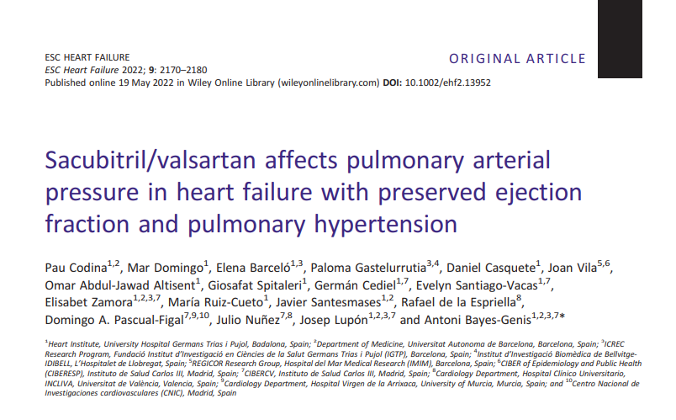

Slide 17
The aim of the Treatment of PH With Angiotensin II Receptor Blocker and Neprilysin Inhibitor in HFpEF Patients With CardioMEMS Device (ARNIMEMS-HFpEF) study is to assess pulmonary artery pressure (PAP) dynamics by means of implanted PAP monitors in patients with HFpEF–PH treated with sacubitril/valsartan. Sacubitril/valsartan significantly reduced mPAP in patients with HFpEF–PH, independent of loop diuretic management, together with improvement in functional capacity, lung congestion, and QoL. Sacubitril/valsartan may be a therapeutic alternative in HFpEF–PH.

Slide 18
POST MYOCARDIAL INFARCTION:
angiotensin II, a potent vasoconstrictor, a key component of RAS, acting via AT 1 receptors, promotes atherothrombosis, through inflammation, endothelial dysfunction and LDL oxidation . ACE inhibition demonstrated to decrease the risk of coronary events and death in patients with HF and LV dysfunction (with enalapril, lisinopril, ramipril and trandolapril).

Slide 19
post hoc analysis of PARADGM-HF study reported significant reduction in the coronary composite of CV death, nonfatal MI, angina hospitalization or coronary revascularization (HR: 0.83 [0.75–0.92]; p < .001) among patients receiving sacubitril-valsartan compared with enalapril . It might be that sacubitril, by augmenting the effects of NP system, overcomes the ATII effects induced by valsartan. Ongoing PARADISE-AMI trial is evaluating the safety and efficacy of sacubitirl-valsartan compared with ramipril in addition to standard post myocardial infarction pharmacotherapy .

Slide 20
HYPERTENSION :
Sacubitril/valsartan results in systemic vasodilation and increased diuresis and natriuresis, leading to reduction of peripheral vascular resistance and lowering systemic blood pressure. Early studies using LCZ696 as antihypertensive drug were reported by Ruilope et al. A total of 1328 patients with mild-to-moderate hypertension were randomized to LCZ696 or valsartan at varying single daily dosages of drugs, and placebo. The authors compared the effect of LCZ696 with valsartan on the mean sitting diastolic blood pressure at three incremental doses. It was observed that LCZ696 effectively reduced mean sitting diastolic and systolic blood pressure compared with valsartan. Bp 24 hour mean ambulatory systolic BP decreased with 200 mg and 400 mg LCZ696. Kario et al. reported in a similar study, but in Asian patients and against placebo. LCZ696 at all doses tested significantly reduced 24-h, daytime and night-time ambulatory systolic, diastolic and pulse pressures . Several trails are under way comparing the efficacy and safety of LCZ696 with comparators such as olmesartan, valsartan, amlodipine.

Slide 21
One important study comparing sacubitril-valsartan to olmesartan is the PARAMETER study, which aimed to study the effects on central aortic blood pressure. The study included 454 elderly hypertensive patients and found that sacubitril-valsartan-reduced central aortic pressure more than olmesartan and demonstrated less need for additional antihypertensive medications in this elderly cohort .

Slide 22
while the above studies looked at patients with primary hypertension, in the HF trials utilizing sacubitrilvalsartan also there was significant reduction in blood pressure compared with valsartan in PARAMOUNT trial and enalapril in PARADIGM trial. A sub study of the latter trial addressed the concerns about significant lowering of blood pressure in patients with HFrEF might produce decline in cardiac and renal function and showed that even in patients with a persistently low SBP after treatment, sacubitril/valsartan was superior to enalapril in reducing mortality and morbidity .

Slide 23
Sacubitril-valsartan in cardiac remodeling :
Cardiac remodeling is defined as a group of molecular, cellular and interstitial changes that clinically manifest as changes in size, shape and function of the heart resulting from cardiac injury . Remodeling after injury either by myocardial infarction or following myocarditis occurs to the myocardial mass, geometry and shape. Early in the post-myocardial infarction phase, there is a repair of the necrotic area by fibrosis, scarring and subsequently the non infracted zone becomes hypertrophied elongated and assumes spherical shape. These changes lead to decline in ventricular performance. Cardiac remodeling is detected clinically, by echocardiography, radionuclide ventriculography or cardiac magnetic resonance imaging.

Slide 24
Echocardiography is by far the most used and easy method for assessment of cardiac remodeling indices which include LV end-diastolic volume index (LVEDV; normal <30 ml/m2), left atrial volume index (a value ≥34 ml/m2), LV mass index (normal <89 g/m2 in women and <103 g/m2 in men) and doppler derived early diastolic filling velocity (E wave) and early diastolic mitral annular velocity ; an E/e ratio. These indices have independent prognostic utility for predicting clinical outcomes in patients with LV dilation and/or decreased LVEF. numerous studies have shown favorable effects on parameters of LV remodeling for drugs that improve clinical outcomes in patients with decreased LVEF and LV dilation, notably ACE inhibitors, β-blockers and ARBs. Earliest study of ARNI on cardiac remodeling in HFrEF was published by Martens et al., who prospectively evaluated 125 patients switched from RAS blockers to sacubitril-valsartan.

Slide 25
During a median follow-up of 4 months significant improvement in LVEF (29.6 ± 6% vs 34.8 ± 6%; p < .001) and decrease in LVESV (147 ± 57 ml vs 129 ± 55 ml; p < .001) and LVEDV (; 206 ± 71 ml vs 197 ± 72 ml; p = .027) was observed. Diastolic function also improved with decrease in E/A-wave ratio (1.75 ± 1.13 vs 1.38 ± 0.88; p = .002) and drop in the percent of patients with a restrictive mitral filling pattern from 47 to 23% (p = .004). PROVE HF study assessed the correlation of reduction in NT-pro BNP levels with cardiac remodeling indices . Sacubitril-valsartan-treated patients have shown a significant mean 9.4% increase in LVEF, and mean reductions in LVEDV -11.32 ml/m2, LVESV -14.15 ml/m2, left atrial volume index 7.06 ml/m2 and E/e −0.93. These indices started to improve by 6 months but more pronounced at 1 year and underscore the potential benefit of reduction in NT-pro BNP levels and associated improvement in diastolic dysfunction.

Slide 26
OTHERS:
Sacubitril-valsartan in functional mitral regurgitation:t he effect of sacubitril-valsartan on functional mitral regurgitation is noted in studies: In PRIME trial .
ARNI & antiarrhythmic effect:
ARNI & glycemic control:
Sacubitril-valsartan in chronic kidney disease:
Sacubitril-valsartan in pulmonary hypertension & chronic obstructive pulmonary disease:
Sacubitril-valsartan & cognitive function:
Sacubitril-valsartan in sleep apnea syndrome:

Slide 27
Major Ongoing Studies:
Early research on neprilysin inhibition showed that sacubitril/valsartan, a combination of the valsartan and the neprilysin inhibitor sacubitril, was superior to enalapril in patients with heart failure with reduced ejection fraction (HFrEF) in the PARADIGM-HF study in 2014. In addition, sacubitril/valsartan has been investigated in other cardiovascular disease states, such as patients with heart failure and preserved ejection fraction (HFpEF) and following myocardial infarction (MI) events. In February 2021, the FDA expanded the indication use of sacubitril/valsartan to include the HFpEF patient population based on the results of the PARAGON-HF trial. Sacubitril/valsartan is currently being investigated in many other cardiovascular and non-cardiovascular conditions.

Slide 28
Omapatrilat, a neprilysin inhibitor (as well as an ACEi and aminopeptidase P inhibitor), was associated with a higher frequency of angioedema than that seen with enalapril in an RCT of patients
with HFrEF. In a very large RCT of hypertensive patients, omapatrilat was associated with a 3-fold increased risk of angioedema compared
with enalapril . Black patients and patients who smoked were particularly at risk

Slide 29
The rates of angioedema were numerically higher in patients treated
with ARNi than in patients treated with ACEi in PARADIGM-HF, although this difference did not reach significance. ARNi therapy should not be
administered in patients with a history of angioedema because of the concern that it will increase the risk of a recurrence of angioedema.

Slide 30
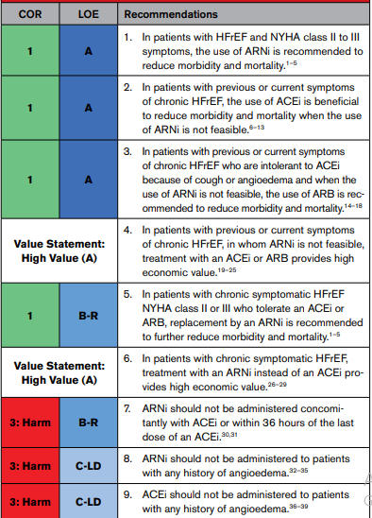

Slide 31
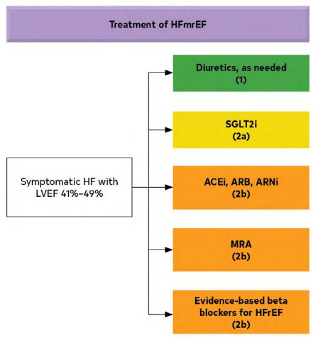

Slide 32
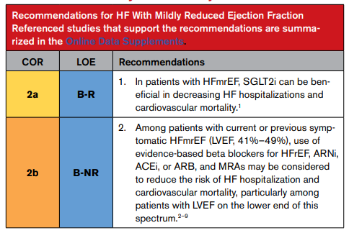

Slide 33
