Slide 1
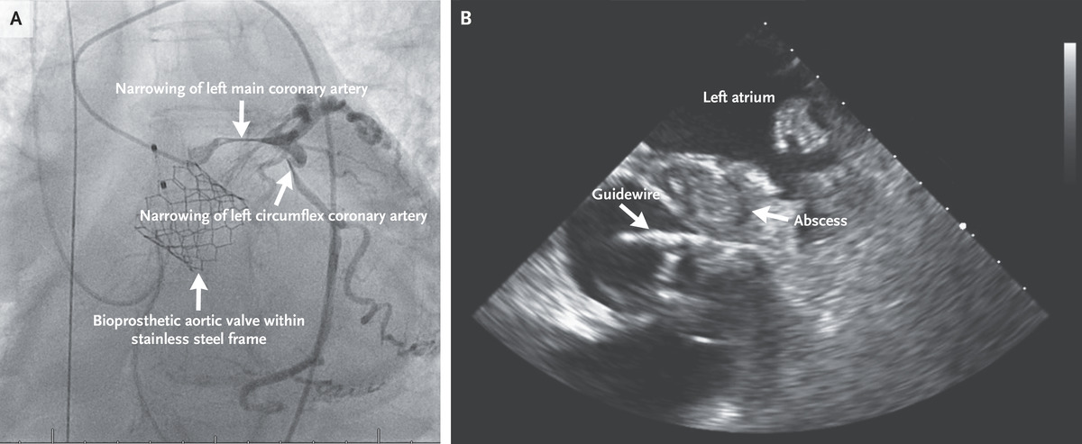

Perivalvular Abscess Causing Coronary-Artery Compression
DL Varela, TL Jones. N Engl J Med 2021. DOI: 10.1056/NEJMicm2029179
Notes:
An afebrile 67-year-old woman presented to the emergency department with fatigue and anorexia. Three years earlier, she had undergone transcatheter aortic-valve replacement. On examination, her heart rate was 82 beats per minute and her blood pressure was 91/70 mm Hg. She had a soft systolic ejection murmur. Laboratory studies showed a brain natriuretic peptide level of 4631 pg per milliliter (reference range, <100) and a peak troponin level of 1.36 ng per milliliter (reference range, <0.03). Electrocardiography was performed and showed first-degree atrioventricular block. Echocardiography showed a hypokinetic left ventricle with an ejection fraction of 23%, which had decreased from a value of 58% observed 10 months before presentation. There was also a severely elevated mean gradient (42 mm Hg) across a thickened bioprosthetic aortic valve. Blood cultures grew Streptococcus mutans. Shock and ventricular tachycardia developed on the third day after admission. Emergency coronary angiography was performed and showed severe narrowing of the left main and left circumflex coronary arteries (Panel A, and Video 1). Intravascular ultrasonography showed external compression of the left main coronary artery, and a large, perivalvular aortic root abscess was identified on transesophageal echocardiography, which also revealed a guidewire that had been placed during coronary angiography and could now be seen compressed within the artery by the abscess (Panel B, and Video 2). Despite attempts to bridge to surgery, the patient died on the fourth day after admission.

