Slide 1
2021 ESC Guidelines on cardiovascular disease prevention in clinical practice
Maryam Mehrpooya MD,
Associate Professor of Interventional Cardiology
Tehran University of Medical Science
Imam Khomeini Hospital Complex

Slide 4
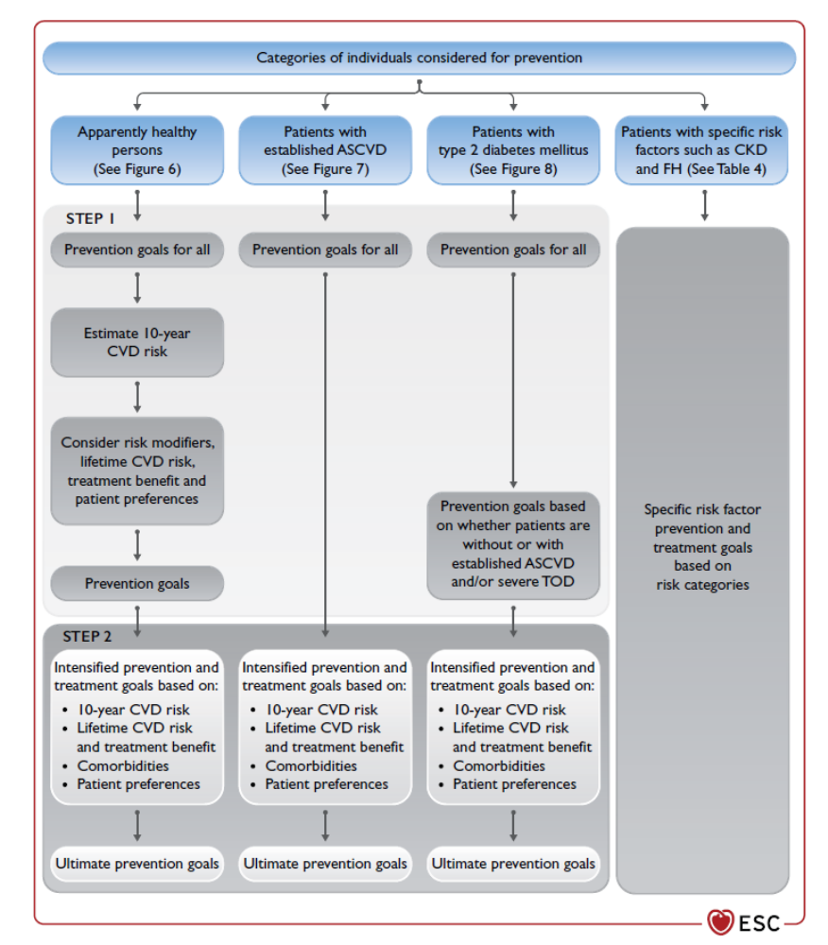
Examples of a stepwise approach to risk stratification and treatment options

Slide 5
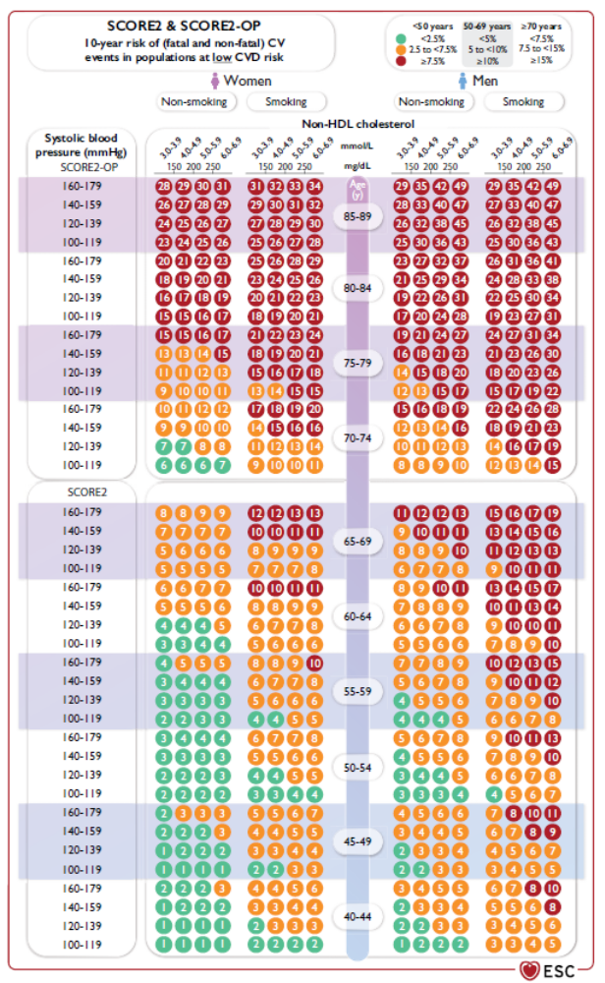
Systematic Coronary Risk Estimation 2 and Systematic Coronary Risk Estimation 2-Older Persons risk charts for fatal and non-fatal (myocardial
infarction, stroke)
SCORE2 = Systematic Coronary Risk Estimation 2
SCORE2-OP = Systematic Coronary Risk Estimation 2-Older Persons
TFYR = The Former Yugoslav Republic
For apparently healthy people aged 40-69 years, the SCORE2 algorithm is used to estimate 10-year risk of fatal and non-fatal (myocardial infarction, stroke) CVD
For apparently healthy people >70 years of age, the SCORE2-OP is used

Slide 6
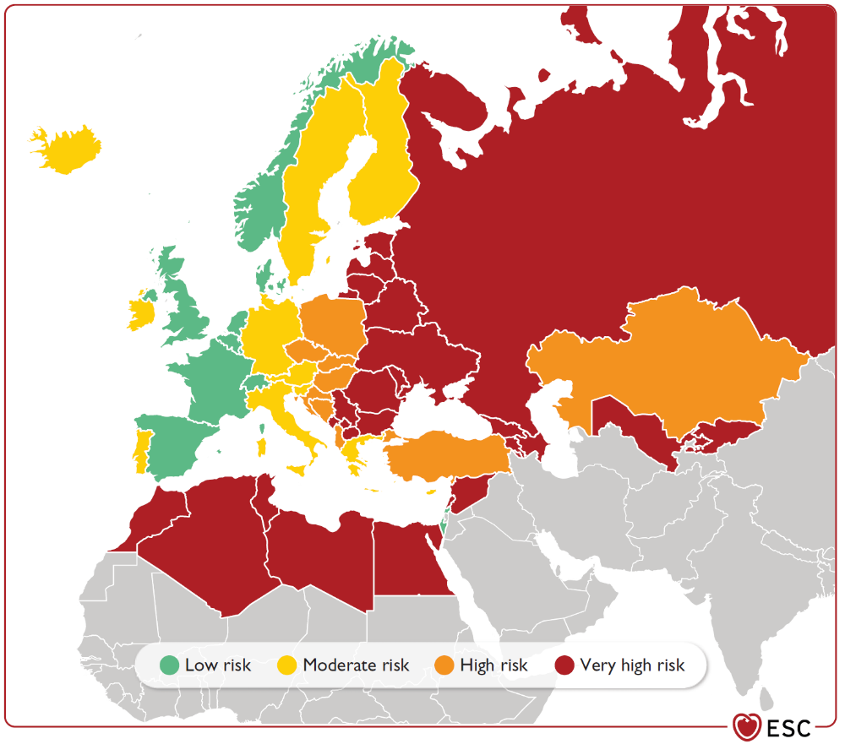
Risk regions based on World Health Organization cardiovascular mortality rates

Slide 7
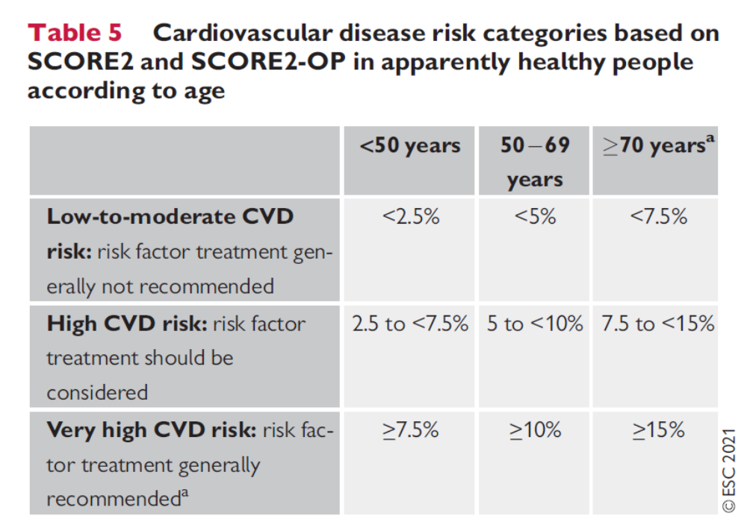

Slide 8
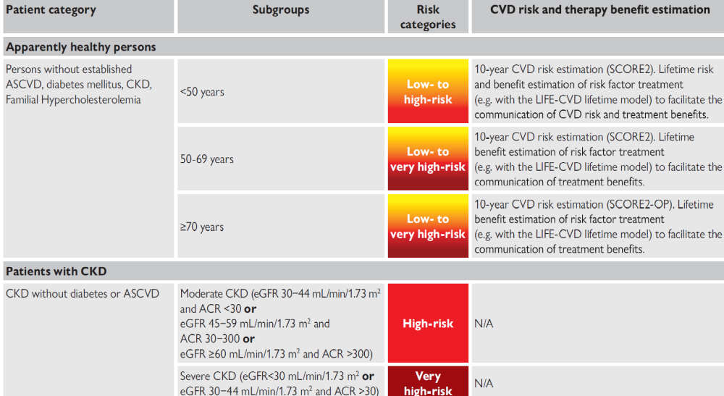
Patient categories and associated cardiovascular disease risk

Slide 9
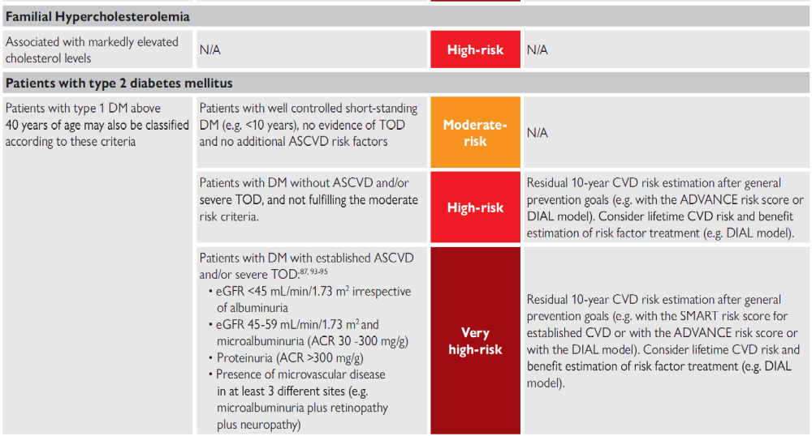
Patient categories and associated cardiovascular disease risk

Slide 10
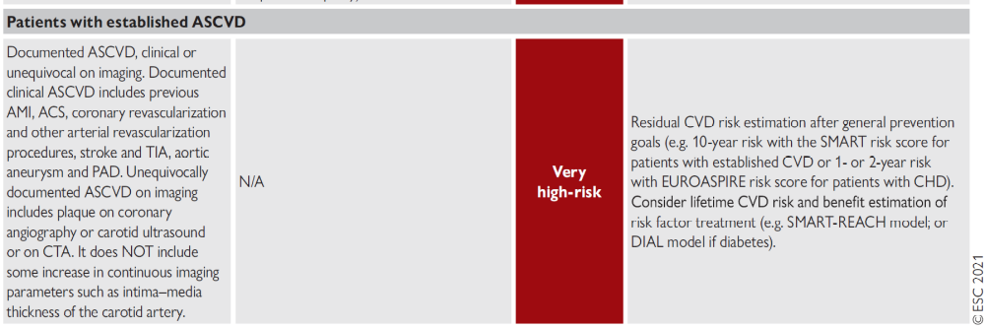
Patient categories and associated cardiovascular disease risk

Slide 11

In apparently healthy people >70 years old, the treatment recommendation for lipid-lowering drugs is Class IIb (‘may be considered’).
The division of the population into three distinct age groups (<50, 50-69, and >70 years) results in a discontinuous increase in risk thresholds for low-to-moderate, high, and very high risk. In reality, age is obviously continuous, and a sensible application of the thresholds in clinical practice would require some flexibility in handling these risk thresholds as patients move towards the next age group, or recently passed the age cut-off.

Slide 12
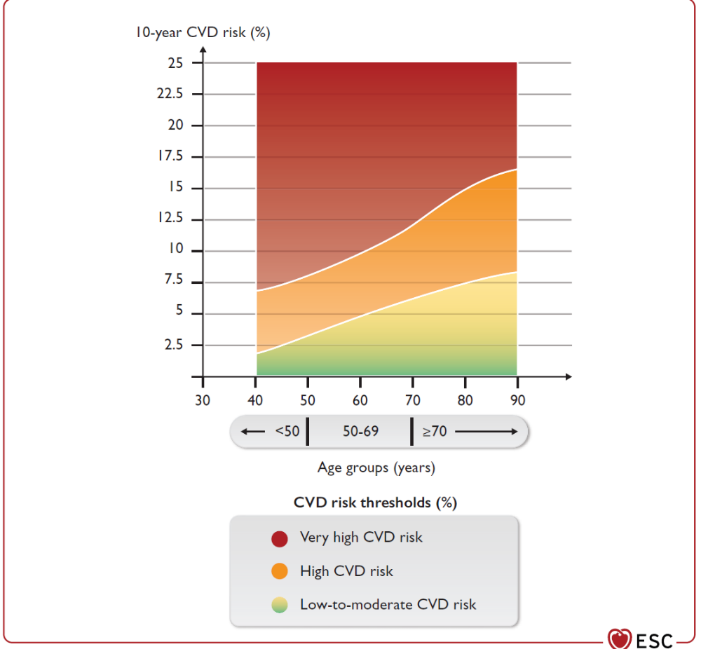
Schematic representation of increasing 10-year cardiovascular disease risk thresholds across age groups

Slide 13
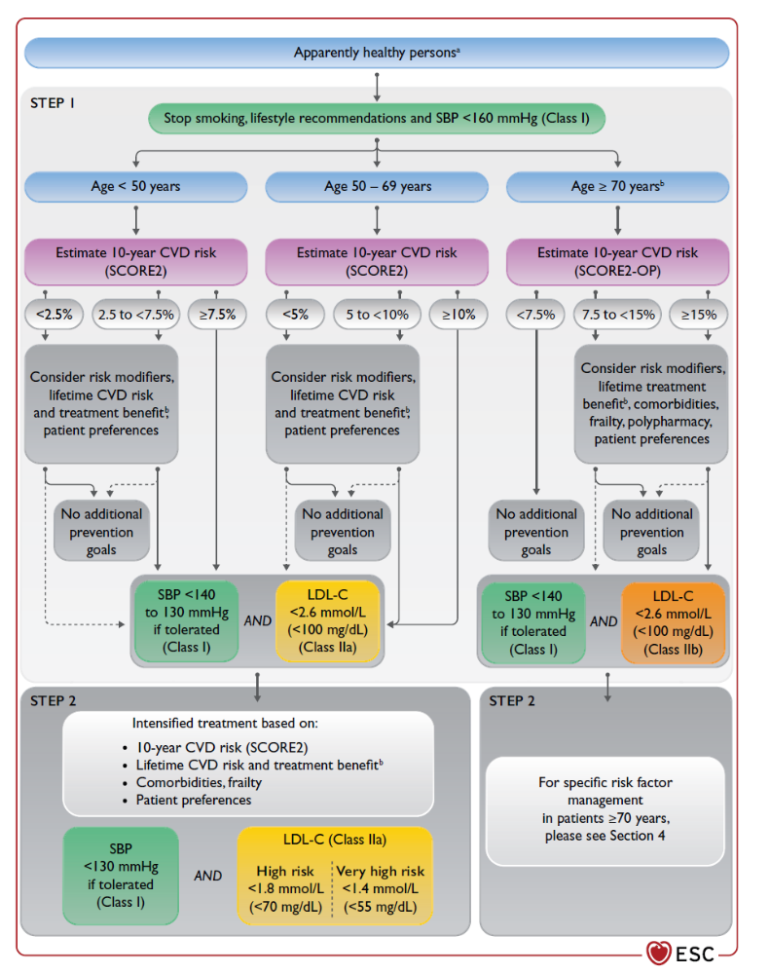

Slide 14
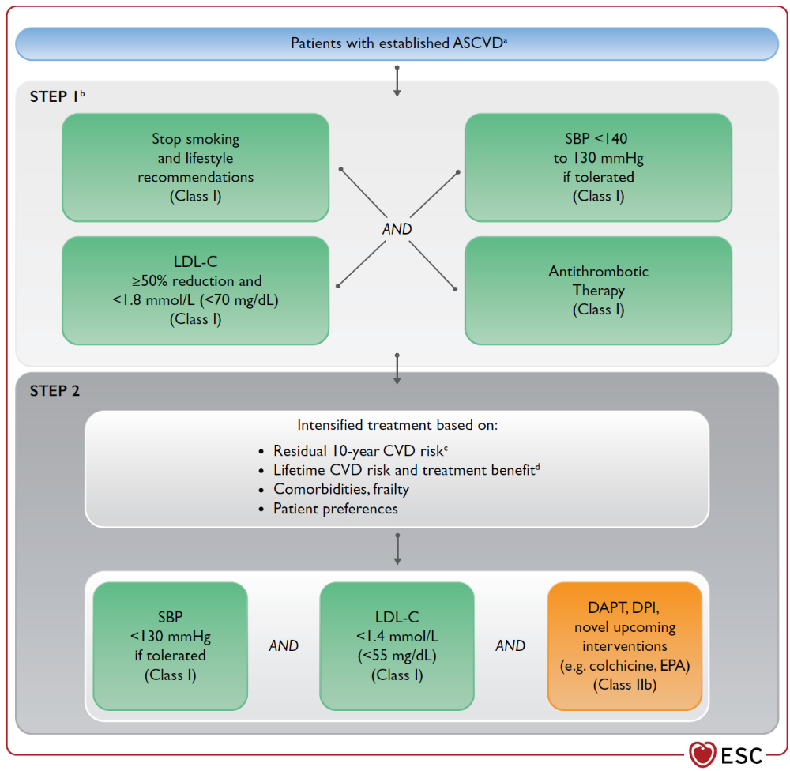

Slide 15
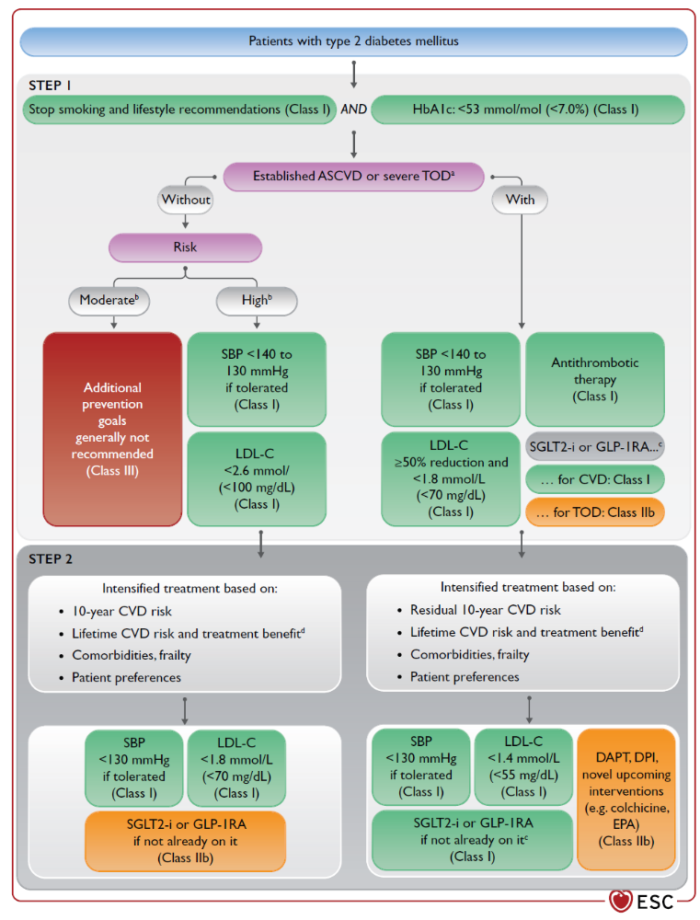

Slide 16
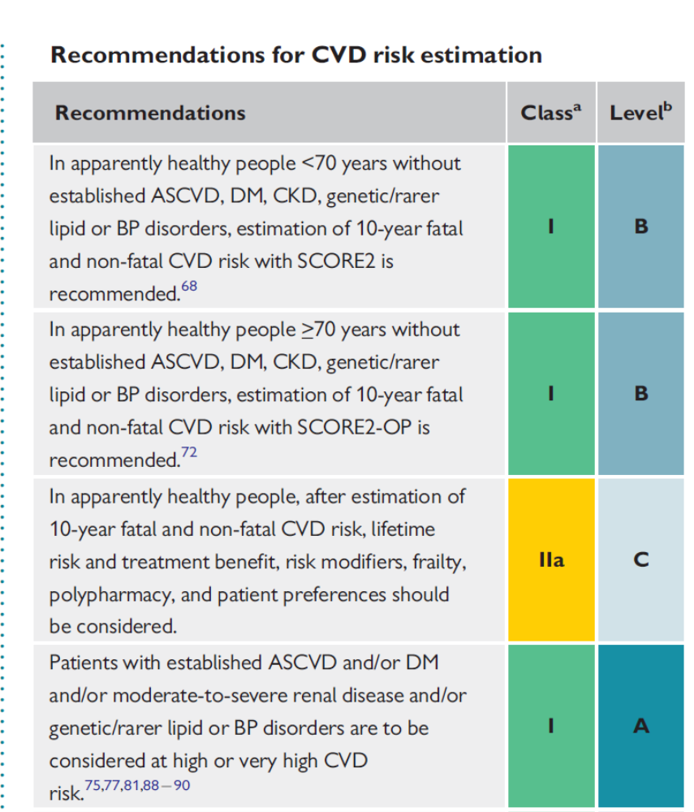

Slide 17
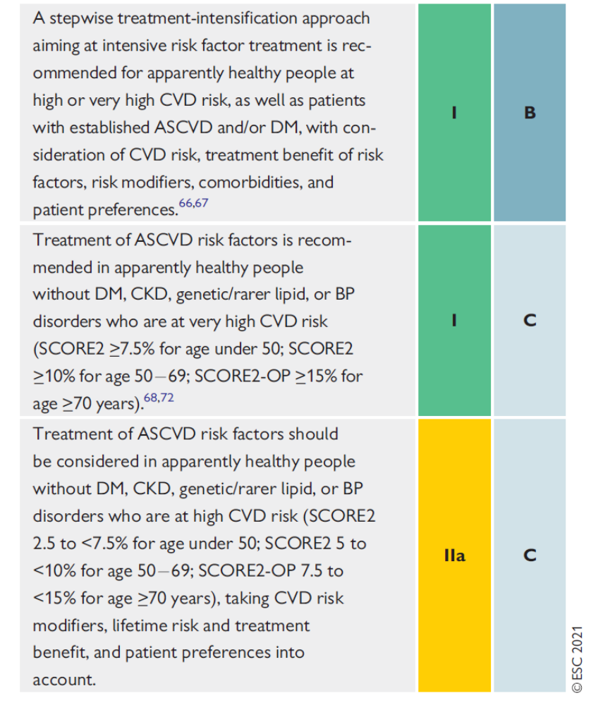

Slide 18
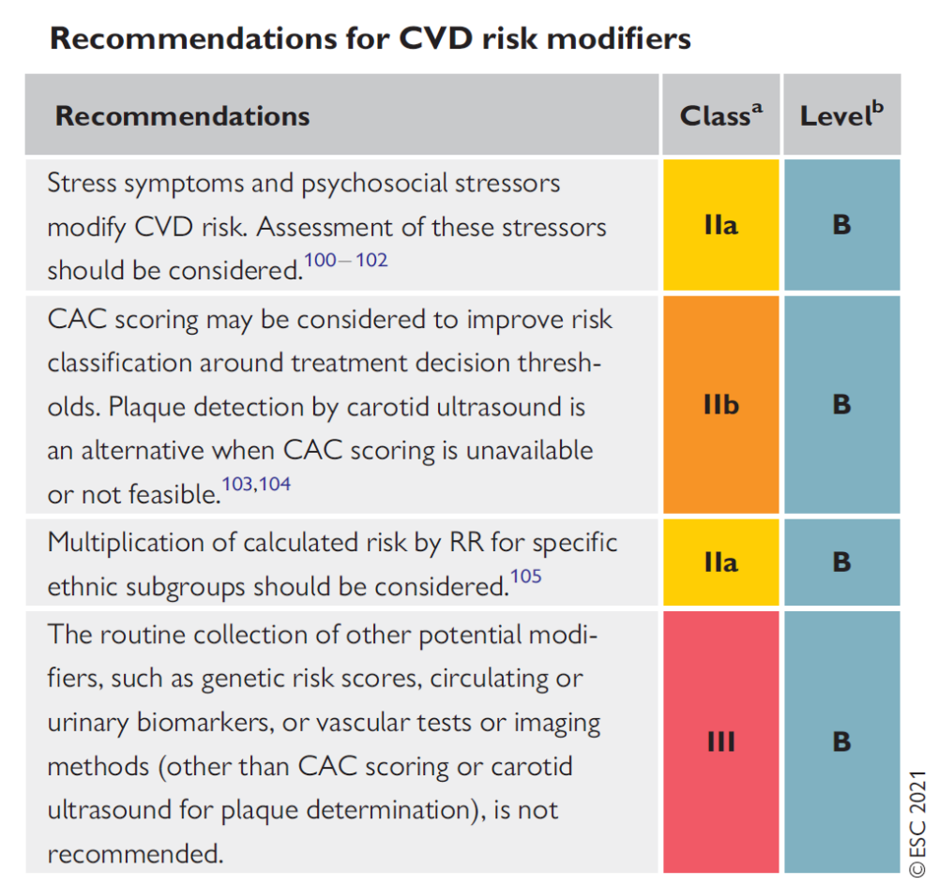

Slide 19
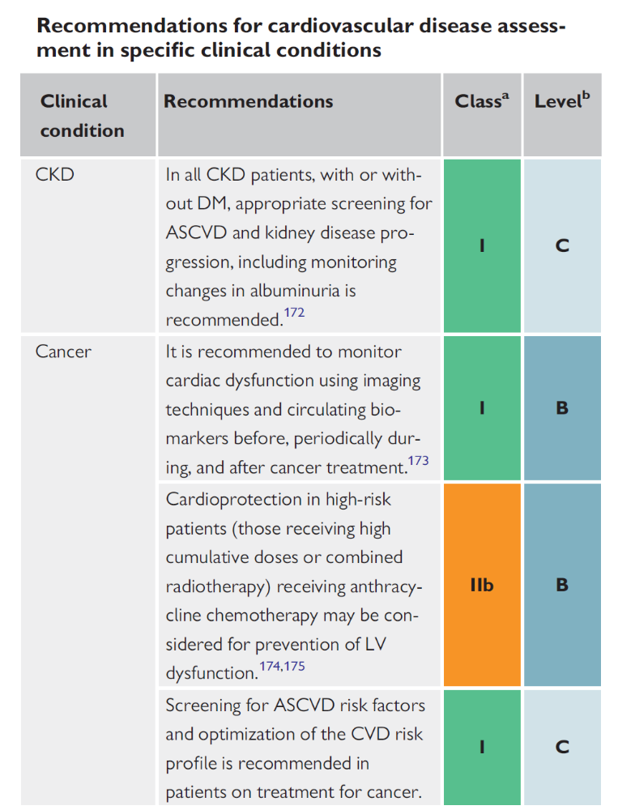

Slide 20
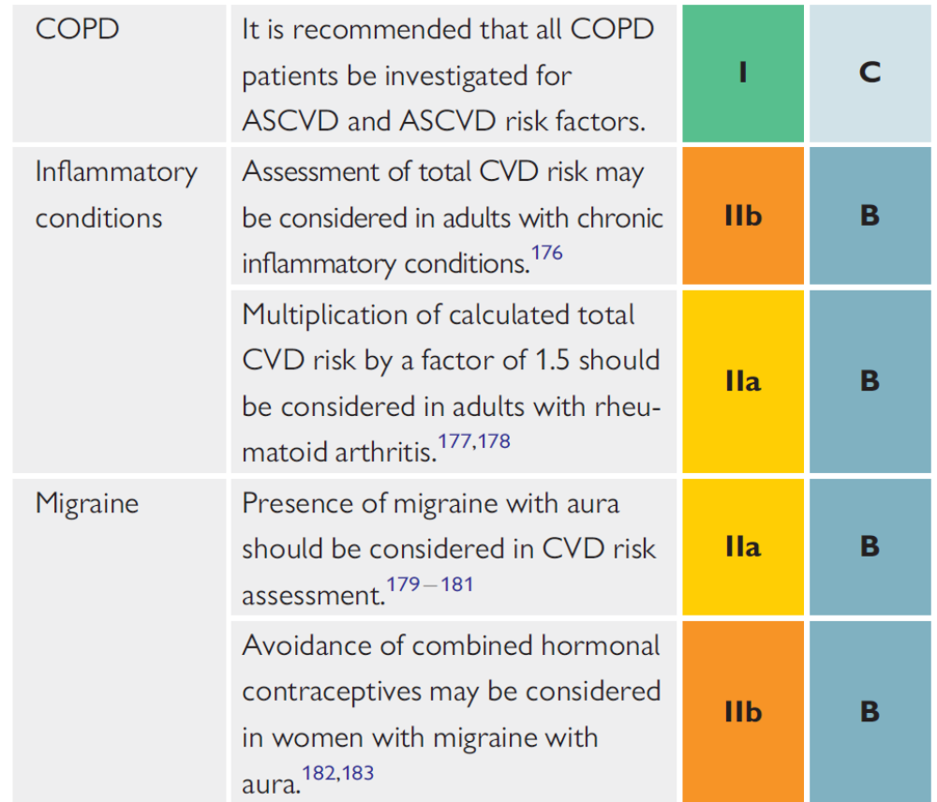

Slide 21
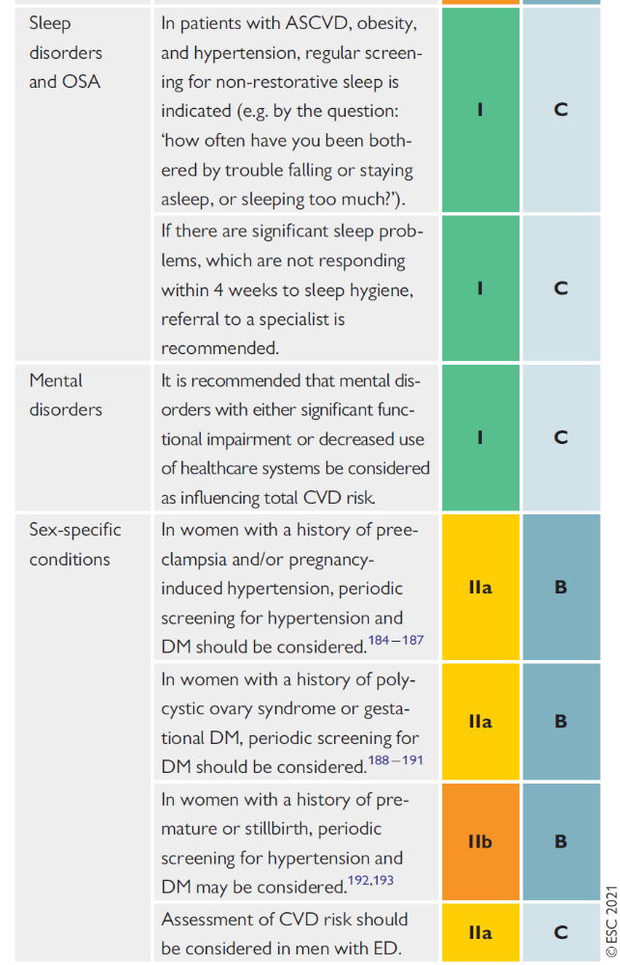

Slide 23
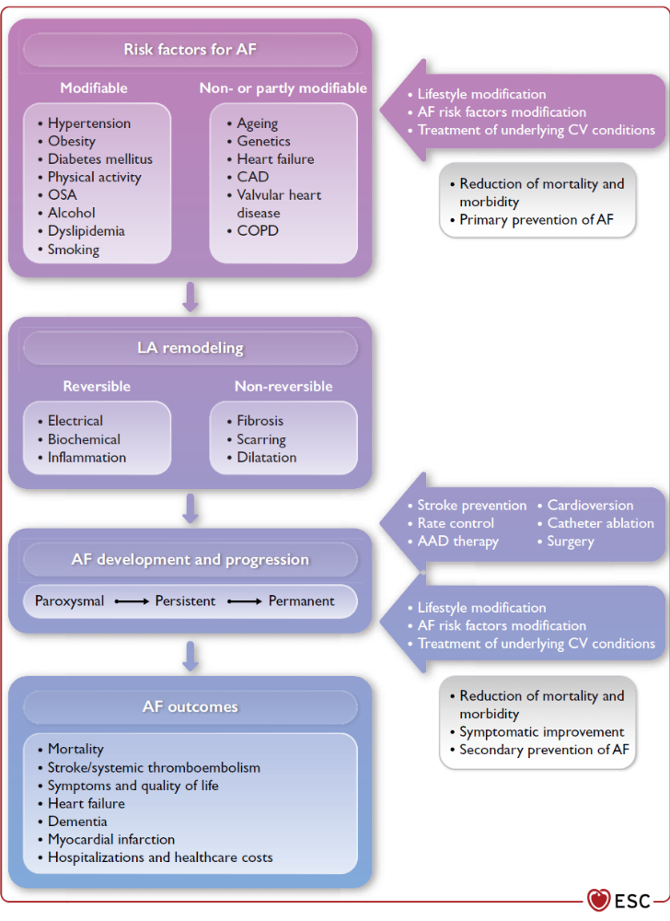
The role of risk factors and comorbidities in atrial fibrillation

Slide 24
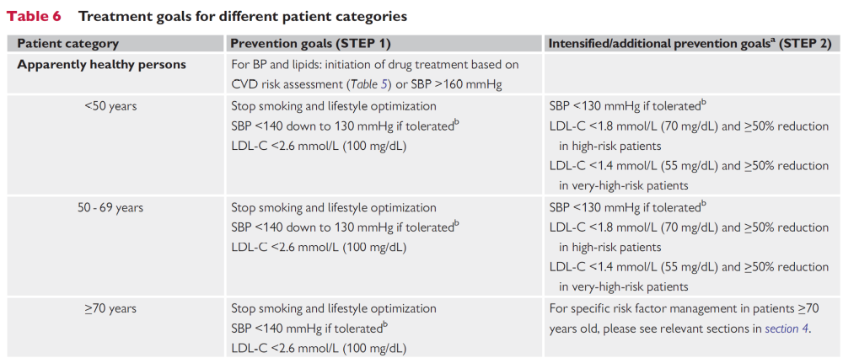

Slide 25
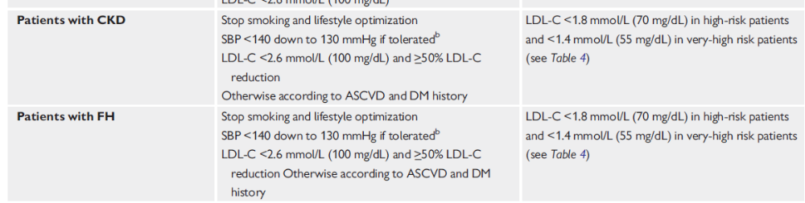

Slide 26
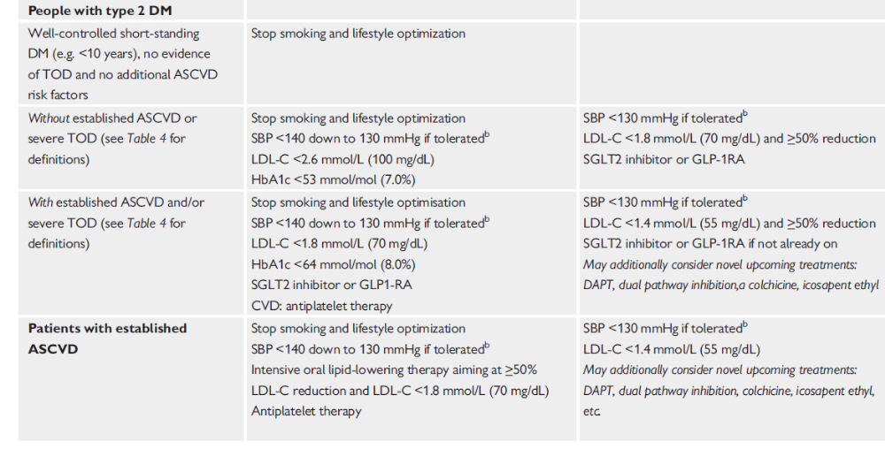

Slide 38
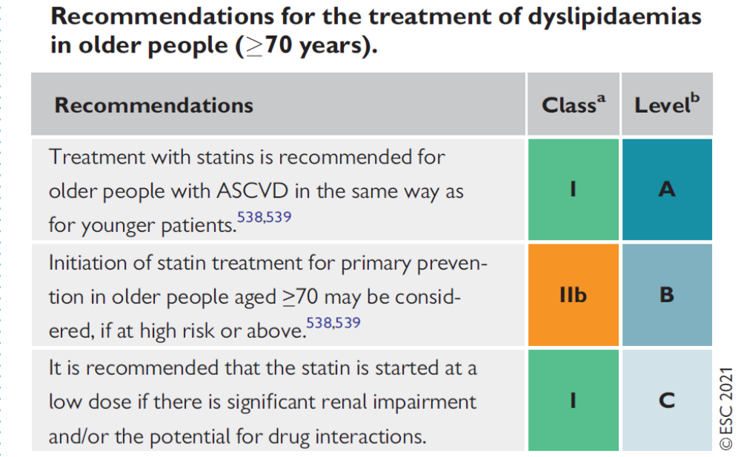

Slide 39
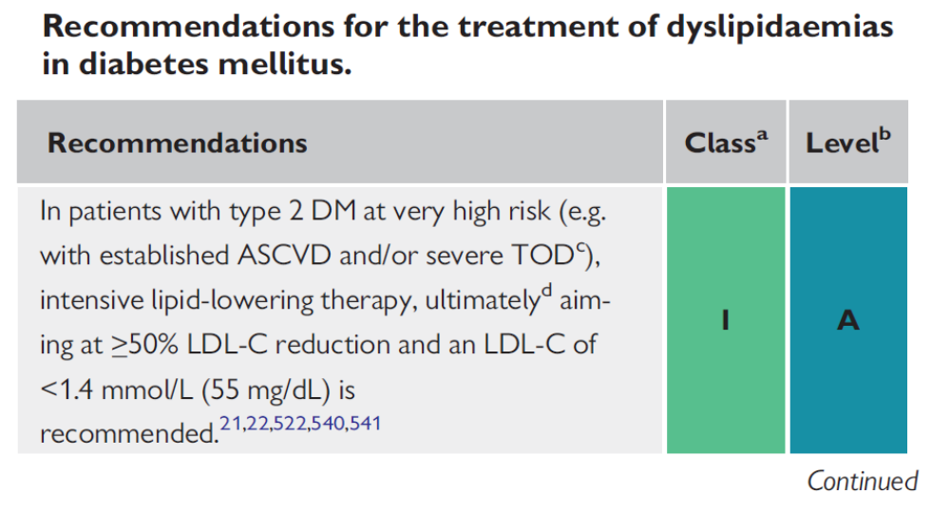

Slide 43


