Slide 1
Au nom de Dieu le Tre`s Mise´ricordieux,
Le Tout Mise´ricordieux
بنام خداوند بخشنده مهربان

Slide 2
Updates on antiplatelete agents in non-cardiac surgery
Maryam Mehrpooya MD,
Associate professor of cardiology
Fellowship of Interventional Cardiology
Tehran university of medical science
Imam Khomeini Hospital

Slide 3
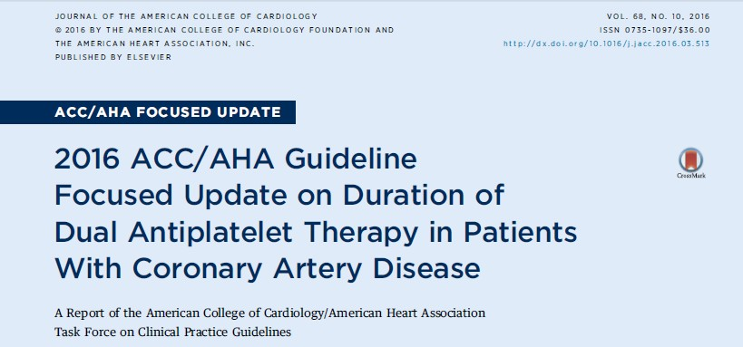
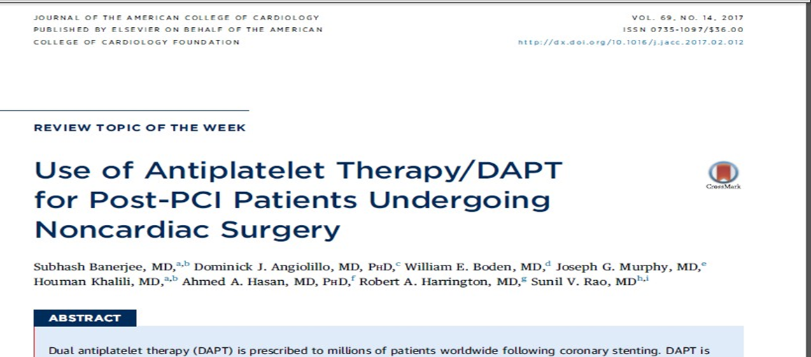

Slide 4
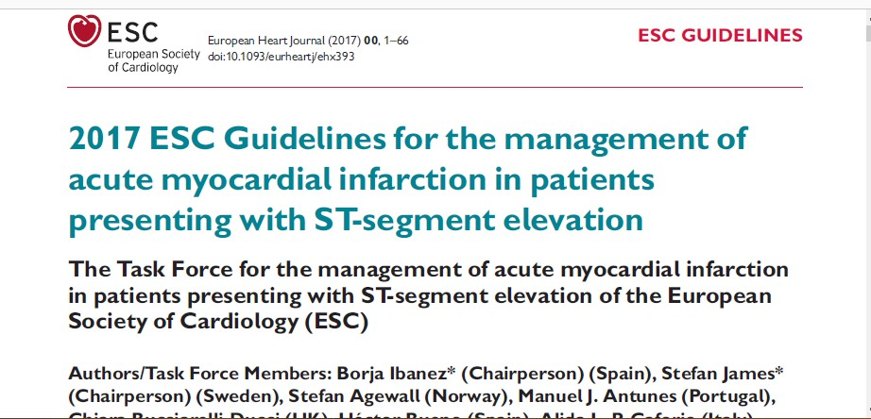
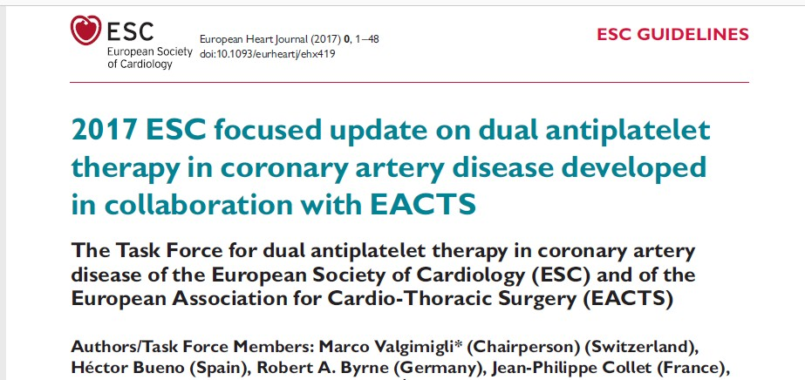

Slide 5
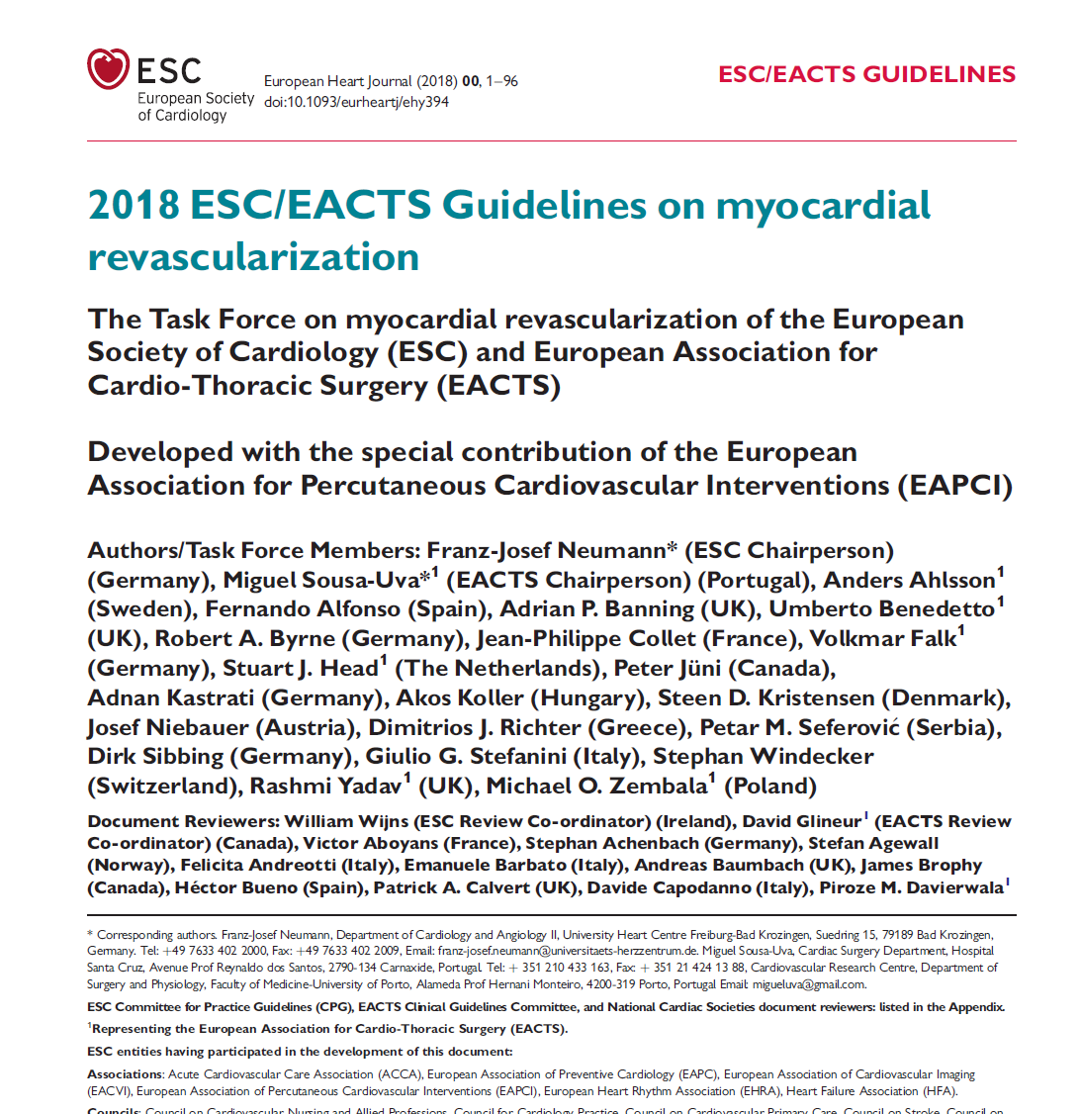

Slide 6
Case 1
A 52-years-old woman was admitted for severe chest pain due to Acute inferior lateral STEMI
She was Scheduled for surgery of high grade endometrial dysplasia on future month( 1.5 month later )
After CAG for PPCI : Significant Lesion in Proximal of LCX
which type of stent you choose?

Slide 7
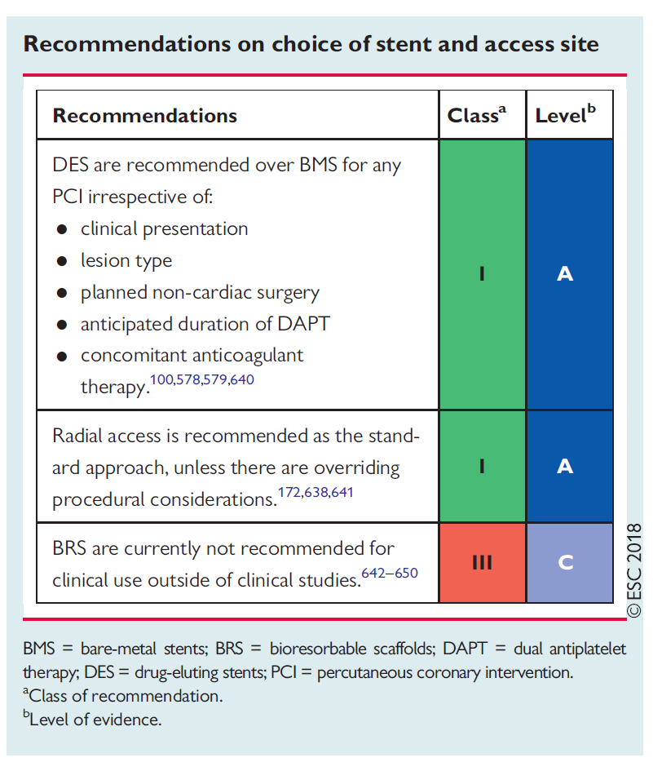
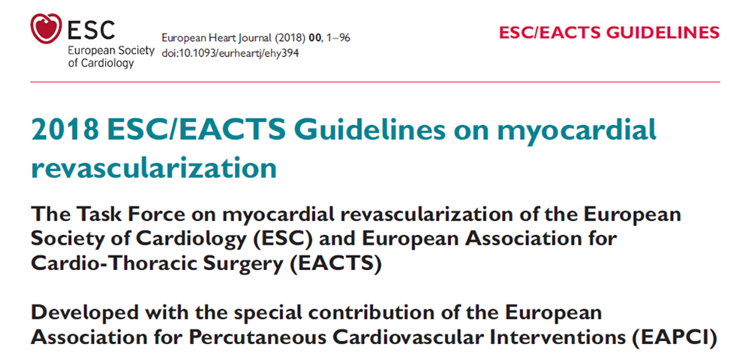

Slide 8
Your Stock of Stents :
Orsiro
Promus Element
Ultimaster
Supra flex
Coroflex ( BMS ) and Coroflex ISAR ( DES)
Onyx ONE

Slide 9
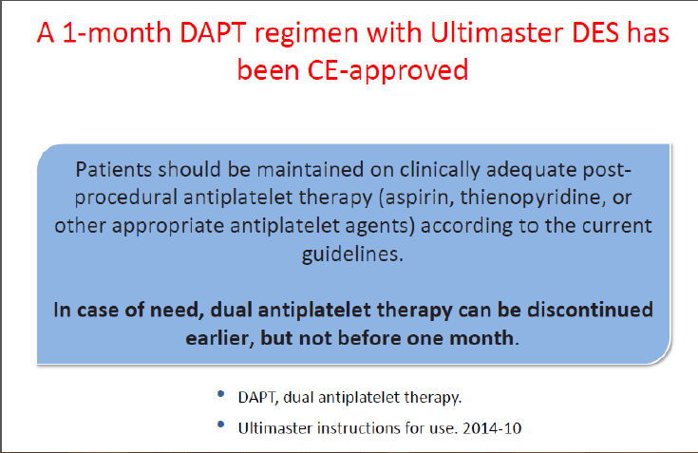

Slide 10
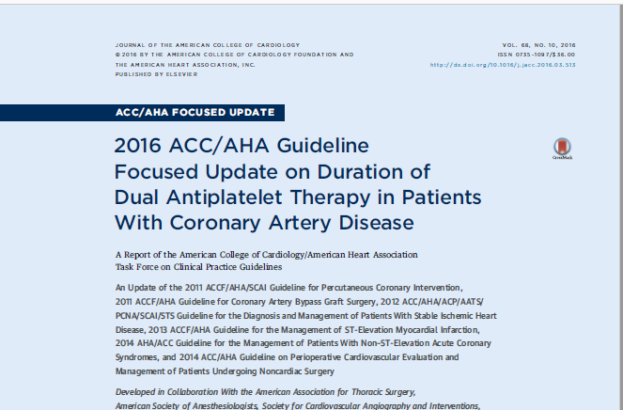

Slide 11
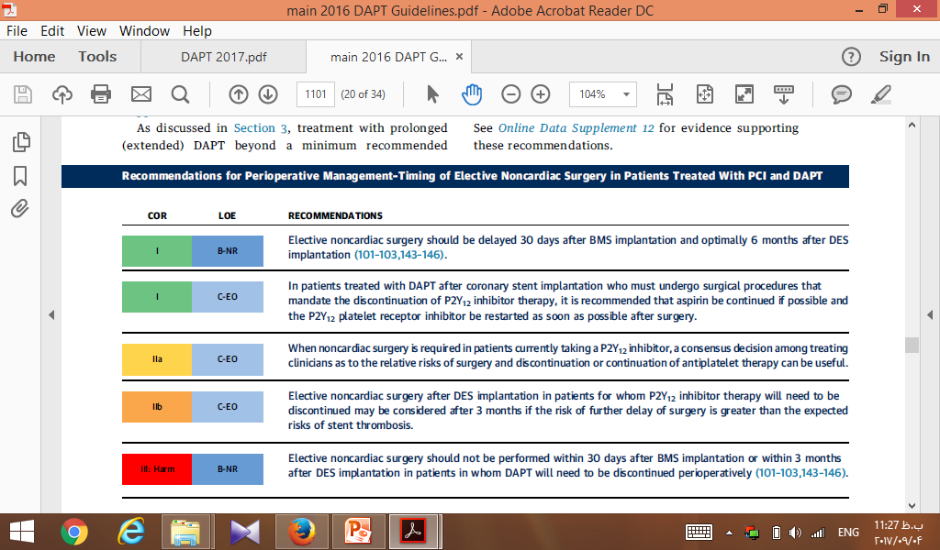

Slide 12
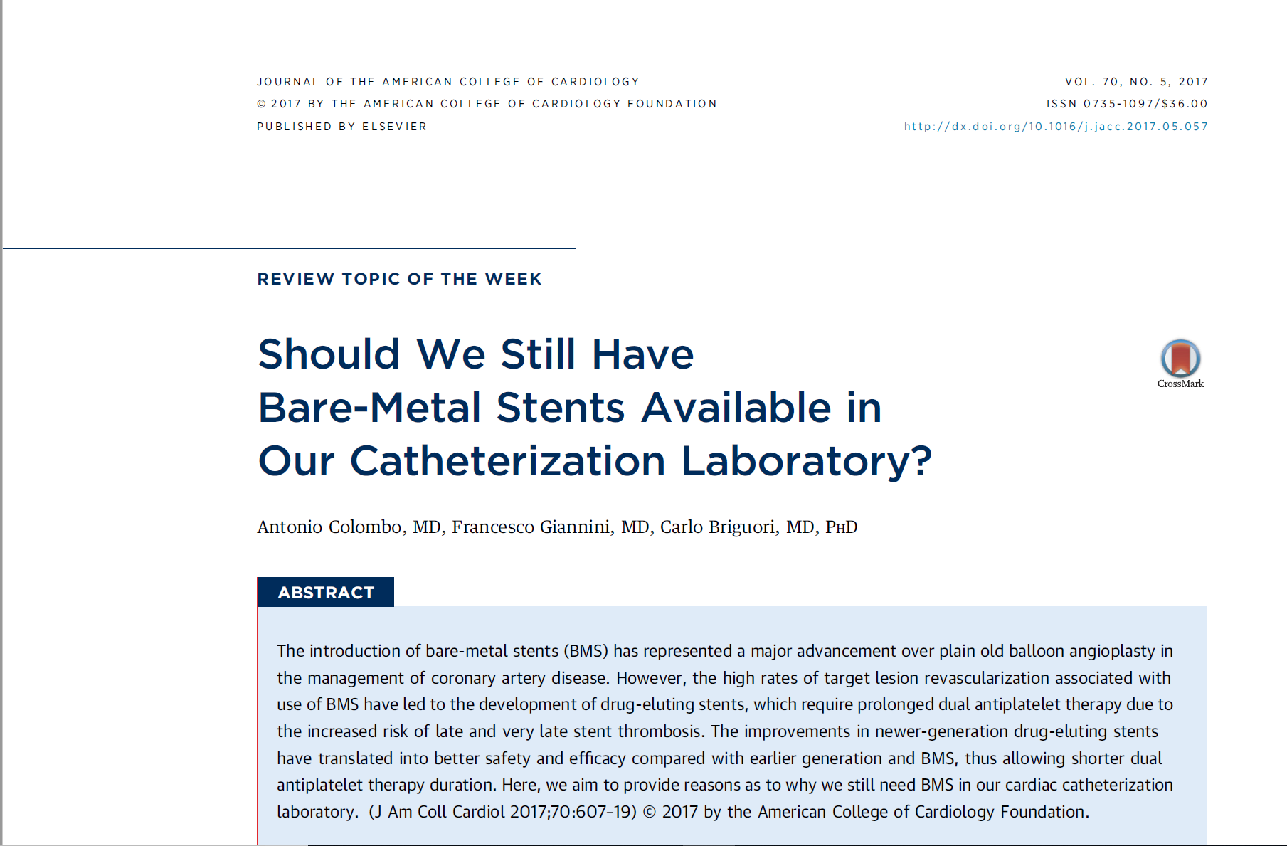

Slide 13
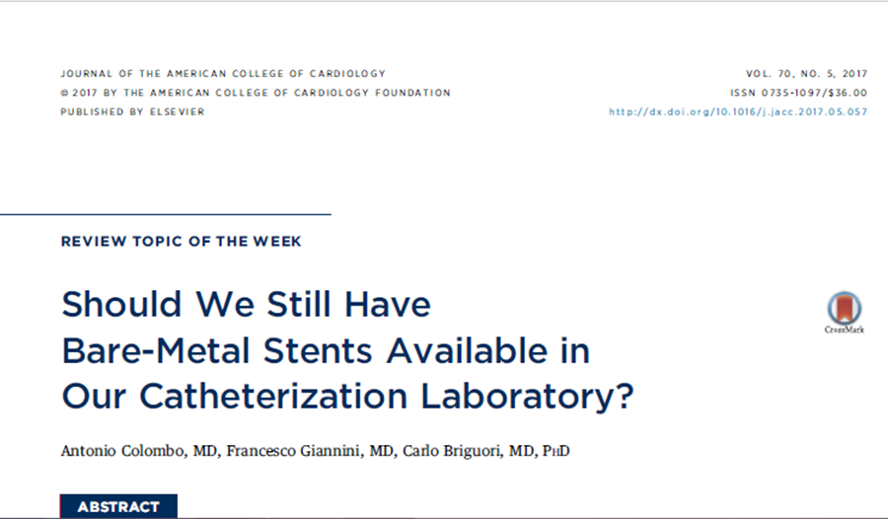
Stent Selection in Special-Risk Patients: A Decision Tree
The patient can continue DAPT for ≥ 3 month
The patient has problems with DAPT compliance
The patient is at high risk for bleeding
DES
BA9- coated stent : consider DES if the lesions are at high risk for restenosis & 3 mo DAPT appears relatively safe
BMS

Slide 14
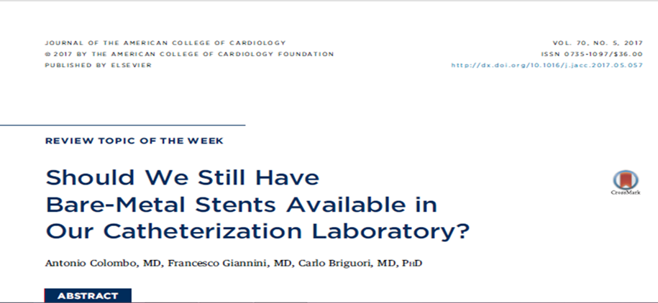
The patient needs surgery after stenting
Surgery can be delayed up to 3 month
Surgery earlier than 3 month
Urgent surgery in < 1 month
DES
BA9- coated stent or BMS
(vessel diameter ≥ 3.5 and short lesion )
BMS ( consider medical therapy or CABG )

Slide 15
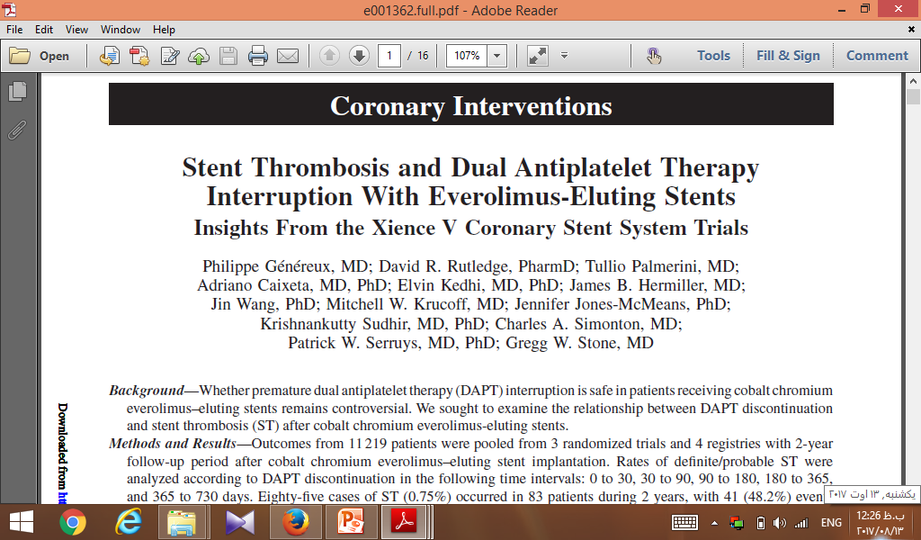
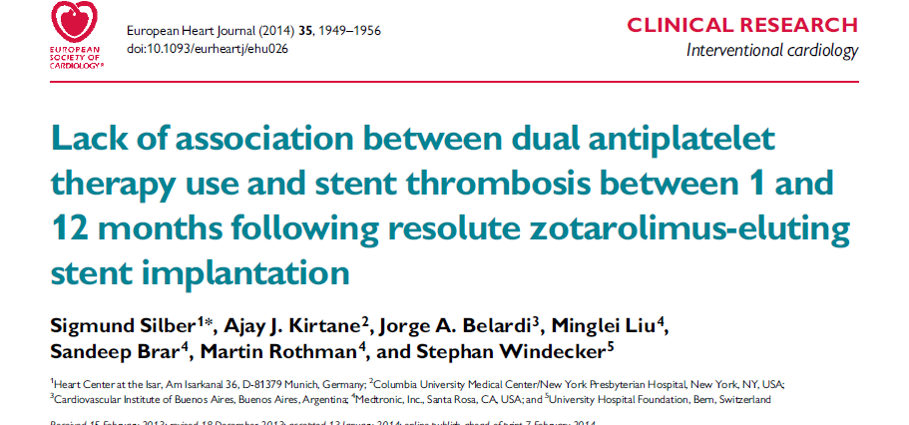

Slide 16
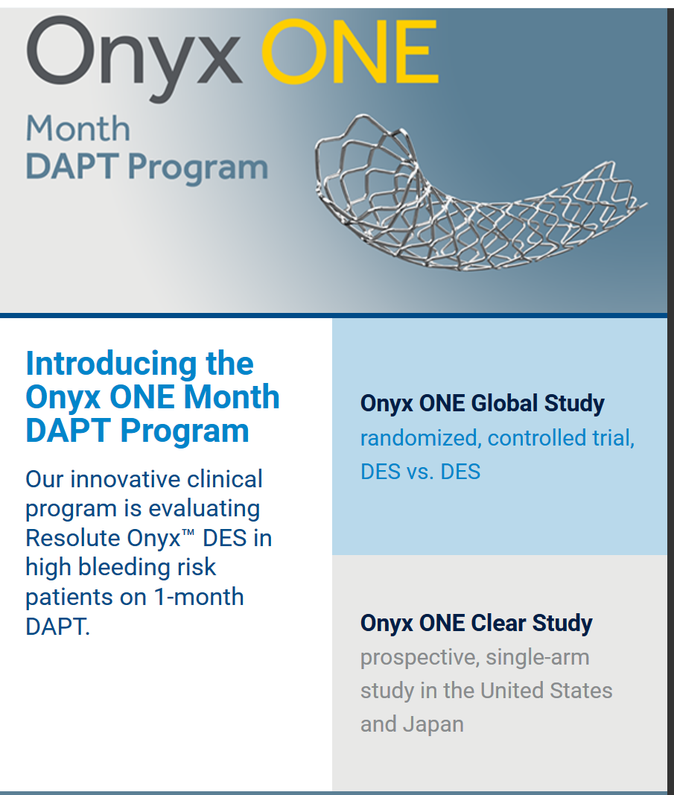
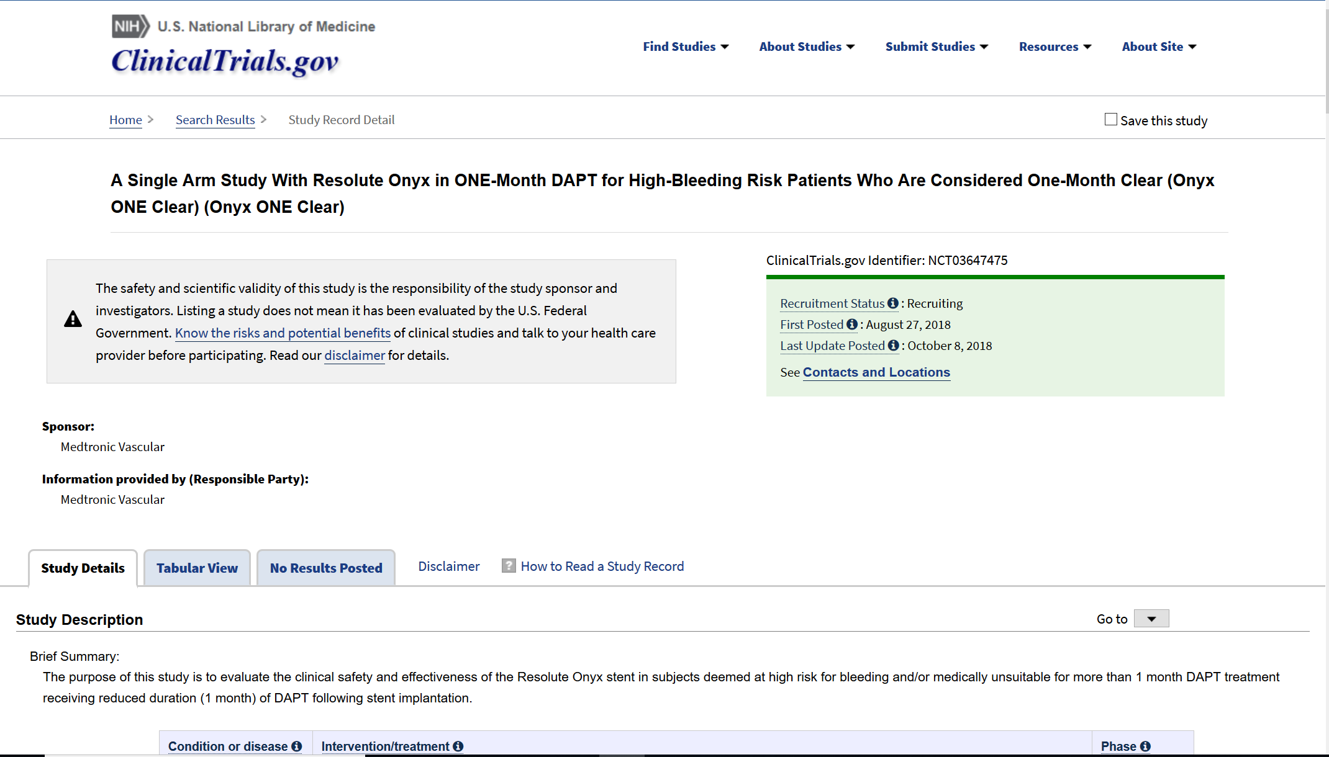
Medtronic (MDT) Initiates ONYX ONE- Clear Study on DAPT

Slide 17
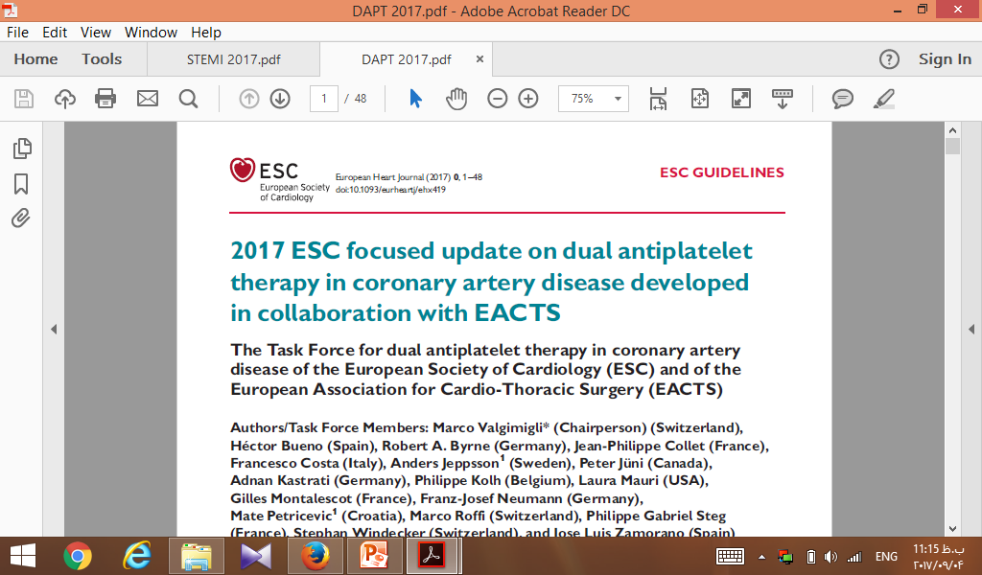
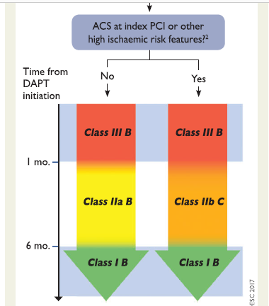

Slide 18
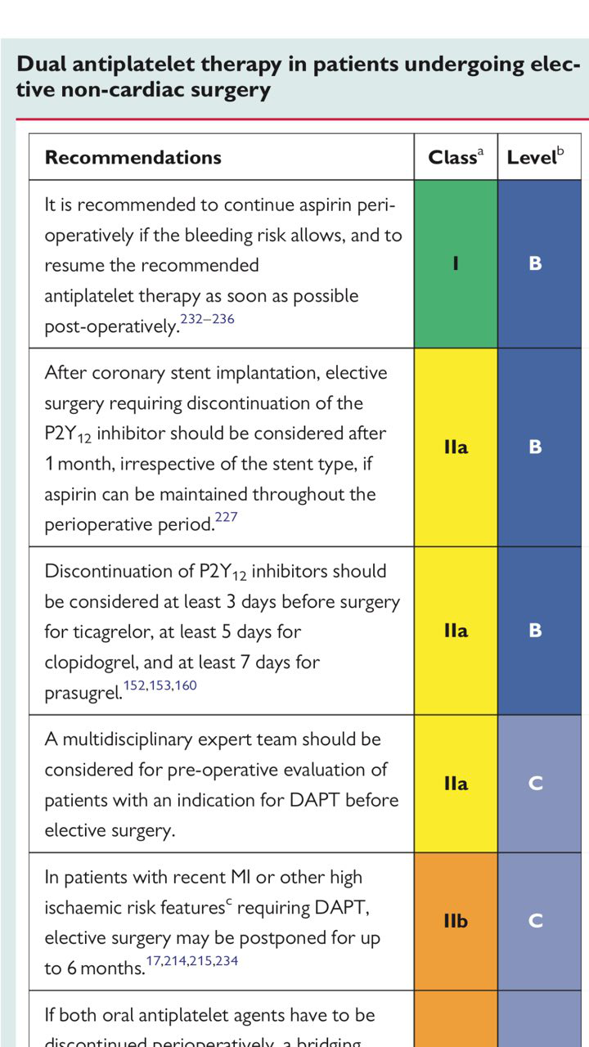
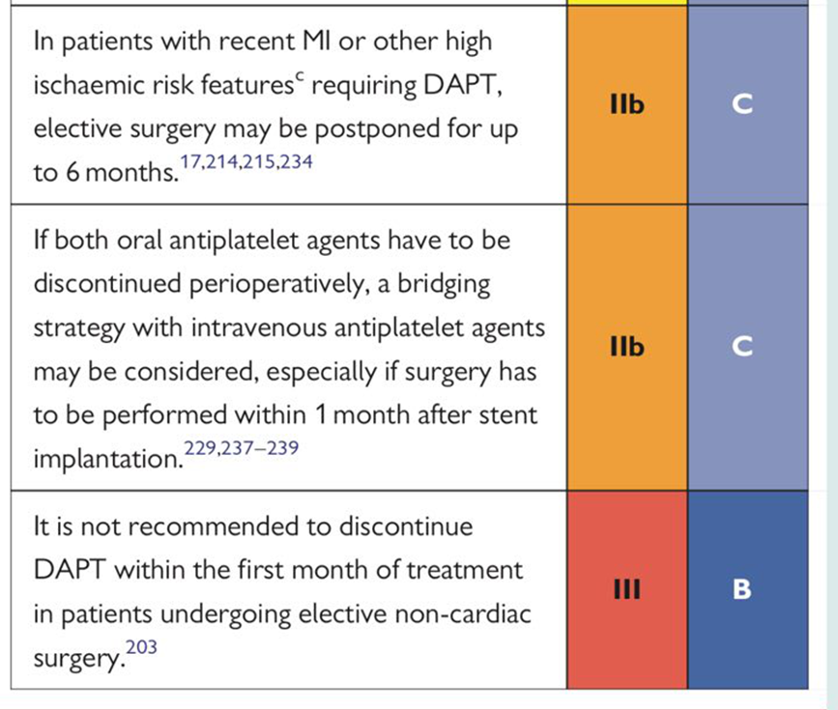

Slide 19
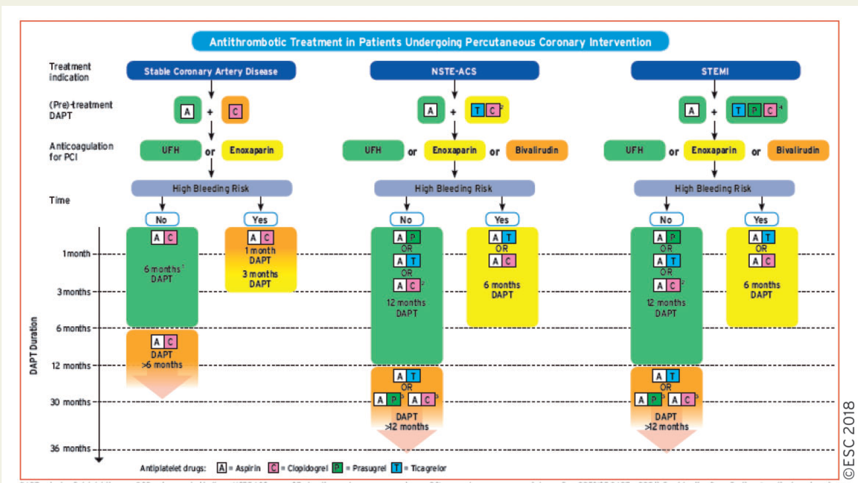

Slide 20
Case 2
The patient is 69-years-old man, with history of PCI on LAD (by DES ) since 2 month ago, gradually he experienced Severe exacerbating abdominal pain.
He became candidate for non-cardiac surgery, (Intestinal obstruction) due to colon cancer , PMH : smoking

Slide 21
Ph.Ex : JVP →
BP : 90/60 mmHg
PR : 100 bpm
OT : 37 °c
RR : 28 c/min
Heart : s1 → , s2 → ,regular
Lung : clear
Abdomen : distend-tenderness
Extremities : no edema 1/2+ pulse

Slide 22
What is your
Suggestions as a consultant cardiologist for DAPT treatment?

Slide 23
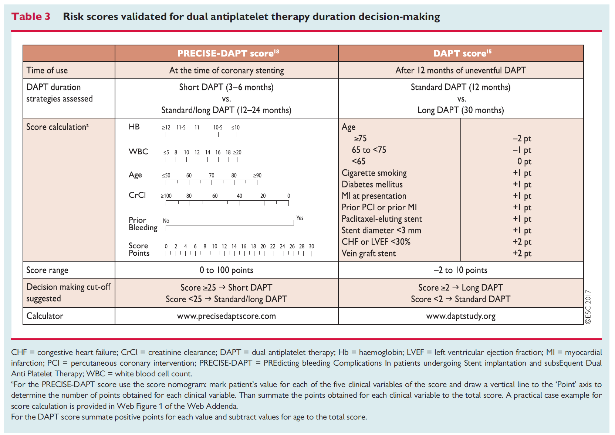

Slide 24
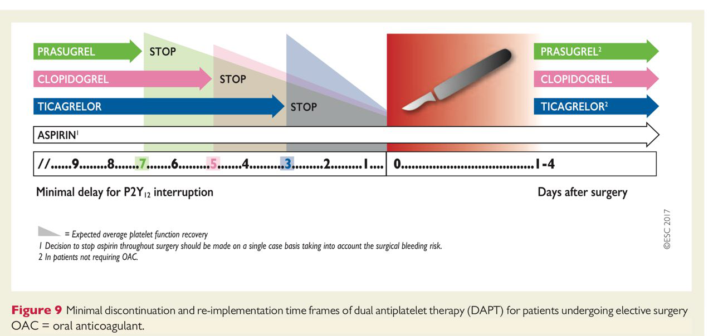

Slide 25
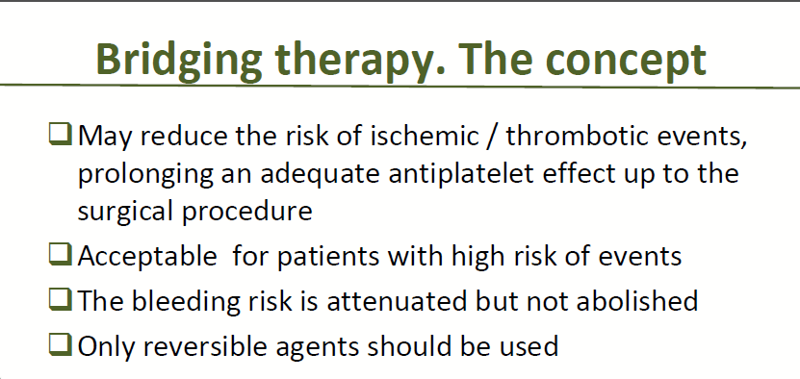

Slide 26
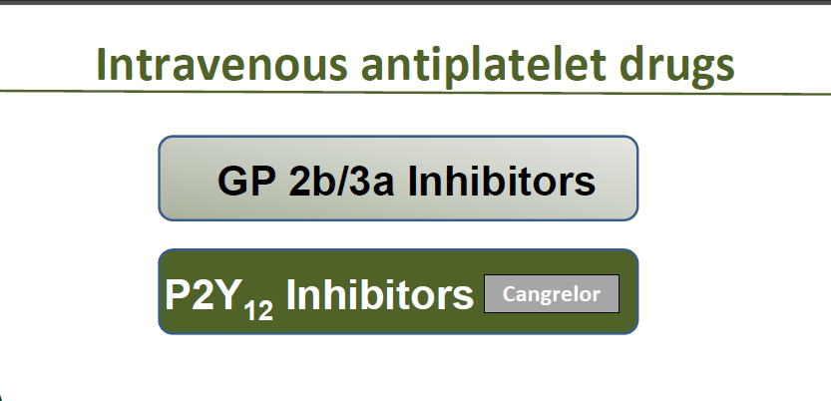

Slide 27
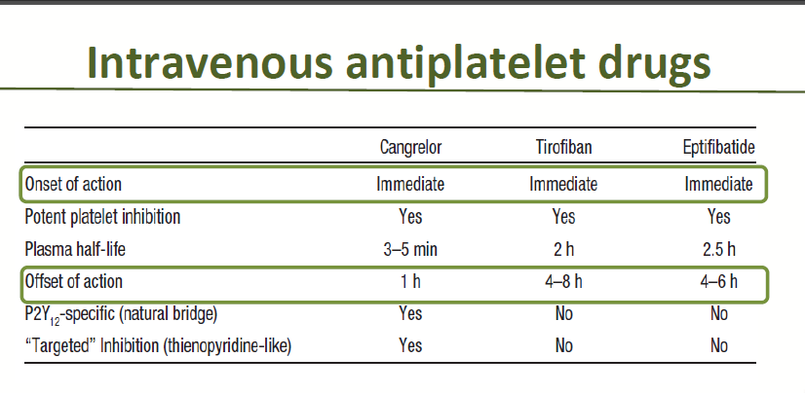

Slide 28
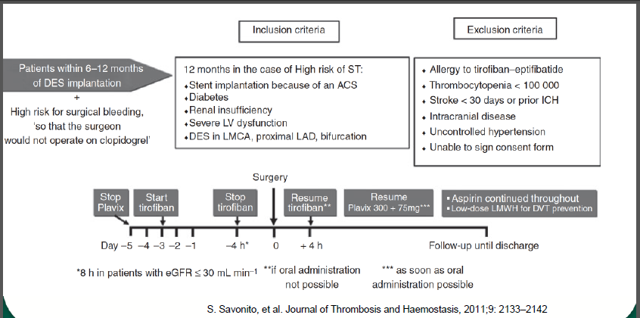

Slide 29
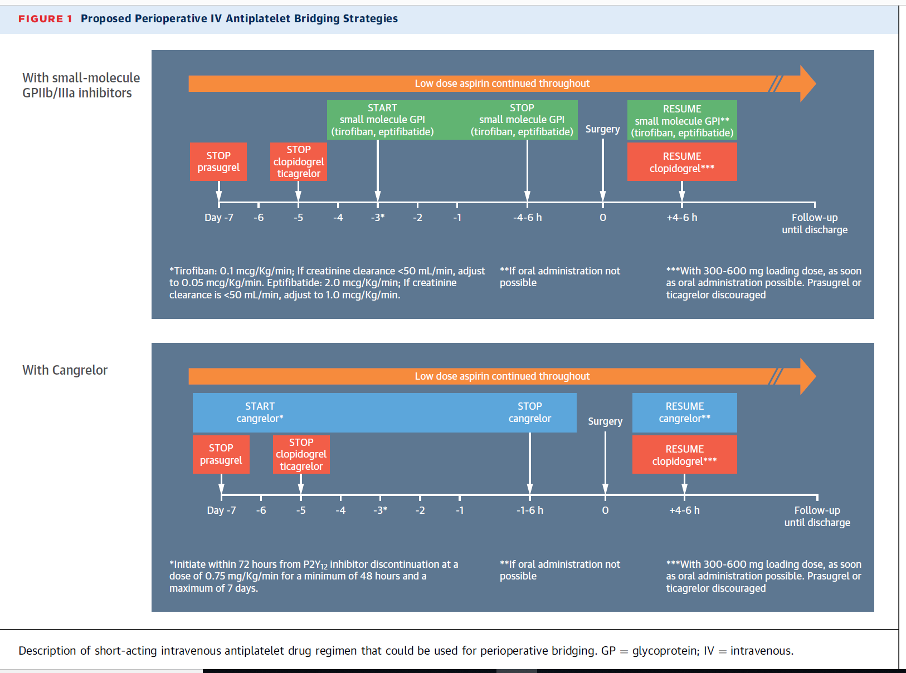

Slide 30
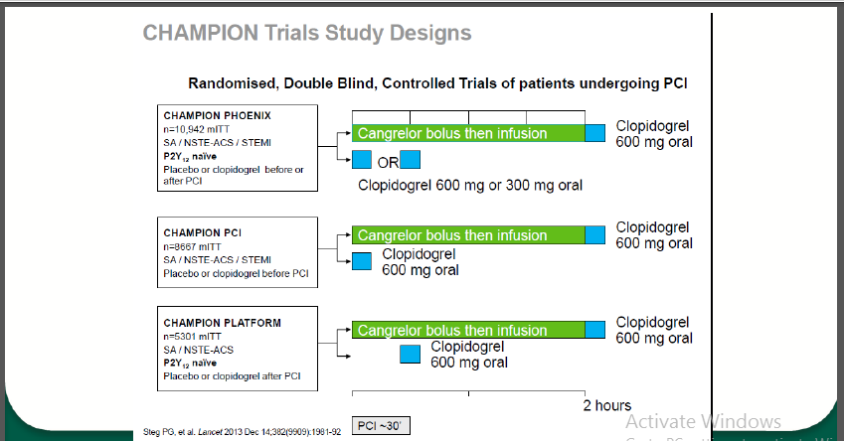

Slide 31
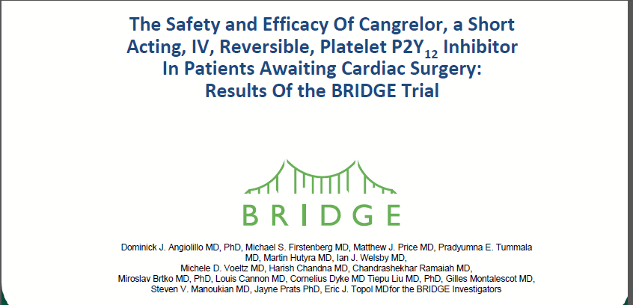

Slide 32
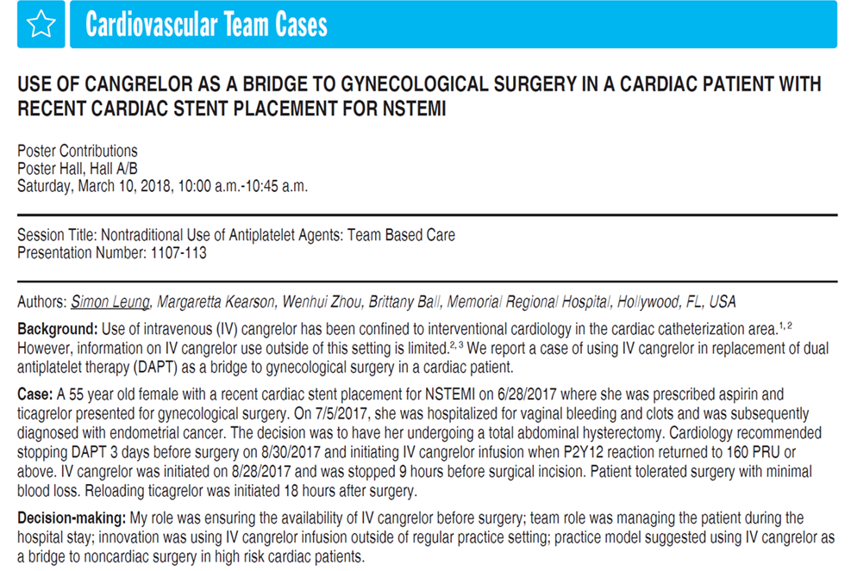
Conclusion: Careful planning, including timing to stop DAPT, initiate Cangrelor and reload Ticagrelor, was the key to achieve positive patient outcomes.

Slide 33


Slide 34
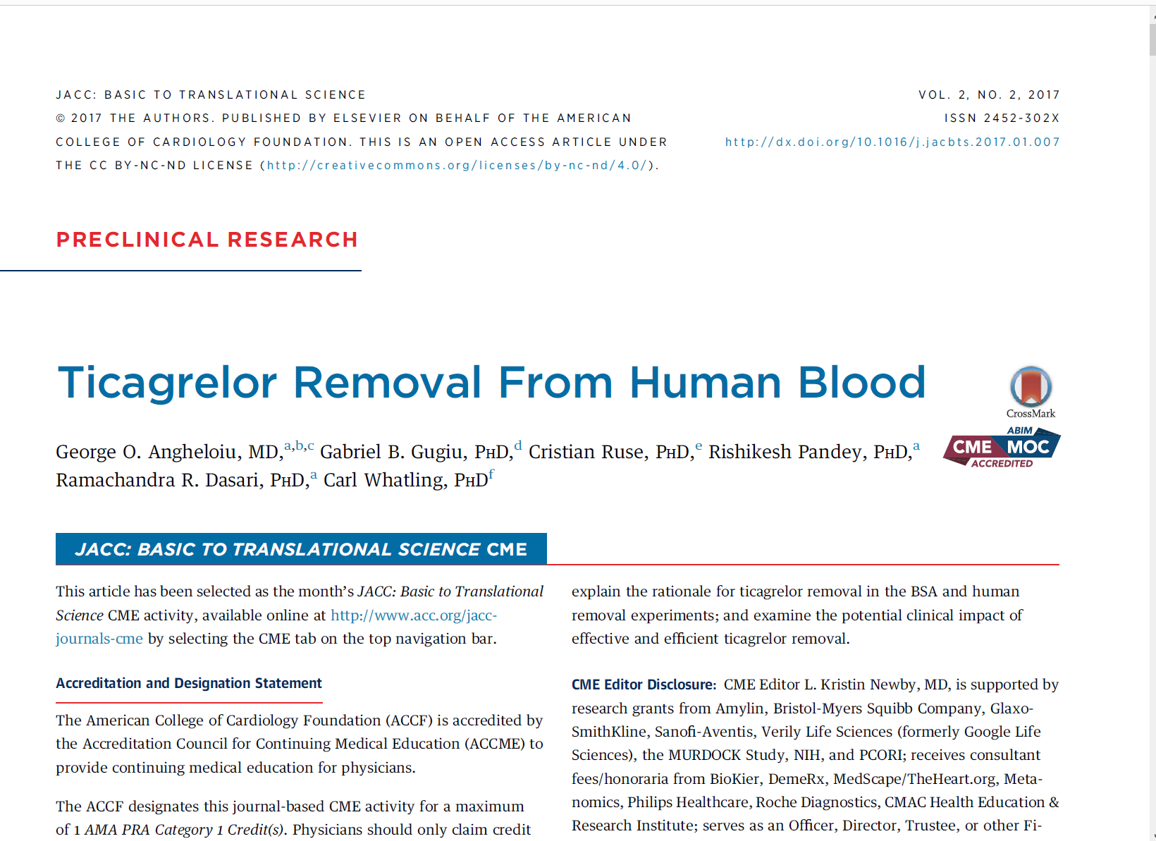
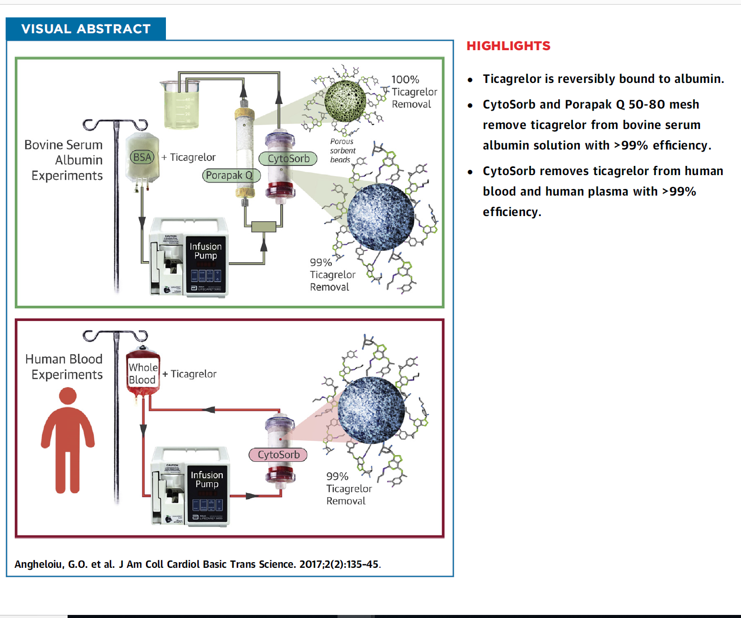

Slide 35
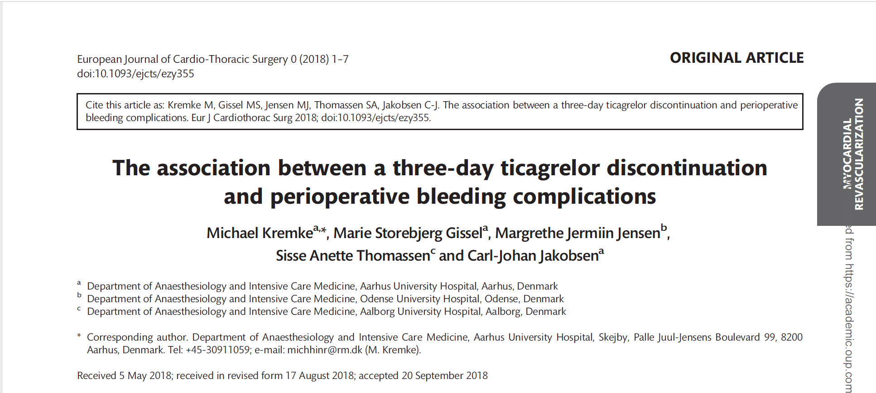
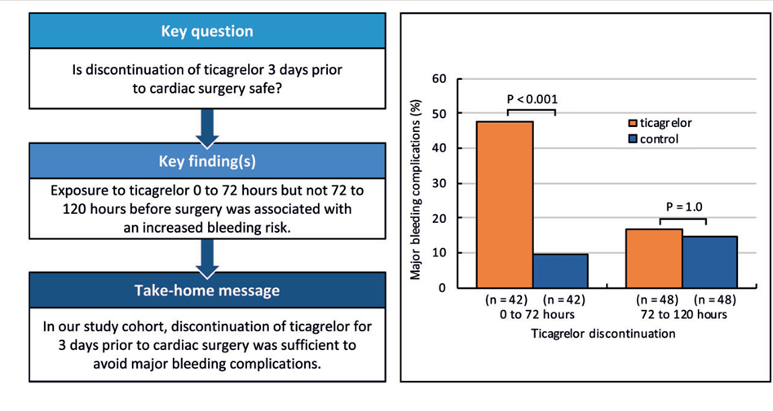

Slide 36
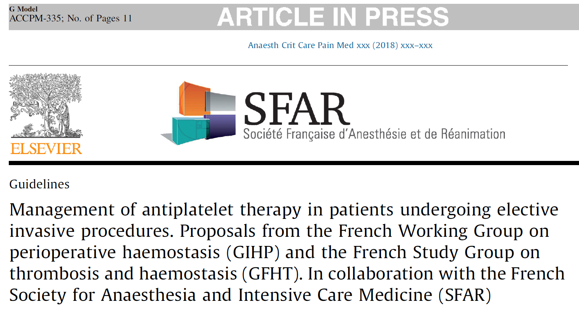
The incidence of major bleeding was high when ticagrelor or clopidogrel were discontinued less than 24 hours before surgery. In the ticagrelor group, there was no significant difference between discontinuation 72–120 hours or more than 120 hours before surgery, as opposed to what was observed in the clopidogrel group. The overall incidence of major bleeding complications was lower with ticagrelor than with clopidogrel.

Slide 37
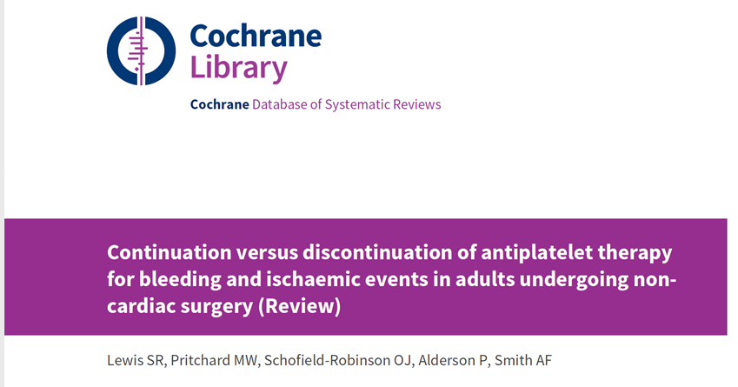
Conclusions :
We found low-certainty evidence that either continuation or discontinuation of antiplatelet therapy before non-cardiac surgery may make little or no difference to mortality, bleeding requiring surgical intervention, or ischemic events. We found moderate-certainty evidence that either continuation or discontinuation of antiplatelet therapy before non-cardiac surgery probably makes little or no difference to bleeding requiring transfusion. Evidence was limited to few studies with few participants, and with few events. The three ongoing studies may alter the conclusions of the review once published and assessed.

Slide 38
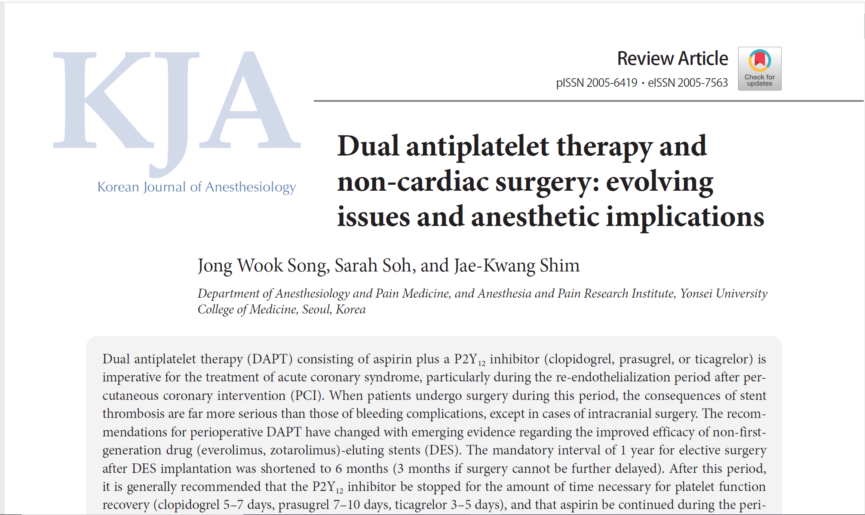

Slide 39
When patients undergo surgery during this period, the consequences of stent thrombosis are far more serious than those of bleeding complications, except in cases of intracranial surgery.
The recommendations for perioperative DAPT have changed with emerging evidence regarding the improved efficacy of non-first-generation drug (everolimus, zotarolimus)-eluting stents (DES).
The mandatory interval of 1 year for elective surgery after DES implantation was shortened to 6 months (3 months if surgery cannot be further delayed).
After this period, it is generally recommended that the P2Y12 inhibitor be stopped for the amount of time necessary for platelet function recovery (clopidogrel 5–7 days, prasugrel 7–10 days, ticagrelor 3–5 days), and that aspirin be continued during the perioperative period.

Slide 40
In emergent or urgent surgeries that cannot be delayed beyond the recommended period after PCI, proceeding to surgery with continued DAPT should be considered.
For intracranial procedures or other selected surgeries in which increased bleeding risk may also be fatal, cessation of DAPT (possibly with continuation or minimized interruption [3–4 days] of aspirin) with bridge therapy using short-acting, reversible intravenous antiplatelet agents such as cangrelor (P2Y12 inhibitor) or glycoprotein IIb/IIIa inhibitors (tirofiban, eptifibatide) may be contemplated.
Such a critical decision should be individually tailored based on consensus among the anesthesiologist, cardiologist, surgeon, and patient to minimize both ischemic and bleeding risks.

Slide 41
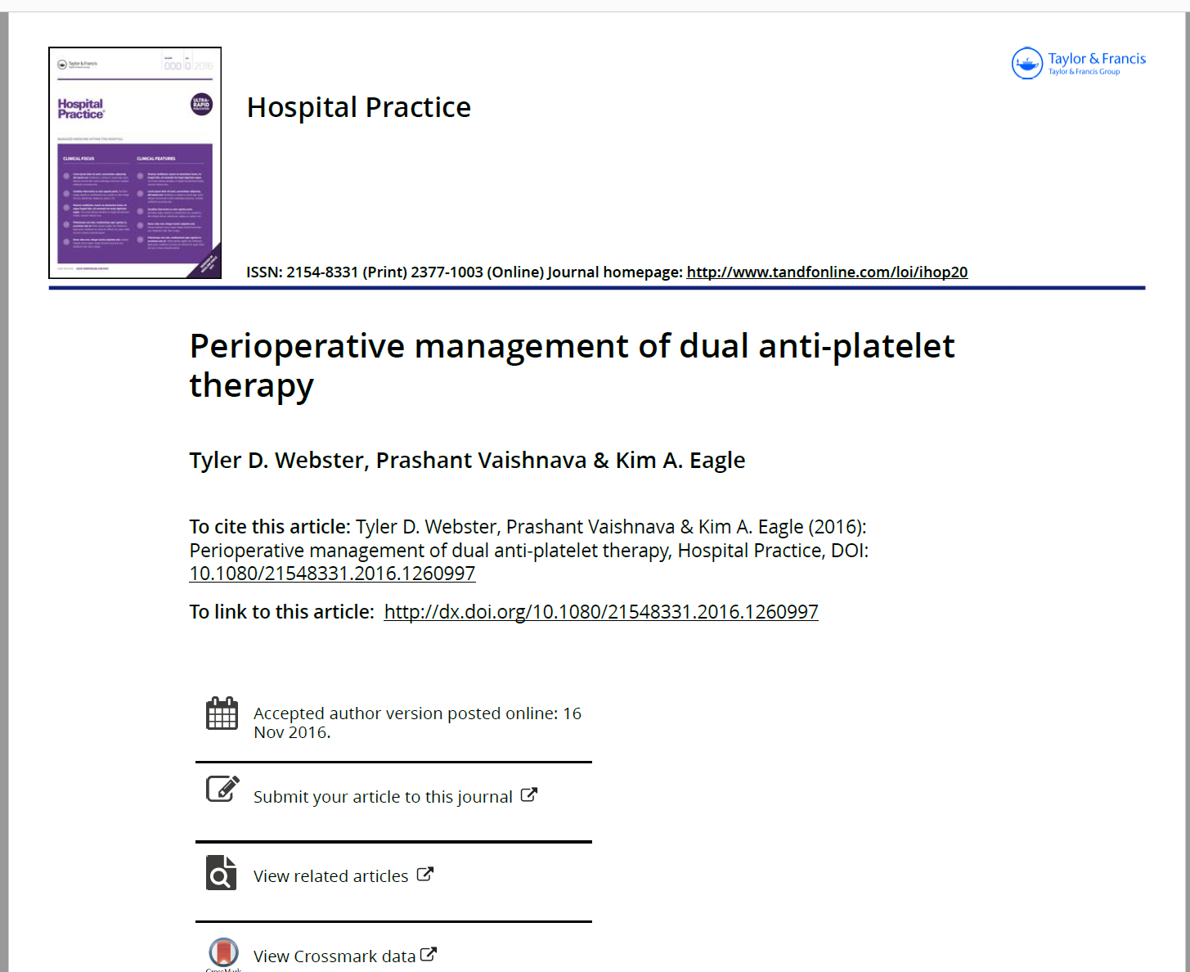

Slide 42
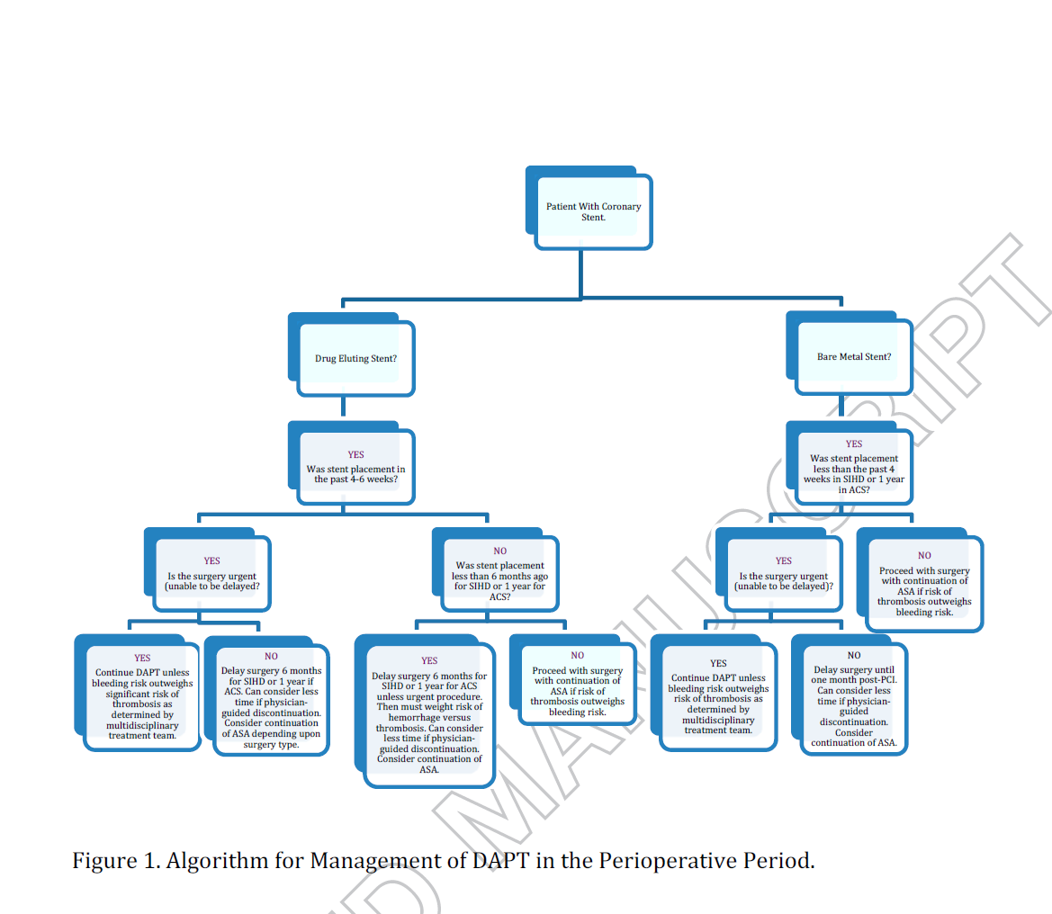

Slide 43
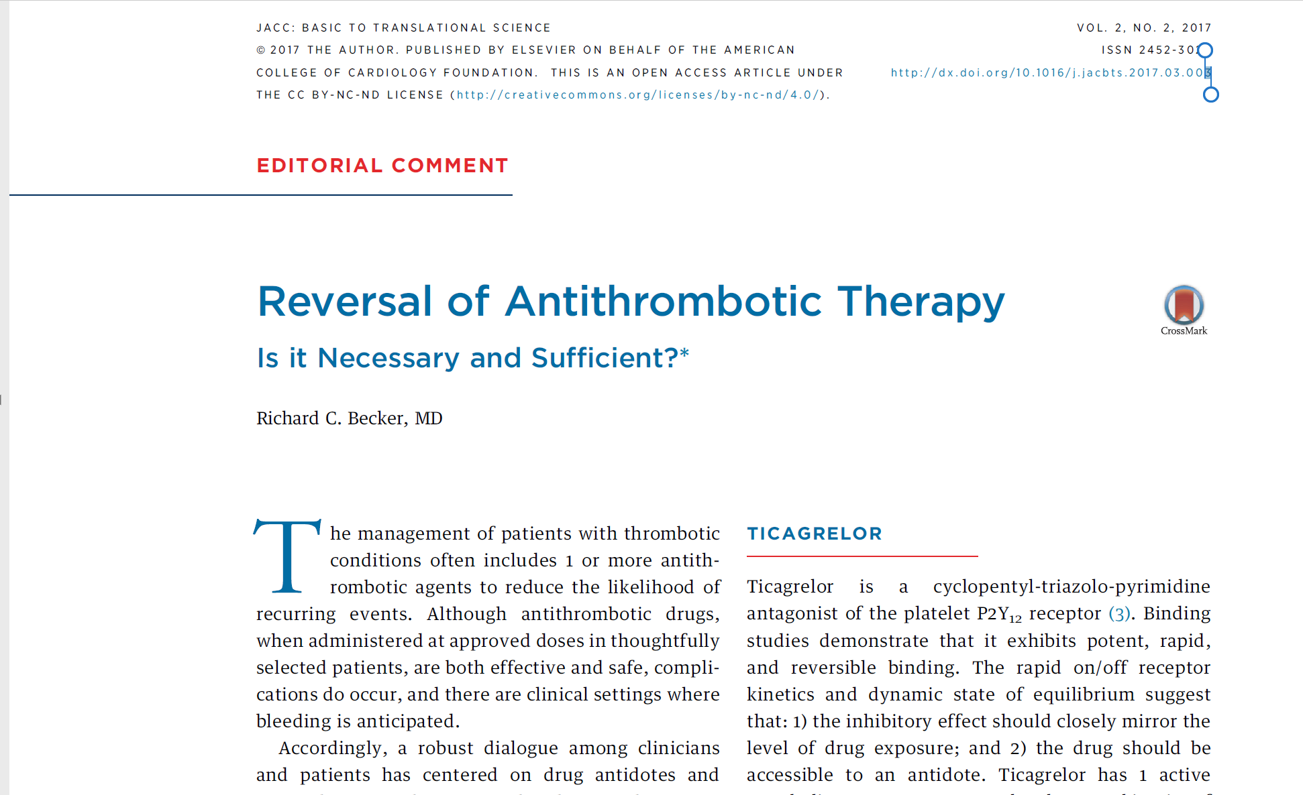

Slide 44
Monoclonal antibody
Buchanan et al developed an antigen-binding fragment (Fab) to ticagrelor and its major active metabolite (TAM).
The Fab had a 20 pmol/l affinity for ticagrelor—100 stronger than ticagrelor’s affinity for the platelet P2Y12 receptor.
The antidote neutralized the free fraction of ticagrelor and also reversed its antiplatelet activity both in vitro, employing human platelet-rich plasma, and in vivo in mice.
The antidote normalized ticagrelor-dependent bleeding in a mouse model of acute surgery. Last, the antidote had a circulating half-life of approximately 12 h—similar to ticagrelor (9.8 h) and TAM (12.4 h).
The ticagrelor-specific neutralizing Fab, MEDI2452, binds unbound ticagrelor and TAM in a 1:1 ratio (12) and restores ADP-induced platelet aggregation.

Slide 45
Platelet Function Test
Besides the variance in platelet inhibitory effects between different P2Y12 inhibitors, there is also a large individual variation in the magnitude and duration of the antiplatelet effect.
Because of the individual variation, the use of platelet function tests may aid the optimization of the timing of surgical procedures.
However, platelet function tests could also be of value to establish the grade of platelet inhibition in patients in whom the time since discontinuation is unclear, e.g. in unconscious or confused patients, and in patients with uncertain compliance to the treatment.

Slide 46
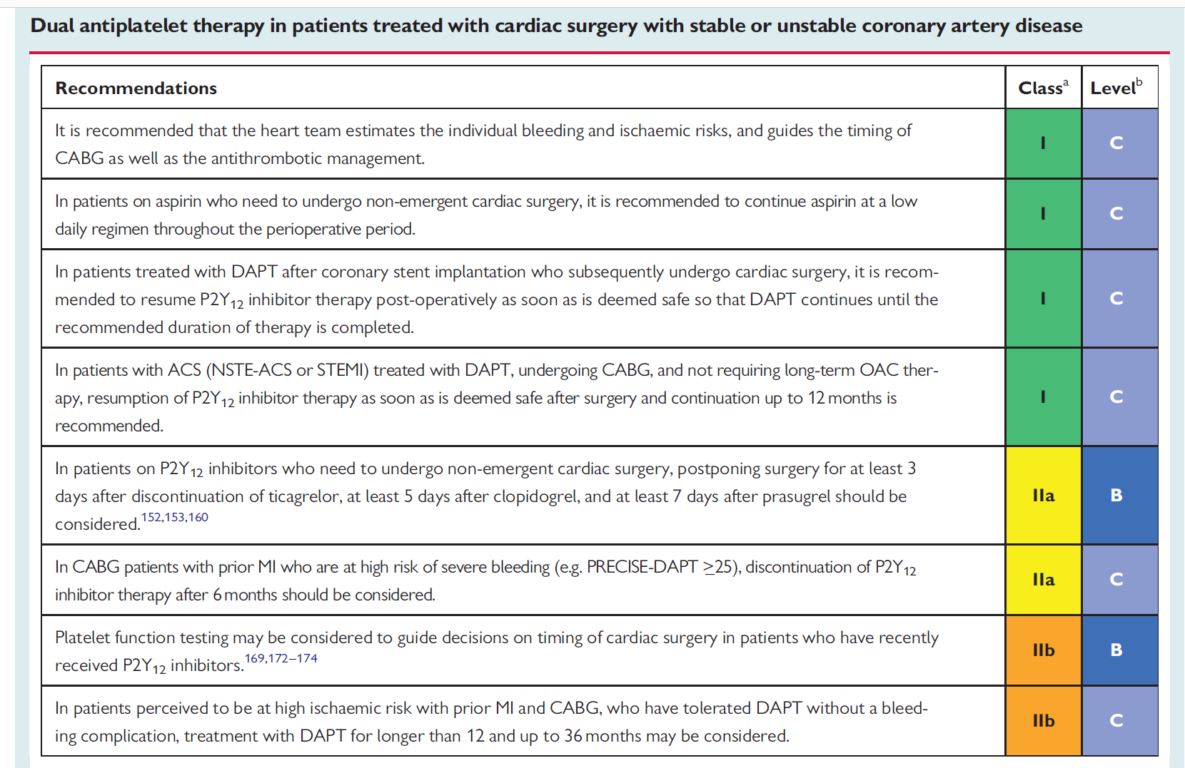

Slide 47


