Slide 1
Perioperative Management of Antithrombotics
Maryam Mehrpooya MD,
Associate professor of cardiology
Fellowship of Interventional Cardiology
Tehran university of medical science
Imam Khomeini Hospital

Slide 2
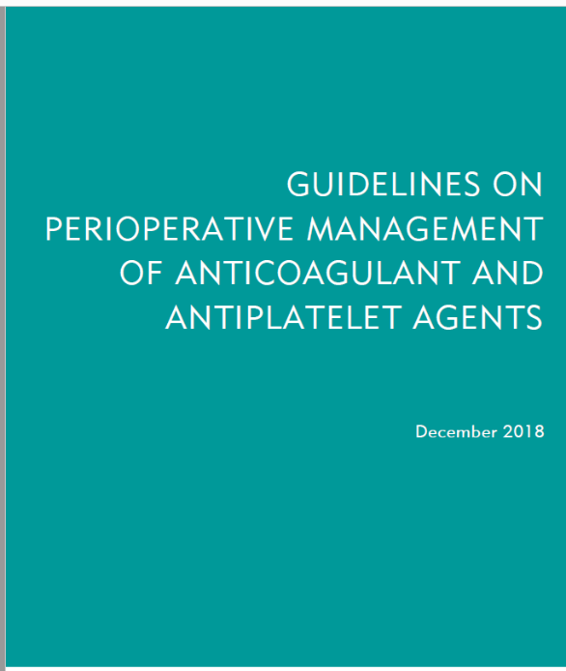
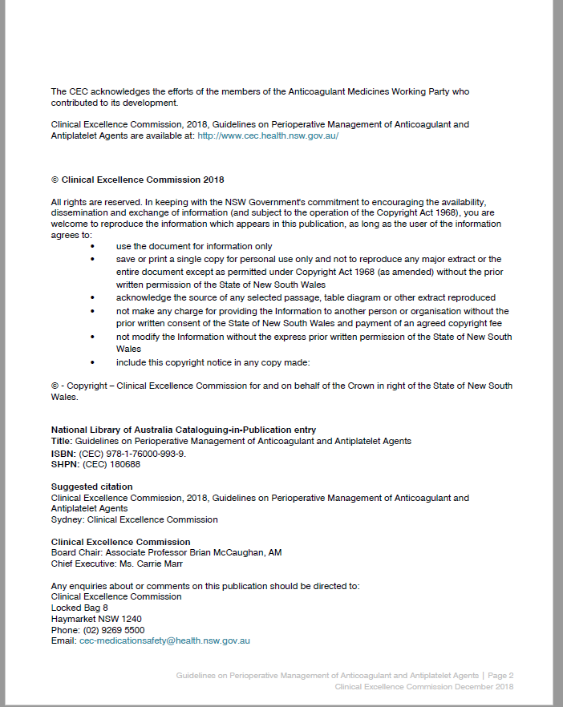
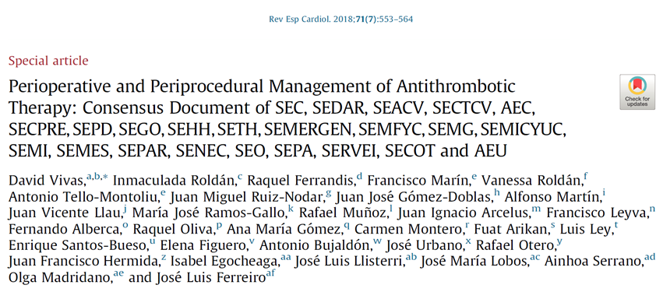

Slide 3
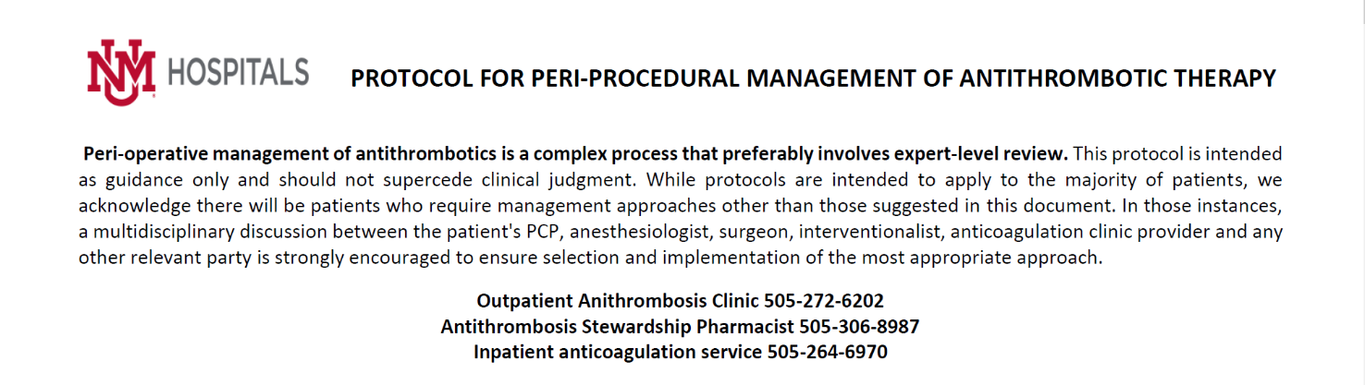
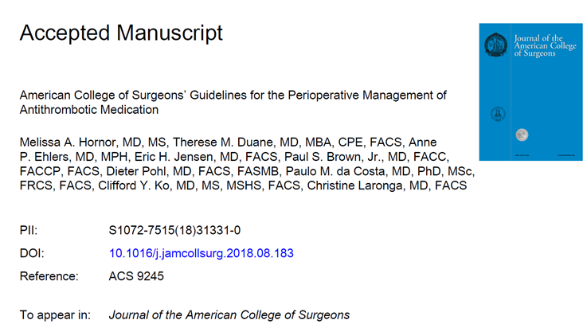
UNMH Inpatient Pharmacy Anticoagulation Services
Updated April 2019

Slide 4
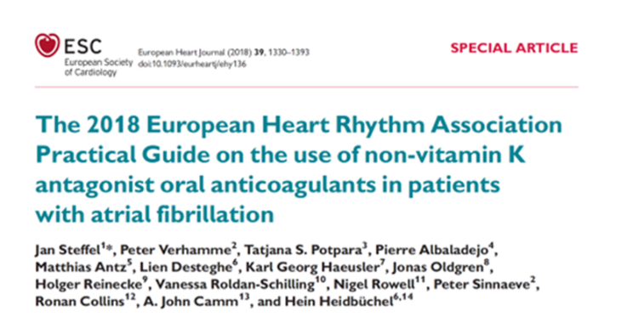

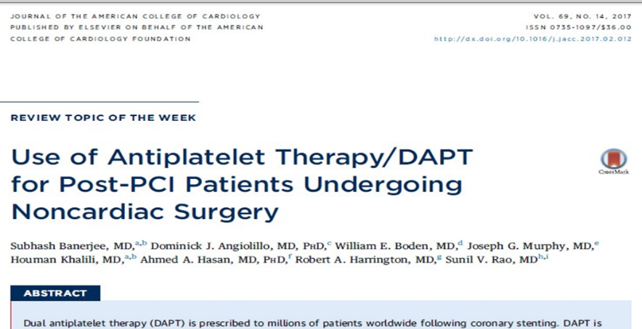

Slide 5
1- Antiplatelet Agents (Emergent Surgery-Elective Surgery )
2- Anticoagulants Agents (Emergent Surgery-Elective Surgery )
(Stopping time before surgery-Reinitiate time after surgery )

Slide 6
Anticoagulant Issues

Slide 7
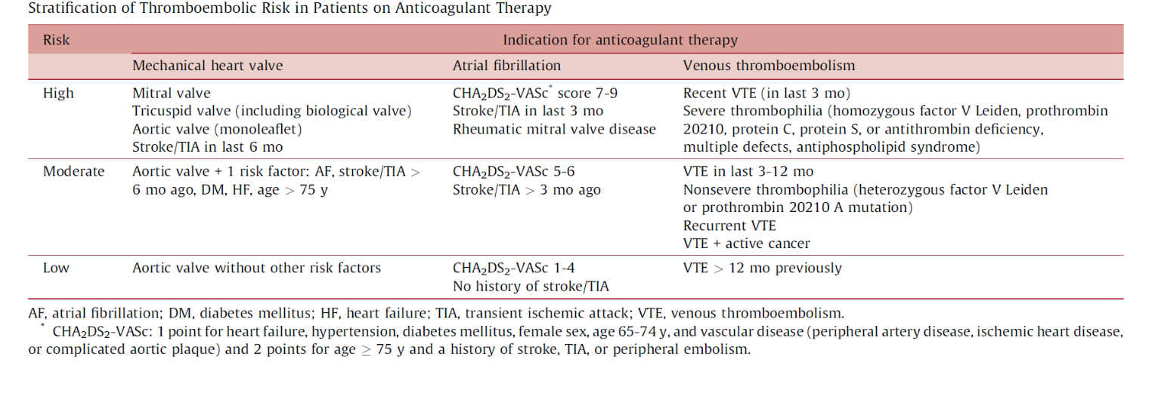

Slide 8
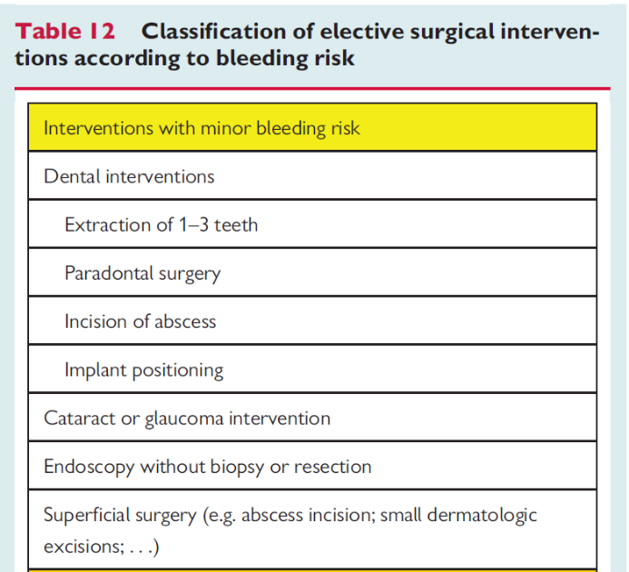
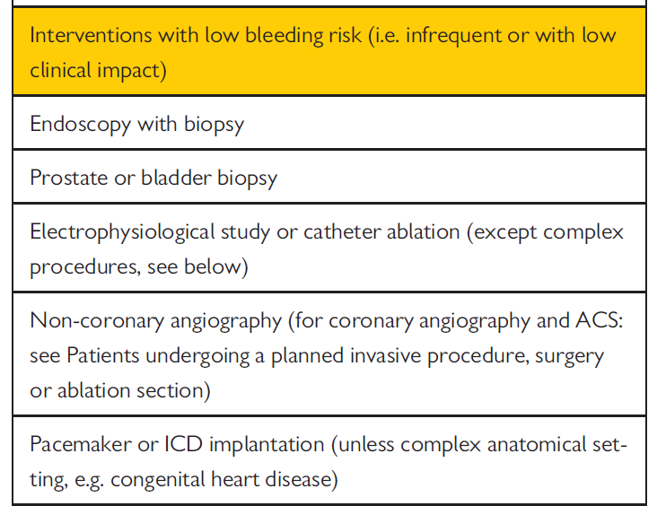

Slide 9
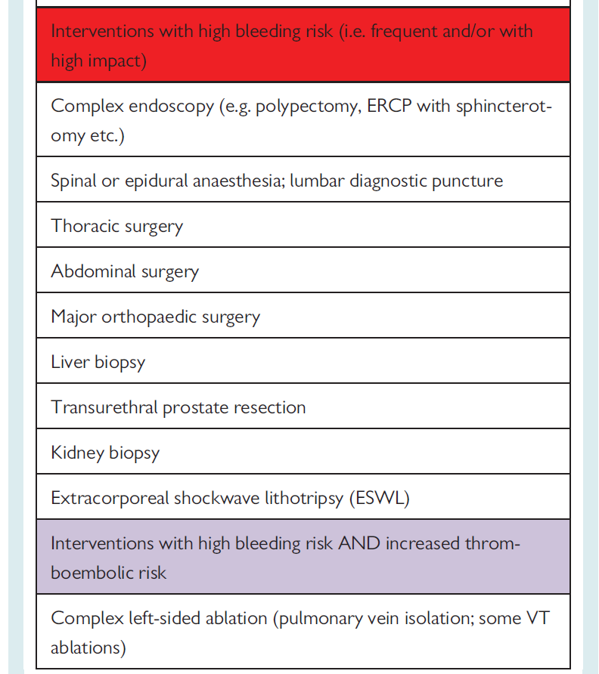

Slide 10
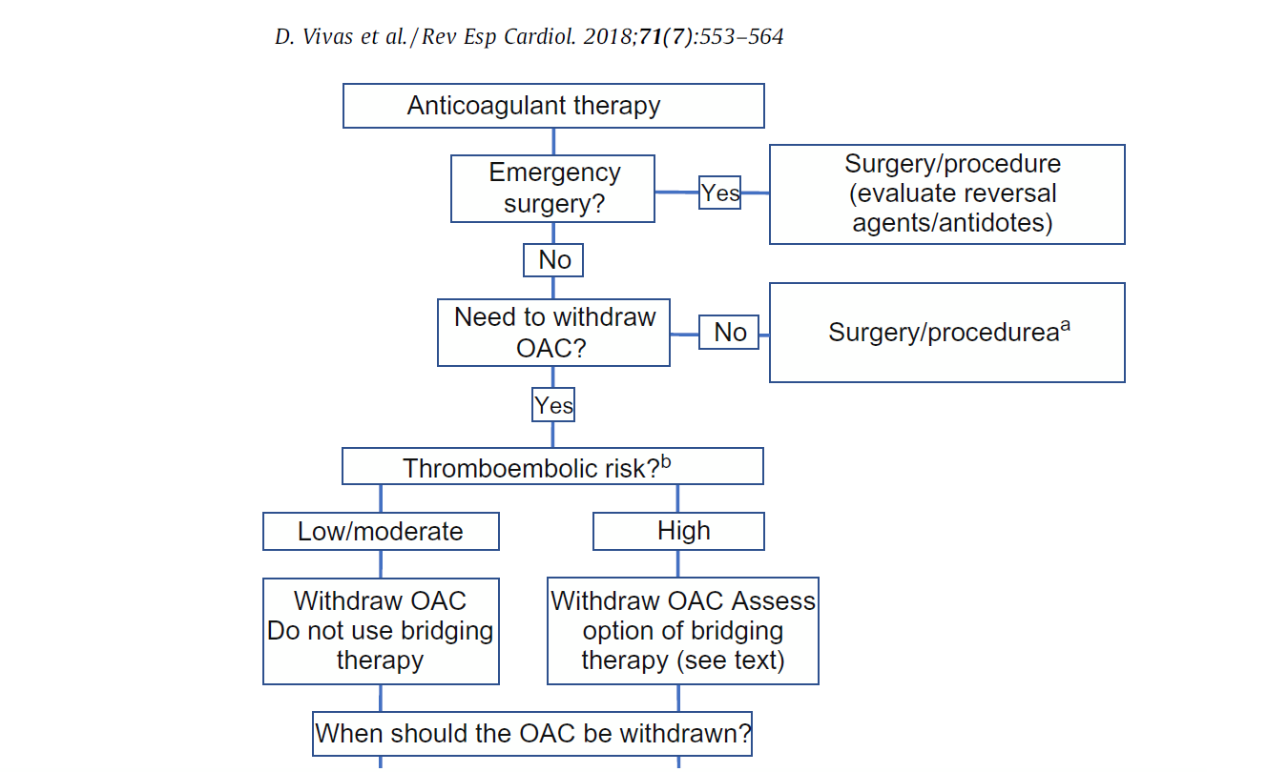

Slide 11
Common practice in patients undergoing noncardiac surgery with a mechanical
prosthetic valve in place is cessation of warfarin 3 days before surgery
This allows the international normalized ratio (INR) to fall to less than 1.5 times normal; oral anticoagulants can then be resumed on postoperative day 1
An alternative approach in patients at high risk for thromboembolism is conversion to heparin during the perioperative period, which can then be discontinued 4 to 6 hours before surgery and resumed shortly thereafter

Slide 12
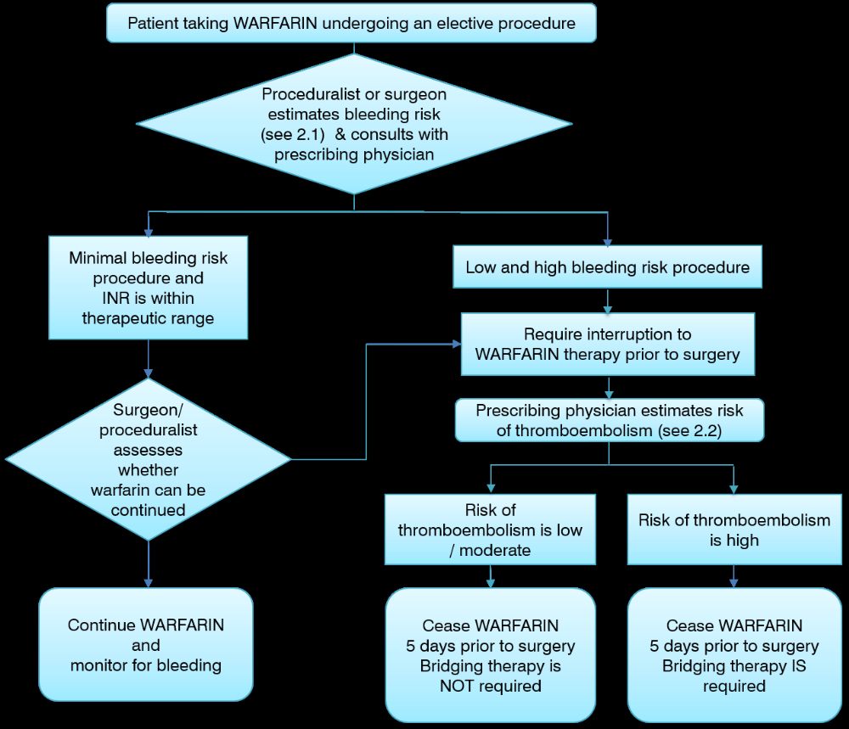

Slide 13
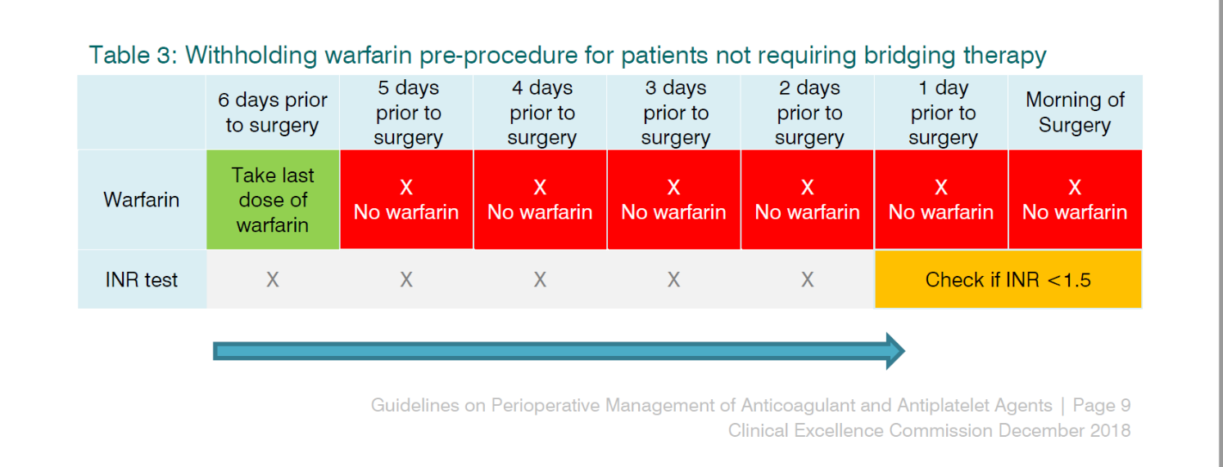

Slide 14
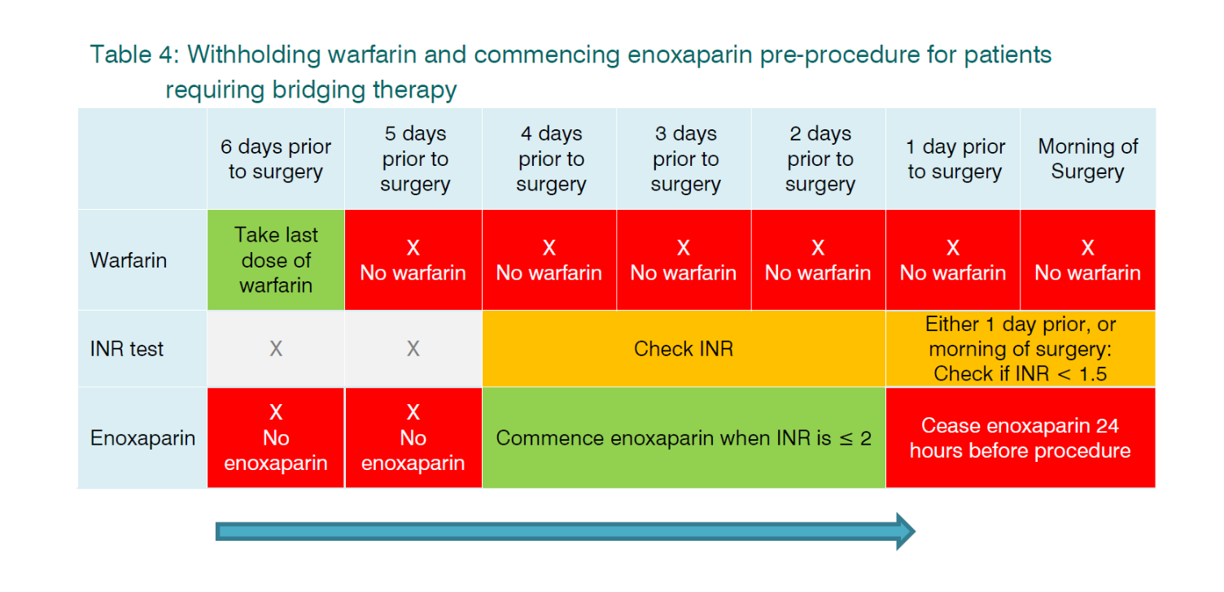

Slide 15
Enoxaparin Treatment Dose
Situation | Dose
Patient with CrCl <30 mL/min | 1 mg/kg subcutaneous injection once daily
Patient with CrCl ≥30 mL/min | 1 mg/kg subcutaneous injection twice daily or 1.5 mg/kg once daily
Age > 75 years | 0.75 mg/kg subcutaneously every 12 h (no IV bolus)

Slide 16
Post-procedure
The treating surgeon and treating physician should advise when anticoagulant therapy can be recommenced
Bleeding risk can be minimized after major procedures by adjusting the time when anticoagulant is resumed
Following high bleeding risk procedures, therapeutic LMWH should be delayed for 48 to 72 hours or substituted with prophylactic dose LMWH
Warfarin can be restarted on the evening of surgery at the previous maintenance dose if there is adequate surgical hemostasis
Continue LMWH or intravenous unfractionated heparin infusion until the target INR is reached

Slide 17
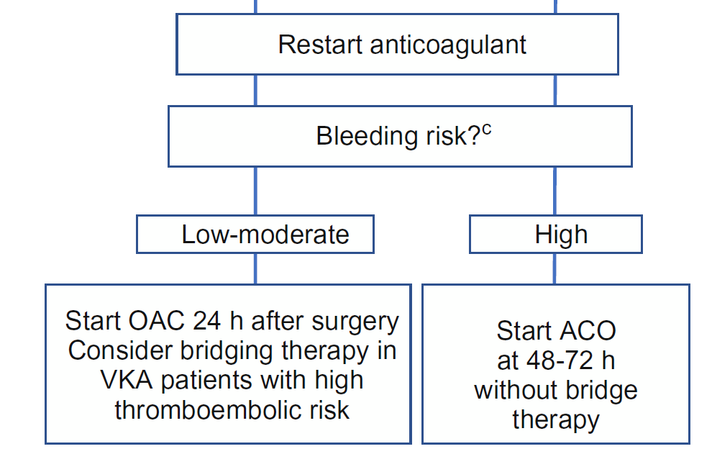

Slide 18
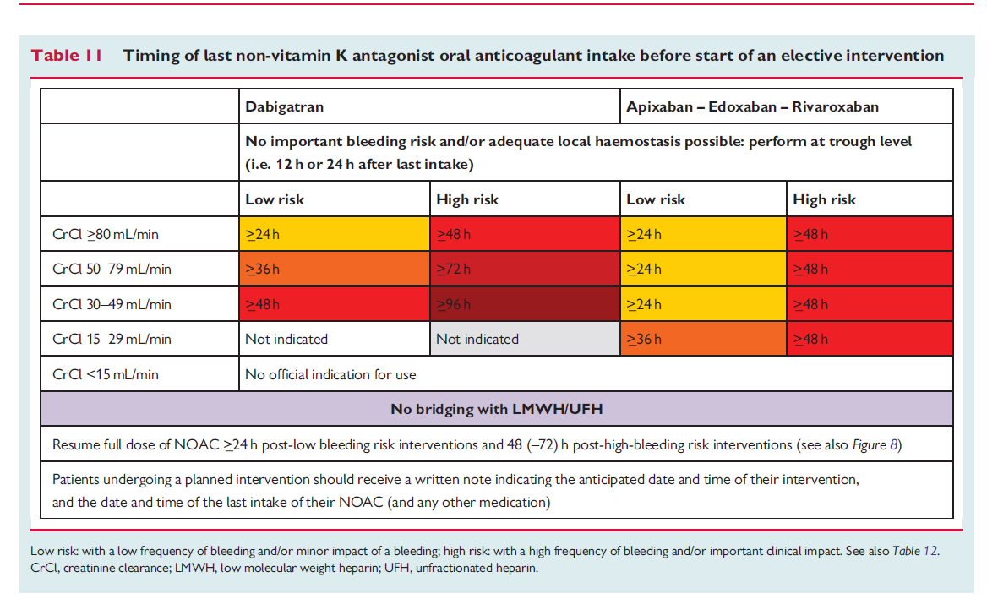

Slide 19
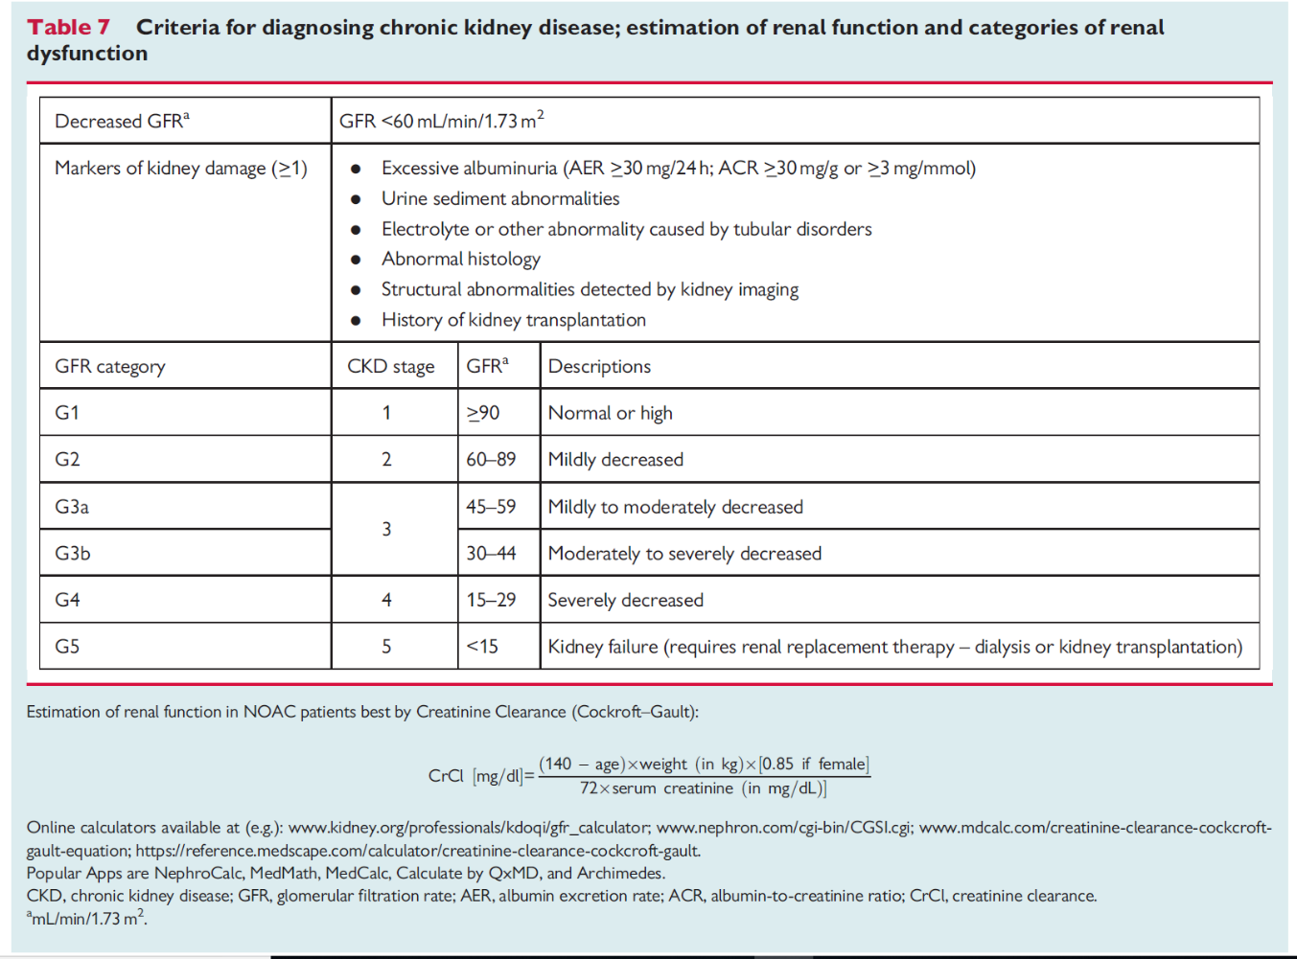

Slide 20
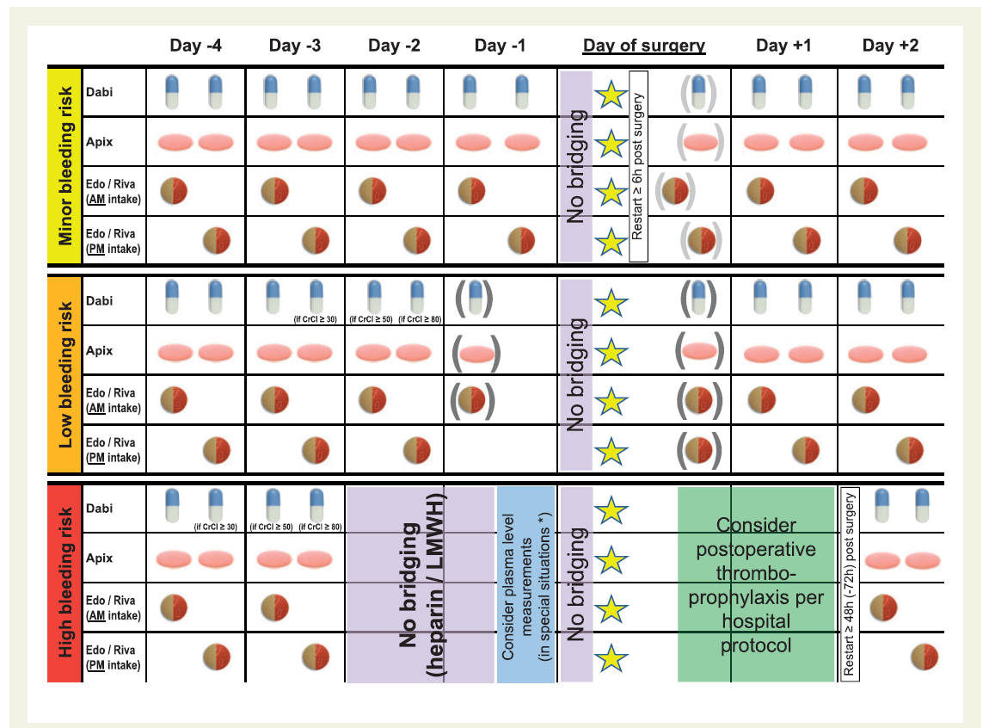

Slide 21
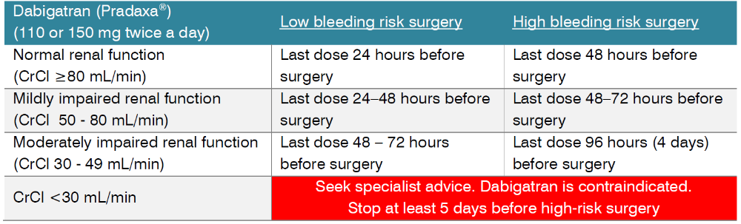
Timing for ceasing Dabigatran (Pradaxa®) prior to surgery

Slide 22
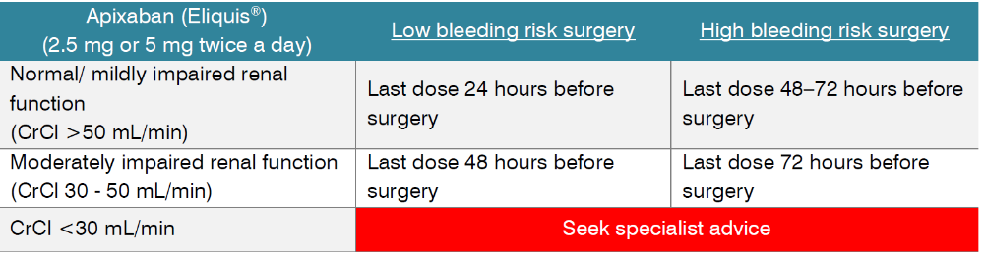
Timing for ceasing Apixaban (Eliquis®) prior to surgery

Slide 23
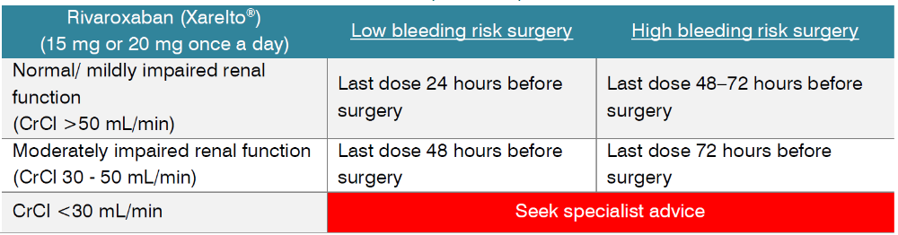
Timing for ceasing Rivaroxaban prior to surgery

Slide 24
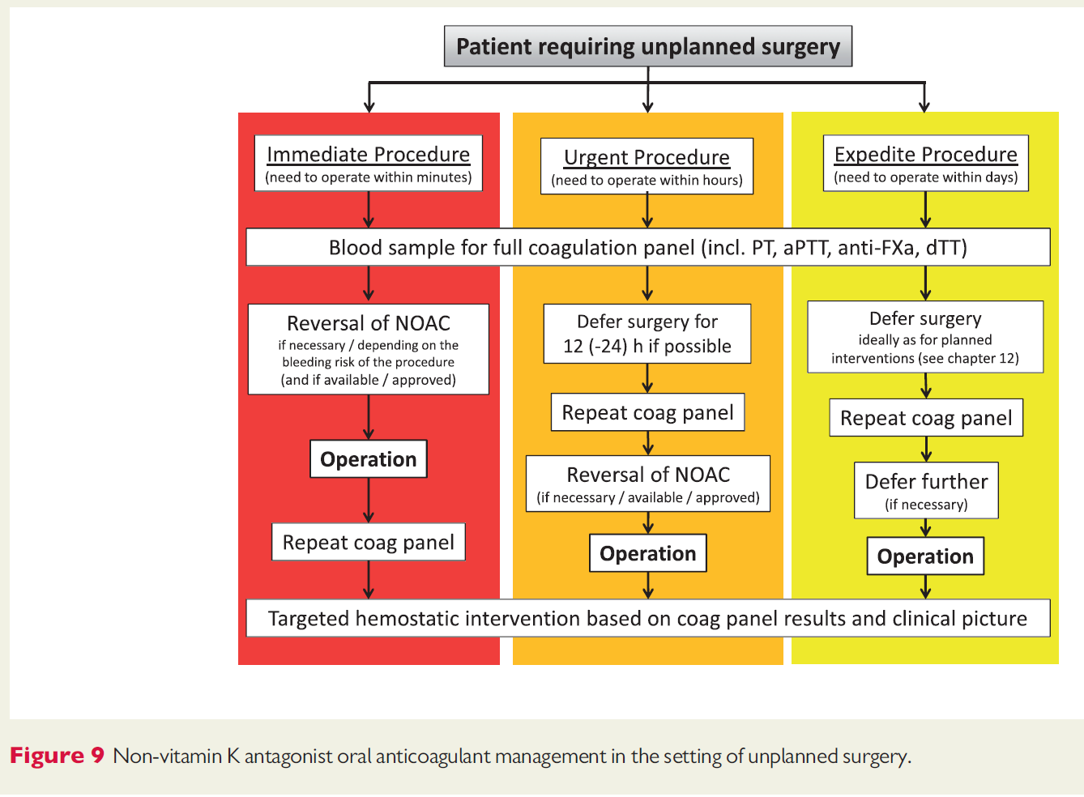

Slide 25
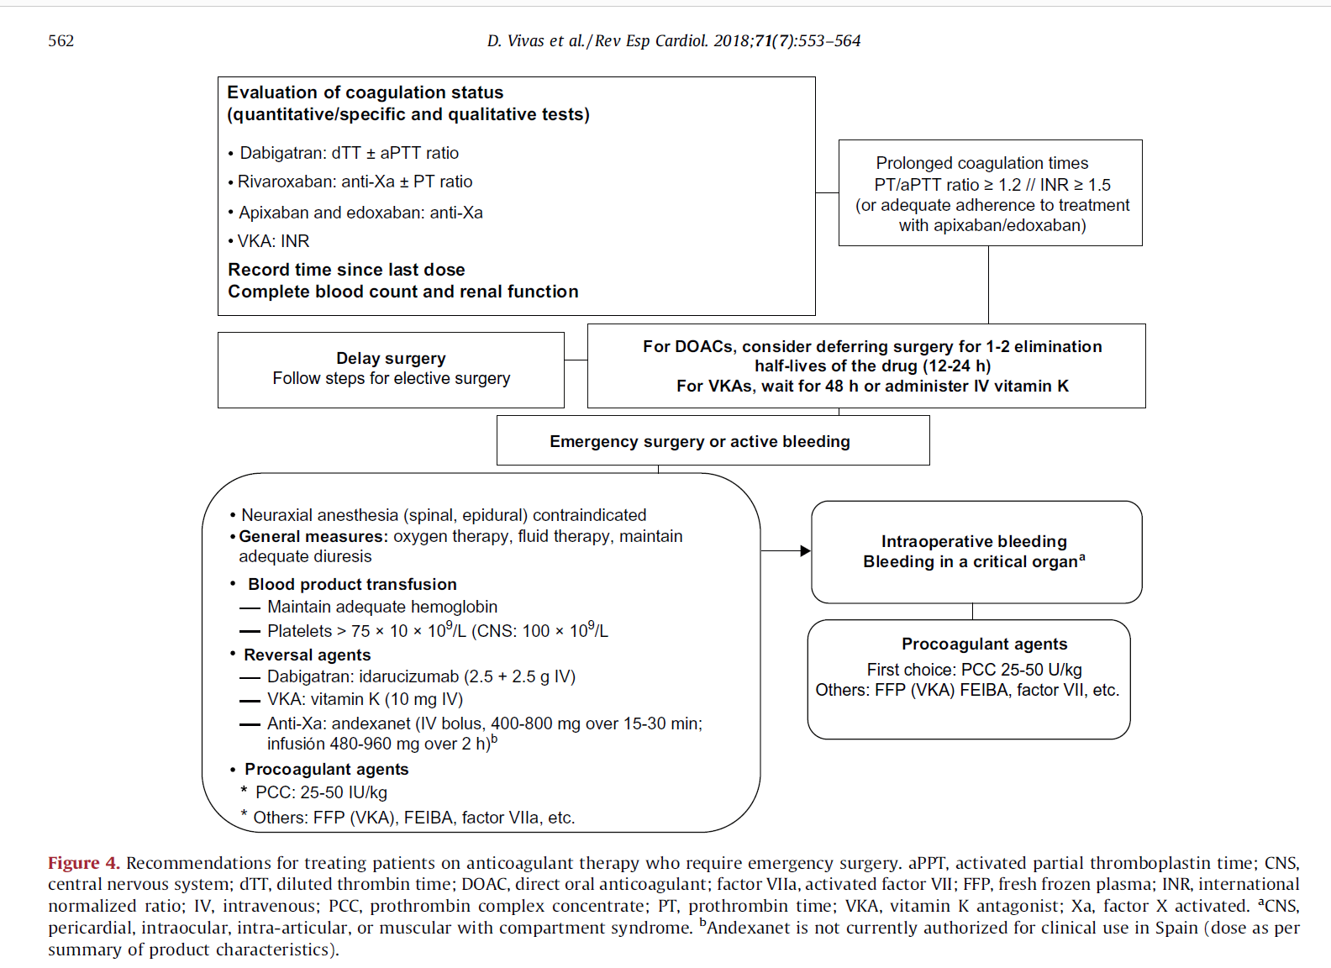

Slide 26
Antiplatelet Issues

Slide 27
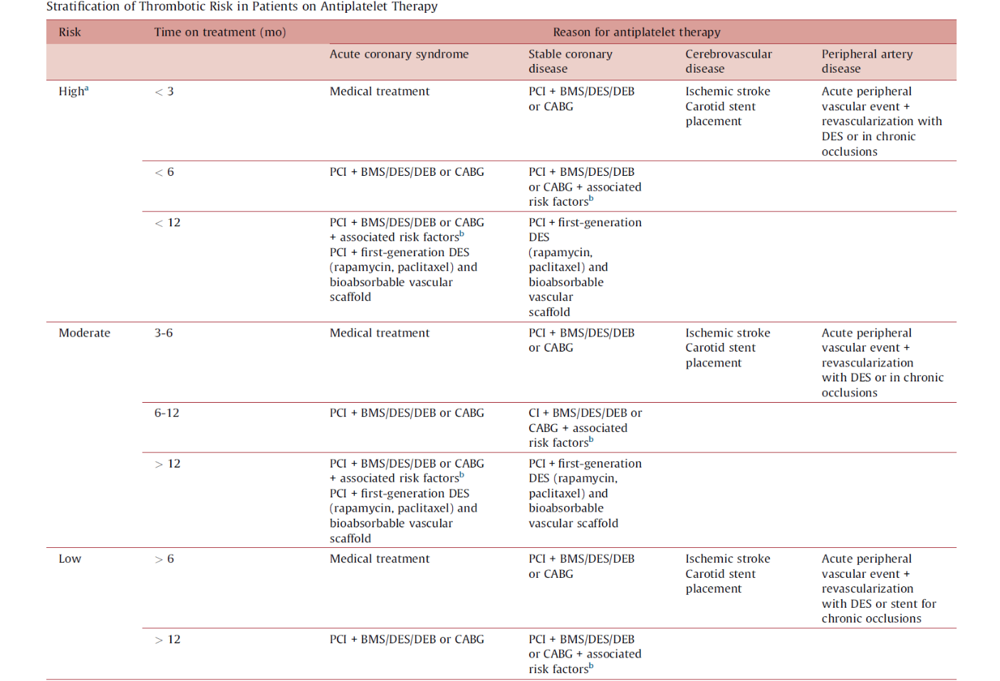

Slide 28
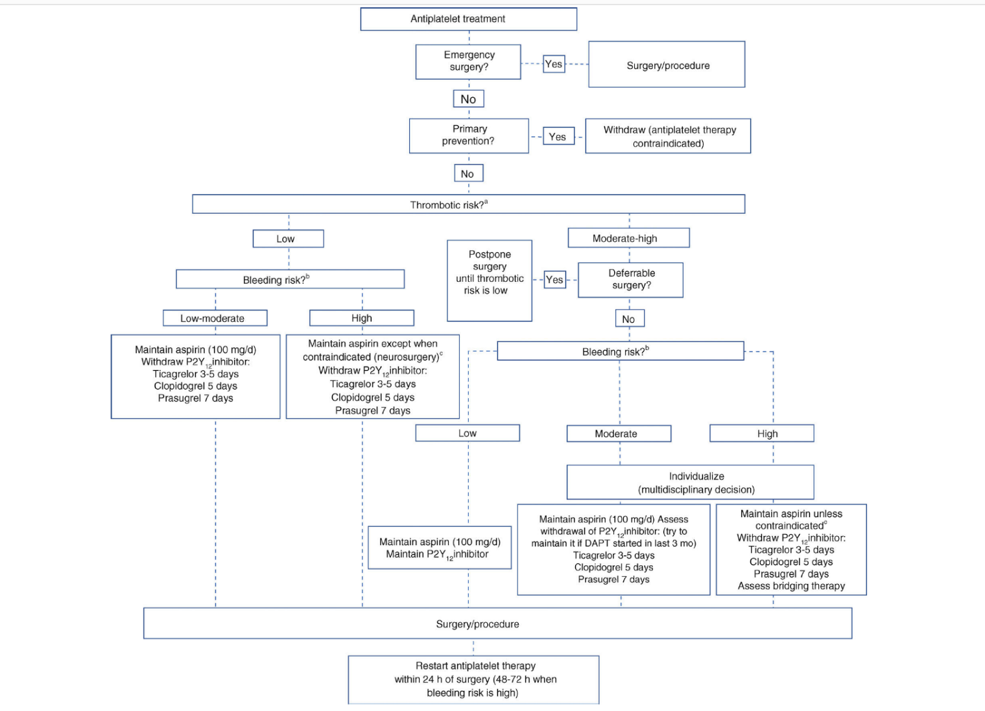

Slide 29
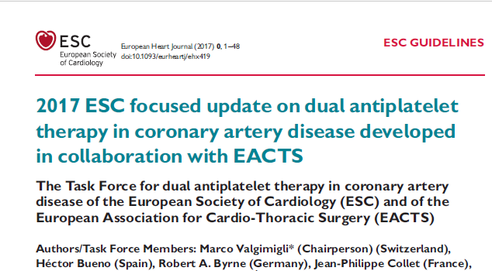
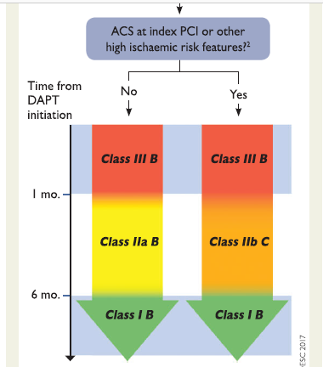

Slide 30
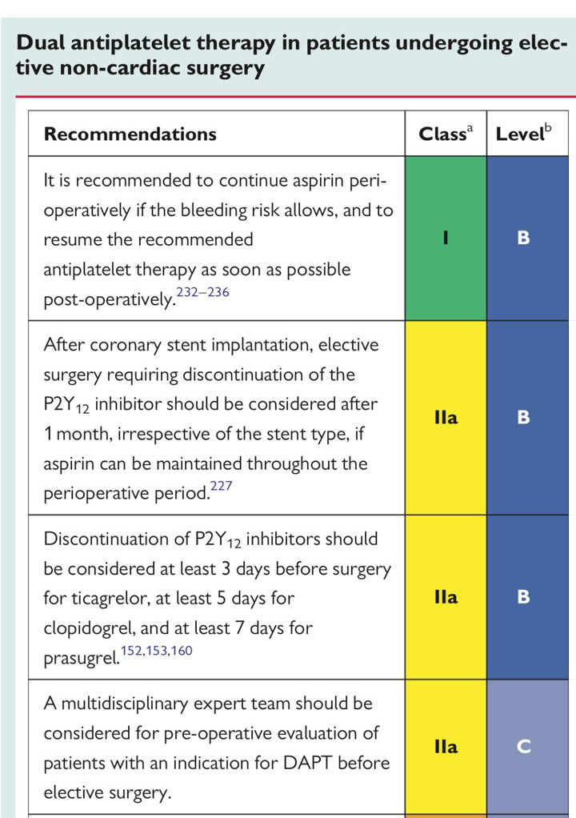
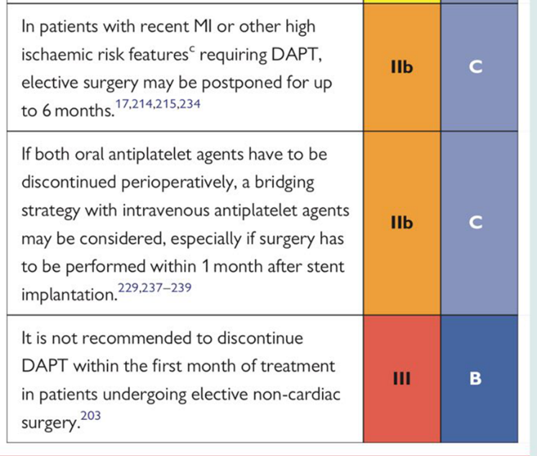

Slide 31
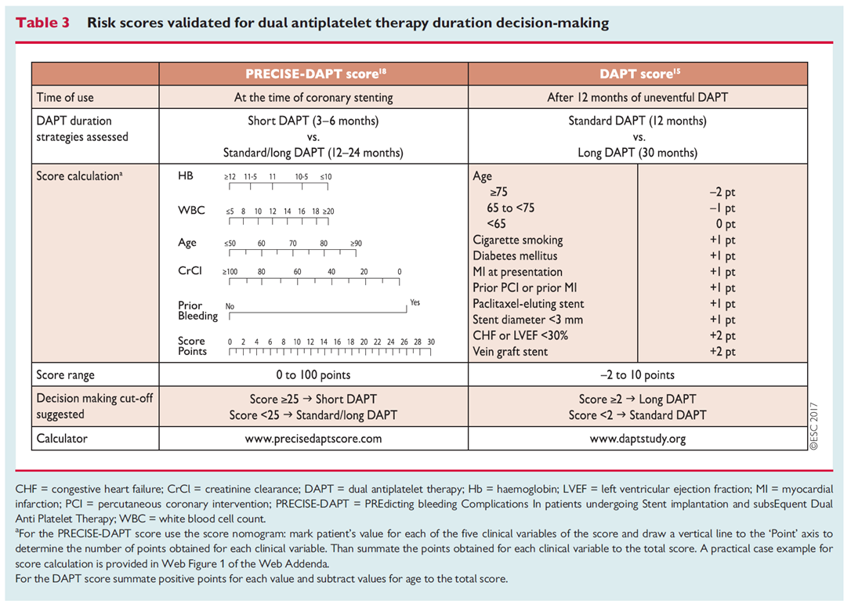

Slide 32
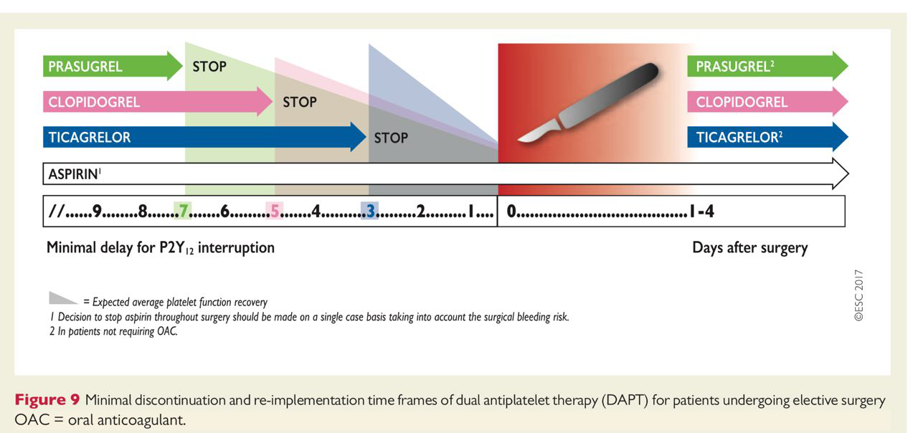

Slide 33
Management of therapeutic heparin and warfarin therapy during neuraxial procedures
Neuraxial procedures include lumbar puncture and insertion or removal of spinal or epidural catheter. In general, neuraxial procedures for therapeutically anticoagulated patients is not recommended
Specialist anesthetic advice should be sought for patients receiving anticoagulant or antiplatelet therapy who require neuraxial procedures
The risk of epidural or spinal hematoma is greater with traumatic or repeated spinal/epidural puncture
The risk of epidural or spinal hematoma is increased with the use of indwelling catheters, and these should be avoided in patients requiring therapeutic anticoagulation.

Slide 34
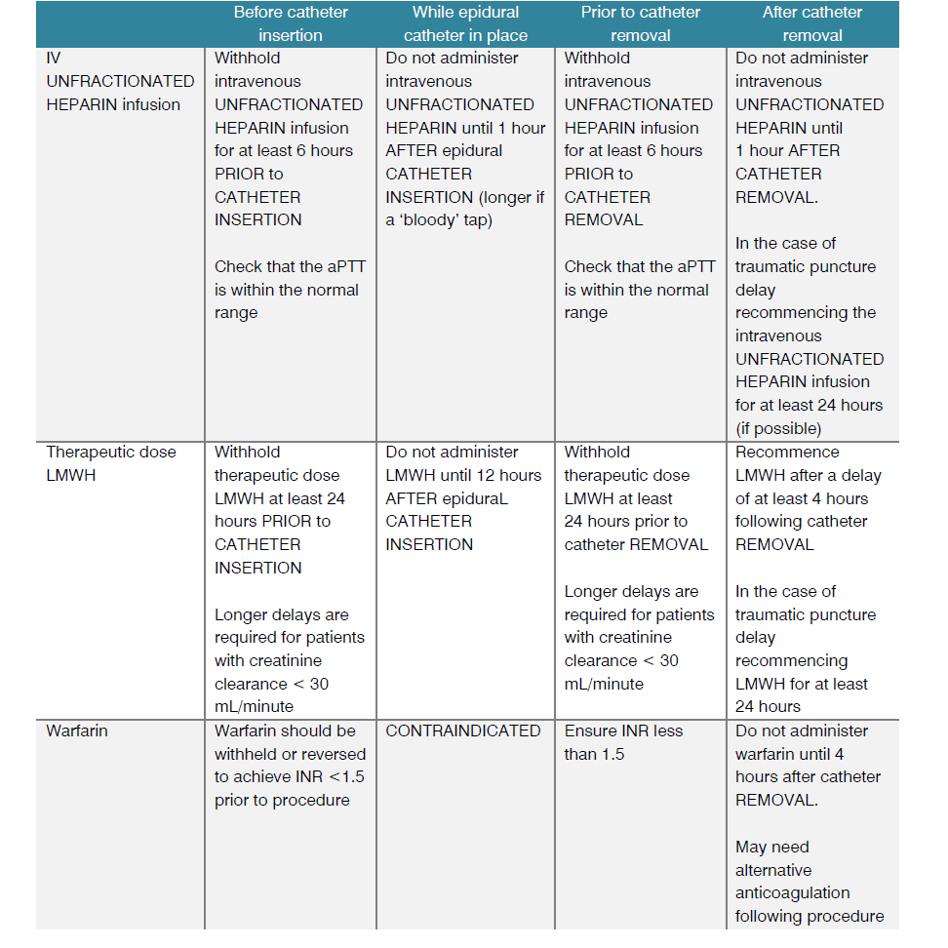

Slide 35
Case 1
The 59-years-old woman ,under treatment with Rivaroxaban for DVT since 3 month ago
Presented with acute abdomen
Candidate for surgery due to intestinal obstruction within 3 hours
Last ingested dose : 12 hours ago
What is your strategy in this patient ?
Do you consider reversal of Rivaroxaban before abdominal surgery in this case ?

Slide 36
A) Check PT, aPTT, Anti-Fxa , dTT before surgery
B) Proceed to surgery without reversal
C) Reversal with Antidote or PCC before surgery
D) A&B

Slide 37
Answer : D

Slide 38
Case 2
The 64-years-old man was admitted for definite non-Cardiac Surgery (Renal Cell Carcinoma ) within one week
He had history of Primary PCI due to Acute Inferior lateral STEMI 2 month ago and was on DAPT (ASA+ Ticagrelor )
What is your recommendation as a consulting cardiologist ?

Slide 39
A) Discontinuation of Ticagrelor for 5 days then Proceed to surgery
B) Proceed to surgery without discontinuation of DAPT
C) Defer surgery up to one month if possible (after consensus with surgeon) then discontinuation of Ticagrelor before surgery
D) Bridging therapy with Cangrelor according to protocol

Slide 40
Answer: A

Slide 42
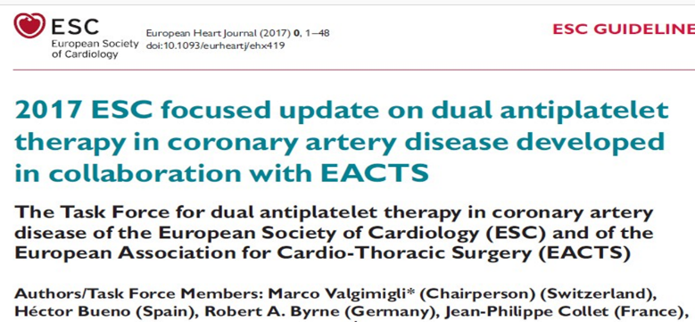


Slide 44
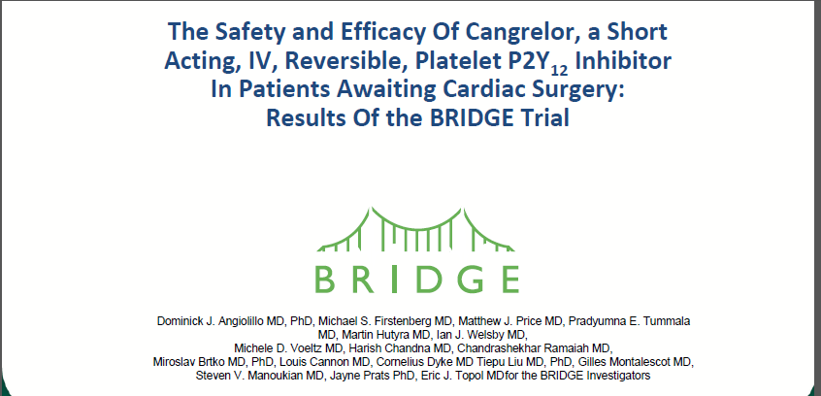

Slide 45
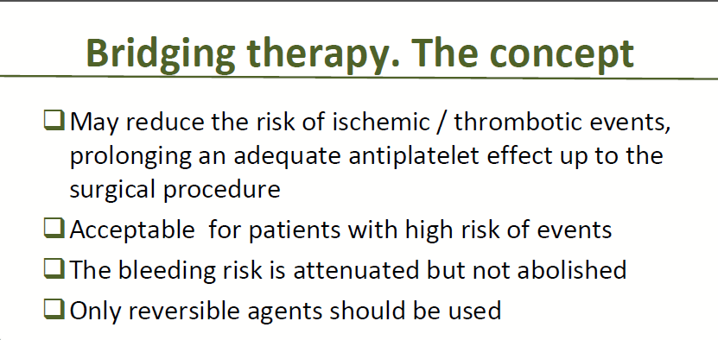

Slide 46
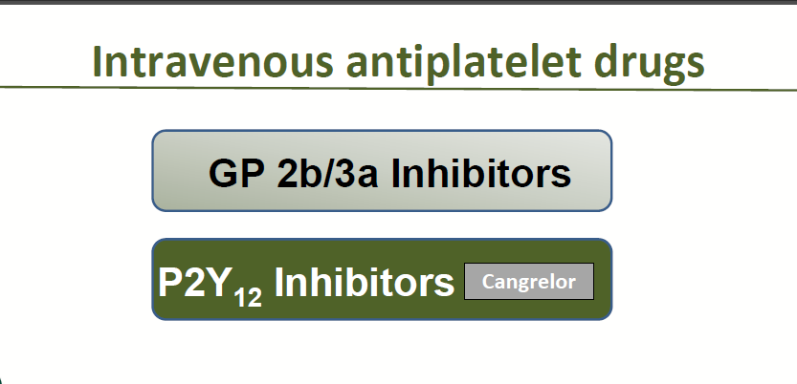

Slide 47
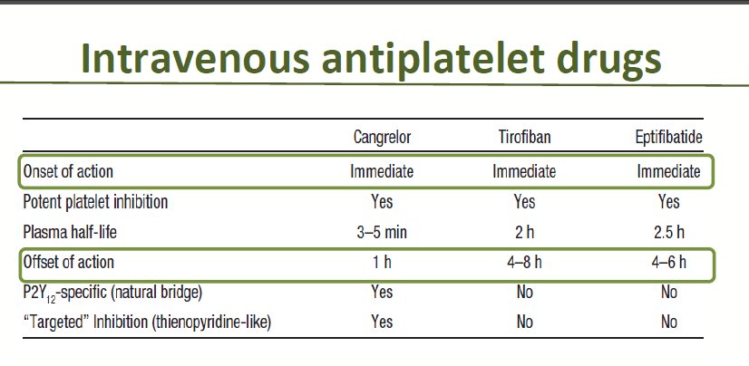

Slide 48
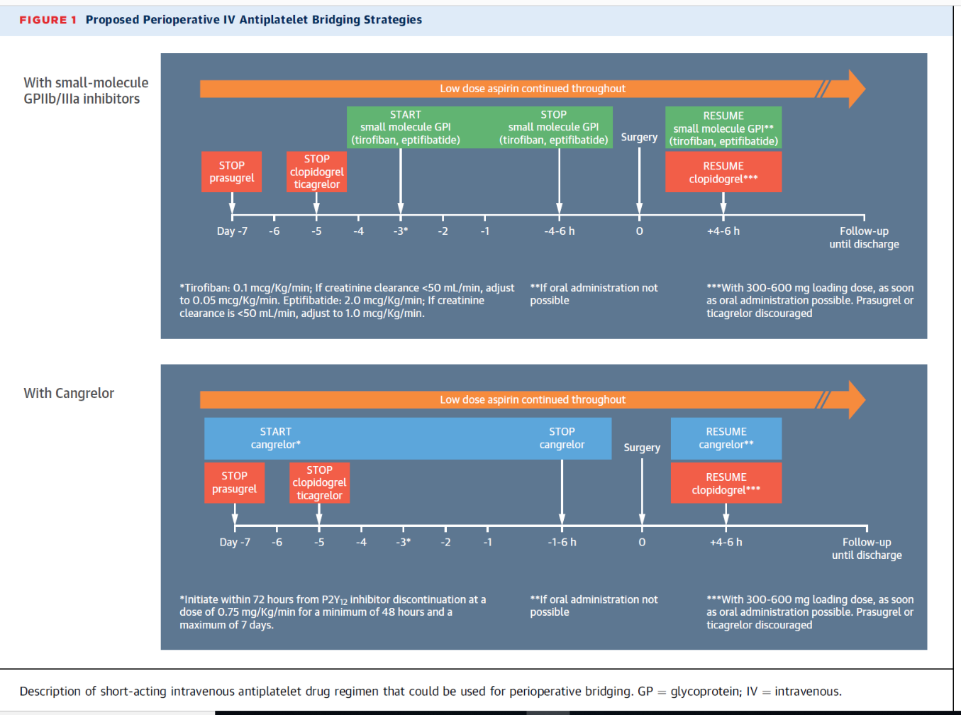

Slide 49
Low dose Aspirin continued throughout
Start Cangrelor Stop Cangrelor
Resume Cangrelor
Stop Ticagrelor
Clopidogrel
Stop Prasugrel
Start Clopidogrel
day |  |  |  |  |  |  | hour | Surgery | hour
-7 | -6 | -5 | -4 | -3 | -2 | -1 | 1-6 h | 0 | +4-6 h

Slide 50
Low dose Aspirin continued throughout
Start Eptifibatide
Stop Eptifibatide
Resume Eptifibatide
Stop Ticagrelor
Clopidogrel
Stop Prasugrel
Start Clopidogrel
day |  |  |  |  |  |  | hour | Surgery | hour
-7 | -6 | -5 | -4 | -3 | -2 | -1 | 4-6 h | 0 | +4-6 h

Slide 51
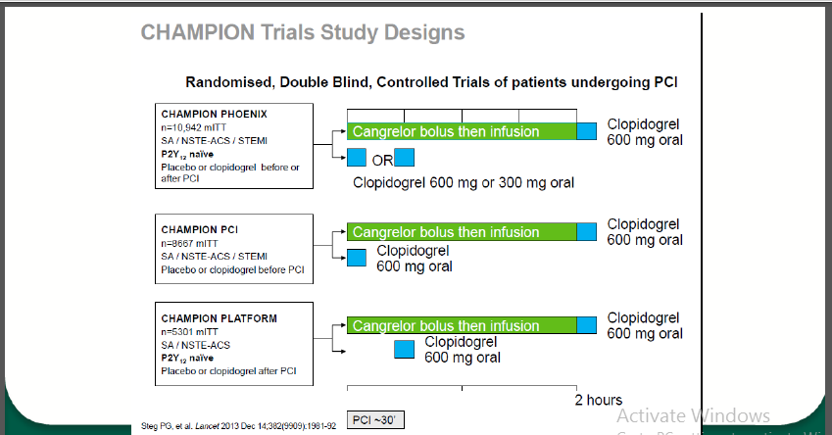

Slide 52
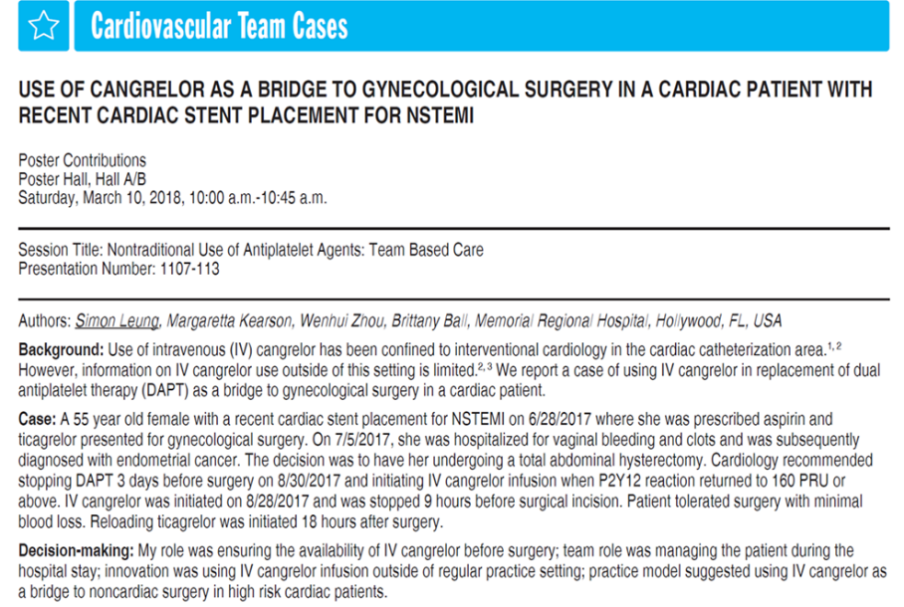
Conclusion: Careful planning, including timing to stop DAPT, initiate Cangrelor and reload Ticagrelor, was the key to achieve positive patient outcomes.

Slide 53
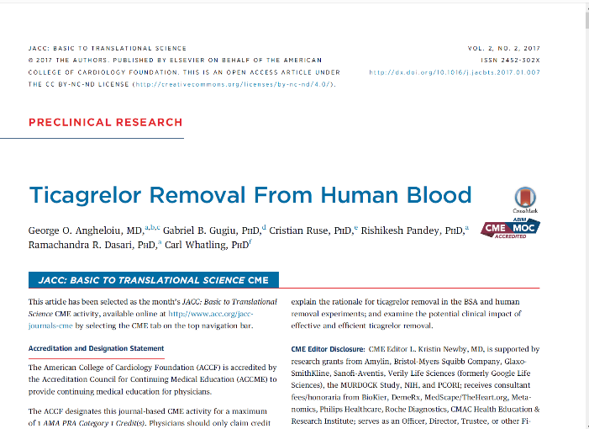
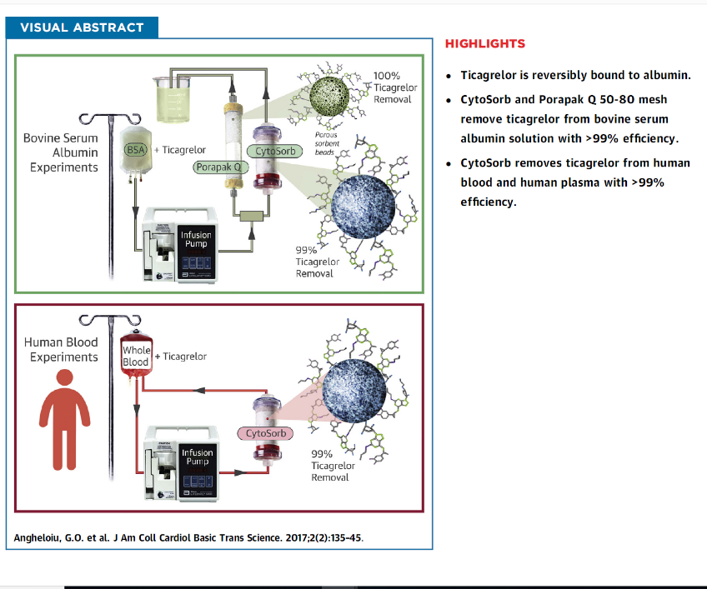

Slide 54
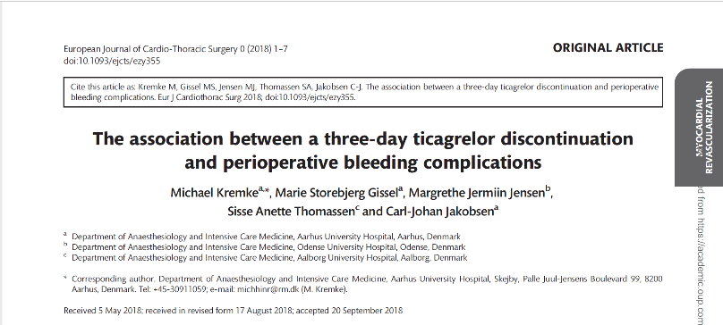
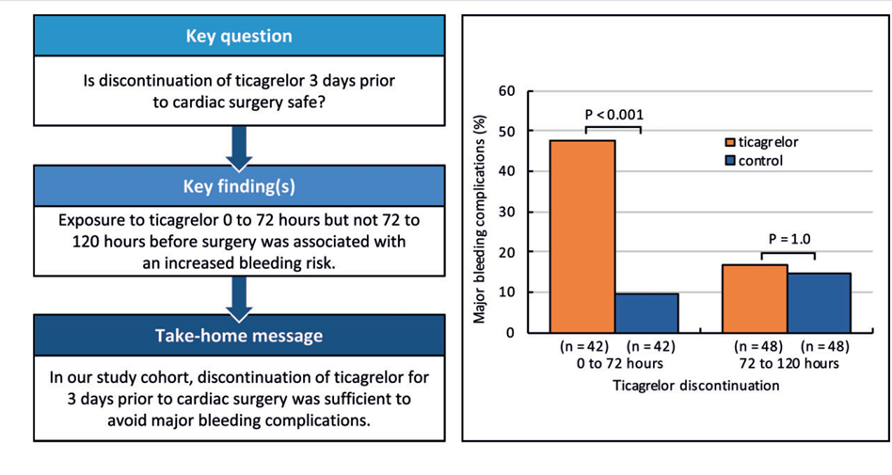

Slide 55
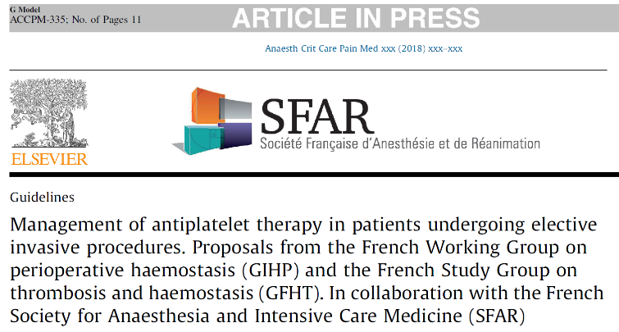
The incidence of major bleeding was high when ticagrelor or clopidogrel were discontinued less than 24 hours before surgery. In the ticagrelor group, there was no significant difference between discontinuation 72–120 hours or more than 120 hours before surgery, as opposed to what was observed in the clopidogrel group.
The overall incidence of major bleeding complications was lower with ticagrelor than with clopidogrel.

Slide 56
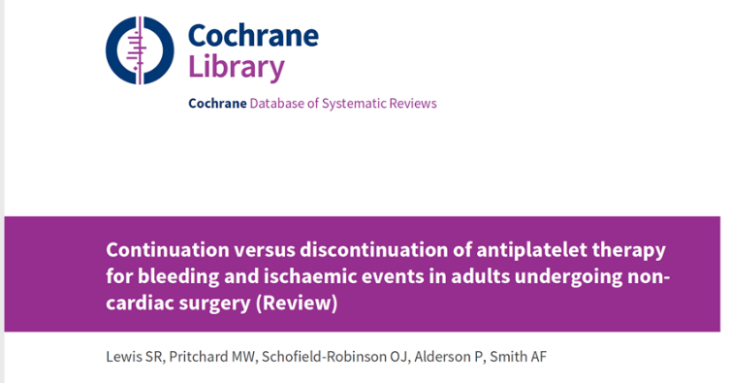
Conclusions :
We found low-certainty evidence that either continuation or discontinuation of antiplatelet therapy before non-cardiac surgery may make little or no difference to mortality, bleeding requiring surgical intervention, or ischemic events and transfusion
Evidence was limited to few studies with few participants, and with few events. The three ongoing studies may alter the conclusions of the review once published and assessed.

Slide 57
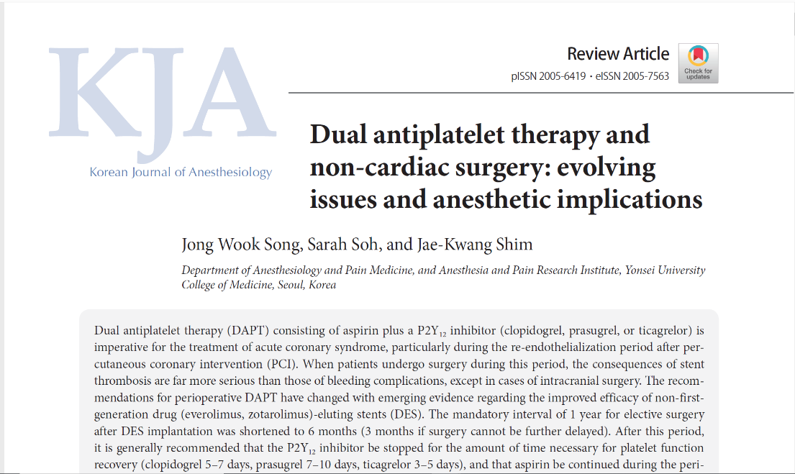

Slide 58
In emergent or urgent surgeries that cannot be delayed beyond the recommended period after PCI, proceeding to surgery with continued DAPT should be considered.
For intracranial procedures or other selected surgeries in which increased bleeding risk may also be fatal, cessation of DAPT (possibly with continuation or minimized interruption [3–4 days] of aspirin) with bridge therapy using short-acting, reversible intravenous antiplatelet agents such as cangrelor (P2Y12 inhibitor) or glycoprotein IIb/IIIa inhibitors (tirofiban, eptifibatide) may be contemplated.
Such a critical decision should be individually tailored based on consensus among the anesthesiologist, cardiologist, surgeon, and patient to minimize both ischemic and bleeding risks.

Slide 59
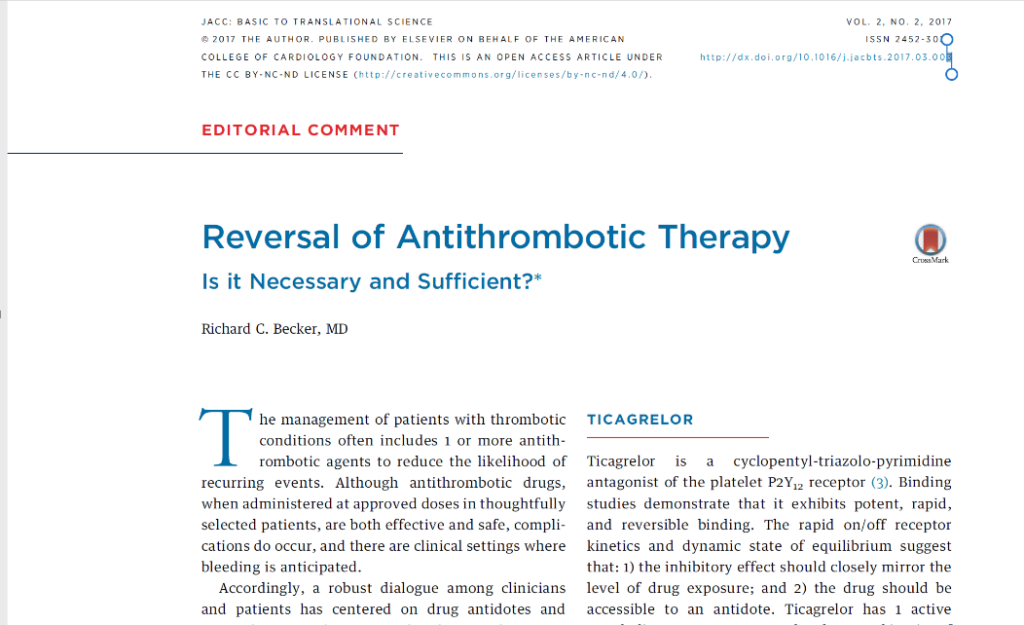

Slide 60
Monoclonal antibody
Buchanan et al developed an antigen-binding fragment (Fab) to ticagrelor and its major active metabolite (TAM).
The Fab had a 20 pmol/l affinity for ticagrelor—100 stronger than ticagrelor’s affinity for the platelet P2Y12 receptor
The antidote neutralized the free fraction of ticagrelor and also reversed its antiplatelet activity both in vitro, employing human platelet-rich plasma, and in vivo in mice
The antidote normalized ticagrelor-dependent bleeding in a mouse model of acute surgery. Last, the antidote had a circulating half-life of approximately 12 h—similar to ticagrelor (9.8 h) and TAM (12.4 h)
The ticagrelor-specific neutralizing Fab, MEDI2452, binds unbound ticagrelor and TAM in a 1:1 ratio (12) and restores ADP-induced platelet aggregation

Slide 61
Platelet Function Test
Besides the variance in platelet inhibitory effects between different P2Y12 inhibitors, there is also a large individual variation in the magnitude and duration of the antiplatelet effect.
Because of the individual variation, the use of platelet function tests may aid the optimization of the timing of surgical procedures.
However, platelet function tests could also be of value to establish the grade of platelet inhibition in patients in whom the time since discontinuation is unclear, e.g. in unconscious or confused patients, and in patients with uncertain compliance to the treatment.

Slide 62
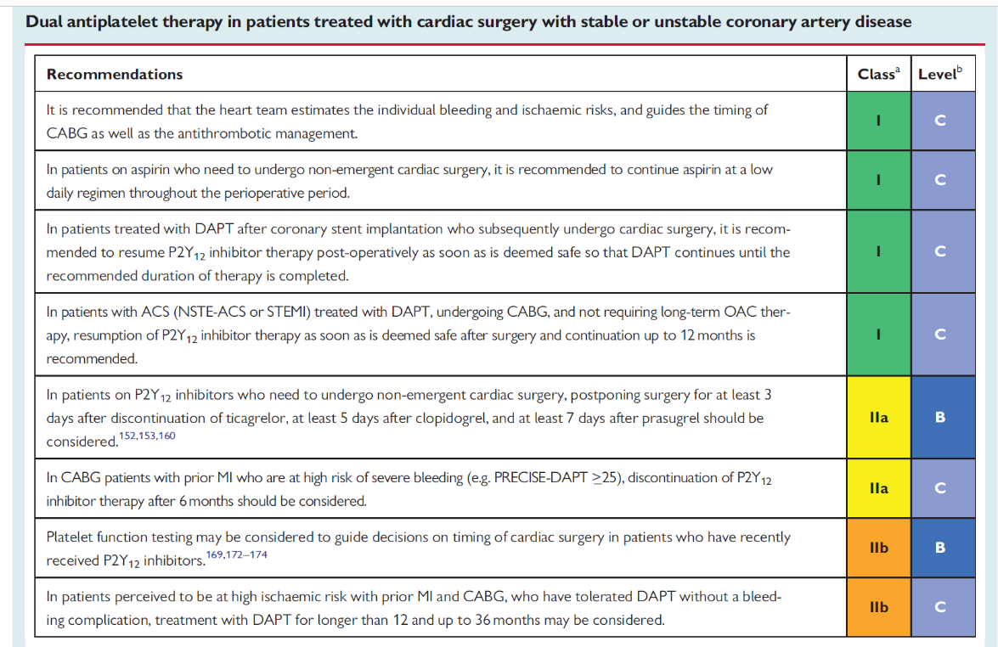

Slide 63


