Slide 1
Au nom de Dieu le Tre`s Mise´ricordieux,
Le Tout Mise´ricordieux
بنام خداوند بخشنده مهربان

Slide 2
Updates on DoACs
Sezavar hashem, MD
Mohebbi Bahram , MD
Firuzi Ata, MD
Eftekhar Zade Mahmoud, MD
Mehrpooya Maryam MD,

Slide 3
Case 1
The 68-years-old man with good socioeconomical condition
History of chronic kidney disease , AF rhythm and under warfarin
Irregular monitoring of INR ( exhausted!!!!!!!)
History of ischemic stroke 4 years ago without neurological sequela
Presented with new lab exam : estimated creatinine clearance 14 ml/min and impending starting of dialysis
Which anticoagulant agent do you recommend for him ?

Slide 4
Case 1
Which anticoagulant agent do you recommend for him ?
Warfarin
Rivaroxaban (10 mg daily )
Apixaban ( 2.5 BID)
Dabigatran ( 110 mg BID)

Slide 5
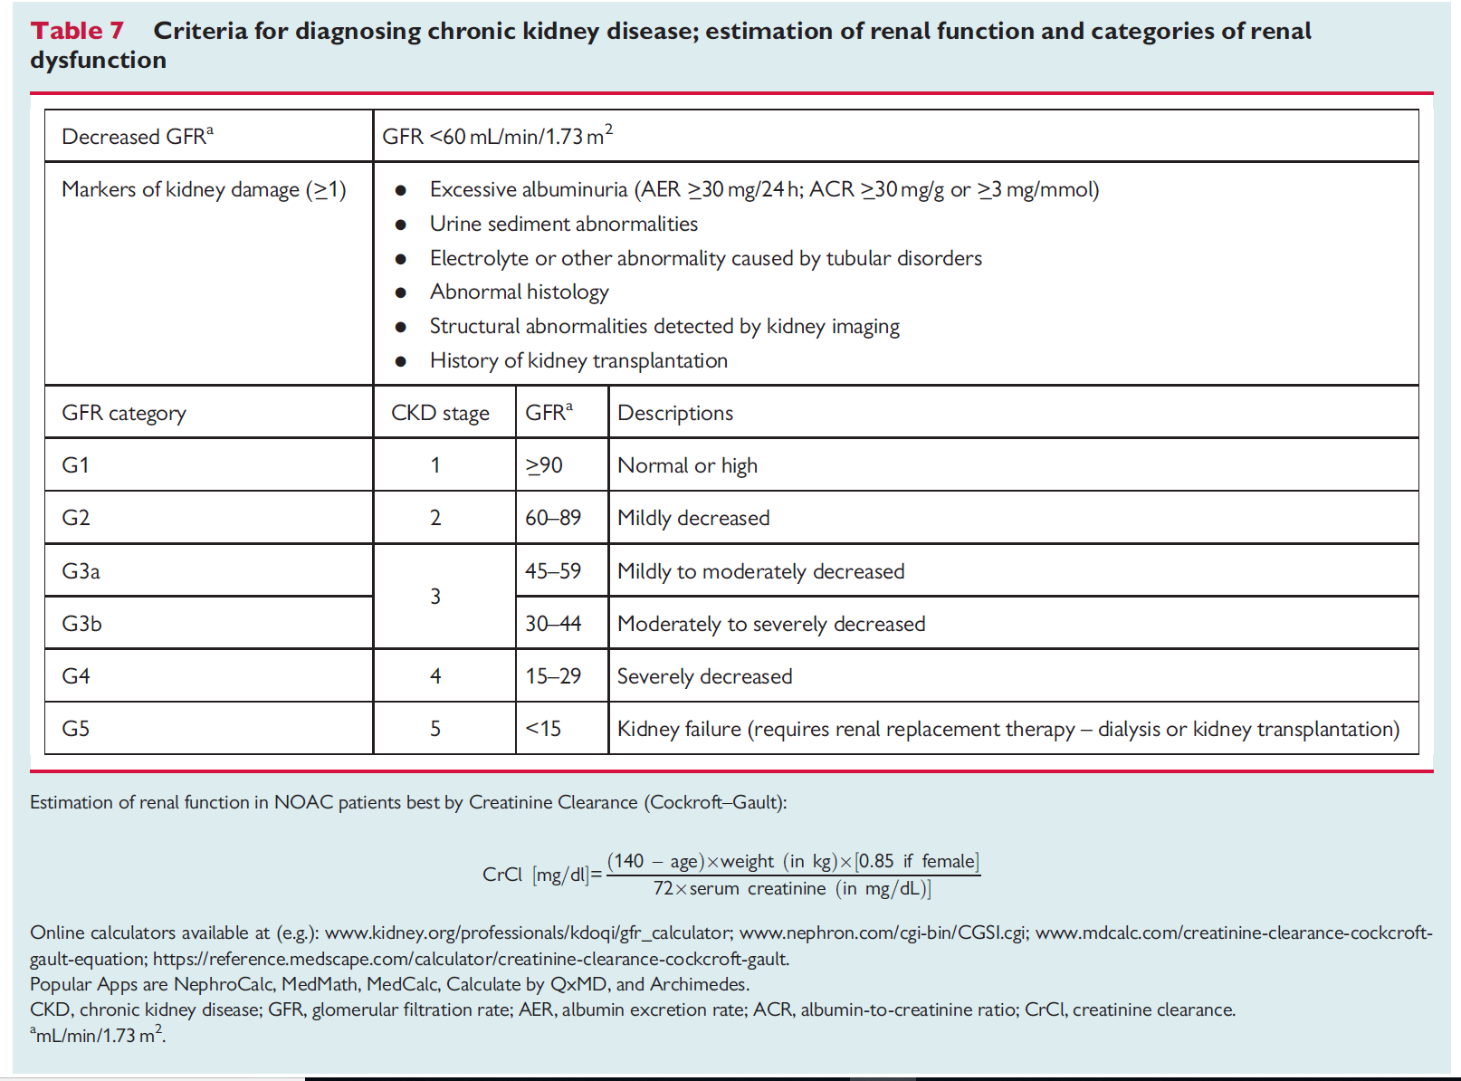

Slide 6
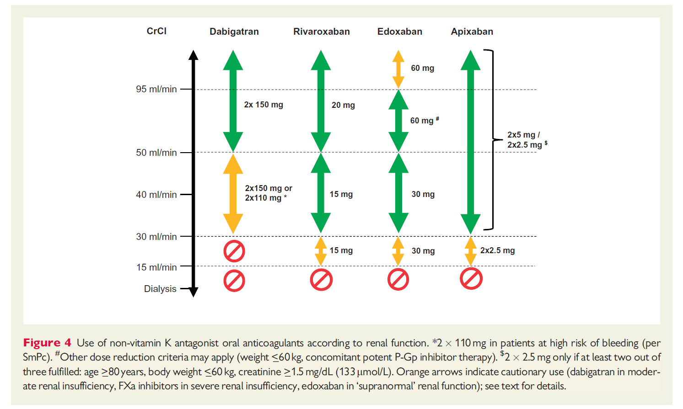

Slide 7
use of warfarin in patients with end-stage renal failure may in some cases result in calciphylaxis, a painful and often lethal condition caused by calcification and occlusion of cutaneous arteries and arterioles

Slide 8
In fact, given the lack of strong evidence also for VKA in this patient population, the decision to anticoagulate remains a very individualized one requiring a multidisciplinary approach considering and respecting patients’ preferences.

Slide 9
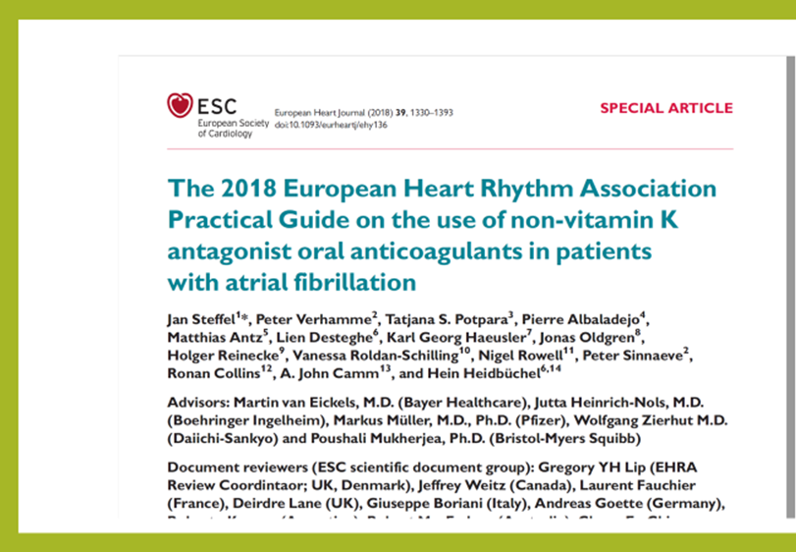
In the US (but not in Europe) apixaban 5mg BID is currently approved in chronic, stable dialysis-dependent patients. However, plasma levels with apixaban 5mg BID were recently shown to be supra-therapeutic.

Slide 10
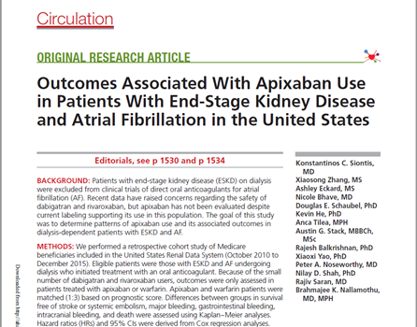
Among patients with ESKD and AF on dialysis, apixaban use may be associated with a lower risk of major bleeding compared with warfarin, with a standard 5 mg twice a day dose also associated with reductions in thromboembolic and mortality risk

Slide 11
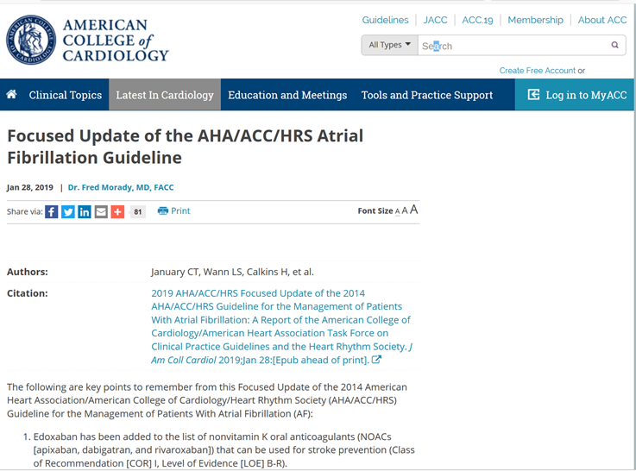
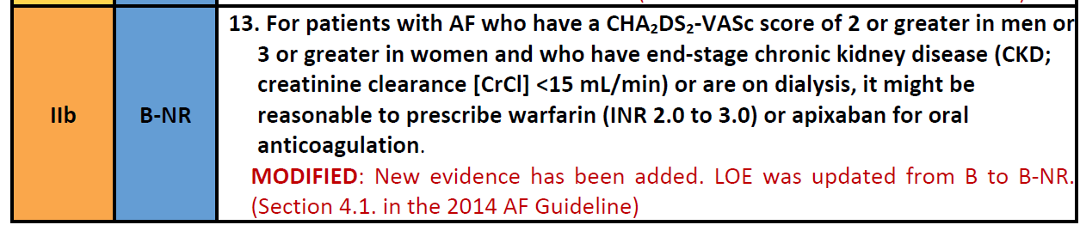
In AF patients with a CHA2DS2-VASc score ≥2 in men or ≥3 in women and a creatinine clearance <15 ml/min or who are on dialysis, it is reasonable to use warfarin or apixaban for oral anticoagulation (COR IIb, LOE B-NR)

Slide 12
What about after kidney transplantation ?

Slide 13
There are no data on the use of NOACs in AF patients after kidney
transplantation.
If NOACs are used in such patients, the dosing regimen should be selected according to the estimated renal function, and caution is needed with respect to possible drug–drug interactions between the NOAC and concomitant immunosuppressive therapies

Slide 14
Case 2
The 69-years-old woman with good socioeconomical condition
History of AF rhythm and irregular use of warfarin
Presented with acute inferior STEMI
Primary PCI on RCA
High thrombotic risk based on syntax or REACH score
Which triple therapy regimen do you recommend for her ?

Slide 15
1- Do you recommend GI bleeding prophylaxis for this patient?
YES
NO
2- If yes, which of them ?

Slide 16
Case 2
Triple therapy (NOAC+ ASA+ Ticagrelor) for 3 month then dual therapy ( Apixaban + Clopidogrel /Tica/ASA) for 1 years
ASA+ Clopidgrel+ Apixaban ( for 7 days ) then dual therapy ( Apixaban + Clopidogrel /ASA) for 1 years
ASA+ Ticagrelor + Apixaban ( for 7 days ) then dual therapy ( Apixaban + Clopidogrel /Tica/ASA) for 1 years
Warfarin + ASA+Clopidogrel for three month then dual therapy (warfarin + clopidogrel) up to one yeras

Slide 17
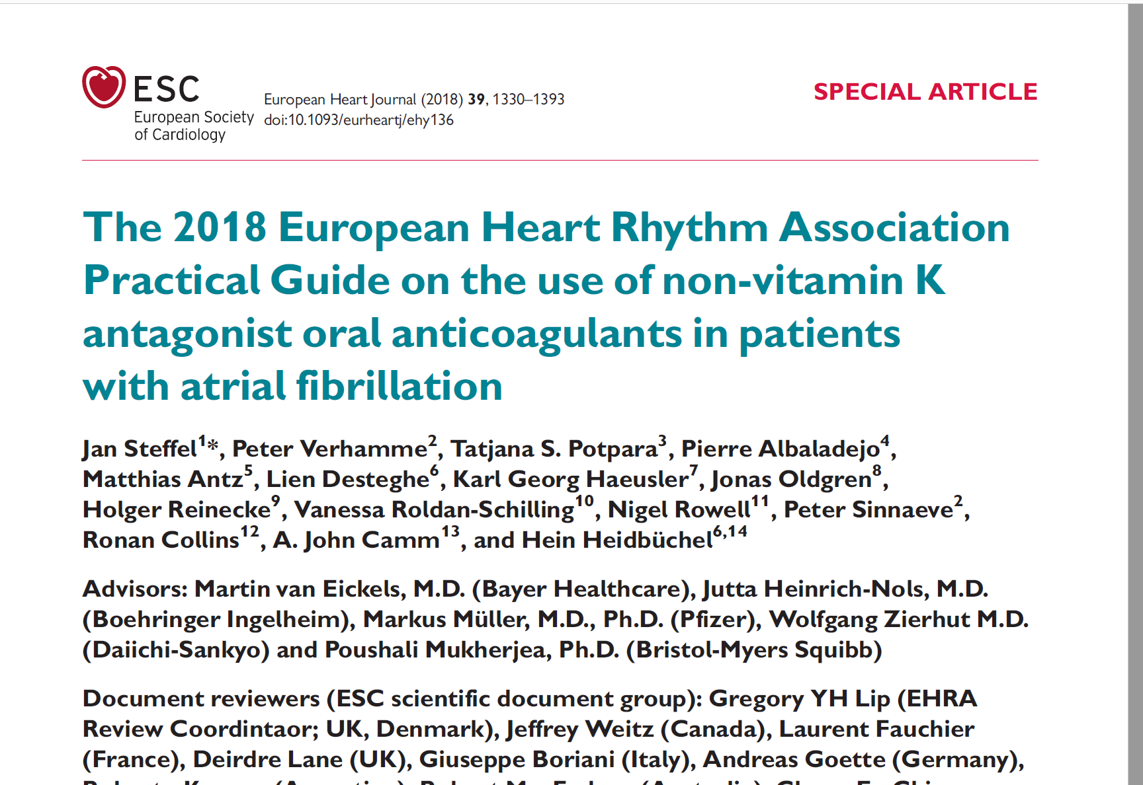

Slide 18
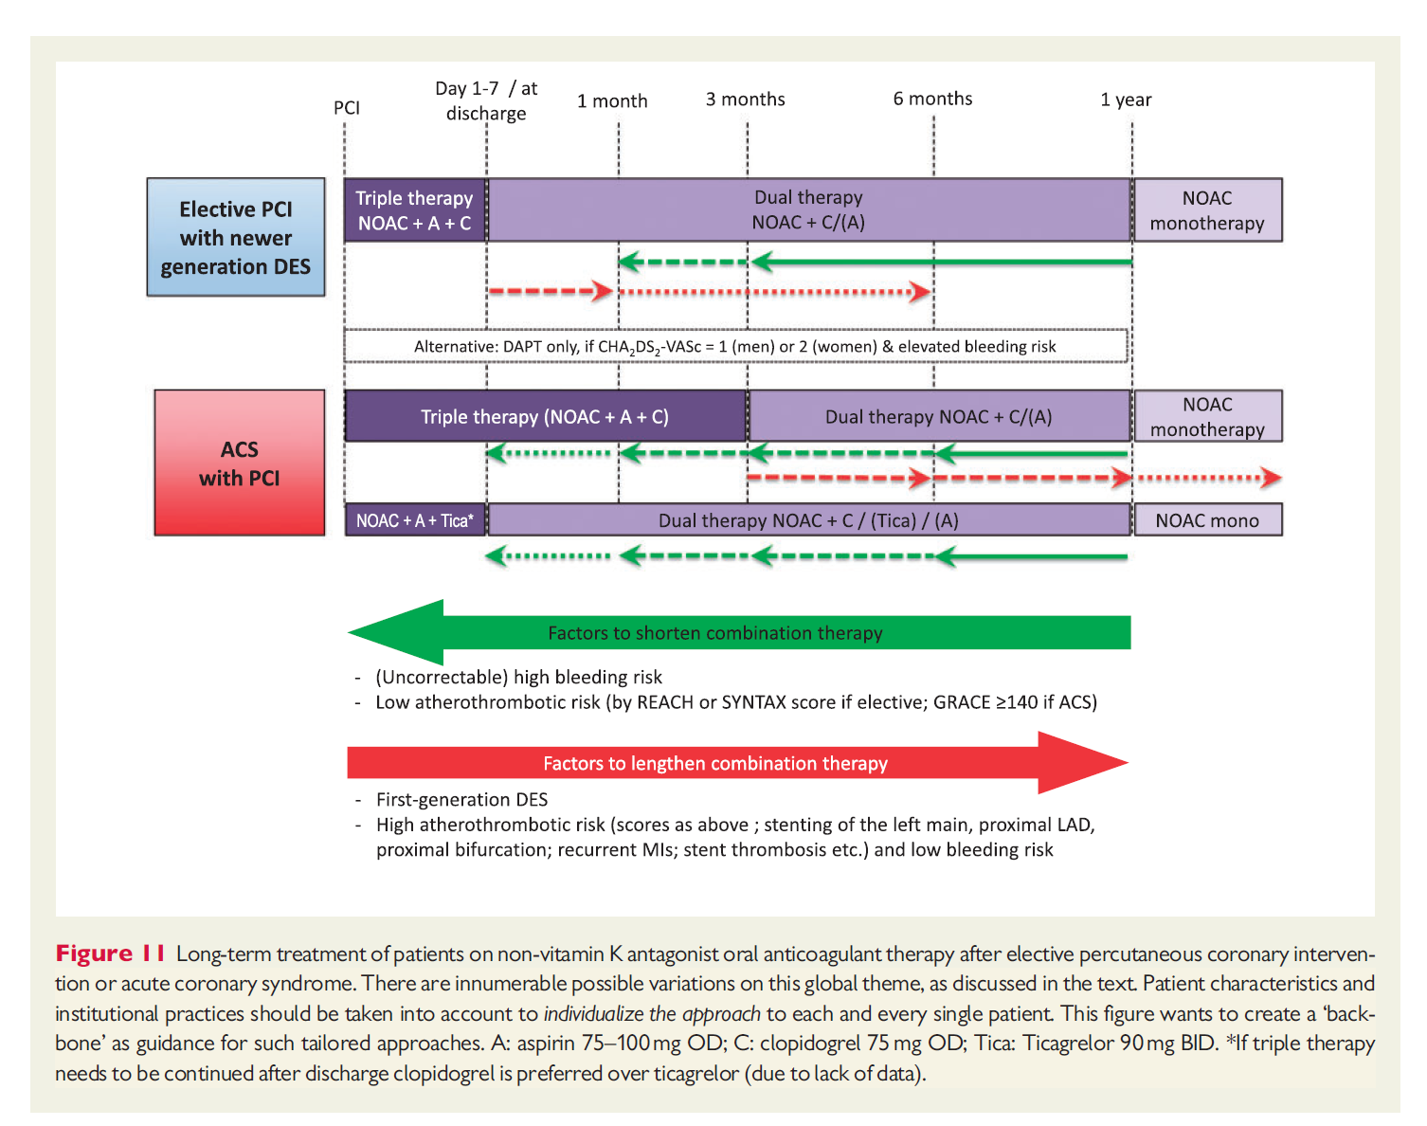

Slide 19
Case 3
The 65-years-old gentleman with history of AF rhythm and PCI on midportion LAD (stent new generation 3.5 * 18) 3 month ago
On NOAC and clopidogrel

Slide 20
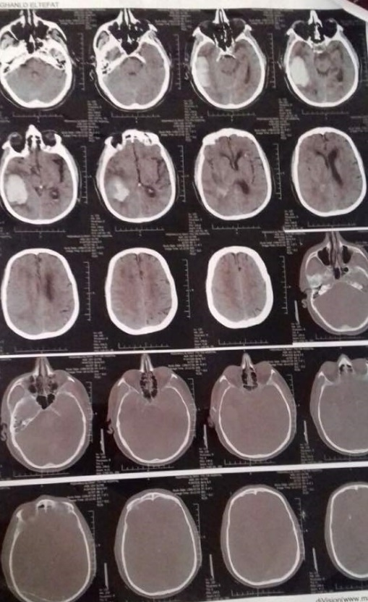
Presented with ICH

Slide 21
After adequate management of ICH, and anti thrombotic approval by neurosurgeon , what is your decision for continuation of antithrombotic regimen for him?

Slide 22
ASA initially + NOAC two weeks after ICH
DAPT initially after ICH
ASA initially + NOAC one month after ICH
ASA initially + warfarin one month after ICH

Slide 23
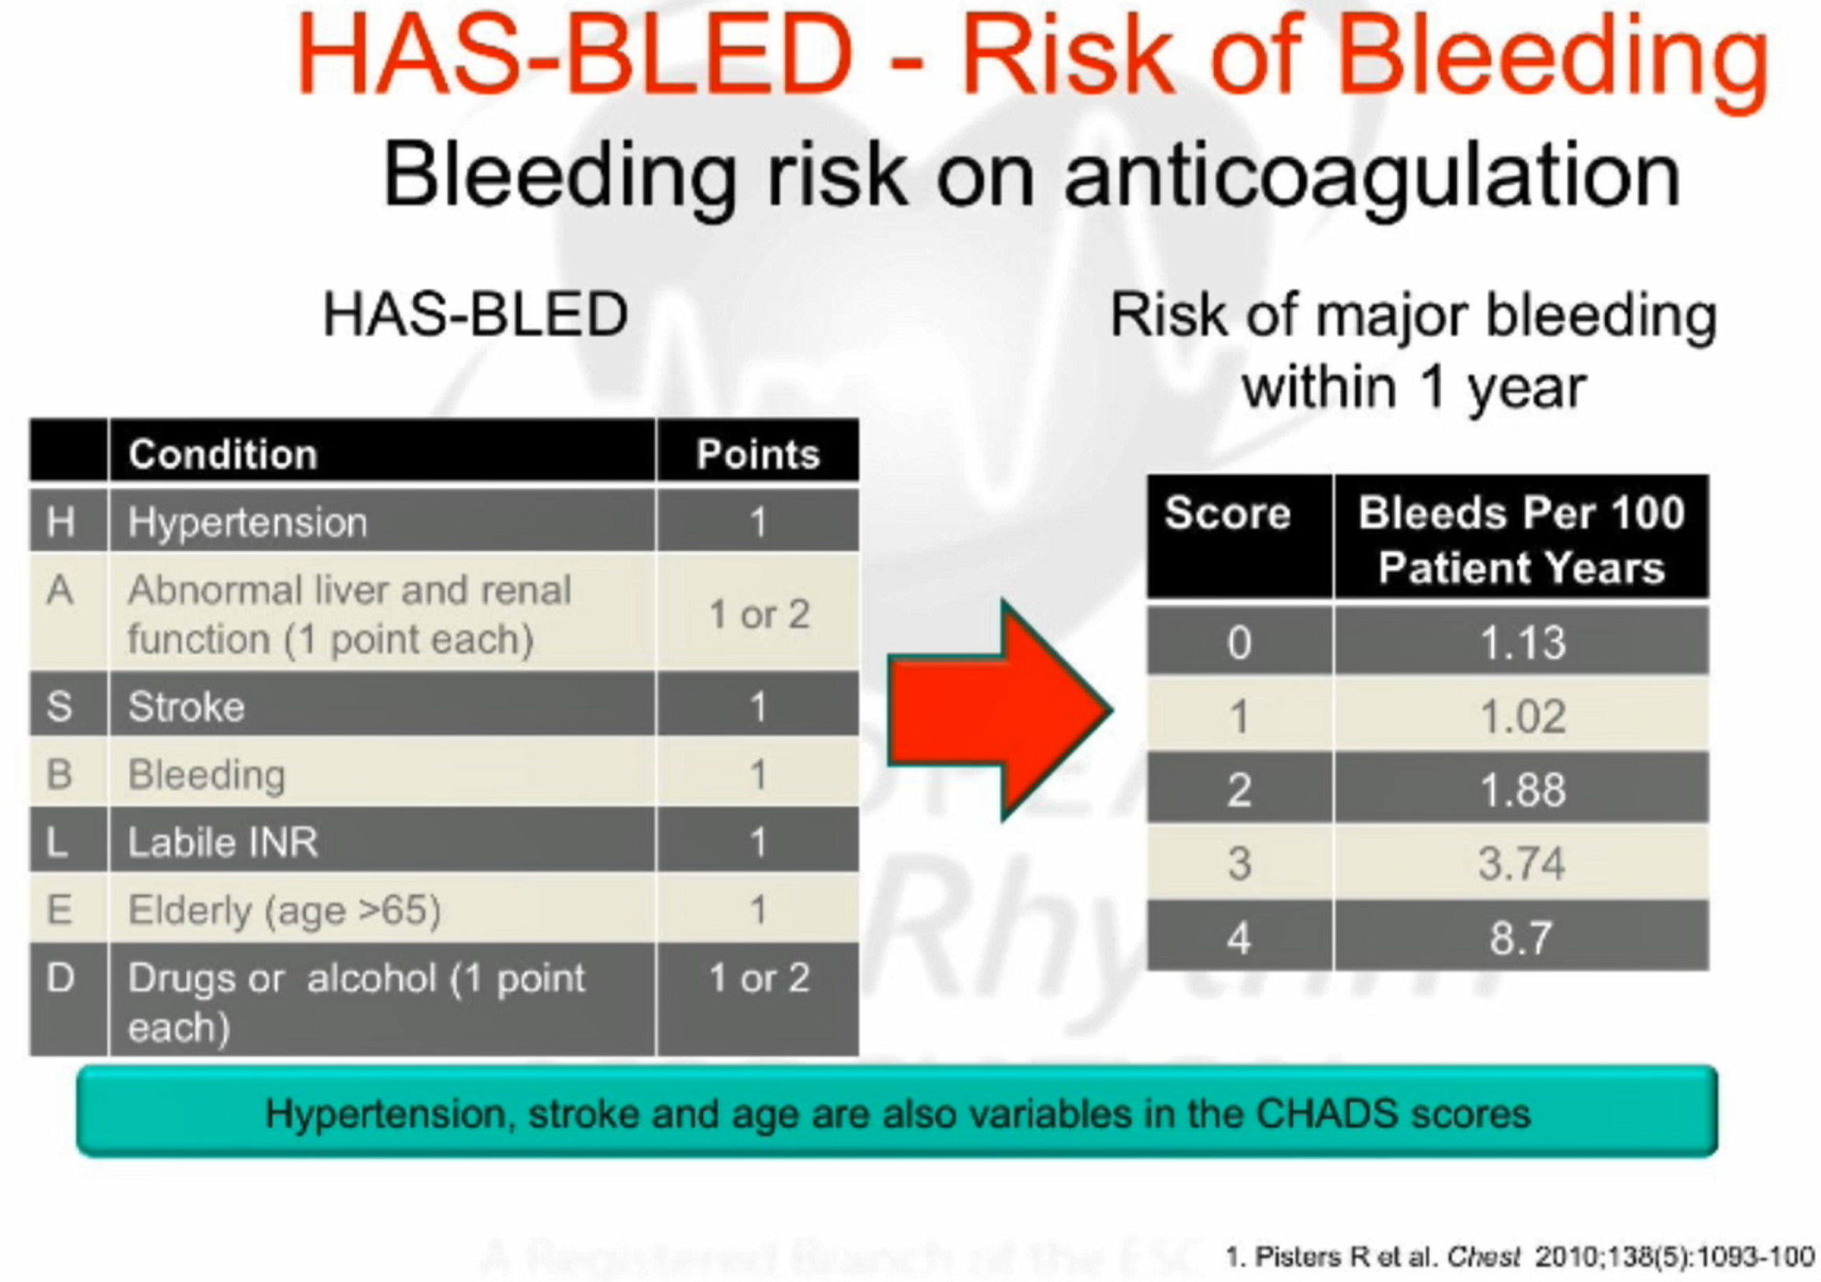

Slide 24
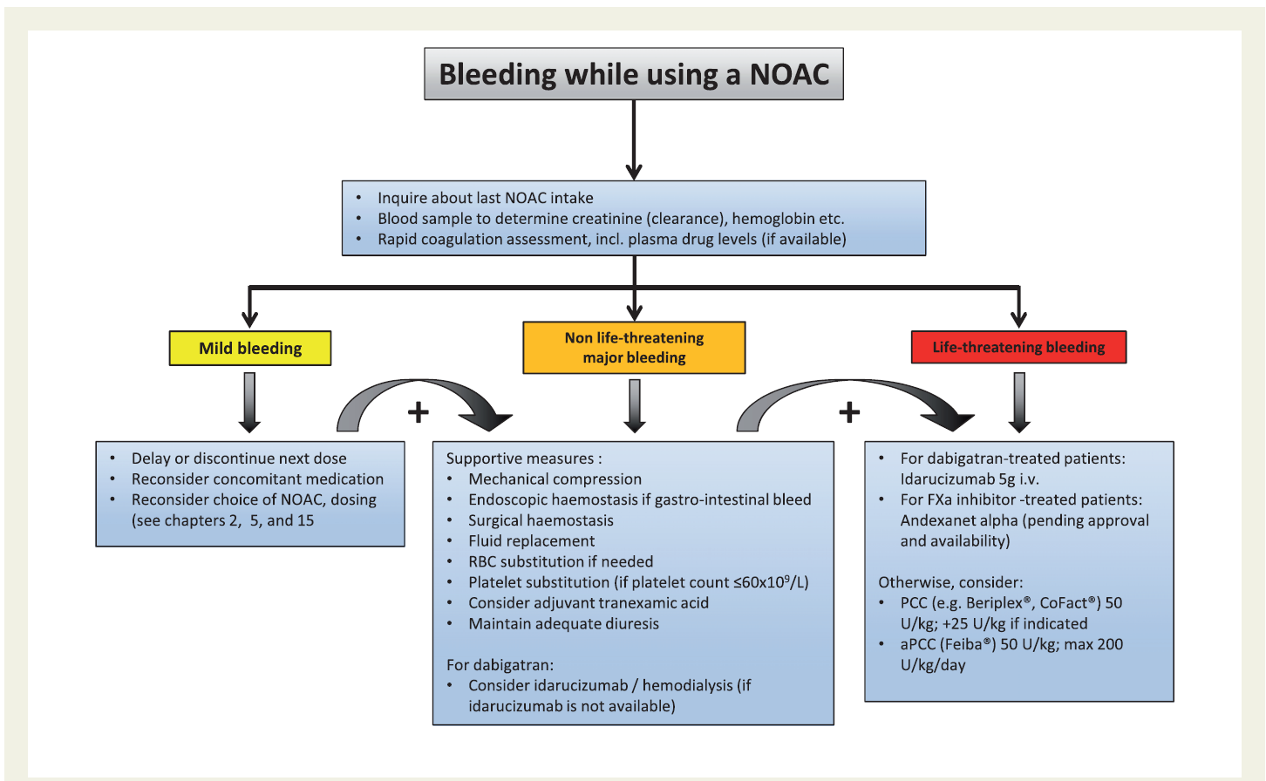

Slide 25
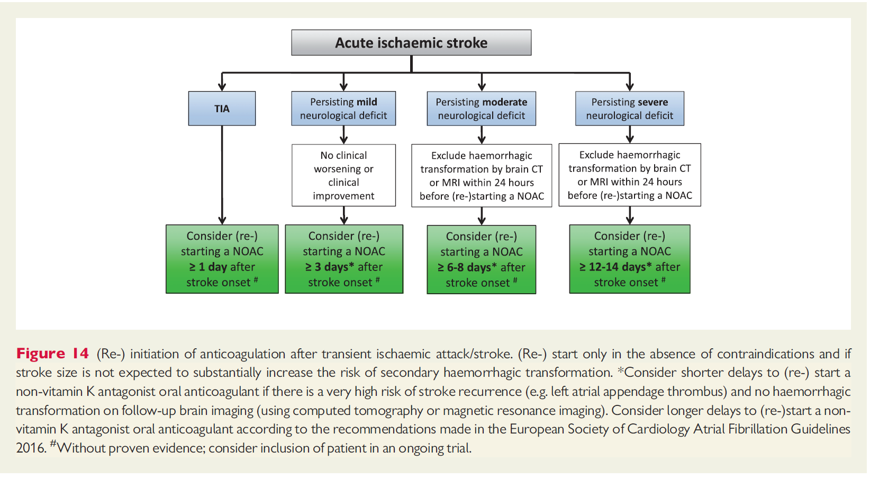

Slide 26
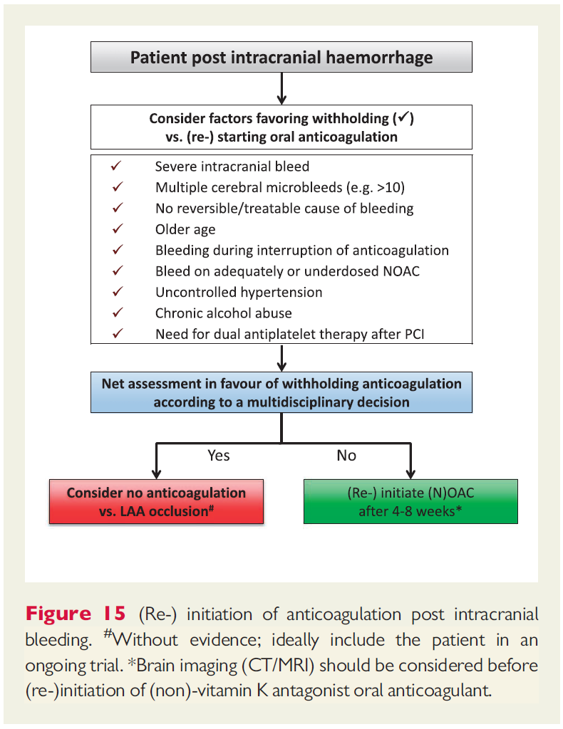

Slide 27
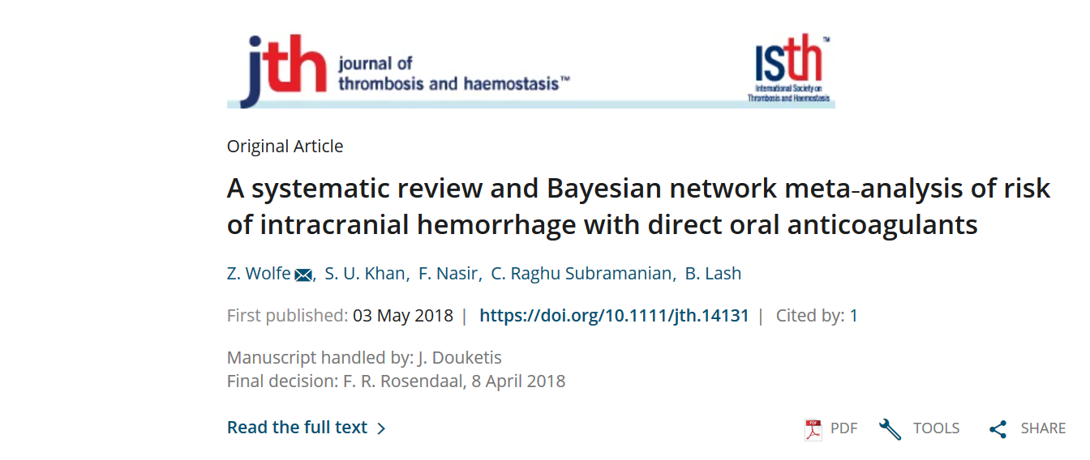
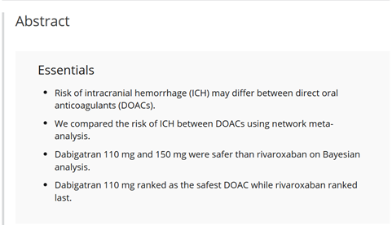

Slide 28
This is a systematic review and meta-analysis of the risk of intracranial hemorrhage (ICH) with use of direct oral anticoagulants (DOACs)
Investigators reviewed 17 randomized controlled trials studying four DOACs (rivaroxaban, apixaban, edoxaban, and dabigatran) and including 116,000 participants
The comparator arm was warfarin in 13 trials and low molecular–weight heparin (LMWH) in the remaining 4

Slide 29
All of the DOACs were associated with a reduced risk of ICH compared with warfarin (OR, 0.46), but there was no difference when compared with LMWH
Dabigatran appeared to be associated with the lowest risk
This large meta-analysis suggests that DOACs as a group are associated with a lower risk of ICH

Slide 30
Risk of intracranial hemorrhage (ICH) may differ between direct oral anticoagulants (DOACs)
We compared the risk of ICH between DOACs using network meta‐analysis
Dabigatran 110 mg and 150 mg were safer than rivaroxaban on Bayesian analysis
Dabigatran 110 mg ranked as the safest DOAC while rivaroxaban ranked last.

Slide 31
Case 4
The 59-years-old man with history of recurrent VTE and use of Dabigatran
Presented with GI Bleeding
What is your strategy in this patient ?

Slide 32
Initiate Warfarin 5-7 days later
Reinitiate Dabigatran 5-7 days later
Initiate Rivaroxaban 5-7 days later
Initiate Apixaban 5-7 days later

Slide 33
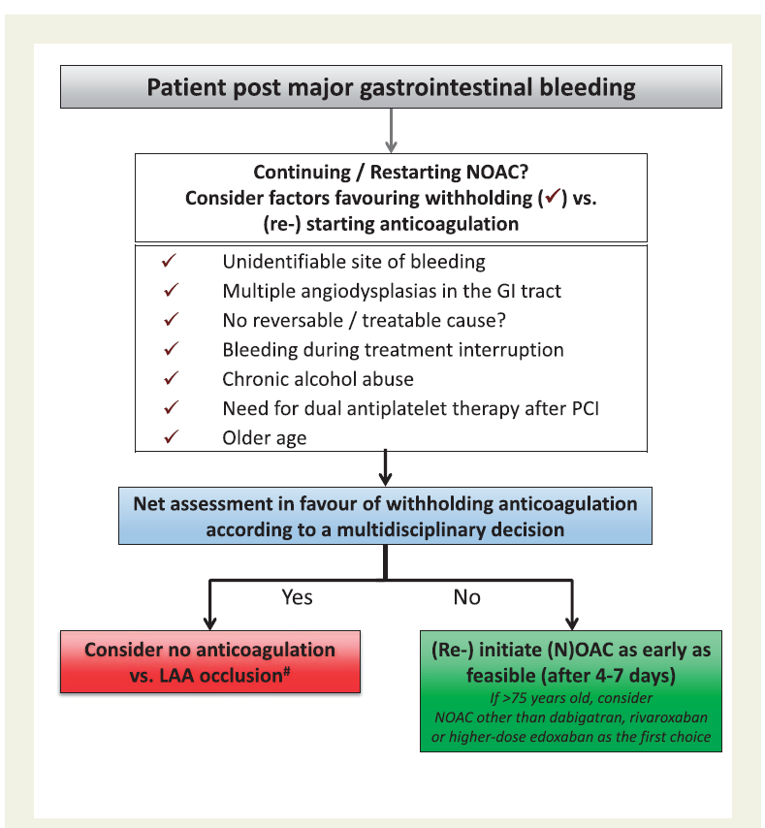

Slide 34
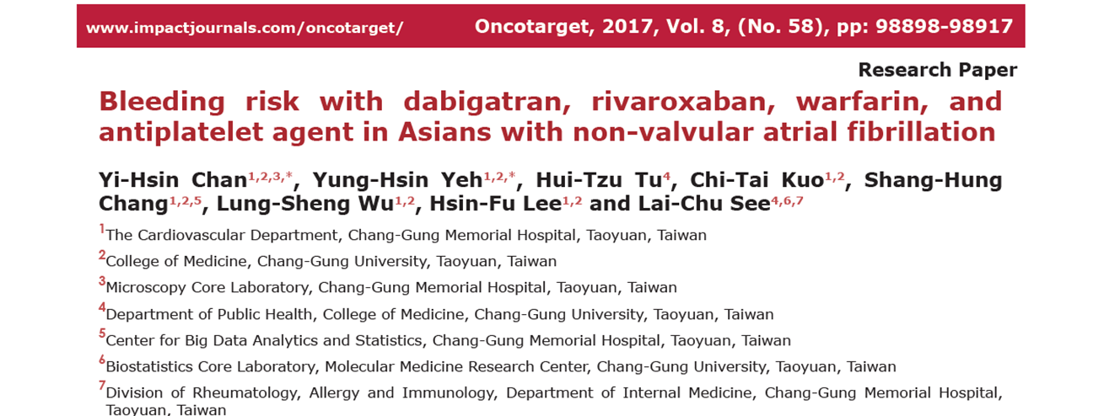
In conclusion, we observed that Dabigatran was associated with a lower risk of all major bleeding in Asians with NVAF, whereas rivaroxaban had a similar risk of all major bleeding compared with antiplatelet agents after adjustment of comorbidities.

Slide 35
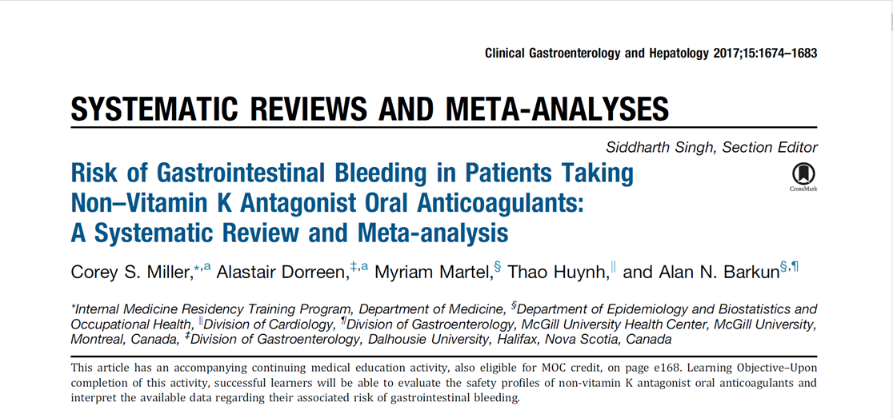
Dabigatran (2.0% vs 1.4%, respectively; OR, 1.27; 95% CI, 1.04–1.55)and rivaroxaban (1.7% vs 1.3%, respectively; OR, 1.40; 95% CI, 1.15–1.70) were associated with increased odds of major GI bleeding compared with conventional anticoagulation, whereas no difference was found for apixaban (0.6% vs 0.7%, respectively; OR, 0.81; 95% CI, 0.64–1.02) or edoxaban (1.9% vs 1.6%, respectively; OR, 0.93; 95% CI, 0.78–1.11).

Slide 36
In a systematic review and meta-analysis, we found risk of major GI bleeding to be similar between NOACs and conventional anticoagulation.
Dabigatran and rivaroxaban, however, may be associated with increased odds of major GI bleeding. Further high-quality studies are needed to characterize GI bleeding risk among NOACs.

Slide 37
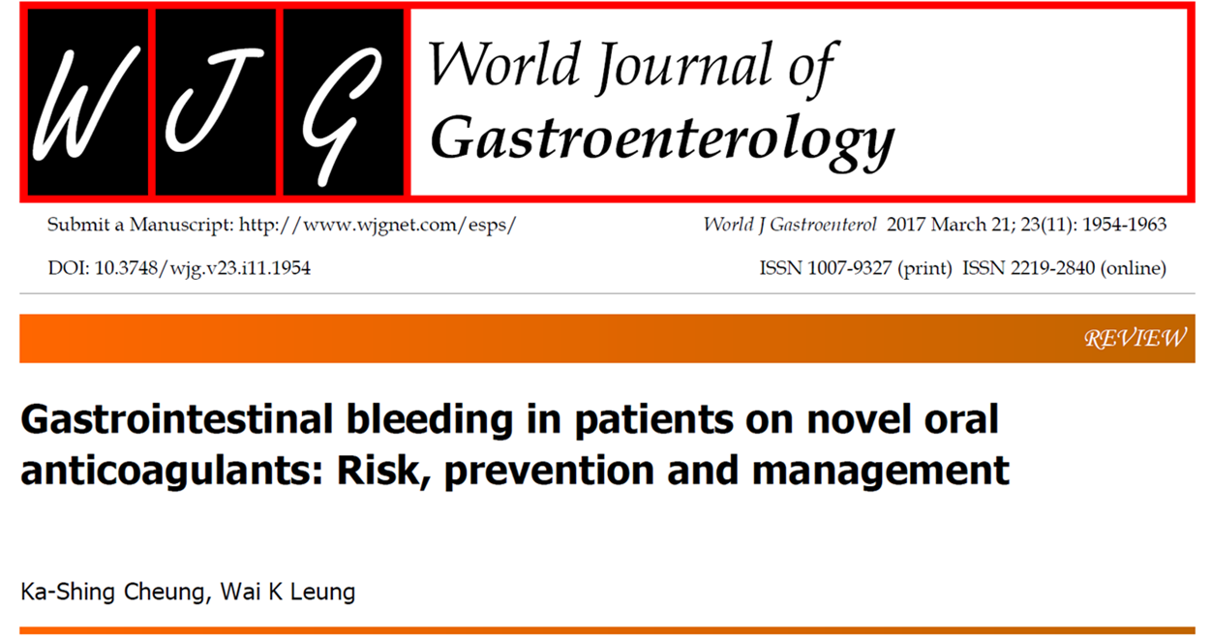
Among different NOACs, both dabigatran and rivaroxaban were associated with a higher risk of GIB (OR 1.58 and 1.48, respectively), but not apixaban and edoxaban
once daily dosing of rivaroxaban may also account for the higher GIB risk observed in the head-to-head study of rivaroxaban and dabigatran

Slide 38
Case 5
The 59-years-old woman ,under treatment with Rivaroxaban ( last dose 6 hours ago)
Presented with acute abdomen
Candidate for emergent surgery due to intestinal obstruction
What is your strategy in this patient ?

Slide 39
Immediate Reversal and transferring to operating room
Check PT and decision making for reversal
proceed to surgery immediately

Slide 40
Case 6
The 59-years-old woman ,under treatment with Apixaban
Normal GFR
Candidate for elective hysterectomy
What is your strategy in this patient ?

Slide 41
Discontinuation of Apixaban one day before surgery
Discontinuation of Apixaban 2 days before surgery
Discontinuation of Apixaban 3 days before surgery
Discontinuation of Apixaban 4 days before surgery

Slide 42
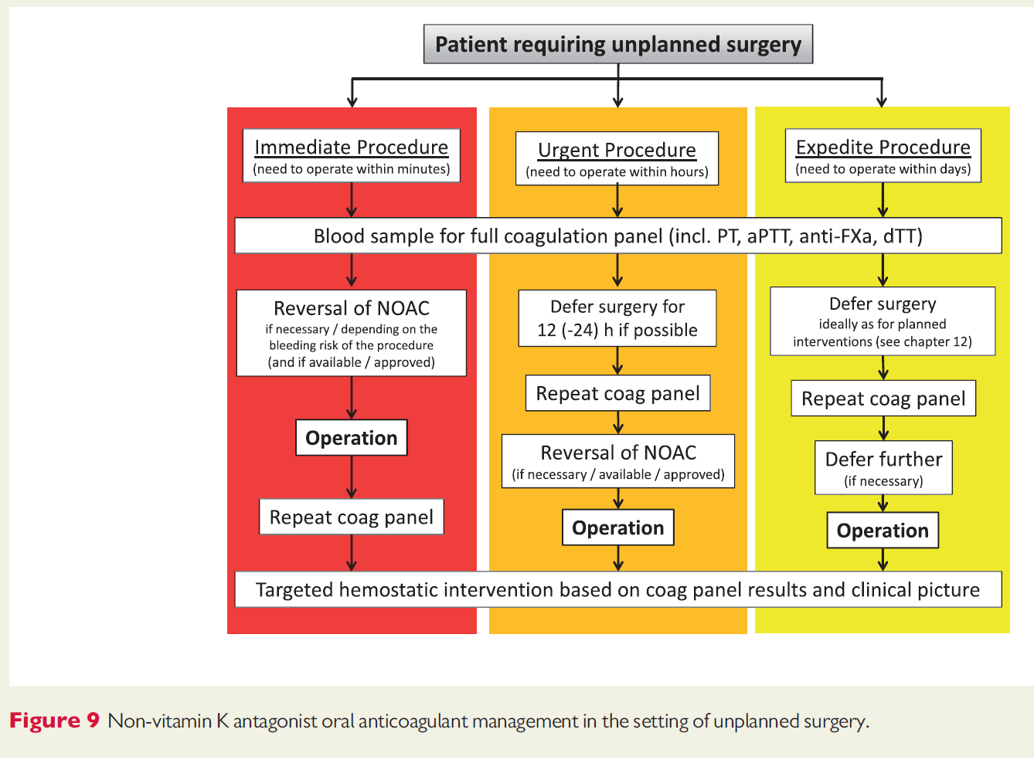

Slide 43
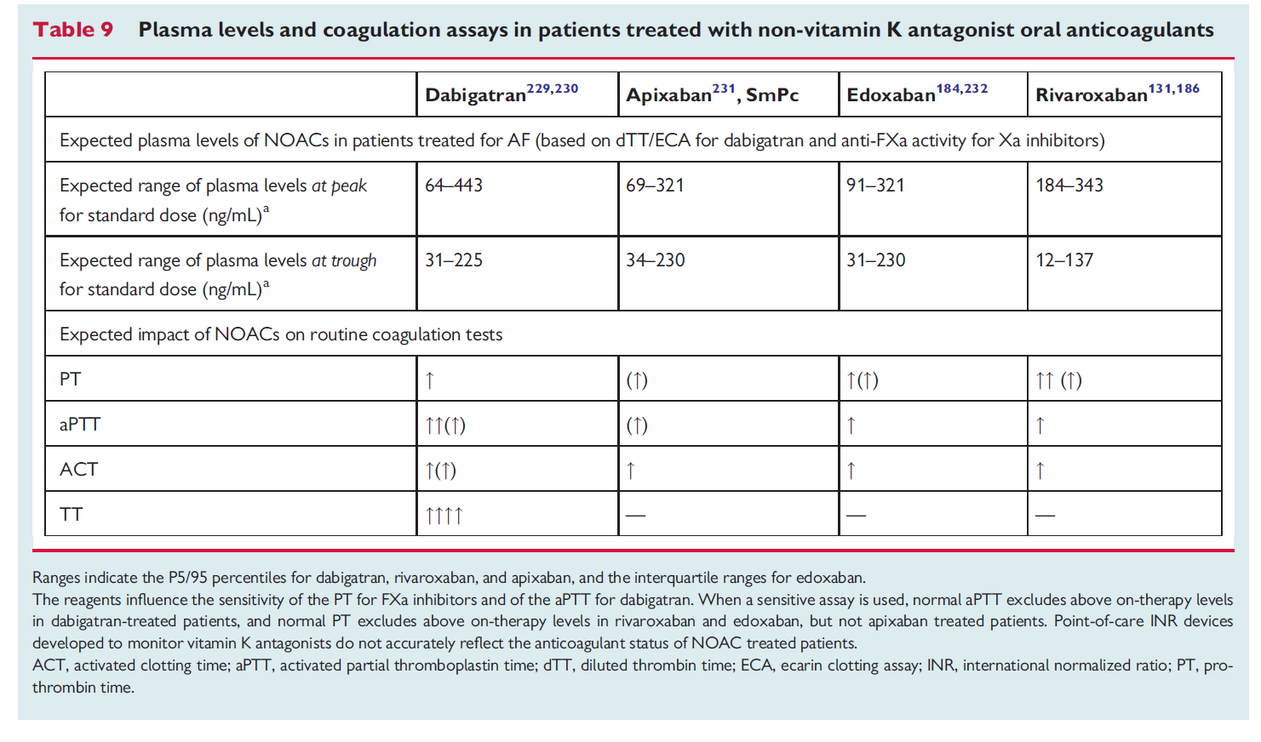

Slide 44
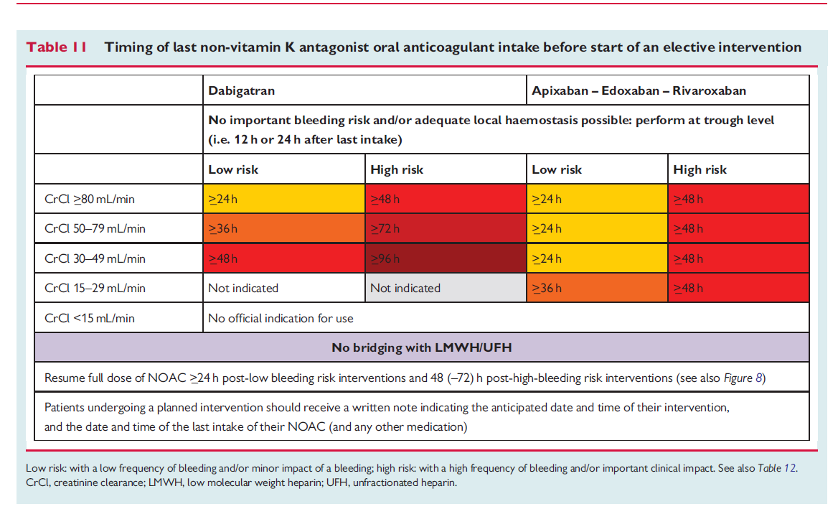

Slide 45
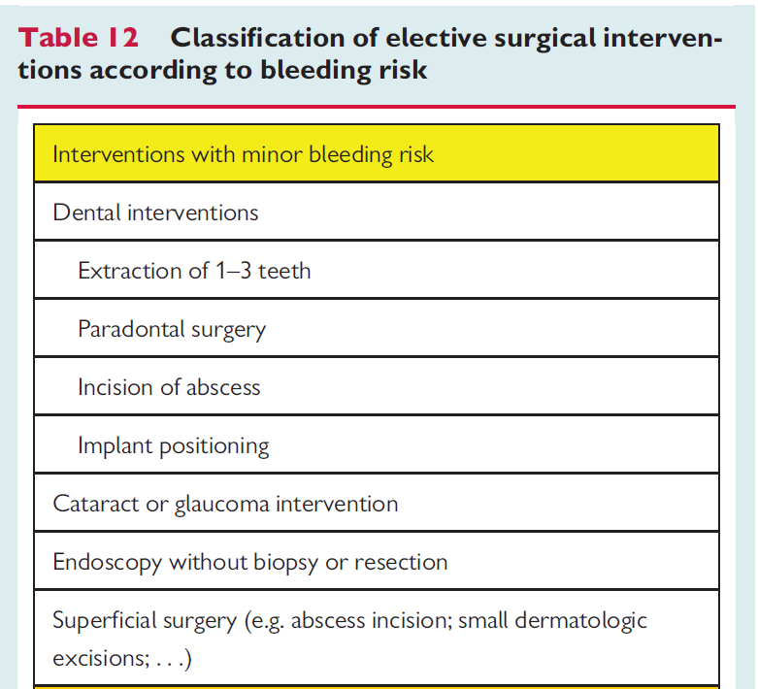
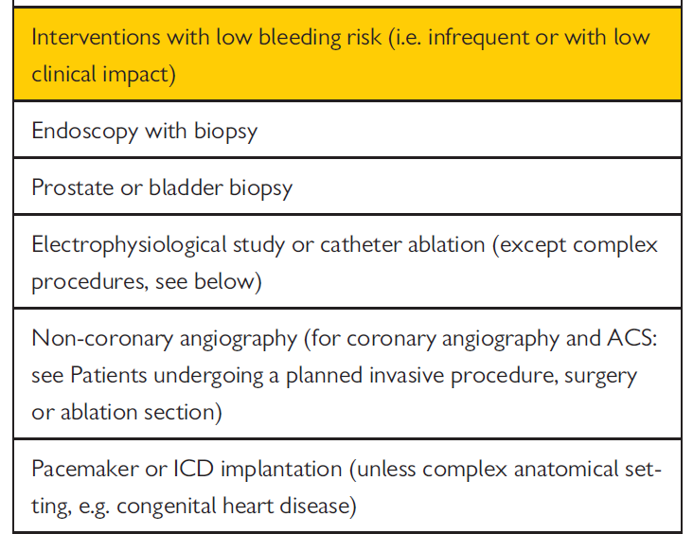

Slide 46
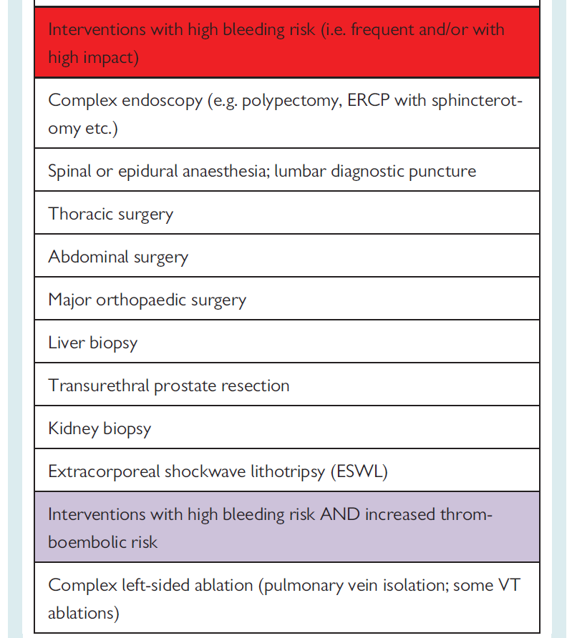

Slide 47
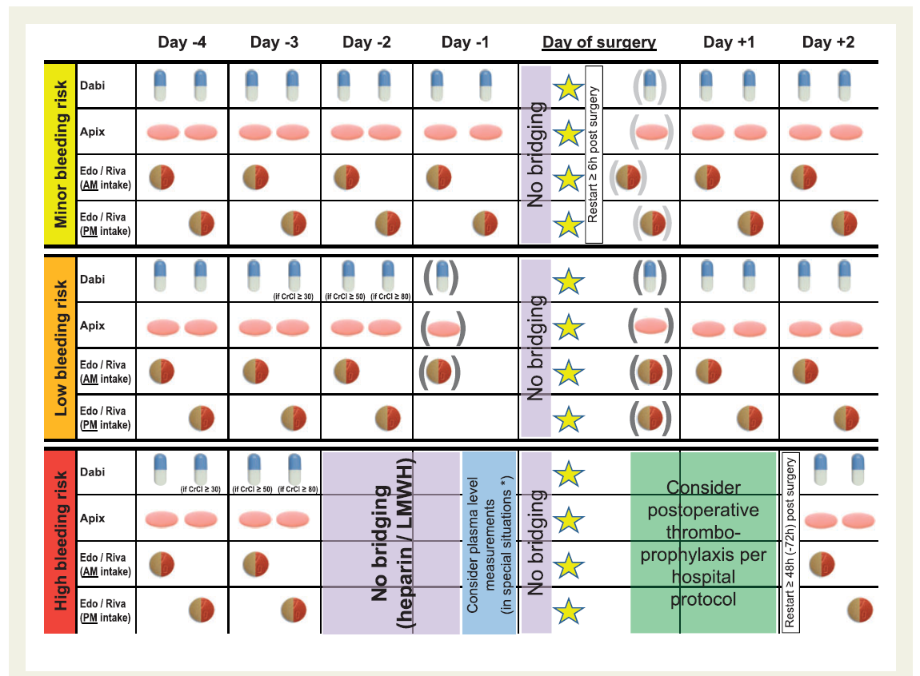

Slide 48


