Slide 1

Reduction in Ischemic Events with Ticagrelor in Diabetic Patients from the PEGASUS-TIMI 54 Trial
Deepak L. Bhatt, MD, MPH, Marc P. Bonaca, MD, MPH, Sameer Bansilal, MD, MS, Dominick J. Angiolillo, MD, PhD, Marc Cohen, MD, Robert F. Storey, MD, Kyungah Im, PhD, Sabina A. Murphy, MPH, Peter Held, MD, PhD, Eugene Braunwald, MD, Marc S. Sabatine, MD, MPH, Ph. Gabriel Steg MD, on behalf of the PEGASUS-TIMI 54 Steering Committee and Investigators
NCT00526474

Slide 2
Disclosures
PEGASUS-TIMI 54 funded via grant to Brigham and Women’s Hospital by AstraZeneca
Dr. Bhatt discloses the following relationships - Advisory Board: Cardax, Elsevier Practice Update Cardiology, Medscape Cardiology, Regado Biosciences; Board of Directors: Boston VA Research Institute, Society of Cardiovascular Patient Care; Chair: American Heart Association Quality Oversight Committee; Data Monitoring Committees: Duke Clinical Research Institute, Harvard Clinical Research Institute, Mayo Clinic, Population Health Research Institute; Honoraria: American College of Cardiology (Senior Associate Editor, Clinical Trials and News, ACC.org), Belvoir Publications (Editor in Chief, Harvard Heart Letter), Duke Clinical Research Institute (clinical trial steering committees), Harvard Clinical Research Institute (clinical trial steering committee), HMP Communications (Editor in Chief, Journal of Invasive Cardiology), Journal of the American College of Cardiology (Guest Editor; Associate Editor), Population Health Research Institute (clinical trial steering committee), Slack Publications (Chief Medical Editor, Cardiology Today’s Intervention), Society of Cardiovascular Patient Care (Secretary/Treasurer), WebMD (CME steering committees); Other: Clinical Cardiology (Deputy Editor), NCDR-ACTION Registry Steering Committee (Vice-Chair), VA CART Research and Publications Committee (Chair); Research Funding: Amarin, AstraZeneca, Bristol-Myers Squibb, Eisai, Ethicon, Forest Laboratories, Ischemix, Medtronic, Pfizer, Roche, Sanofi Aventis, The Medicines Company; Royalties: Elsevier (Editor, Cardiovascular Intervention: A Companion to Braunwald’s Heart Disease); Site Co-Investigator: Biotronik, Boston Scientific, St. Jude Medical; Trustee: American College of Cardiology; Unfunded Research: FlowCo, PLx Pharma, Takeda.

Slide 3
Design of PEGASUS-TIMI 54
Stable pts with history of MI 1-3 yrs prior
+ ≥1 additional atherothrombosis risk factor*
N = 21,162
* Age >65 yrs, diabetes, 2nd prior MI, multivessel CAD, or chronic non-end stage renal dysfunction
RANDOMIZED
DOUBLE BLIND
Planned treatment with ASA 75 – 150 mg &
Standard background care
Ticagrelor
90 mg bid
Ticagrelor
60 mg bid
Placebo
Follow-up Visits
Q4 mos for 1st yr, then Q6 mos
Minimum 1 year follow-up
Event-driven trial
Bonaca MP, Bhatt DL, Braunwald E, et al. Sabatine MS. Am Heart J. 2014.

Slide 4
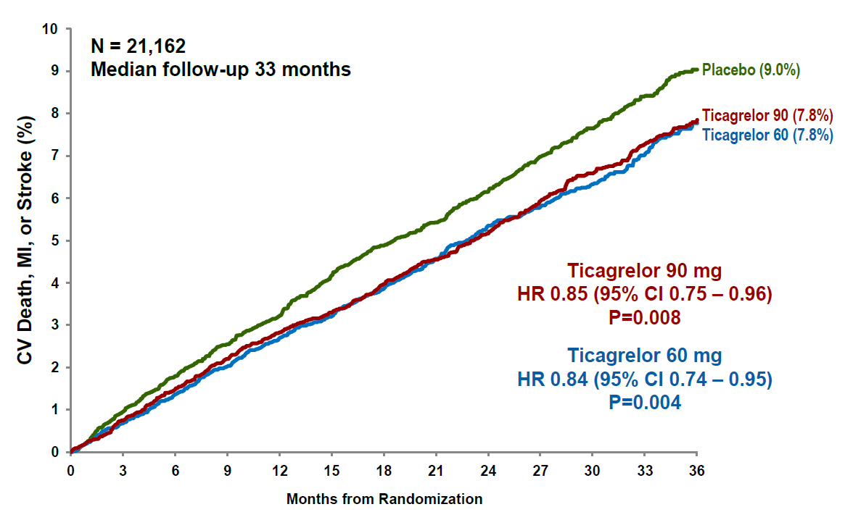
PEGASUS TIMI- 54 Overall Results
Bonaca MP, Bhatt DL, Cohen M, et al. Sabatine MS. NEJM. 2015.

Slide 5
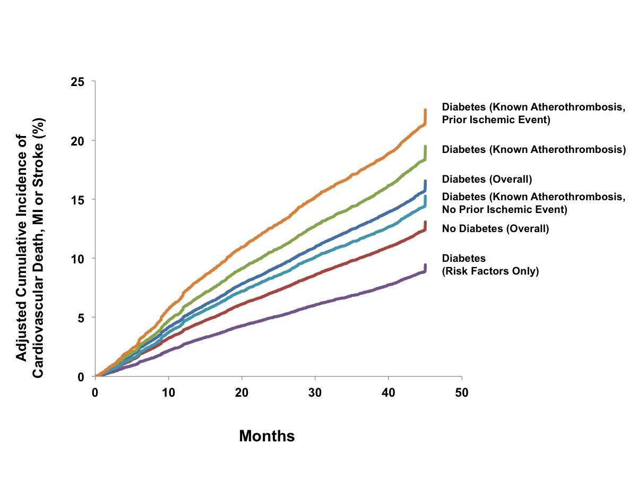
REACH Registry - Diabetes
Cavender MA, Steg PG, Smith SC, et al. Bhatt DL. Circulation. 2015.

Slide 6
Hypothesis
Diabetic patients within PEGASUS TIMI-54 would be at greater risk of ischemic events than non-diabetic patients
Therefore, diabetic patients would derive greater absolute benefit from ticagrelor versus placebo than would non-diabetic patients

Slide 7
Methods
Patients categorized as having diabetes mellitus at baseline
Rates of the composite of cardiovascular death, MI, or stroke compared between the pooled ticagrelor and placebo arms
Additionally, individual components of the primary endpoint and bleeding endpoints were compared between the treatment arms

Slide 8
Baseline Characteristics by History of DM
 | No Diabetes N=14,355 | Diabetes N=6806 | P value
Age (median, years) | 66.0 | 63.0 | <0.0001
Male | 77.9% | 72.3% | <0.0001
Body Mass Index (kg/m²) | 27.4 | 29.2 | <0.0001
eGFR <60 mL/min/1.73m² | 21.9% | 25.9% | <0.0001
Multivessel CAD | 63.2% | 51.1% | <0.0001
History of Hypertension | 73.8% | 85.5% | <0.0001
History of Hypercholesterolemia | 75.6% | 79.3% | <0.0001
Current Smoker | 17.2% | 15.6% | 0.0027
History of PCI | 84.6% | 79.6% | <0.0001
Statin | 93.1% | 91.7% | 0.0002
ACE-I or ARB | 79% | 83.5% | <0.0001
Diabetes Requiring Drugs | 0% | 87.6%
Diabetes Type II | 0% | 99.0%
Insulin | 0% | 22.0%
Oral Hypoglycemic | 0% | 78.9%

Slide 9
Baseline Characteristics by Treatment
 | Ticagrelor in Diabetic Pts N=4549 | Placebo in Diabetic Pts N=2257 | P value
Age (median, years) | 63.0 | 64.0 | 0.54
Male | 72.6% | 71.6% | 0.36
Body Mass Index (kg/m²) | 29.1 | 29.3 | 0.26
eGFR <60 mL/min/1.73m² | 25.8% | 26.1% | 0.80
Multivessel CAD | 50.5% | 52.4% | 0.15
History of Hypertension | 85.5% | 85.5% | 0.98
History of Hypercholesterolemia | 79.2% | 79.3% | 0.99
Current Smoker | 15.7% | 15.3% | 0.64
History of PCI | 79.7% | 79.4% | 0.77
Statin | 91.3% | 92.3% | 0.15
ACE-I or ARB | 83.6% | 83.3% | 0.77
Diabetes Requiring Drugs | 87.7% | 87.4% | 0.73
Diabetes Type II | 99.1% | 98.8% | 0.21
Insulin | 21.4% | 23.0% | 0.13
Oral Hypoglycemic | 79.1% | 78.4% | 0.49

Slide 10
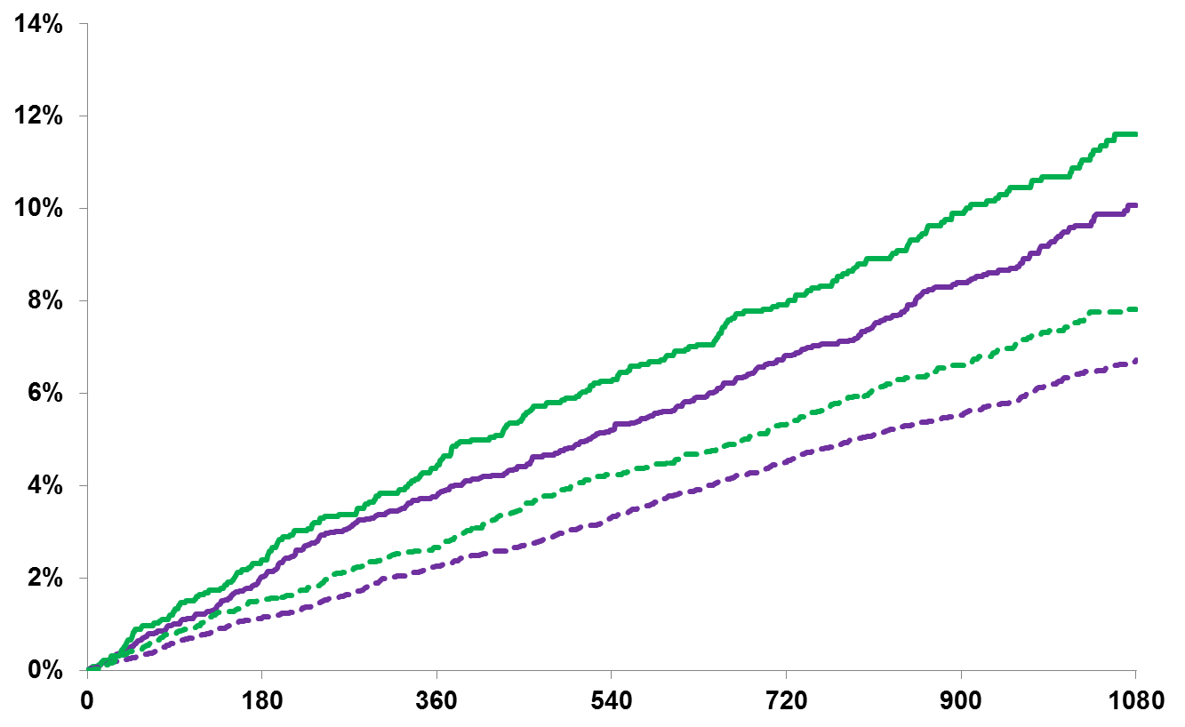
Primary Endpoint - MACE
Ticagrelor (doses pooled)
Ticagrelor in Diabetic Patients
HR 0.84 (95% CI 0.72 – 0.99)
ARR 1.5%; P=0.03
Placebo
11.6%
10.1%
Benefit in Diabetic vs. Non-Diabetic Patients:
Interaction P=0.99
7.8%
CV Death, MI, Stroke (%)
6.7%
Ticagrelor in Non-Diabetic Patients
HR 0.84 (95% CI 0.74 – 0.96)
ARR 1.1%; P=0.01
Days from Randomization

Slide 11
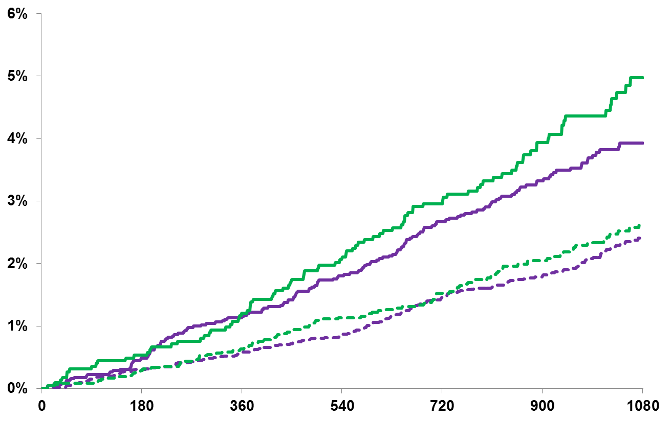
Cardiovascular Death
Ticagrelor (doses pooled)
Ticagrelor in Diabetic Patients
HR 0.78 (95% CI 0.61 – 0.99)
ARR 1.1%; P=0.0495
Placebo
5.0%
3.9%
Benefit in Diabetic vs. Non-Diabetic Patients:
Interaction P=0.38
Cardiovascular Death (%)
2.6%
2.4%
Ticagrelor in Non-Diabetic Patients
HR 0.91 (95% CI 0.72 – 1.15)
ARR 0.2%; P=0.42
Days from Randomization

Slide 12
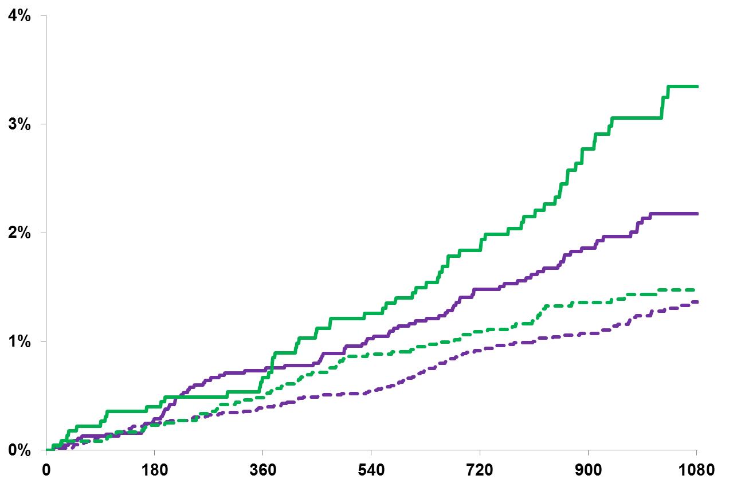
Coronary Death
Ticagrelor (doses pooled)
Ticagrelor in Diabetic Patients
HR 0.66 (95% CI 0.48 – 0.91)
ARR 1.1%; P=0.01
Placebo
3.4%
Benefit in Diabetic vs. Non-Diabetic Patients:
Interaction P=0.21
Coronary Death (%)
2.3%
1.5%
1.4%
Ticagrelor in Non-Diabetic Patients
HR 0.88 (95% CI 0.65 – 1.19)
ARR 0.1%; P=0.39
Days from Randomization

Slide 13
Efficacy of Ticagrelor – Diabetic Patients
3-Year KM Rate (%)
Ticagrelor Placebo
HR (95% CI)
P-value
10.1
0.85 (0.71 – 1.03)
0.093
CVD / MI / Stroke
10.0
0.83 (0.69 – 1.004)
0.055
10.1
11.6
0.84 (0.72 – 0.99)
0.035
4.1
0.82 (0.62 – 1.10)
0.19
CV Death
3.8
0.74 (0.55 – 0.99)
0.043
3.9
5.0
0.78 (0.61 – 0.99)
0.049
2.2
0.68 (0.47 – 1.00)
0.049
Coronary Heart Disease Death
2.1
0.64 (0.43 – 0.94)
0.02
2.2
3.4
0.66 (0.48 – 0.97)
0.01
5.8
0.88 (0.68 – 1.13)
0.31
Myocardial Infarction
6.0
0.90 (0.70 – 1.15)
0.39
5.9
6.5
0.89 (0.72 – 1.10)
0.28
1.8
0.69 (0.45 – 1.06)
0.09
Stroke
1.8
0.69 (0.46 – 1.06)
0.09
1.8
2.5
0.69 (0.49 – 0.99)
0.045
Ticagrelor 90 mg
0.5
0.8
1.2
1.0
Ticagrelor 60 mg
Ticagrelor Better
Placebo Better
Pooled
Based on N=6806 patients

Slide 14
Safety of Ticagrelor – Diabetic Patients
3-Year KM Rate (%)
Ticagrelor Placebo
HR (95% CI)
P-value
2.6
2.67 (1.52 – 4.71)
0.001
TIMI Major Bleeding
2.5
2.47 (1.40 – 4.35)
0.002
2.6
1.0
2.56 (1.52 – 4.33)
0.0004
4.3
3.48 (2.15 – 5.63)
<0.001
TIMI Major or Minor Bleeding
3.2
2.39 (1.45 – 3.94)
0.001
3.8
1.3
2.91 (1.84 – 4.59)
<0.001
0.5
0.83 (0.33 – 2.07)
0.69
ICH or Fatal Bleeding
0.7
0.96 (0.41 – 2.26)
0.92
0.6
0.6
0.90 (0.42 – 1.90)
0.78
6.3
0.88 (0.70 – 1.12)
0.30
All-Cause mortality
6.2
0.84 (0.66 – 1.06)
0.15
6.2
7.1
0.86 (0.70 – 1.05)
0.15
Ticagrelor 90 mg
0.8
1.0
3.0
Ticagrelor 60 mg
Ticagrelor Better
Placebo Better
Pooled
Based on N=6735 patients

Slide 15
Limitations
The study was not powered for subgroups or for individual endpoints
No adjustments were made for multiple comparisons and therefore the reductions in cardiac death should be viewed as hypothesis generating
Duration of diabetes or levels of glycemic control were not captured

Slide 16
THEMIS
Design and main eligibility criteria
Type 2 diabetes; men and women ≥ 50 years
≥ 6 months glucose lowering drug treatment
At high risk for CV events*
No previous MI or stroke
No planned use of ADP receptor antagonist
or planned revascularization
Low-dose ASA and other background therapy
* At high risk of CV events defined as history of PCI or CABG or angiographic evidence of ≥ 50% lumen stenosis of at least 1 coronary artery
Ticagrelor
60 mg BID
Placebo
Event driven study; 1034 CV events required; 28 months mean follow-up; (n=19,000)
Primary endpoint : Composite of CV death, MI, or stroke
Secondary endpoint: Composite of all-cause death, MI, or stroke; CV death; all-cause death
Primary safety: TIMI major bleeding
http://www.clinicaltrials.gov/show/NCT01991795

Slide 17
Conclusions
Even in the contemporary era, patients with prior MI with diabetes mellitus have an elevated risk of ischemic events compared with non-diabetic patients
Long-term ticagrelor reduces the composite of cardiovascular death, MI, or stroke in diabetic patients, with a greater absolute risk reduction than in non-diabetic patients
There is an increase in TIMI major bleeding, but not fatal bleeding or intracranial hemorrhage
Within the diabetic subgroup, there was a reduction in cardiovascular and coronary heart disease deaths with ticagrelor versus placebo

Slide 18
ACC.org
For full details, please go to ACC.org.
Bhatt DL, Bonaca MP, Bansilal S, Angiolillo DJ, Cohen M, Storey RF, Im K, Murphy SA, Held P, Braunwald E, Sabatine MS, Steg PG.
Reduction in Ischemic Events with Ticagrelor in Diabetic Patients from the PEGASUS-TIMI 54 Trial. JACC 2016.

