Slide 1
New Studies Concerning Antiplatelet Agents , Focus on Ticagrelor
Maryam Mehrpooya MD,
Associate professor of cardiology
Fellowship of Interventional Cardiology
TUMS- Imam Khomeini Hospital

Slide 2
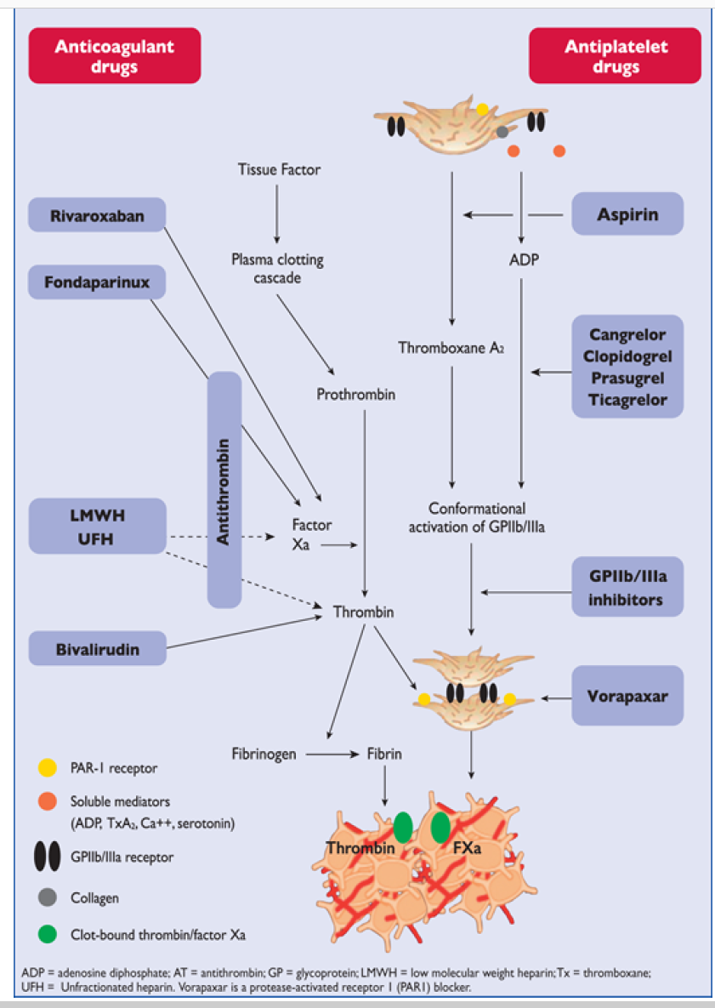

Slide 3
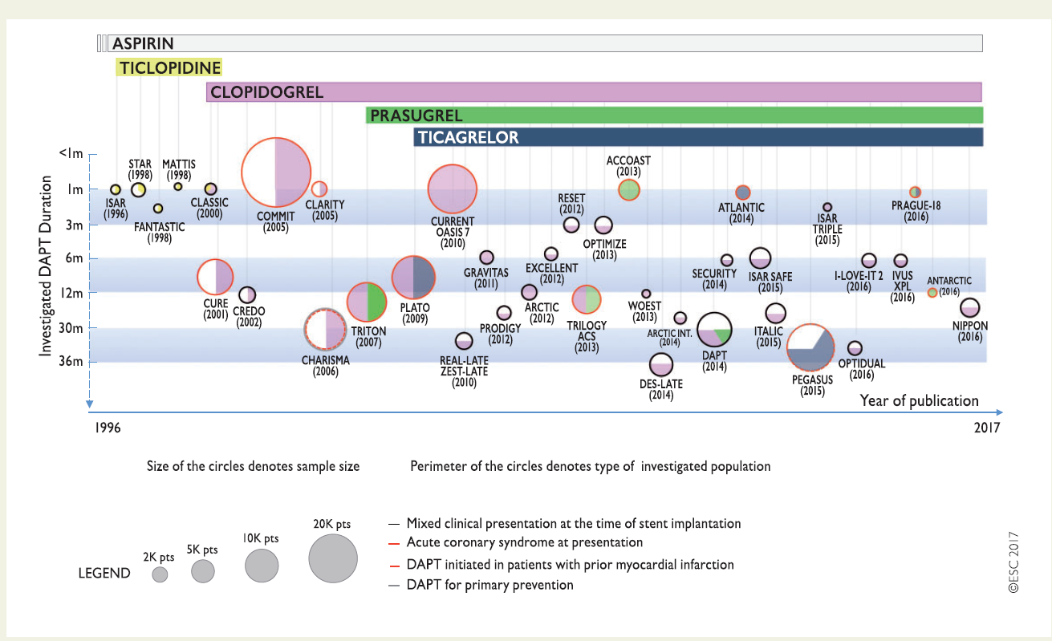

Slide 4
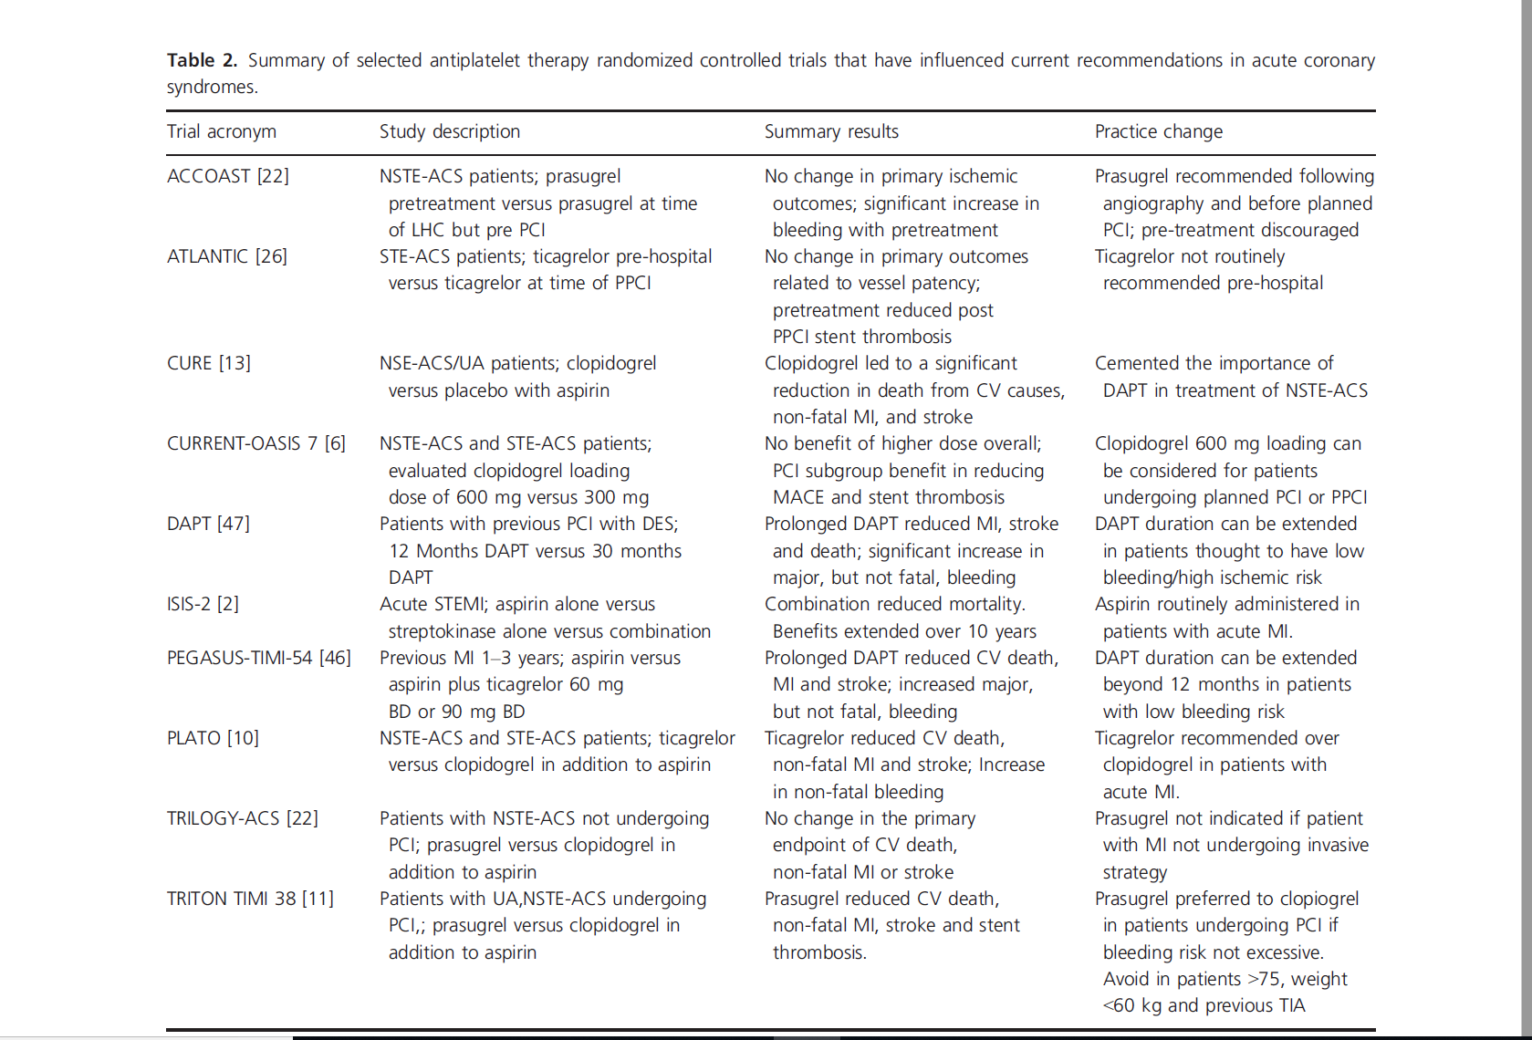

Slide 5
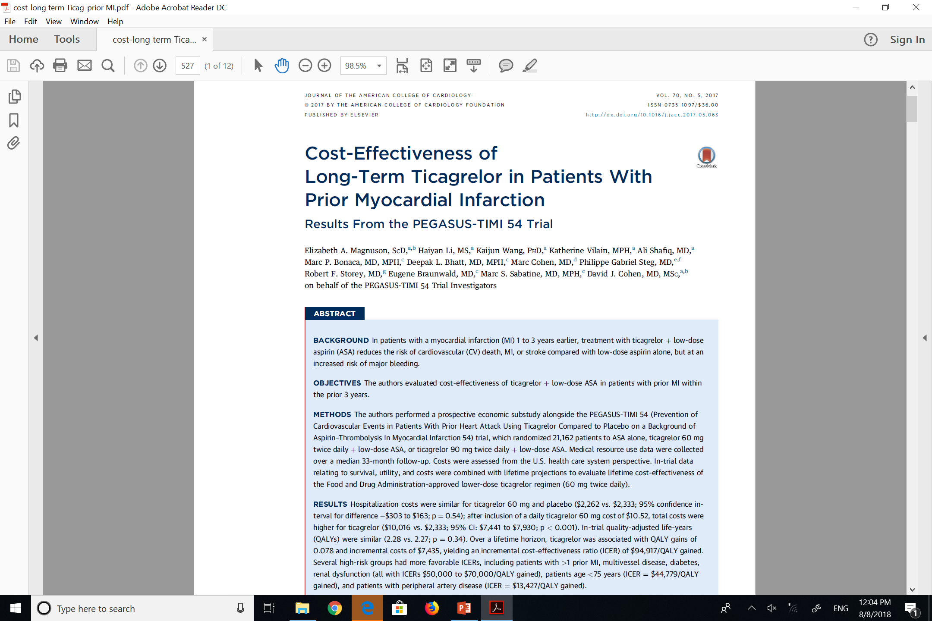

Slide 6
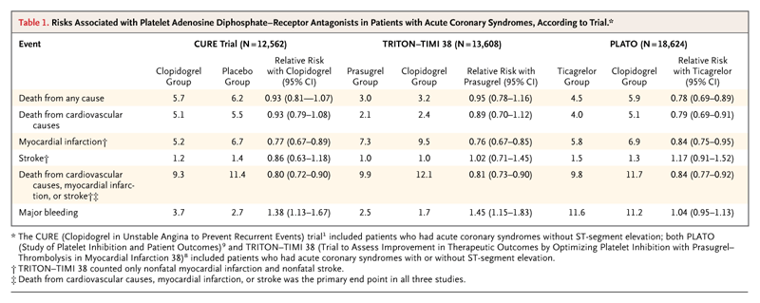
Risks Associated with ADP receptor
Antagonists in Patients with ACS by Trial
Schӧmig, A NEJM 2009; 361: 1108-1111

Slide 7
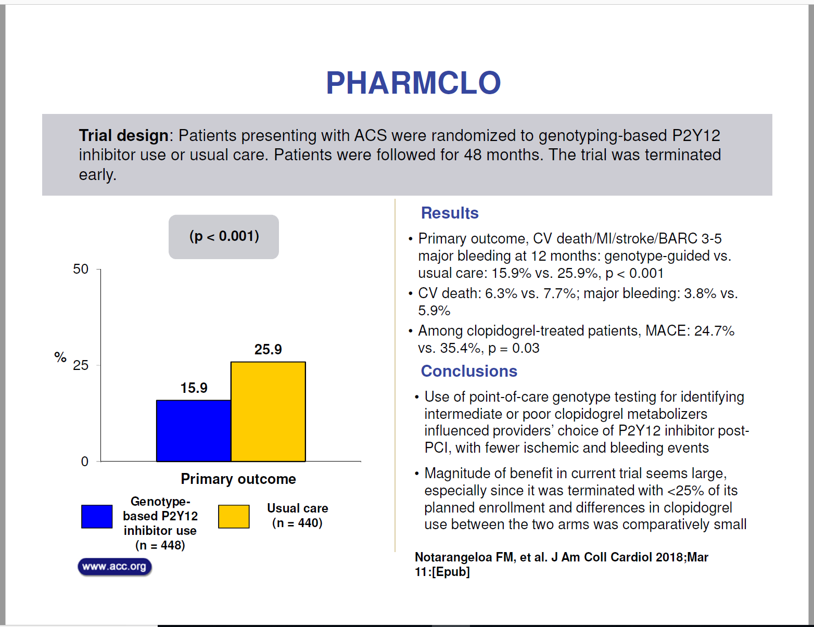

Slide 8
Pharmacogenomic Approach to Selecting Antiplatelet Therapy in Acute Coronary Syndromes: PHARMCLO trial
Background: Clopidogrel is still frequently used in patients with acute coronary syndromes (ACS), but its efficacy is hampered by interpatient response variability, due to genetic polymorphisms associated with clopidogrel metabolism.
Objective: To evaluate whether selecting antiplatelet therapy (clopidogrel, prasugrel or ticagrelor) on the basis of a patient’s genetic and clinical characteristics leads to better clinical outcomes in comparison with the standard of care, which bases the selection on clinical characteristics alone

Slide 9
Methods:
Patients hospitalized for ACS were randomly assigned to standard of care or pharmacogenomic arm, which included the genotyping of ABCB1, CYP2C19*2, CYP2C19*17 using an ST Q3 system that provide the data within 70 minutes at each patient’s bedside.
The patients were followed up for 12 ± 1 months for the primary composite endpoint of cardiovascular death and the first occurrence of non-fatal myocardial infarction, non-fatal stroke and BARC 3 to 5-defined major bleeding.

Slide 10
The primary endpoint was the composite of cardiovascular death and the first occurrence of non-fatal myocardial infarction, non-fatal stroke and 3 to 5-defined major bleeding within 12 months of randomization.
The secondary end-point was the composite of the primary endpoint plus the occurrence of definite or probable stent thrombosis.

Slide 11
Results:
After enrolling 888 patients, the study was prematurely stopped. Clopidogrel was used more frequently in the standard of care arm (50.7% vs 43.3%), ticagrelor in the pharmacogenomic arm (42.6% vs 32.7%; P=0.02), and prasugrel was equally used in both arms.
The primary endpoint occurred in 71 patients (15.9%) in the pharmacogenomic arm and in 114 (25.9%) in the standard of care arm (hazard ratio 0.58; 95% confidence interval [CI] 0.43 to0.78; P<0.001).

Slide 12
Conclusion:
A personalized approach to selecting antiplatelet therapy for ACS patients may reduce ischemic and bleeding events

Slide 13
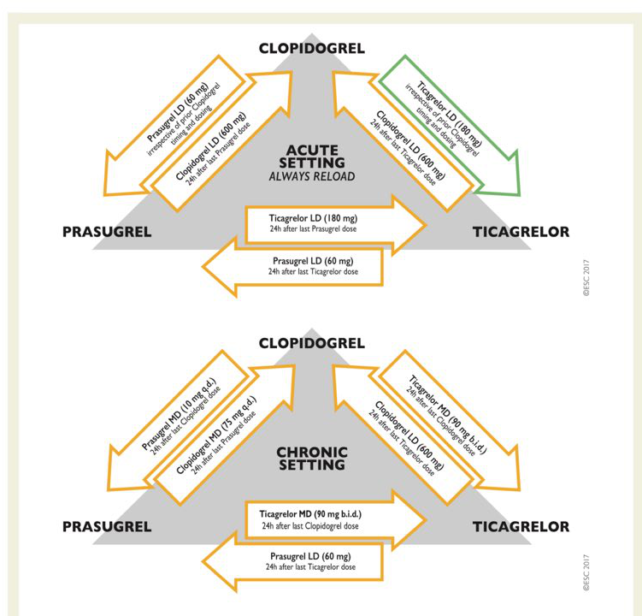

Slide 14
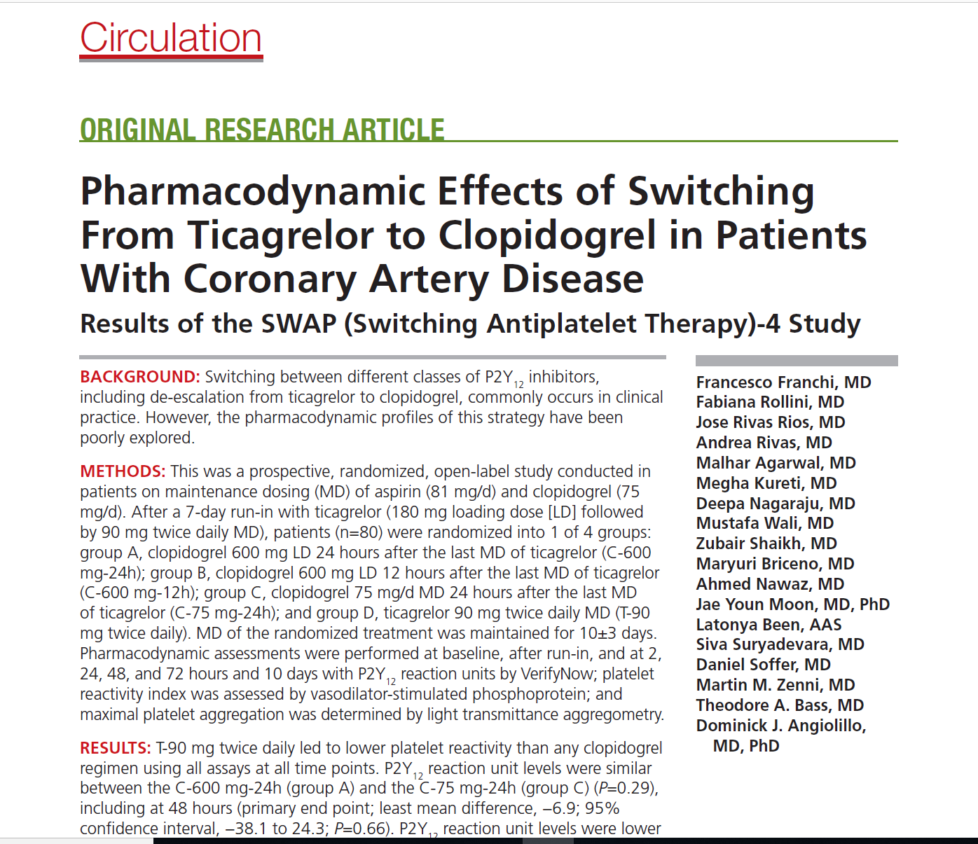

Slide 15
BACKGROUND
Switching between different classes of P2Y12 inhibitors, including
de-escalation from ticagrelor to clopidogrel, commonly occurs in clinical practice. However, the pharmacodynamic profiles of this strategy have been poorly explored.

Slide 16
METHODS
This was a prospective, randomized, open-label study conducted in patients on maintenance dosing (MD) of aspirin (81 mg/d) and clopidogrel (75 mg/d). After a 7-day run-in with ticagrelor (180 mg loading dose [LD] followed by 90 mg twice daily MD), patients (n=80) were randomized into 1 of 4 groups:
group A, clopidogrel 600 mg LD 24 hours after the last MD of ticagrelor (C-600 mg-24h);
group B, clopidogrel 600 mg LD 12 hours after the last MD of ticagrelor (C-600 mg-12h);
group C, clopidogrel 75 mg/d MD 24 hours after the last MD of ticagrelor (C-75 mg-24h); and
group D, ticagrelor 90 mg twice daily MD (T-90 mg twice daily). MD of the randomized treatment was maintained for 10±3 days.
Pharmacodynamic assessments were performed at baseline, after run-in, and at 2, 24, 48, and 72 hours and 10 days with P2Y12 reaction units by Verify Now; platelet reactivity index was assessed by vasodilator-stimulated phosphoprotein; and maximal platelet aggregation was determined by light transmittance aggregometry.

Slide 17
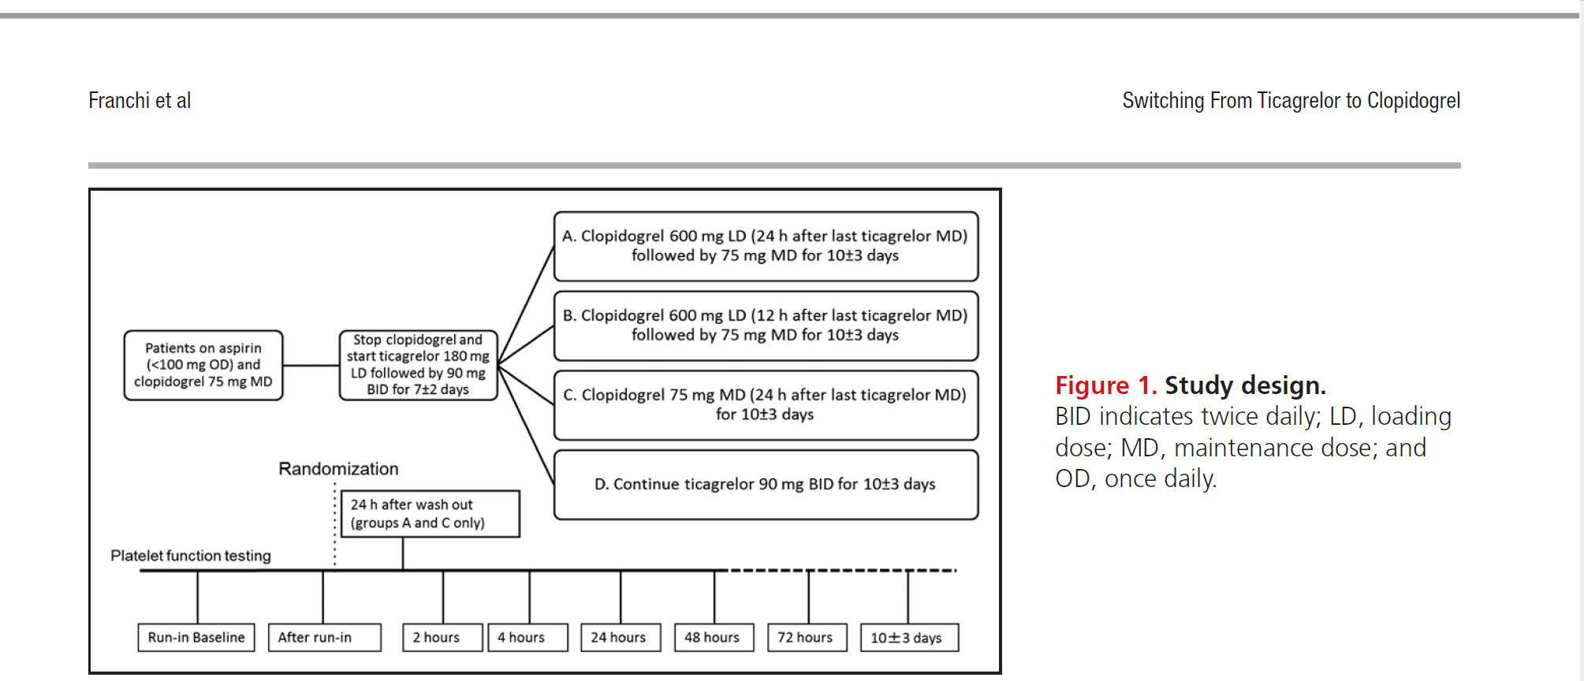

Slide 18
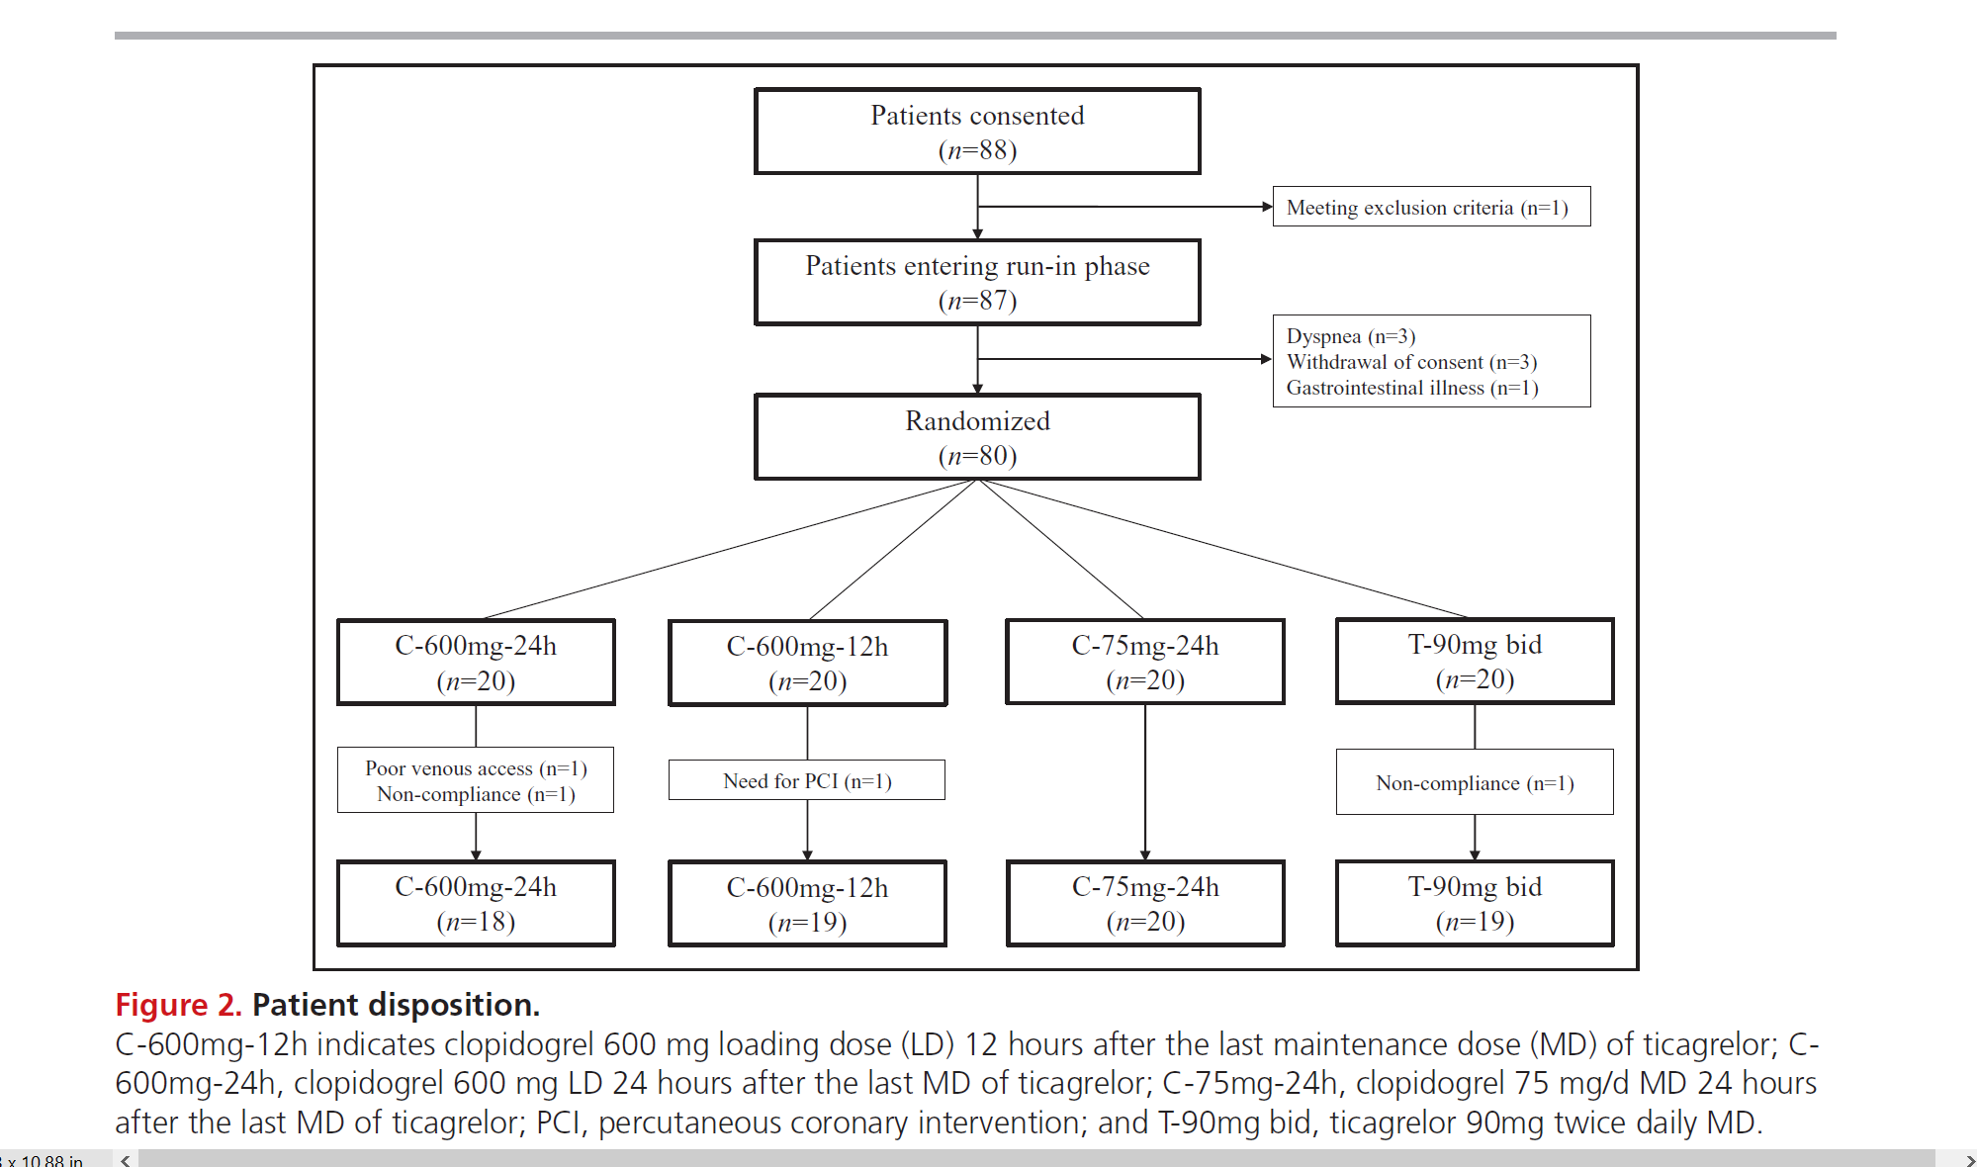

Slide 19
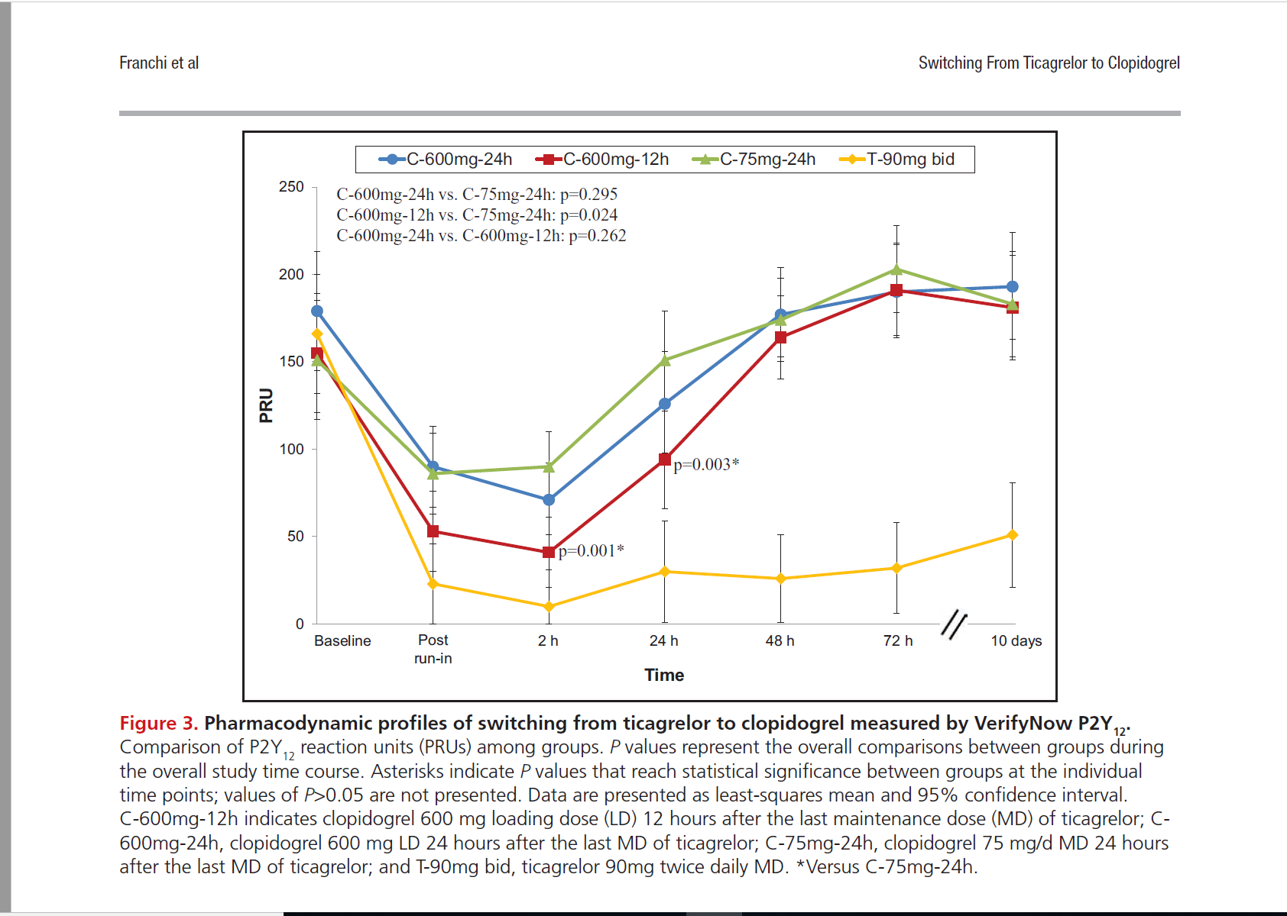

Slide 20
RESULTS
T-90 mg twice daily led to lower platelet reactivity than any clopidogrel regimen using all assays at all time points. P2Y12 reaction unit levels were similar between the C-600 mg-24h (group A) and the C-75 mg-24h (group C) (P=0.29), including at 48 hours (primary end point; least mean difference, −6.9; 95% confidence interval, −38.1 to 24.3; P=0.66). P2Y12 reaction unit levels were lower with C-600 mg-12h (group B) than with C-75 mg-24h (group C; P=0.024).
Maximal platelet aggregation over time was lower with both C-600 mg-24h (group A; P=0.041) and C-600 mg-12h (group B; P=0.028) compared with C-75 mg-24h (group C).

Slide 21
Platelet reactivity index profiles paralleled those observed with P2Y12 reaction units. There were no pharmacodynamic differences for all tests between C-600 mg-24h (group A) and C-600 mg-12h (group B).
In group C (C-75 mg-24h), platelet reactivity increased compared with baseline as early as 24 hours, reaching statistical significance at 48 and 72 hours and up to 10 days.
These pharmacodynamic findings were delayed and blunted in magnitude with the administration of an LD, regardless of the timing of administration.

Slide 22
CONCLUSIONS
De-escalation from ticagrelor to clopidogrel therapy is associated
with an increase in platelet reactivity. The use of an LD before the initiation of
an MD regimen of clopidogrel mitigates these observations, although this is not affected by the timing of its administration after ticagrelor discontinuation.

Slide 23
Details on the modality of switching(timing and dosing) from ticagrelor to clopidogrel in these clinical investigations are not fully reported. Indeed, more studies are warranted to better assess the safety and efficacy of a de-escalation strategy, including the impact of timing and the role of guidance by platelet function or genetic testing.

Slide 24
Triton-TIMI 38
13,608 patients with moderate to high-risk acute coronary syndromes with scheduled PCI
Randomized to prasugrel (60 mg loading dose and a 10 mg daily maintenance dose) or clopidogrel (300 mg loading dose and a 75 mg daily maintenance dose) for 6-15 months.
Triton –TIMI Investigators. NEJM; 357: 2001 2015

Slide 25
TRITON-TIMI 38: EFFICACY and SAFETY
15
138
events
Clopidogrel
12.1
HR 0.81
(0.73-0.90)
p=0.0004
CV Death/MI/Stroke
CV Death / MI / Stroke
10
9.9
NNT = 46
Endpoint (%)
Prasugrel
5
35
events
TIMI Major Non-CABG Bleeds
Prasugrel
2.4
HR 1.32
(1.03-1.68)
p=0.03
1.8
Clopidogrel
0
NNT = 167
0
30
60
90
180
270
360
450
Days
Notes:
25

Slide 26
Ticagrelor compared with clopidogrel in patients with acute coronary syndromes – the PLATO trial

Slide 27
August 30, 2009 at 08.00 CET

Slide 28
PLATO background
In NSTE-ACS and STEMI, current guidelines recommend 12 months aspirin and clopidogrel
Efficacy of clopidogrel is hampered by
  slow and variable transformation to the active metabolite
  modest and variable platelet inhibition
  increased risk of bleeding
  risk of stent thrombosis and MI in poor responders
PLATO = PLATelet inhibition and patient Outcomes; NSTEMI = non-ST segment elevation;
STEMI = ST segment elevation; ACS = acute coronary syndromes; MI = myocardial infarction

Slide 29
Ticagrelor (AZD 6140): an oral reversible P2Y₁₂ antagonist
H
O
N
N
N
H
O
H
Ticagrelor is a cyclo-pentyl-triazolo-pyrimidine (CPTP)
N
F
O
N
N
S
F
O
H
Direct acting
  Not a prodrug; does not require metabolic activation
  Rapid onset of inhibitory effect on the P2Y₁₂ receptor
  Greater inhibition of platelet aggregation than clopidogrel
Reversibly bound
  Degree of inhibition reflects plasma concentration
  Faster offset of effect than clopidogrel
  Functional recovery of all circulating platelets

Slide 30
PLATO
Ticagrelor vs Clopidogrel in Patients with Acute Coronary Syndromes
18,624 patients with acute coronary syndromes
Randomization:
  Ticagrelor 180 mg loading dose, 90mg BID
  Clopidogrel 300-600 mg loading dose, 75 mg QD
All patients received ASA 75-325 mg
Wallentin, L et al NEJM 2009; 361: 1045-1057

Slide 31
PLATO study design
NSTE-ACS (moderate-to-high risk) STEMI (if primary PCI)
Clopidogrel-treated or -naive;
randomised within 24 hours of index event
(N=18,624)
Clopidogrel
If pre-treated, no additional loading dose;
if naive, standard 300 mg loading dose,
then 75 mg qd maintenance;
(additional 300 mg allowed pre PCI)
Ticagrelor
180 mg loading dose, then
90 mg bid maintenance;
(additional 90 mg pre-PCI)
6–12-month exposure
Primary endpoint: CV death + MI + Stroke
Primary safety endpint: Total major bleeding
PCI = percutaneous coronary intervention; ASA = acetylsalicylic acid;
CV = cardiovascular; TIA = transient ischaemic attack

Slide 32
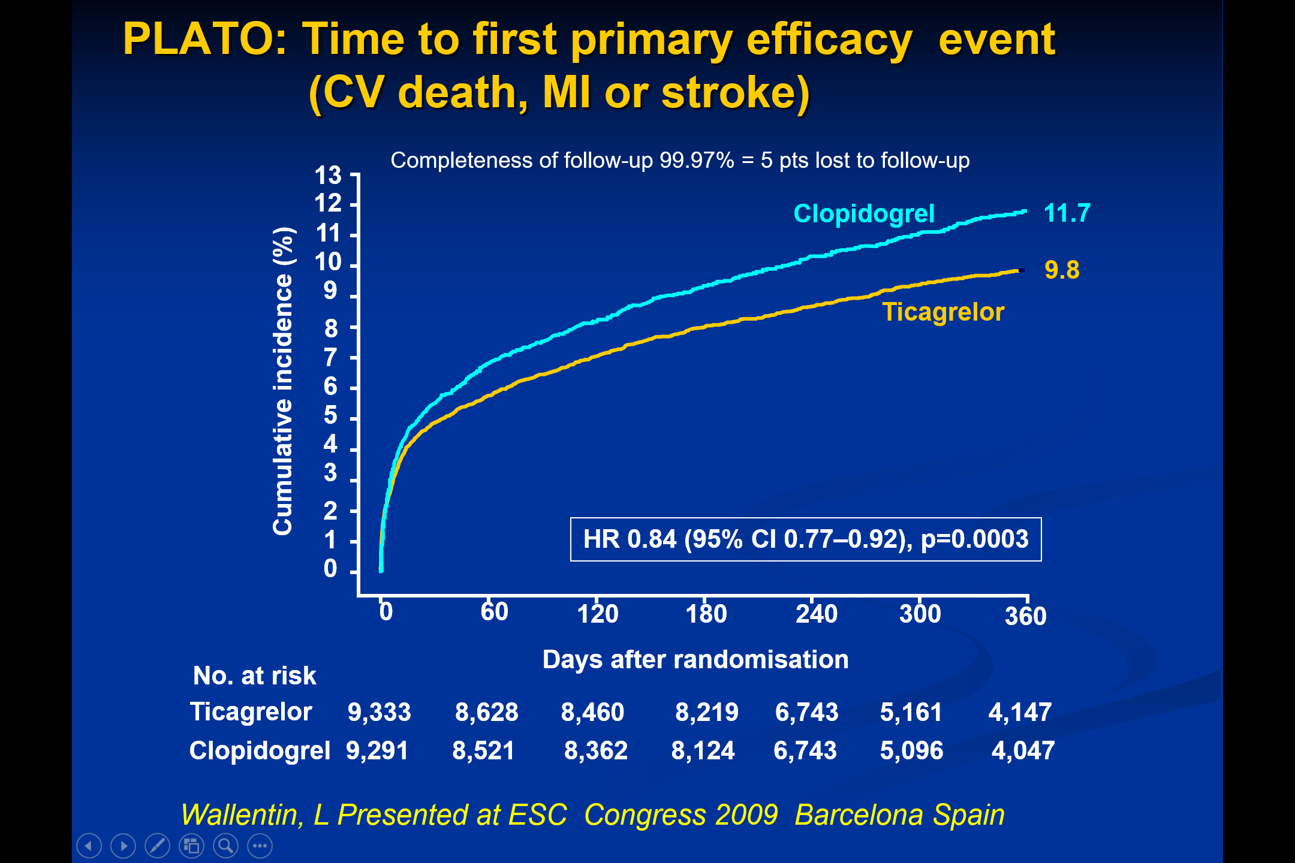

Slide 33
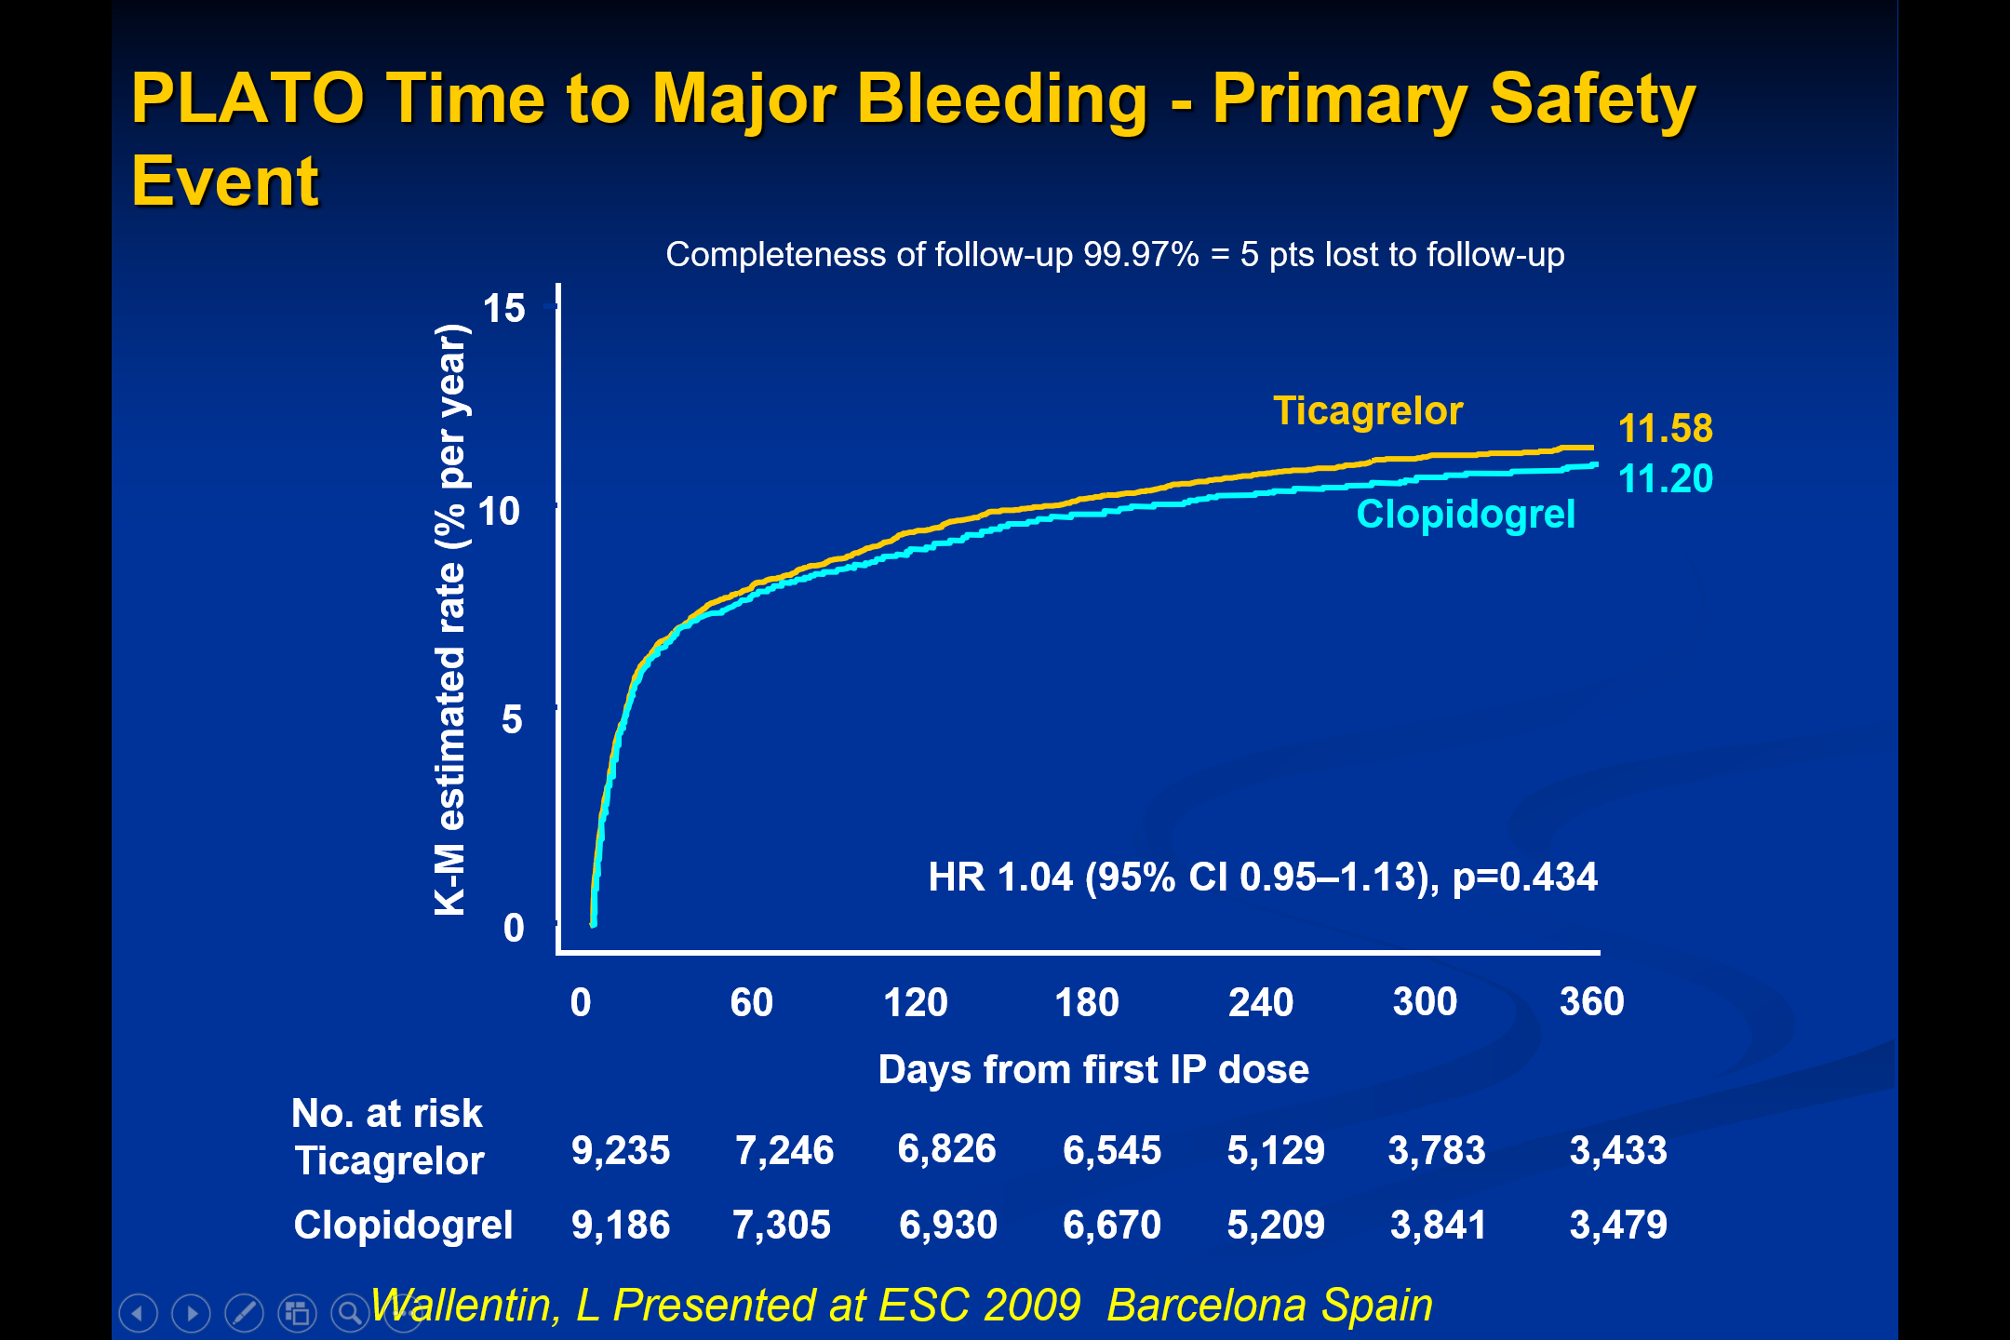

Slide 34
Therapeutic considerations
Based on 1,000 patients admitted to hospital for ACS, using ticagrelor instead of clopidogrel for 12 months resulted in
  14 fewer deaths
  11 fewer myocardial infarctions
  6–8 fewer cases with stent thrombosis
  No increase in bleedings requiring transfusion
  9 patients may switch to thienopyridine treatment because of reversible symptoms of dyspnoea
Treating 54 patients with ticagrelor instead of with clopidogrel for one year will prevent one event of CV death, MI or stroke

Slide 35
Conclusions
Reversible, more intense P2Y₁₂ receptor inhibition for one year with ticagrelor in comparison with clopidogrel in a broad population with ST- and non-ST-elevation ACS provides
  Reduction in myocardial infarction and stent thrombosis
  Reduction in cardiovascular and total mortality
  No change in the overall risk of major bleeding
Ticagrelor is a more effective alternative than clopidogrel
for the continuous prevention of ischaemic events, stent thrombosis and death in the acute and long-term treatment
of patients with ACS

Slide 36
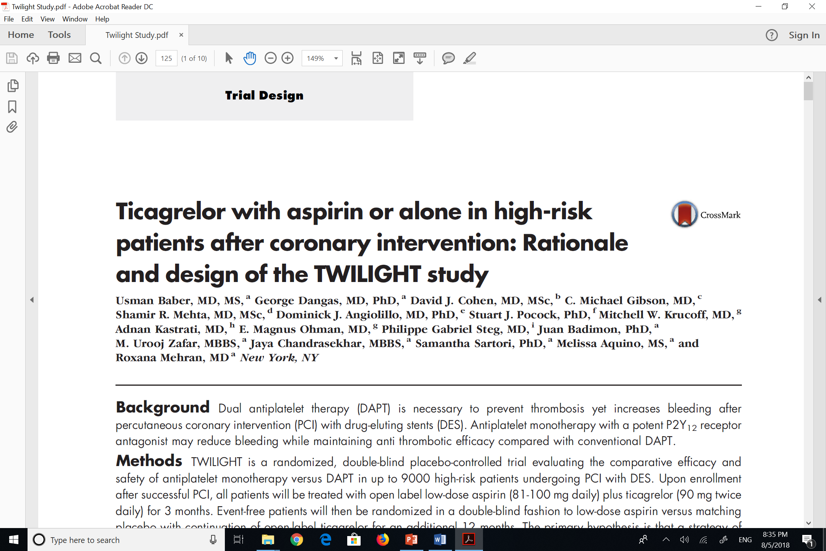

Slide 37
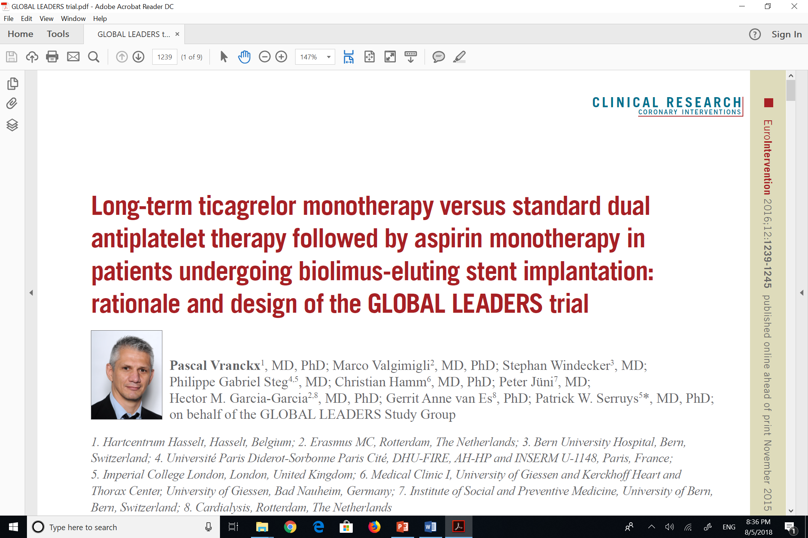

Slide 38
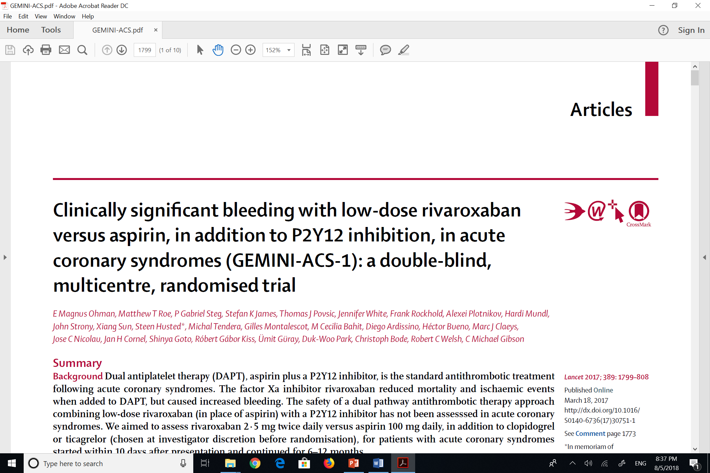

Slide 39
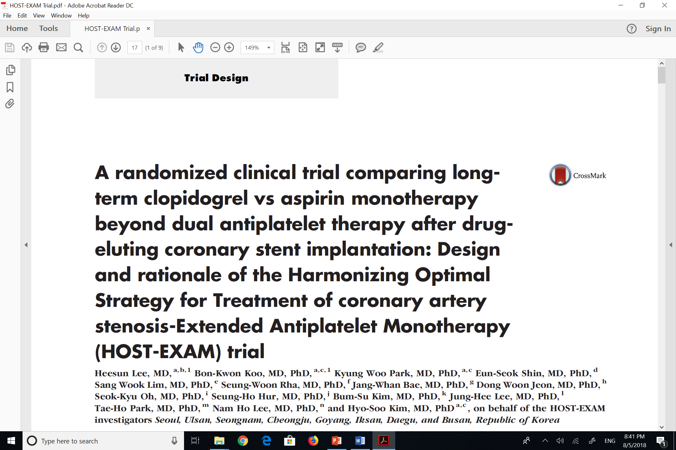

Slide 40
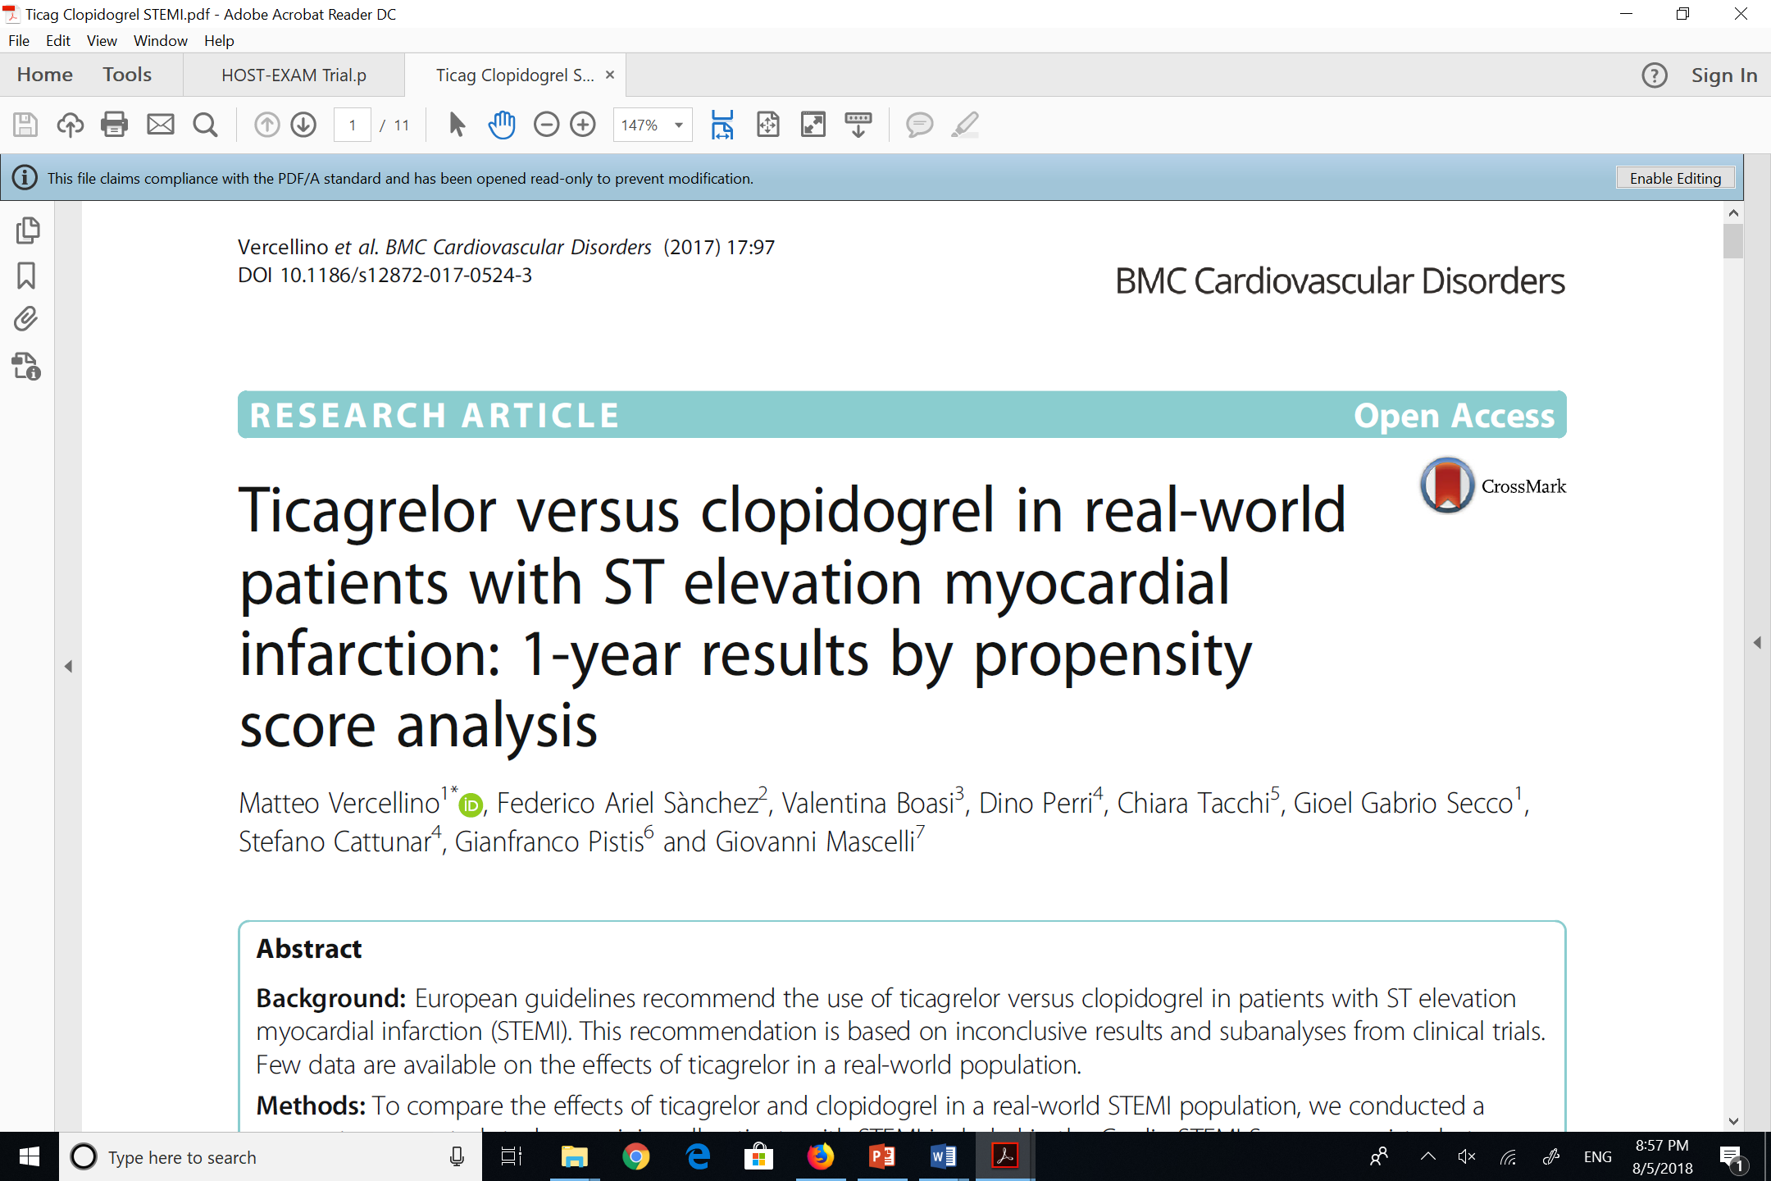

Slide 41
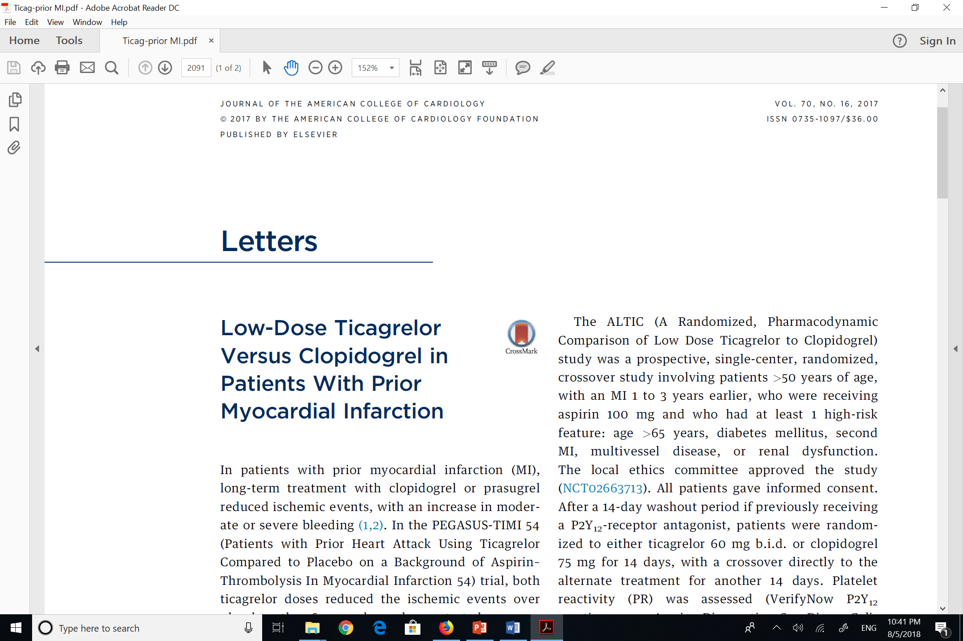

Slide 42
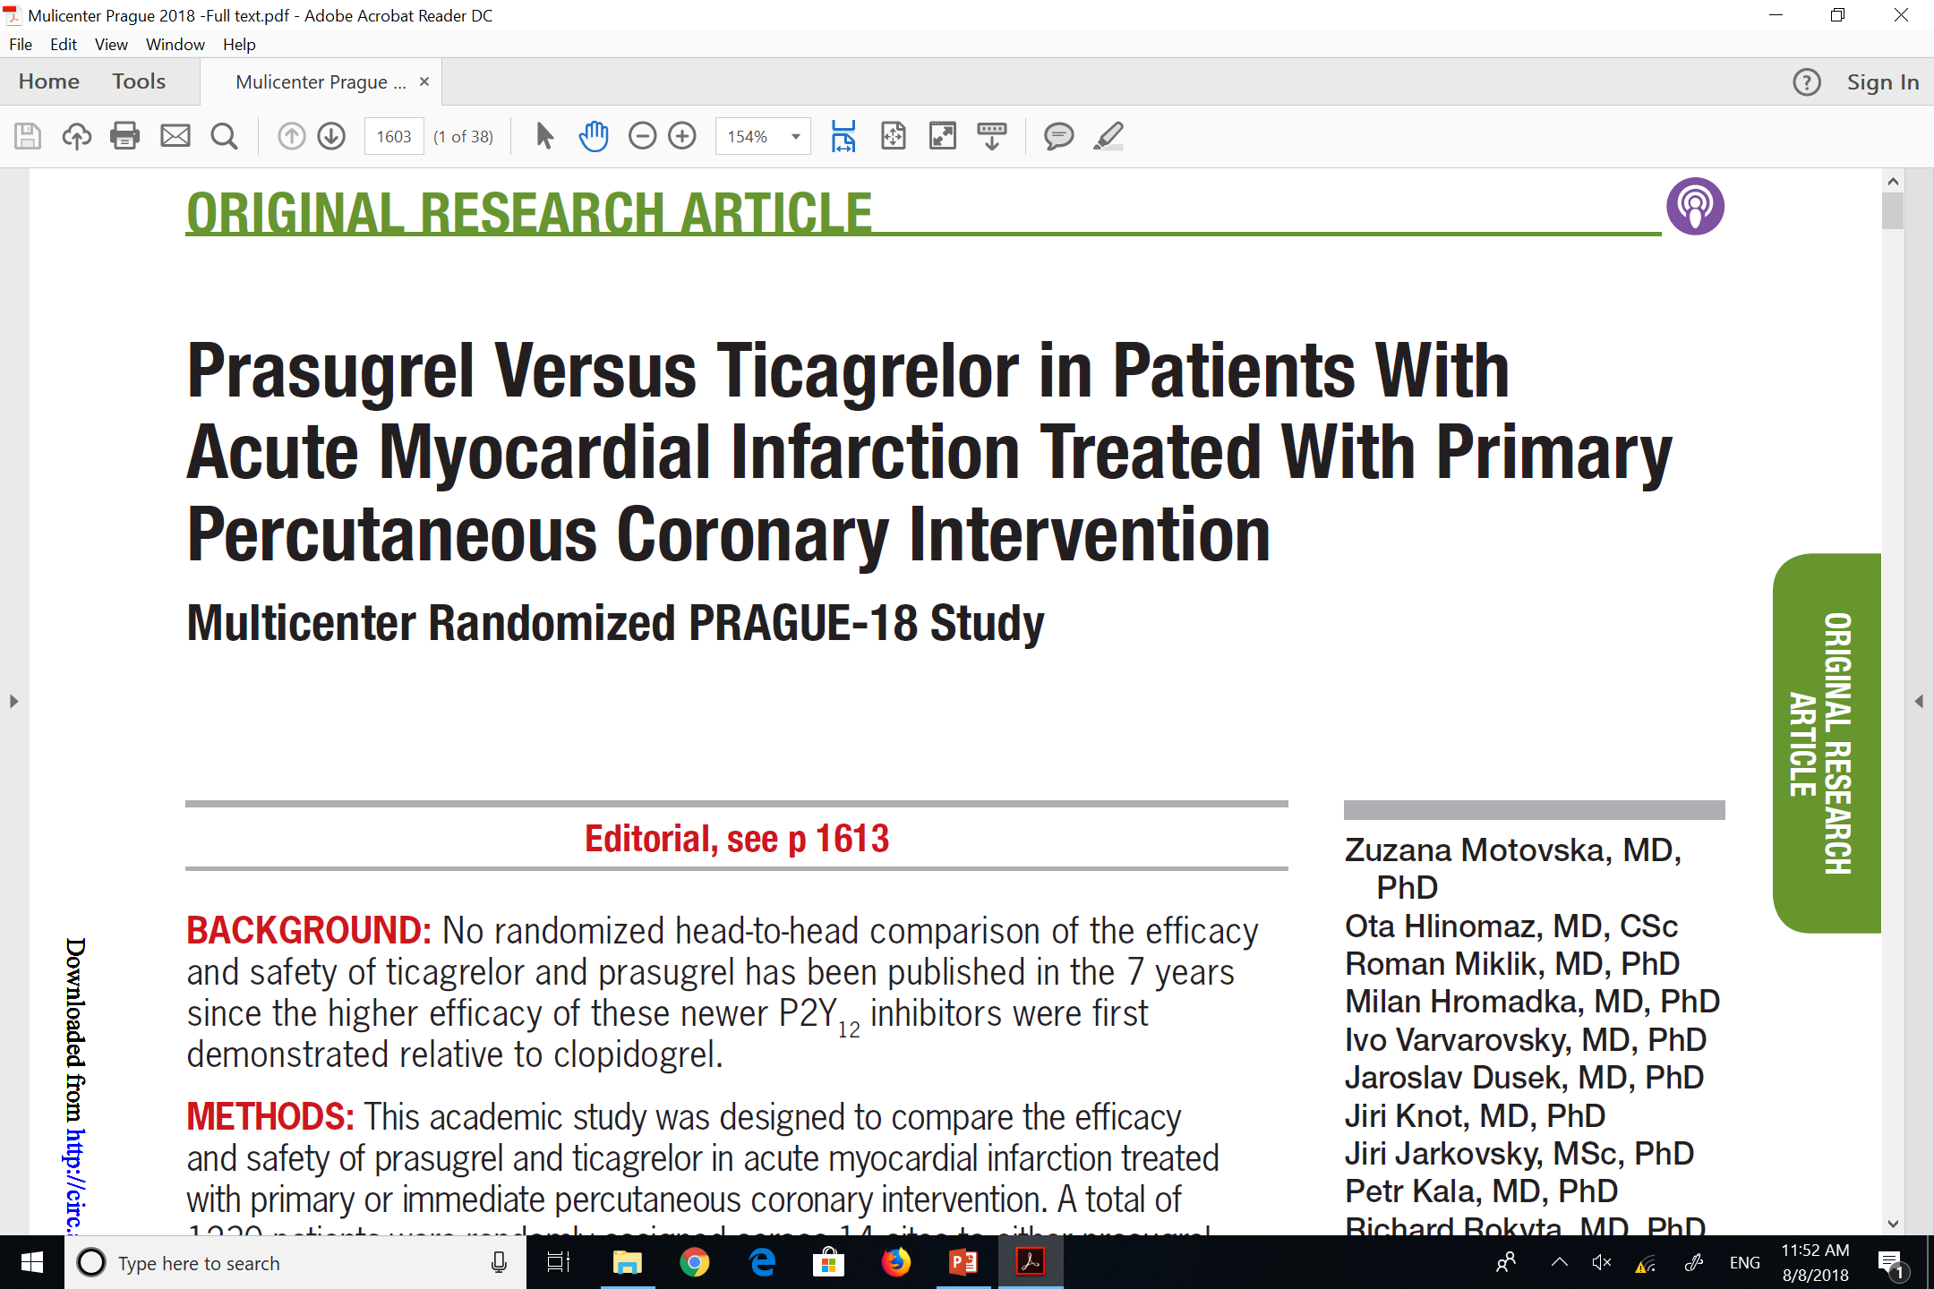

Slide 43
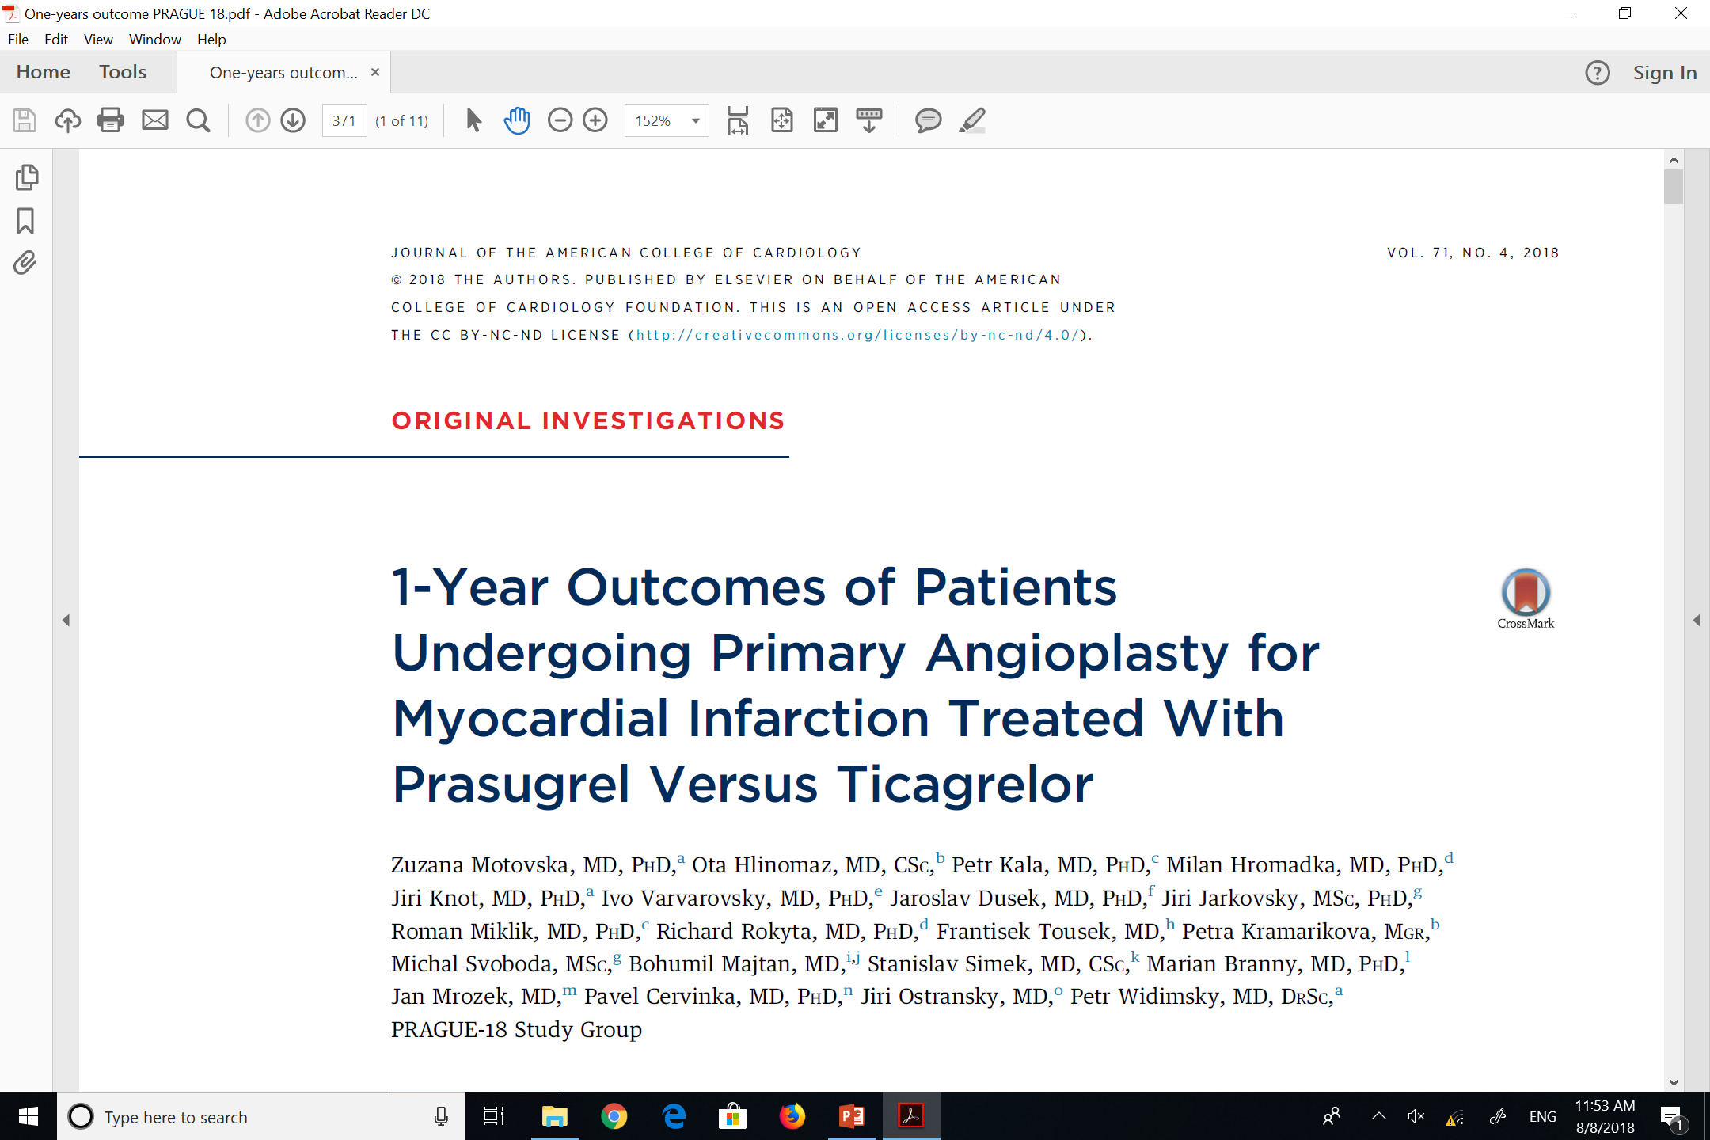

Slide 44
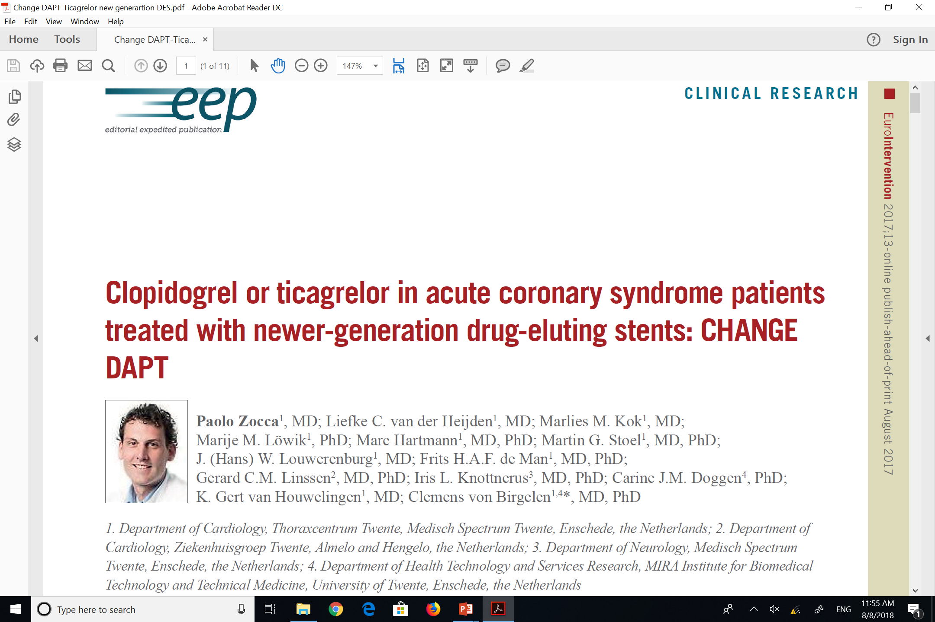

Slide 45



