Slide 1
Highlights from Recent Guidelines on DAPT
S.H. Sezavar

Slide 2
Why DAPT is so Important?
Increasing the Number of the patients
In 2015, 2,200,000 patients may have indication for DAPT in Europe
DAPT is among the most intensively investigated treatments in cardiovascular medicine

Slide 3
Why DAPT is so Important?
New P2Y12 inhibitors in the market
Concerns for longer/shorter DAPT duration
New generation stents
Long term risk of non-stent related MI / Stroke

Slide 4
Case #1
55 y/o Gentleman referred to ER with Retrosternal Chest Pain. ECG showed 2mm ST depression in Inferior Leads. Lab date showed Troponin rising. He was on ASA 80mg daily & Clopidogrel 75mg daily in recent year due to PCI in SIHD setting.
Which DAPT regimen do you recommend for him before Coronary Angiography?

Slide 5
Case #2
ASA + Clopidogrel
ASA + Clopidogrel + Clopidogrel 300mg LD
ASA + Ticagrelor 180mg LD + Ticagrelor 90mg BD
ASA + Ticagrelor 90mg BD

Slide 6
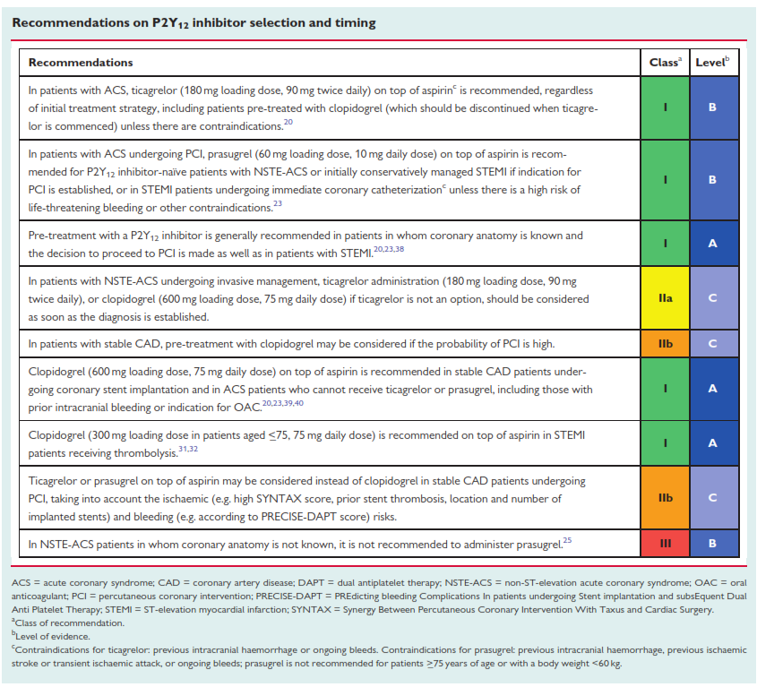

Slide 7
Case #2
63 y/o Gentleman, Diabetic, Smoker, admitted with Recurrent Chest Pain in hospital. ECG shows T inversion in Anterior Leads. Troponin was Normal. Due to clinical presentation & Anterior RWMA, he is scheduled for Coronary Angiography in following 48h.
Which DAPT regimen is not recommended?

Slide 8
Case #2
ASA + Ticlopidin
ASA + Prasugrel
ASA + Clopidogrel
ASA + Ticagrelor

Slide 10
Case #3
47 y/o Lady presented with Crushing Chest Pain & ST elevation in Inferior Leads & is scheduled for Primary PCI.
Which DAPT regimen do you recommend when transferring to CathLab?

Slide 11
Case #3
ASA + Prasugrel
ASA + Clopidogrel
ASA + Ticagrelor
all of the above

Slide 13
Case #4
63 y/o Lady presented with Chest Pain & ST elevation in Anterior & Lateral Leads. She is candidate for Thrombolytic Therapy.
Which DAPT regimen do you recommend for her?

Slide 14
Case #3
ASA + Prasugrel
ASA + Clopidogrel
ASA + Ticagrelor
all of the above

Slide 16
Case #5
A 65 y/o Lady with a history of ACS undergone PCI 3 weeks ago, being treated with ASA + Ticagrelor + Statin, presented with Dyspnea for the last 2 weeks. She had no Lung disease, and has EF:50% in Echocardiography.
What Change do you recommend?

Slide 17
1. D/C Ticagrelor >> Clopidogrel 75mg MD
2. D/C Ticagrelor >> Prasugrel 10mg MD
3. D/C Ticagrelor >> Clopidogrel 600mg LD + 75mg MD

Slide 18
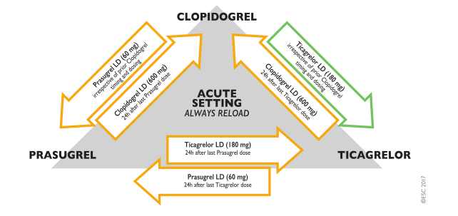

Slide 19
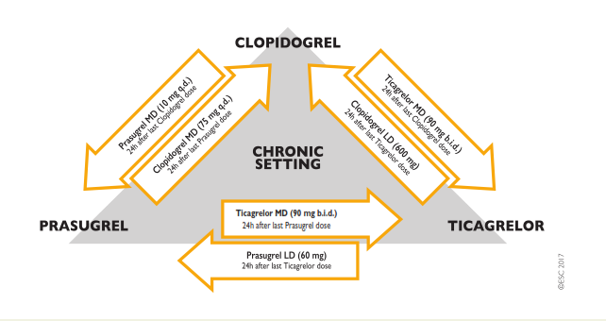

Slide 20
Case #6
66 y/o Man with history of Exertional Chest Pain FC III in recent 3 months is spite of full medical treatment referred for coronary angiography. Angiography was done and CABG was recommended due to Left Main & 3VD.
Which antiplatelet regimen do you recommend?

Slide 21
ASA 80mg Daily
ASA 80mg Daily + Clopidogrel 75mg Daily for 3 months
ASA 80mg Daily + Clopidogrel 75mg Daily for 6 months
ASA 80mg Daily + Clopidogrel 75mg Daily for 12 months

Slide 22
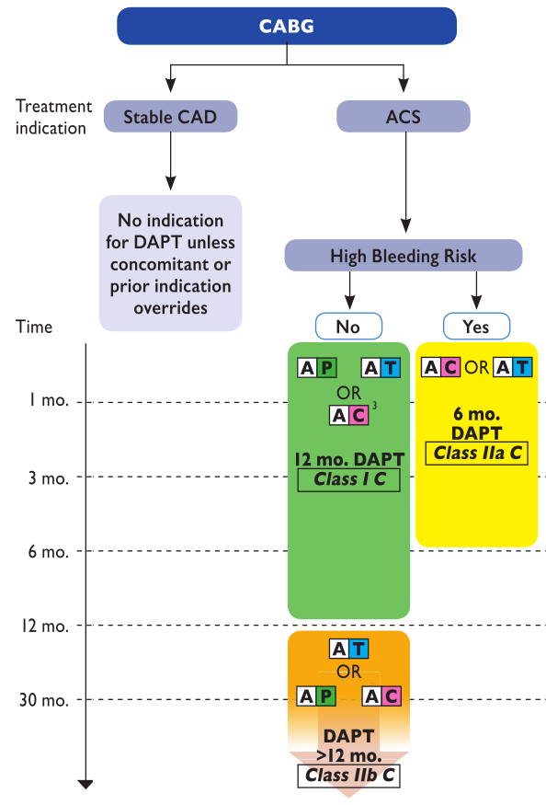

Slide 23
Case #7
53 y/o Lady with history of SIHD undergoes PCI by BMS on Proximal of LAD.
Which DAPT regimen do you recommend?

Slide 24
ASA 80mg Daily + Clopidogrel 75mg Daily for 1 month
ASA 80mg Daily + Clopidogrel 75mg Daily for 3 months
ASA 80mg Daily + Clopidogrel 75mg Daily for 6 months
ASA 80mg Daily + Clopidogrel 75mg Daily for 12 months

Slide 25
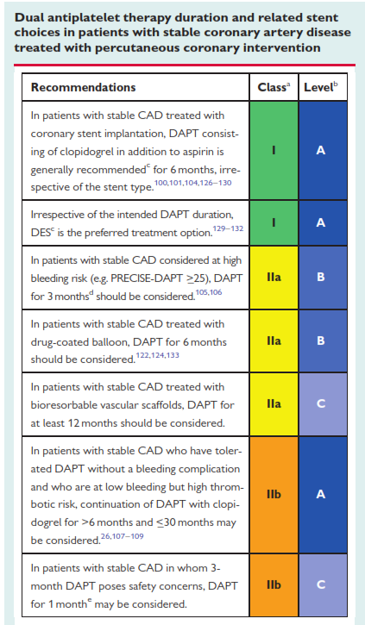
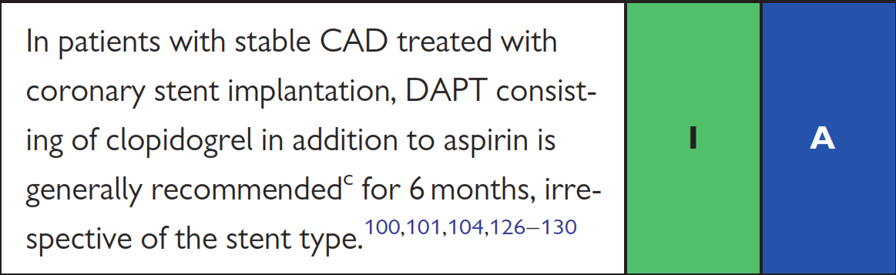

Slide 26
Case #8
68 y/o Man with SIHD undergone PCI by Bioabsorbable Stent.
How long DAPT duration do you consider for him

Slide 27
Case #8
1 month
3 month
6 month
12 month

Slide 28
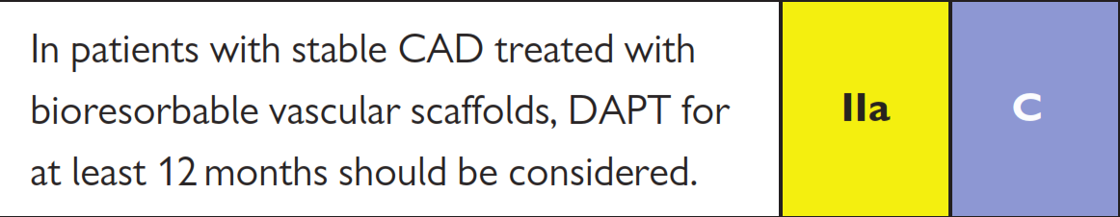

Slide 29
Case #9
80 y/o Man with ACS undergone PCI on LAD & LCX. Hb level is about 9 mg/dL. GFR = 25 ml/min. He has a history of GI bleeding 3 years ago.
Which duration of DAPT do you recommend?

Slide 30
1 month
3 months
6 months
12 months

Slide 31
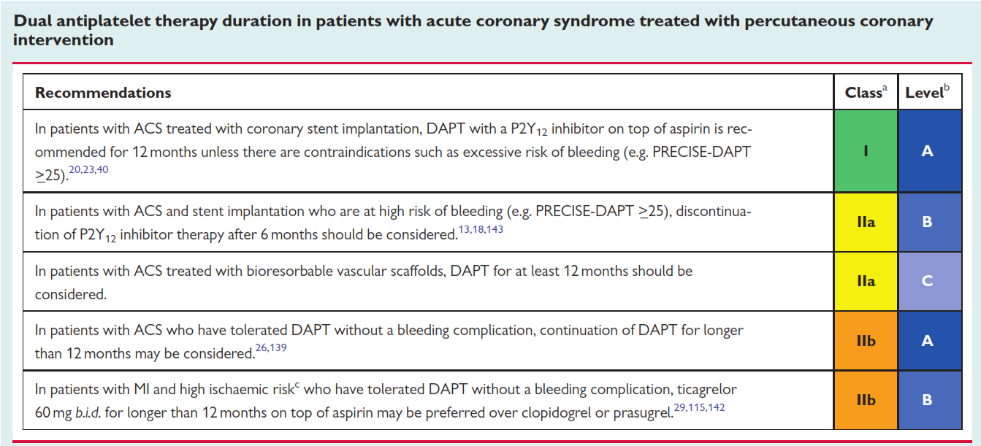

Slide 32
Case #10
65 y/o Man presented with ACS. He has a history of PCI 3 years ago which lead to Stevens Johnson Syndrome because of over-sensitivity reaction to Contrast Media so patient refused Coronary Angiography and medical treatment was recommended for him.
Which DAPT regimen is not recommended?

Slide 33
ASA + Clopidogrel
ASA + Prasugrel
ASA + Ticagrelor
ASA + Ticlopidin

Slide 34
