Slide 1
Potent Antiplatelet Therapy In Acute Coronary Syndrome , Focus on Ticagrelor
Maryam Mehrpooya MD,
Associate professor of cardiology
Fellowship of Interventional Cardiology
TUMS- Imam Khomeini Hospital

Slide 2
Case 1 , question 1
Which antiplatelet in STEMI ?

Slide 3
The 68-years-old man
History of PCI on LAD (by DES ) since 5 month ago
Presented with Severe exacerbating Chest pain , cold sweating
Stopped Clopidogrel since 3 days ago
History of ischemic stroke 2 years ago
No history of GI bleeding
BP= 90/60 mmHg

Slide 4
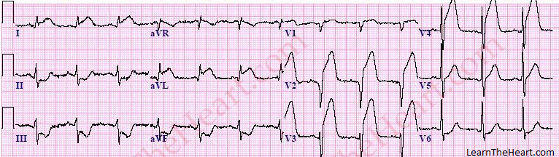

Slide 5
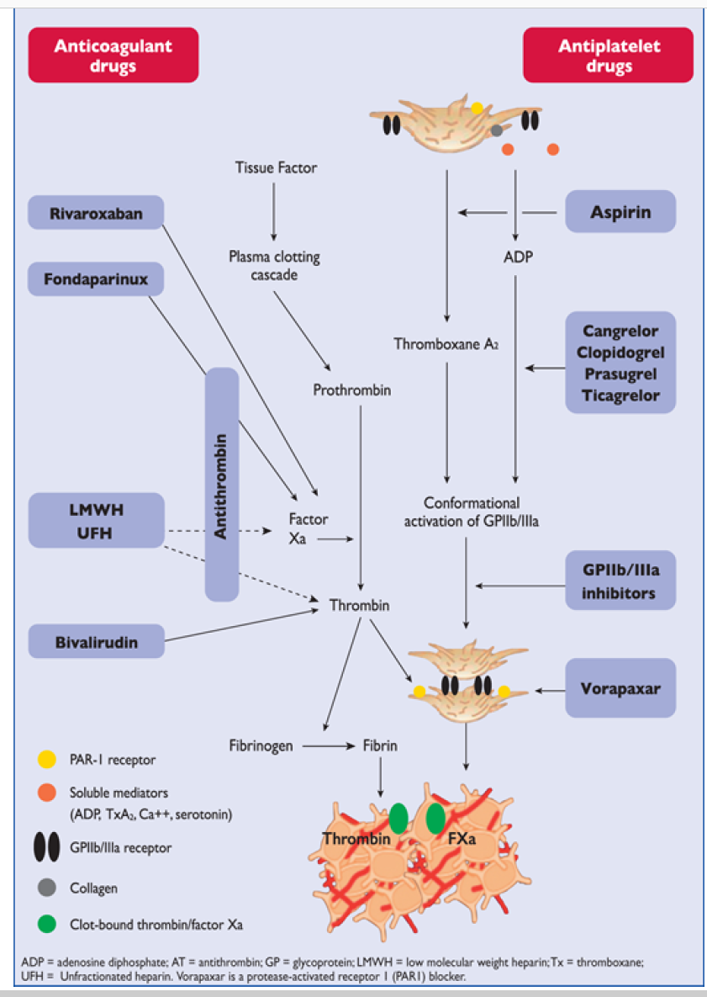

Slide 6
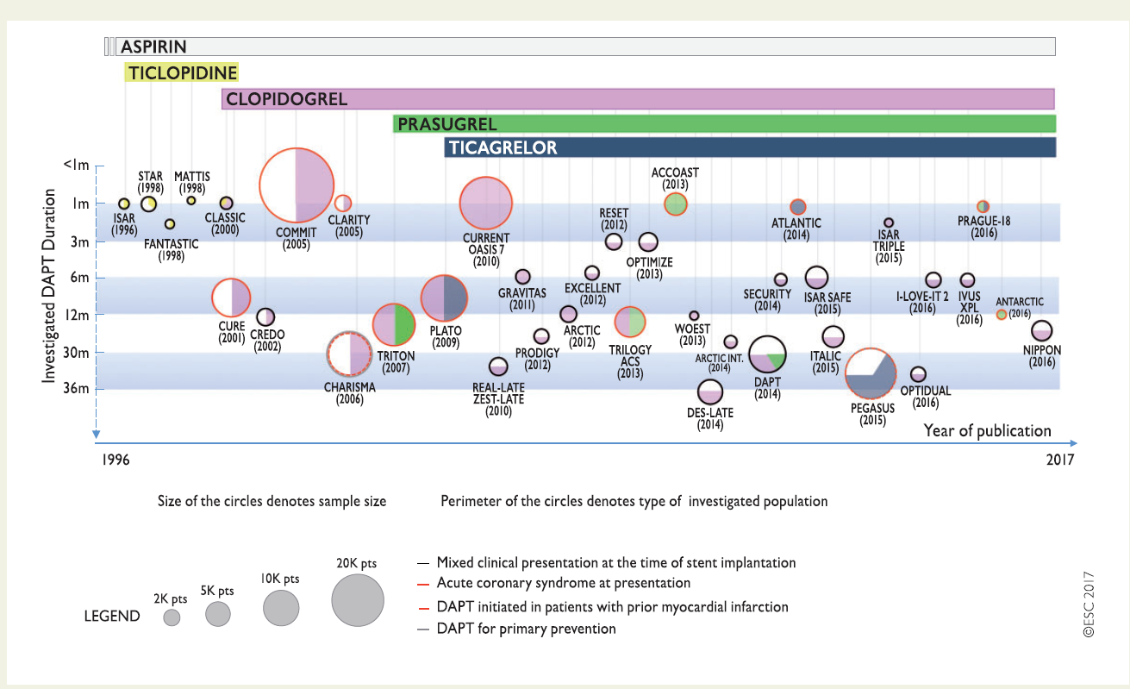

Slide 7
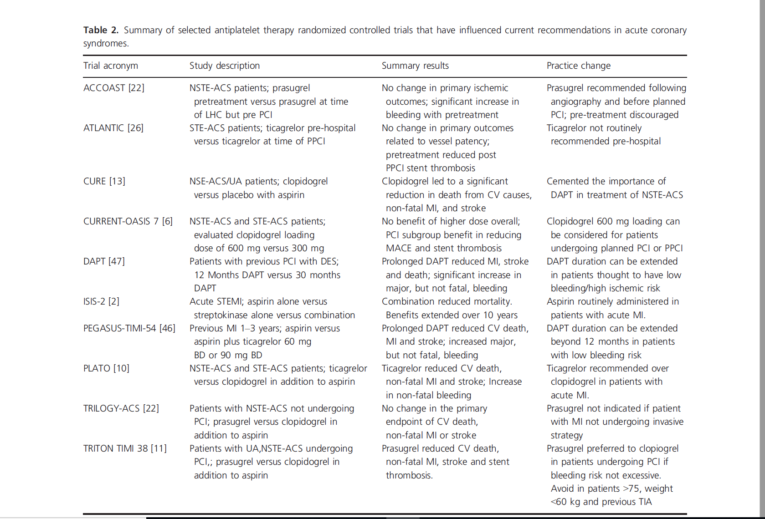

Slide 8
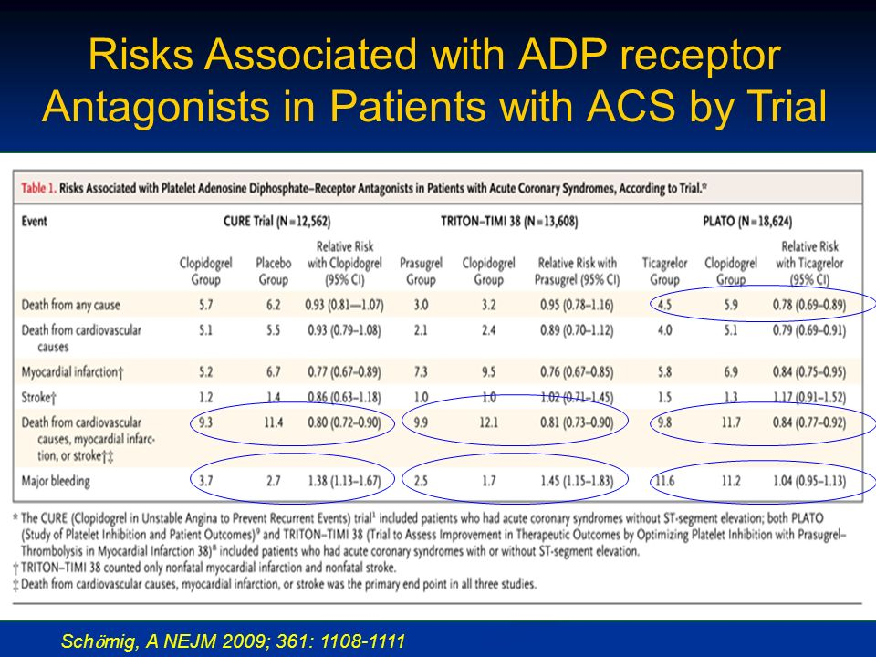
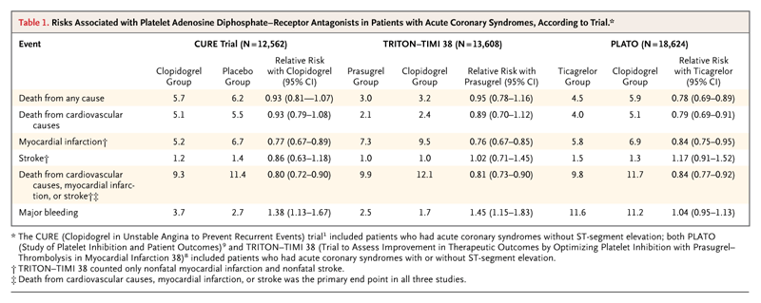
Risks Associated with ADP receptor
Antagonists in Patients with ACS by Trial
Schӧmig, A NEJM 2009; 361: 1108-1111

Slide 9
The dual pathway mediates both antiplatelet effects and an enhanced adenosine response
Inhibition of P2Y₁₂ receptor^{1,2}
  Anti-platelet effect
Inhibition of ENT-1 transporter^{3,4,5}
  Enhanced local adenosine response may result in:*
    Additional inhibition of platelet aggregation/activation^{†3}
    Cardioprotection⁶
    Vasodilation^{5,7,8}
    Modulation of inflammation
    Dyspnoea⁷
Red blood cell
ENT-1
Adenosine
ADP
Ticagrelor
AC
A_{2A}
P2Y₁₂
Gs
cAMP
Gi
Platelet
Platelet activation/aggregation
*See back-up slides for further information; †See figure. Figure adapted from Nylander S, et al. (2013).
AC, adenylyl cyclase; ADP, adenosine diphosphate; cAMP, cyclic adenosine monophosphate; ENT, equilibrative nucleoside transporter.
References in slide notes.
Notes:
References
van Giezen JJJ, et al. J Thromb Haemost 2009;7:1556–1565.
Wallentin L. Eur Heart J 2009;30:1964–1977.
Nylander S, et al. J Thromb Haemost 2013;11:1867–1876.
Armstrong D, et al. J Cardiovasc Pharmacol Ther; In press.
van Giezen JJJ, et al. J Cardiovasc Pharmacol Ther 2012;17:164–172.
Wang K, et al. Thromb Haemost. 2010;104:609-17.
Wittfeldt A, et al. J Am Coll Cardiol 2013;61:723–727.
Alexopoulos D, et al. Circ Cardiovasc Interv 2013;19:5121–5126.

Slide 10
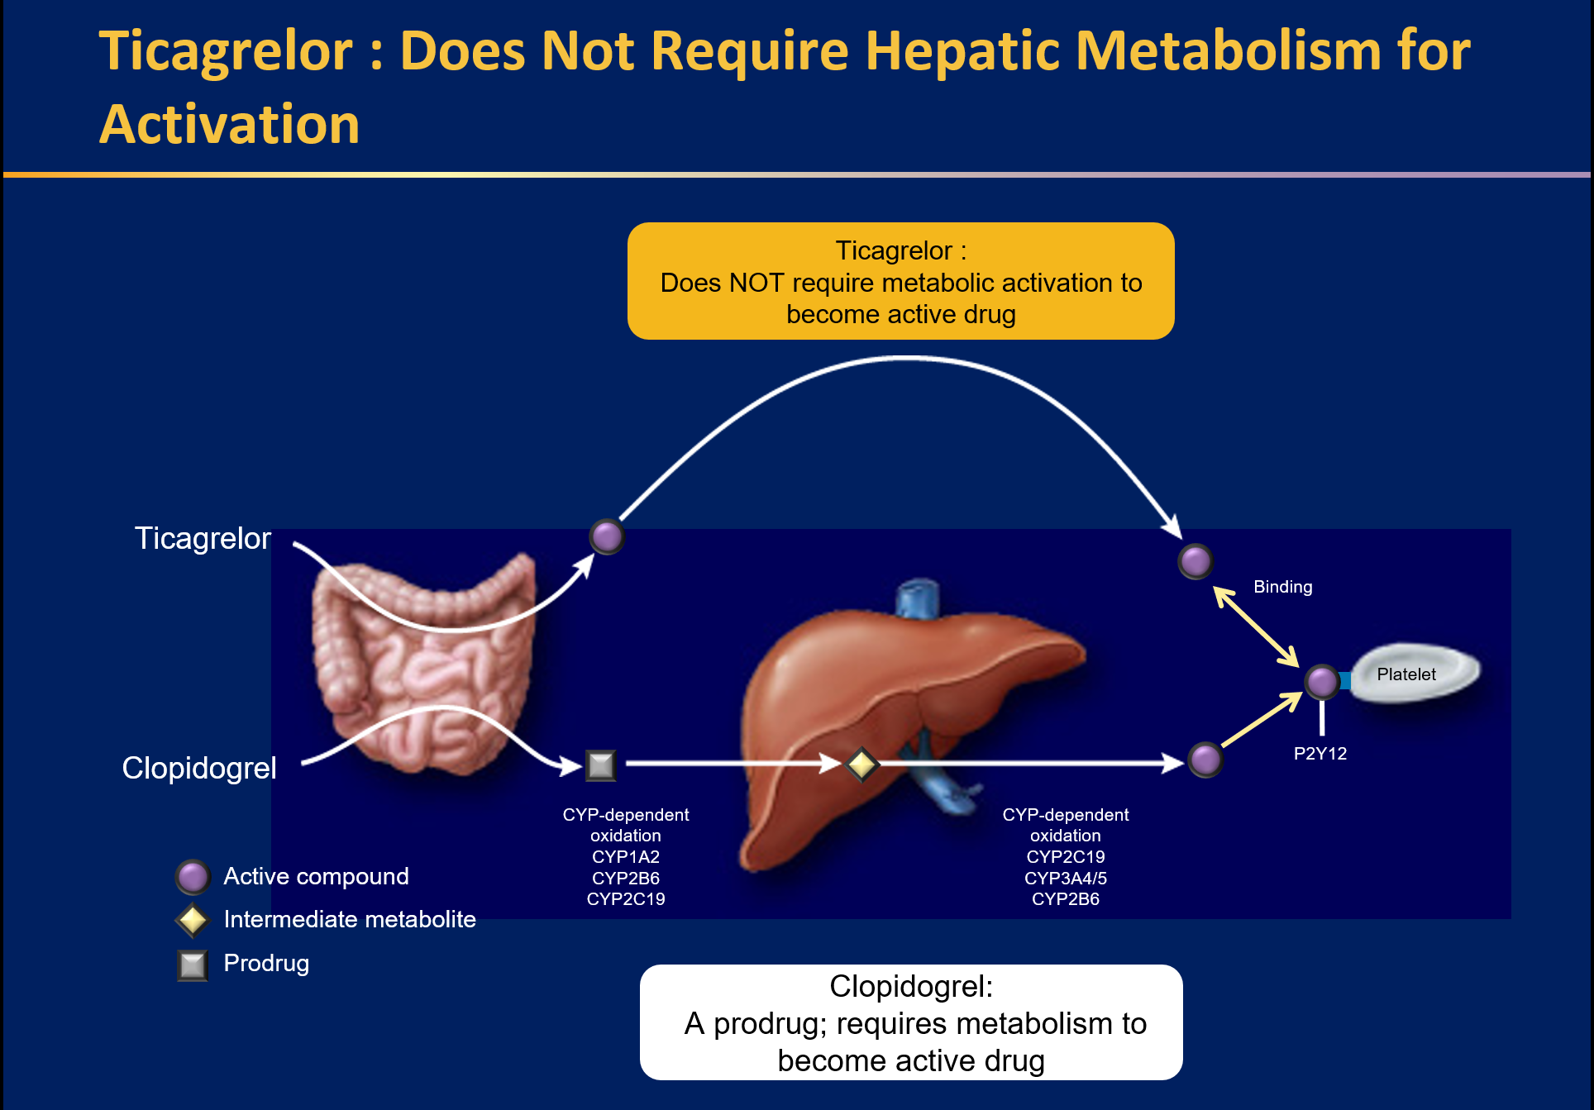
Adapted from Schomig A. N Engl J Med. 2009;361:1108–1111

Slide 11
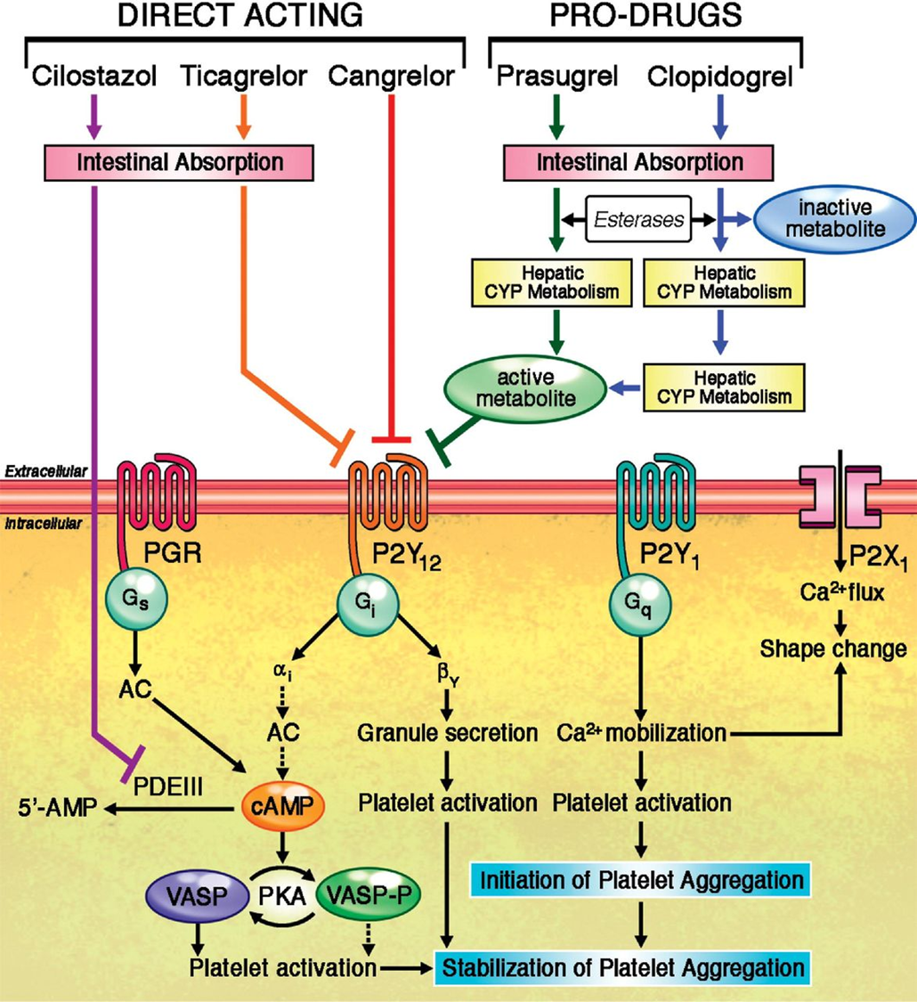

Slide 12
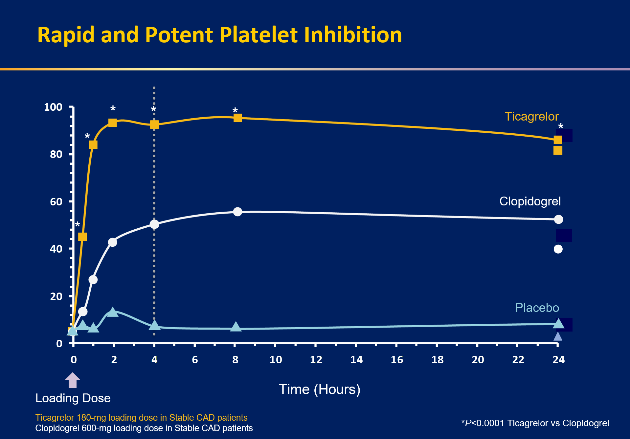
Adapted from Gurbel PA, et al. Circulation. 2009;120:2577–2585.

Slide 13
PLATelet Inhibition and Patient Outcomes

Slide 14
Ticagrelor compared with clopidogrel in patients with acute coronary syndromes – the PLATO trial

Slide 15
August 30, 2009 at 08.00 CET

Slide 16
PLATO background
In NSTE-ACS and STEMI, current guidelines recommend 12 months aspirin and clopidogrel
Efficacy of clopidogrel is hampered by
  Slow and variable transformation to the active metabolite
  Modest and variable platelet inhibition
  Increased risk of bleeding
  Risk of stent thrombosis and MI in poor responders
PLATO = PLATelet inhibition and patient Outcomes; NSTEMI = non-ST segment elevation;
STEMI = ST segment elevation; ACS = acute coronary syndromes; MI = myocardial infarction

Slide 17

Ticagrelor (AZD 6140): an oral reversible P2Y₁₂ antagonist
Ticagrelor is a cyclo-pentyl-triazolo-pyrimidine (CPTP)
Direct acting
  Not a prodrug; does not require metabolic activation
  Rapid onset of inhibitory effect on the P2Y₁₂ receptor
  Greater inhibition of platelet aggregation than clopidogrel
Reversibly bound
  Degree of inhibition reflects plasma concentration
  Faster offset of effect than clopidogrel
  Functional recovery of all circulating platelets

Slide 18
PLATO study design
NSTE-ACS (moderate-to-high risk) STEMI (if primary PCI)
Clopidogrel-treated or -naive;
randomised within 24 hours of index event
(N=18,624)
Clopidogrel
If pre-treated, no additional loading dose;
if naive, standard 300 mg loading dose,
then 75 mg qd maintenance;
(additional 300 mg allowed pre PCI)
Ticagrelor
180 mg loading dose, then
90 mg bid maintenance;
(additional 90 mg pre-PCI)
6–12-month exposure
Primary endpoint: CV death + MI + Stroke
Primary safety endpint: Total major bleeding
PCI = percutaneous coronary intervention; ASA = acetylsalicylic acid;
CV = cardiovascular; TIA = transient ischaemic attack

Slide 19
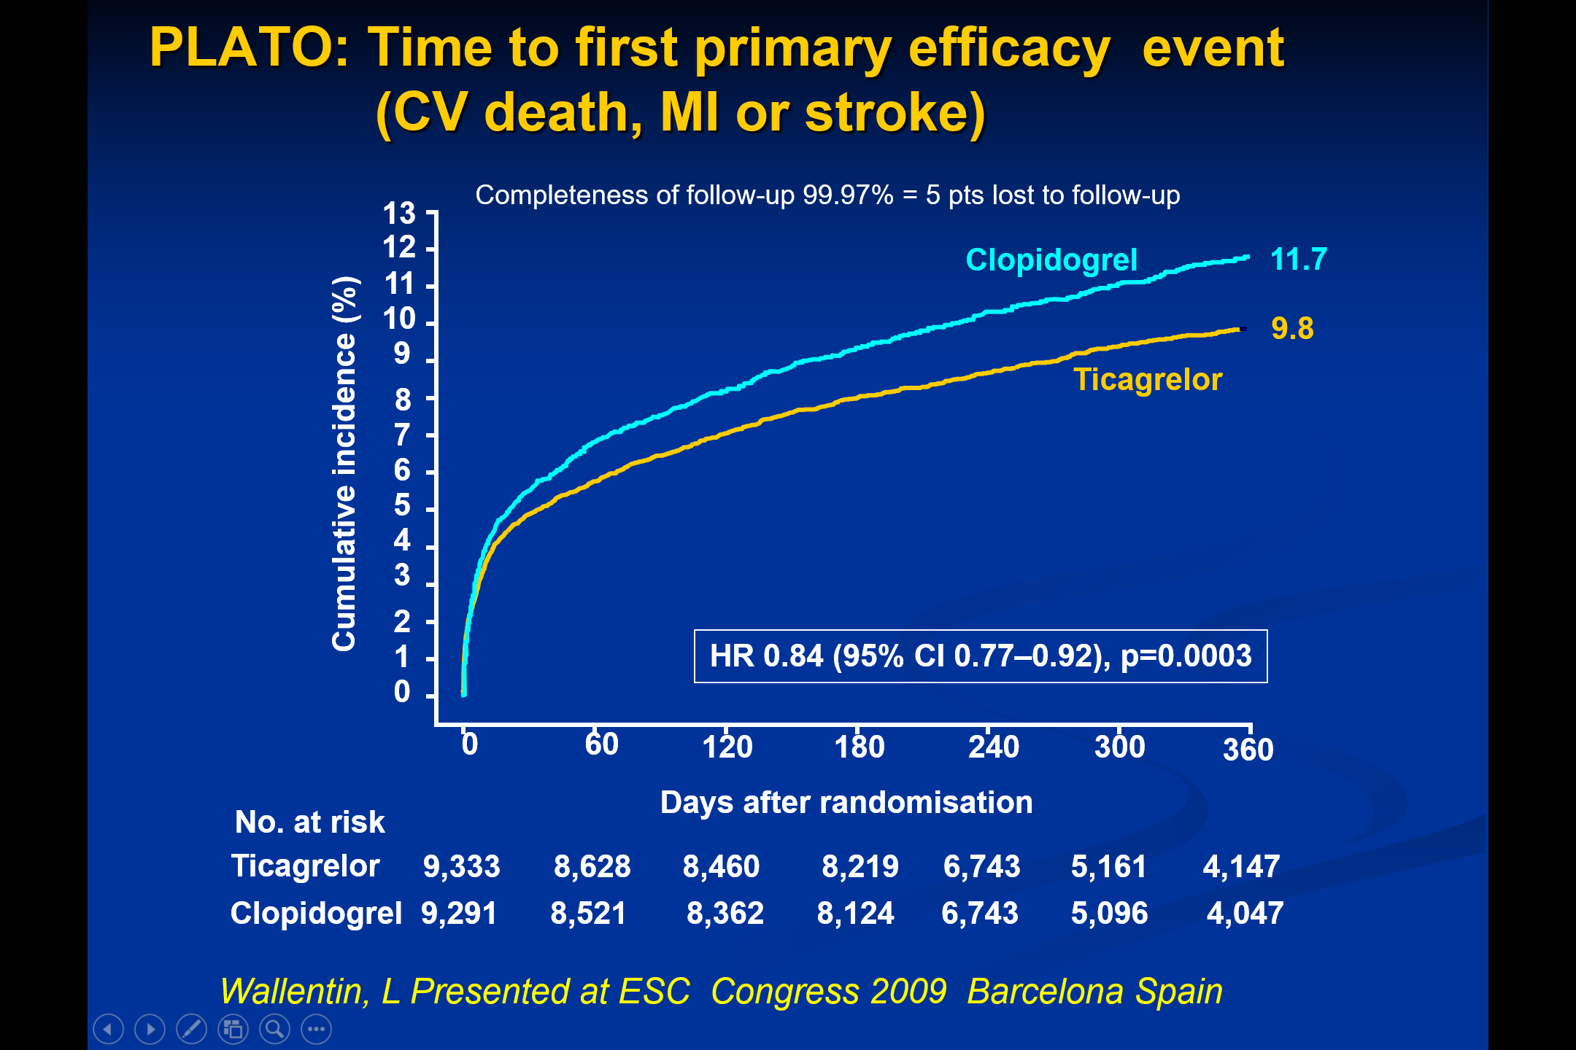

Slide 20
Conclusions
Reversible, more intense P2Y₁₂ receptor inhibition for one year with ticagrelor in comparison with clopidogrel in a broad population with ST- and non-ST-elevation ACS provides
  Reduction in myocardial infarction and stent thrombosis
  Reduction in cardiovascular and total mortality
  No change in the overall risk of major bleeding
Ticagrelor is a more effective alternative than clopidogrel
for the continuous prevention of ischaemic events, stent thrombosis and death in the acute and long-term treatment
of patients with ACS

Slide 21
Case 1 , question 1
Which antiplatelet in STEMI ?

Slide 22
The 68-years-old man
History of PCI on LAD (by DES ) since 5 month ago
Presented with Severe exacerbating Chest pain , cold sweating
Stopped Clopidogrel since 3 days ago
History of ischemic stroke 2 years ago
No history of GI bleeding
BP= 90/60 mmHg

Slide 24


Slide 25
Which DAPT ?
Clopidogrel + ASA
Prasugrel + ASA
Ticagrelor + ASA

Slide 26
Case 1 , question 2
Your recommended dose of ASA in this setting ?
80 mg
150 mg
325 mg

Slide 27
Given the clinical benefit shown in clinical trials in patients with ACS, Prasugrel and Ticagrelor are now the recommended first-line P2Y12-receptor inhibitors in the setting of PPCI

Slide 28
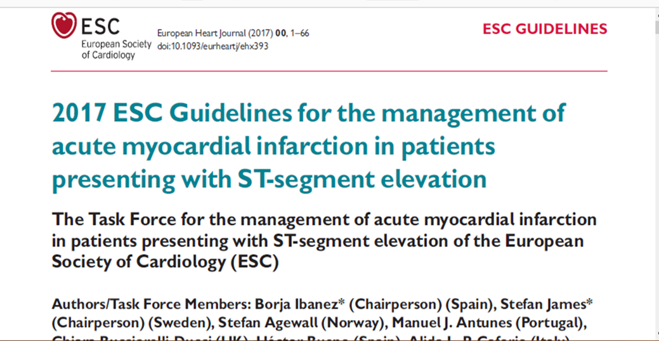
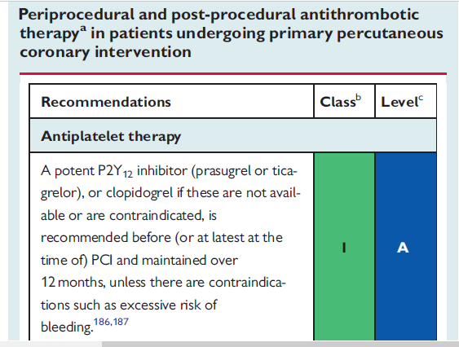

Slide 29
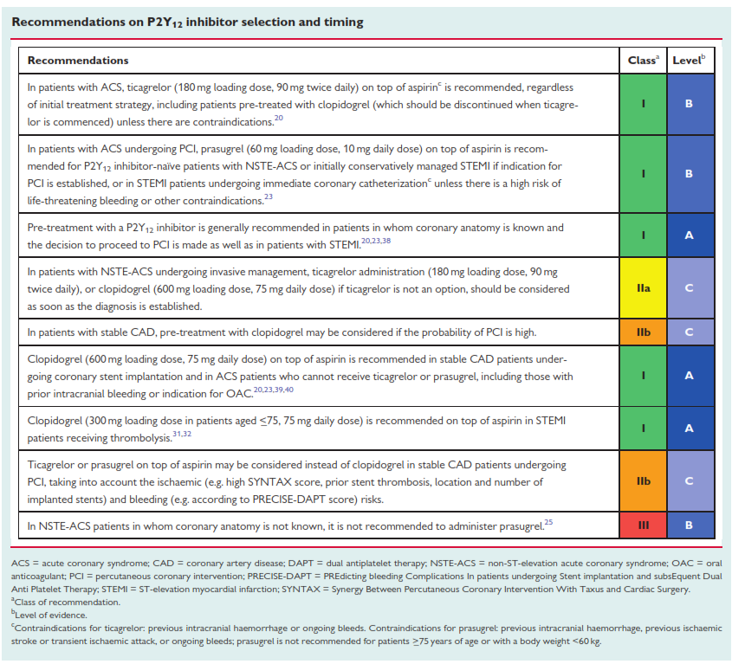

Slide 30
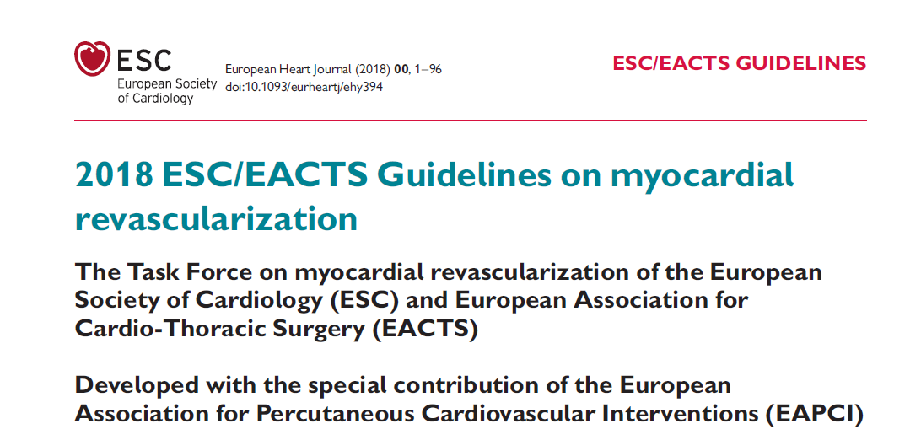
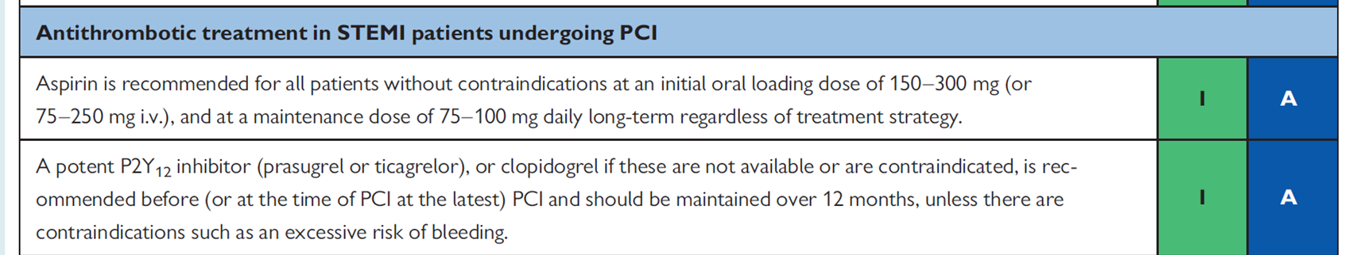

Slide 31
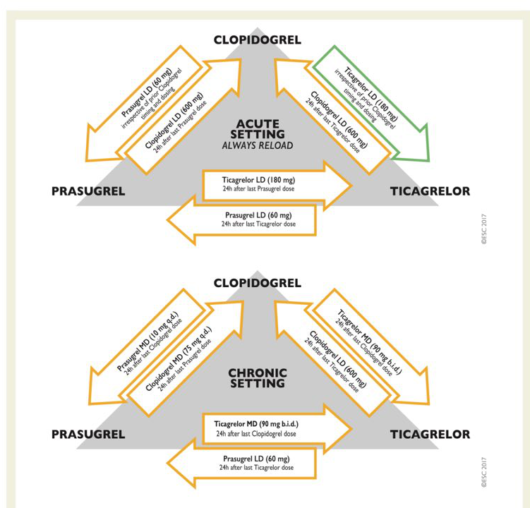

Slide 32
The oral dose of plain aspirin (non-enteric-coated formulation) should preferably be 150–300mg.
Optimal i.v. dosage Given a 50% oral bioavailability of oral aspirin, a corresponding dose is 75–150mg.

Slide 33
The efficacy of ticagrelor seems to be decreased in patients treated with higher aspirin doses ($300 mg daily) versus lower aspirin doses (#100 mg daily) .
On the basis of available data, the optimal range of aspirin dose in patients treated with DAPT that provides maximal protection from ischemic events and minimizes bleeding risk appears to be 75 mg to 100mg

Slide 34
Case 1 , question 3
This patient has recurrent vomiting
What will you do in this case ( recurrent vomiting in setting of primary PCI)
Clopidogrel
Prasugrel
Ticagrelor

Slide 35
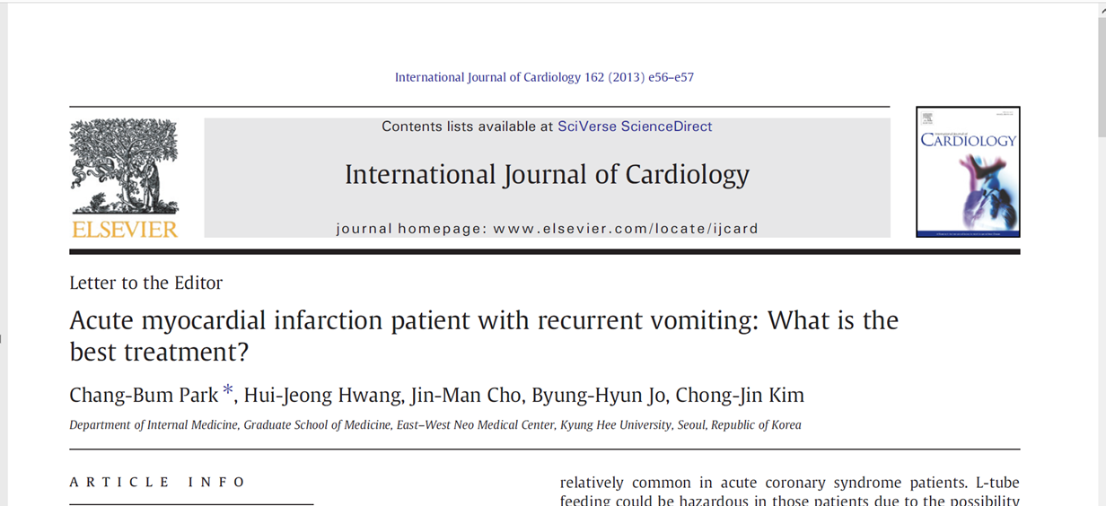
In patients with recurrent vomiting or unconsciousness, intravenous aspirin could be considered as an alternative to oral aspirin in patients with recurrent vomiting or loss of consciousness
Optimal i.v. dosage Given a 50% oral bioavailability of oral aspirin, a corresponding dose is 75–150mg.

Slide 36
Case 2 : An important question of your patients
A 74–years old man with history of PCI on LAD (3 month ago) and under treatment with ASA+Ticagrelor is going to switch from Ticagrelor to Clopidogrel?

Slide 37
De-scalation Therapy

Slide 38
Switching and especially a de-escalation of DAPT (switching from
potent P2Y12-inhibitors to clopidogrel) was subject to a number of
randomized clinical trials.

Slide 39
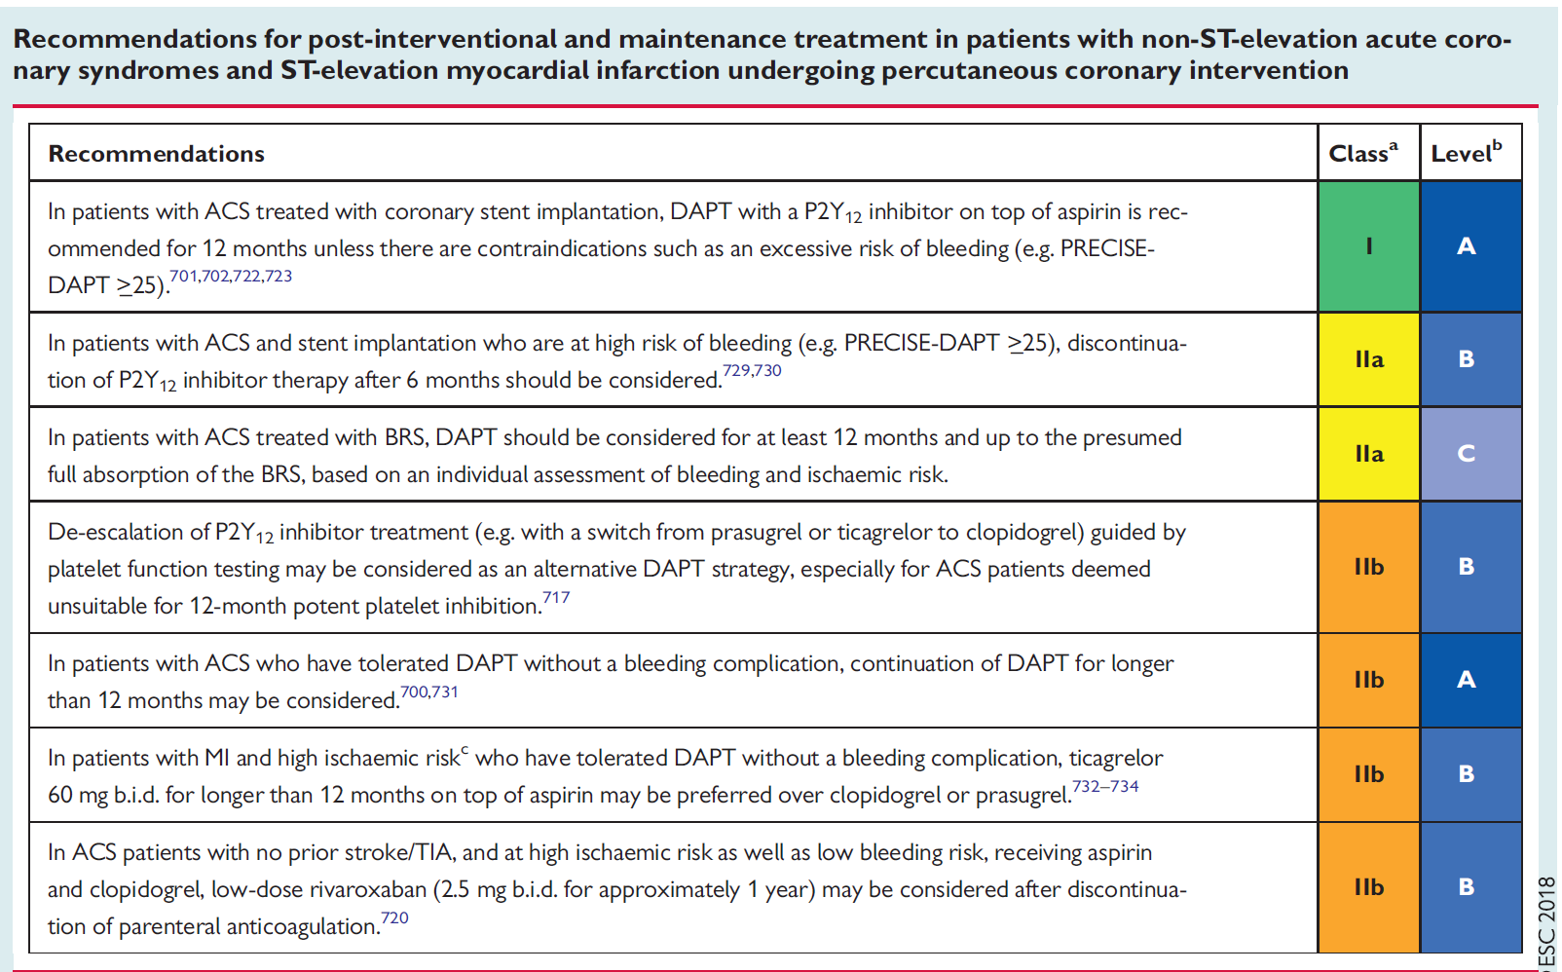

Slide 40
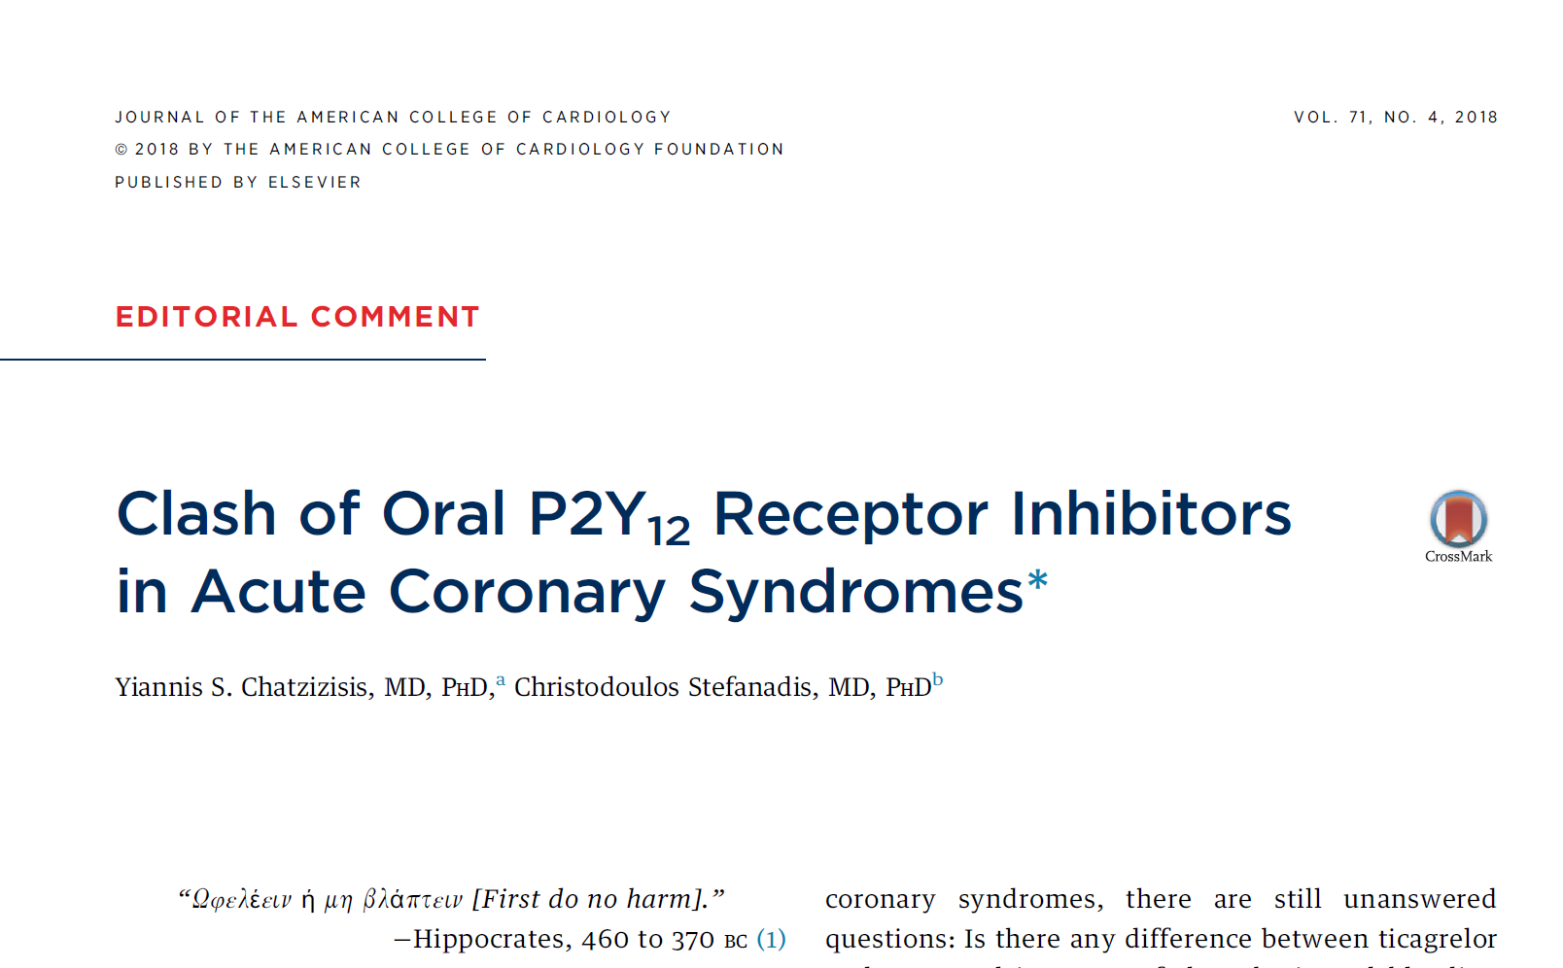
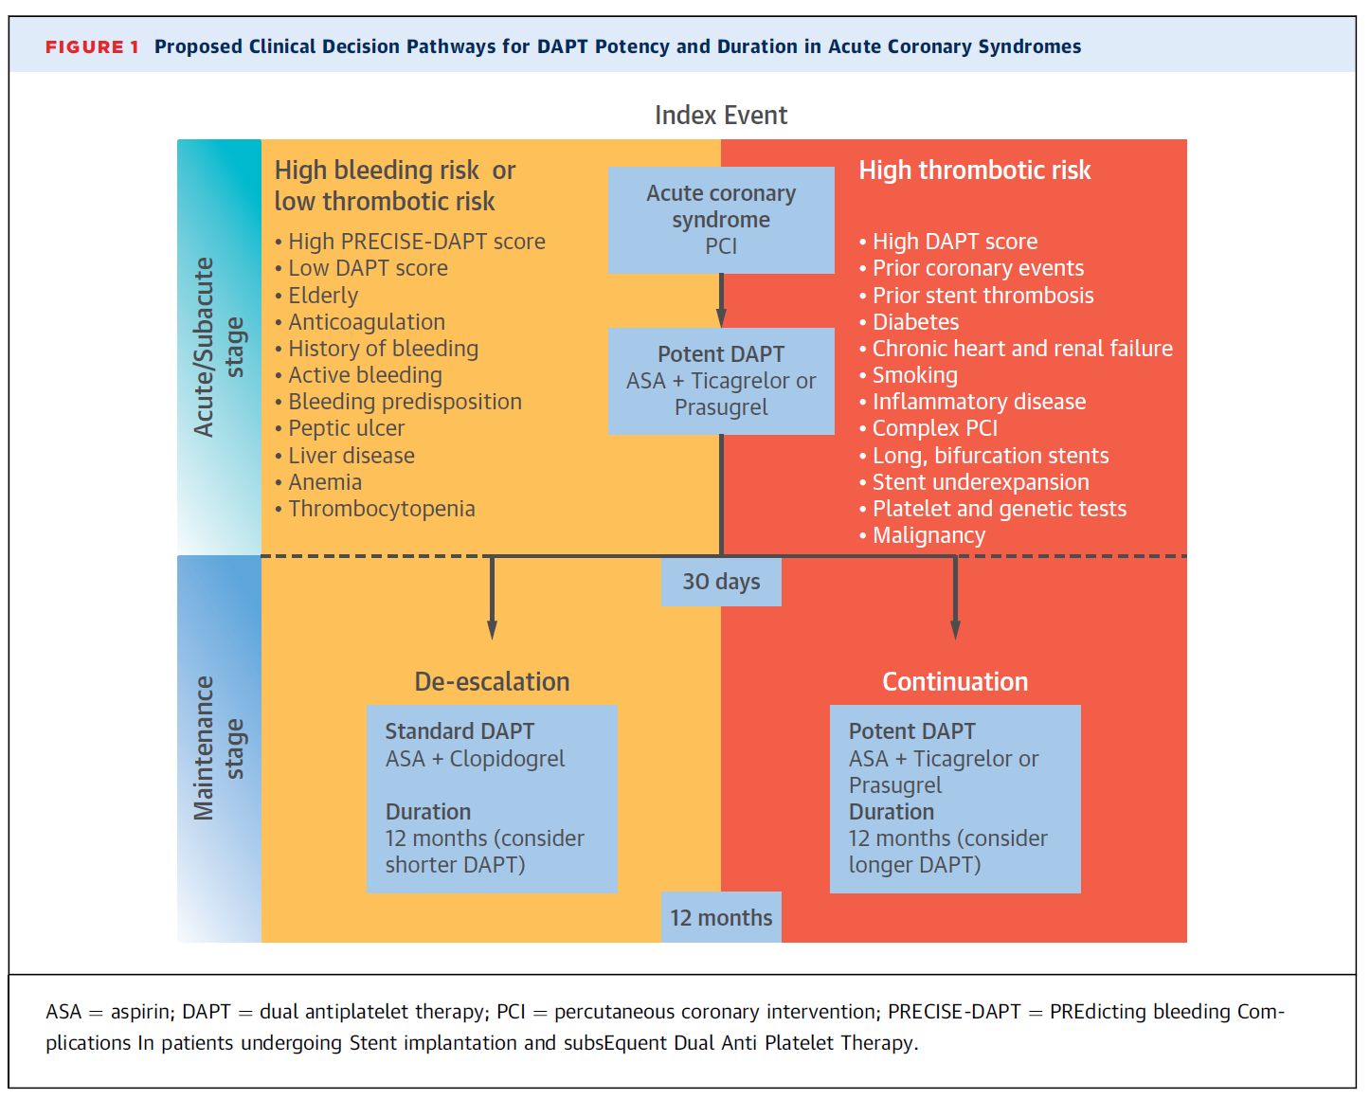

Slide 41
Case 3
A 69 y/o man with a history of ACS has undergone PCI 3 weeks ago, being treated with ASA + Ticagrelor + Statin, now he presented in ED with dyspnea for the last 2 weeks. She had no Lung disease, and has EF:50% in Echocardiography.
What Change do you recommend?

Slide 42
1. Switch Ticagrelor to Clopidogrel 75mg MD
2. Switch Ticagrelor to Prasugrel 10mg MD
3. Switch Ticagrelor to Clopidogrel 600mg LD + 75mg MD
4.None of above ( Continue ASA + Ticagrelor)

Slide 43
Dyspnea in PLATO
Dyspnea was reported more frequently by patients on ticagrelor than clopidogrel (13.8% vs 7.8%; P<0.001)
  Most episodes lasted less than a week
  Ticagrelor-associated dyspnea was mostly mild to moderate and did not affect efficacy
1 in 9 patients discontinued study drug because of dyspnea (0.9% vs 0.1%, P<0.001)
The higher frequency of dyspnea with ticagrelor was not associated with any detectable detrimental effect on pulmonary function compared with clopidogrel
Wallentin L, et al. N Engl J Med. 2009;361:1045-1057; Storey R, et al. JACC. 2010;55(Suppl 1):A108.E1007.
Notes:
The PLATO dyspnea substudy enrolled 199 patients from PLATO, excluding those with advanced lung disease, CHF or recent CABG^{[Storey 2010:A]}
From 30-40 days after PLATO randomization, these patients had pulse oximetry (SpO₂), spirometry (FEV₁, FVC, FEF₂₅₋₇₅; pre- and 20 minutes post inhaled beta-agonist), and lung volumes (TLC, FRC, RV and diffusion capacity DLCO_{SB})
Tests were repeated within 10 days prior to discontinuation, and 20-30 days after discontinuation of study medication
Six ticagelor and 8 clopidogrel patients experienced dyspnea^{[Storey 2010:A]}
After mean treatment of 31 days, no differences were seen between groups on pulmonary function
At the end of treatment (mean 211 days) and after discontinuation of medication (mean 32 days after last dose), there was no evidence of pulmonary function change in either group
Dyspnea seen in patients receiving ticagrelor was usually mild to moderate in intensity and often resolved on continued treatment^{[Storey 2009:A]}
Storey RF, et al. J Am Coll Cardiol. 2010;55(Suppl 1):A108.E1007.
Notes reference:
Storey RF, et al. Circulation. 2009;120:S1145.

Slide 44
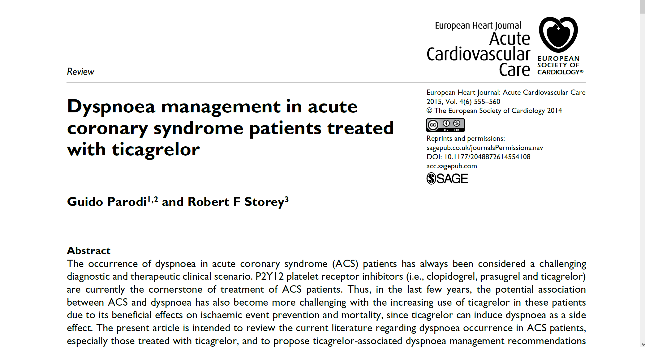

Slide 45
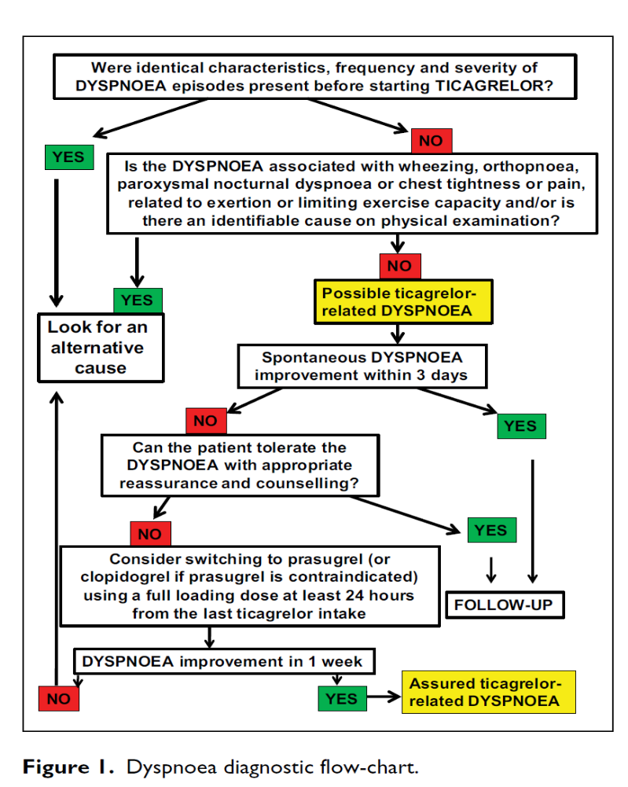

Slide 46
Management of ticagrelor-related dyspnea
1
2
If ticagrelor-related dyspnoea does not resolve spontaneously, is it tolerable for the patient in the context of the benefit: risk profile of ticagrelor treatment?
3
Drug discontinuation should only be considered when dyspnoea is persistent and cannot be tolerated by the patient
After excluding pre-existing or other causes of dyspnoea, observe the patient for 3‒4 days
Eur Heart J: Acute Cardiovasc Care, Sept 29, 2014

Slide 47
Method of administration
Ticagrelor treatment should be initiated with a single 180 mg loading dose (two tablets of 90 mg) and then continued at 90 mg twice daily.
Patients taking Ticagrelor should also take ASA daily, unless specifically contraindicated. Following an initial dose of ASA, Ticagrelor should be used with a maintenance dose of ASA of 75‑150 mg
Treatment is recommended for up to 12 months unless discontinuation of Ticagrelor is clinically indicated
Ticagrelor: Summary of Product Characteristics, 2016.

Slide 48
Special Populations
Elderly population
  No dose adjustment is required in elderly
Renal impairment
  No dose adjustment is necessary for patients with renal impairment
  No information is available concerning treatment of patients on renal dialysis and therefore Ticagrelor is not recommended in these patients
Hepatic impairment
  No dose adjustment is necessary for patients with mild hepatic impairment
  Ticagrelor has not been studied in patients with moderate or severe hepatic impairment. Its use in patients with moderate to severe hepatic impairment is therefore contraindicated
Ticagrelor: Summary of Product Characteristics, 2016.

Slide 49
Contraindications
  Hypersensitivity to the active substance (Ticagrelor) or to any of the excipients
  Active pathological bleeding
  History of intracranial haemorrhage
  Moderate-to-severe hepatic impairment
  Combination with strong CYP3A4 inhibitors such as ketoconazole, clarithromycin, nefazodone, ritonavir and atazanavir is contraindicated, as co-administration may lead to substantial increases in exposure to Ticagrelor
Ticagrelor: Summary of Product Characteristics, 2016.
Notes:
Title:
Contraindications
Key Points:
The following are contraindications for Ticagrelor
Hypersensitivity to the active substance (Ticagrelor) or to any of the excipients
Active pathological bleeding
History of intracranial haemorrhage
Moderate-to-severe hepatic impairment
Combination with strong CYP3A4 inhibitors such as ketoconazole, clarithromycin, nefazodone, ritonavir and atazanavir is contraindicated, as co-administration may lead to substantial increases in exposure to Ticagrelor
Additional Information:
N/A
References:
BRILIQUE: Summary of Product Characteristics, 2010.

Slide 50
Special Warnings and Precautions
Ticagrelor should be used with caution in patients:
  at known increased risk for bleeding
  with a history of asthma and/or COPD
  at risk of bradycardic events
  with concomitant administration of medicinal products that may increase the risk of bleeding (eg, NSAIDs, oral anticoagulants and/or fibrinolytics) within 24 hours of Ticagrelor dosing
Ticagrelor should be discontinued 7 days prior to elective surgery
Ticagrelor use in patients with uric acid nephropathy is discouraged
Creatinine levels may increase during treatment with Ticagrelor
Renal function should be checked after 1 month and thereafter according to routine medical practice
High maintenance dose of ASA (>300 mg) is not recommended
Ticagrelor with doses of simvastatin >40 mg is not recommended
Ticagrelor: Summary of Product Characteristics, 2016.

Slide 51
ESC Latest GUIDLINES

Slide 52

ESC 2017 Guidelines Reinforce Ticagrelor Preference Over Clopidogrel
 | ESC 2017 Guidelines Updates | Class of Recommendation LOE
P2Y12 inhibitor selection | In patients with NSTE- ACS, Ticagrelor on top of aspirin is recommended over Clopidogrel regardless of initial treatment strategy and maintained over 12 months unless contraindicated. 1 For STEMI PCI patients, Ticagrelor is recommended over Clopidogrel before or at latest at the time of PCI and maintained over 12 months, unless contraindicated 1 | Class I; B Class I; A
SURGERY | In patients who need to undergo non-emergent cardiac surgery, postponing surgery for at least 3 days after discontinuation of Ticagrelor, at least 5 days after Clopidogrel, and at least 7 days after Prasugrel should be considered.3 4 | Class IIa; B
1.Wallentin L, Ticagrelor versus clopidogrel in patients with acute coronary syndromes. N Engl J Med 2009;361:1045–1057.2.Yusuf S. Effects of clopidogre ln addition to aspirin in patients with acute coronary syndromes
without ST-segment elevation. N Engl J Med 2001;345:494–502.3 Hansson EC,. Coronary artery bypass grafting-related bleeding complications in patients treated with ticagrelor or clopidogrel: a nationwide study. Eur Heart J
2016;37:189–197.4Tomsic A, Coronary artery bypass grafting-related bleeding complications in patients treated with dual antiplatelet treatment. Eur J Cardiothorac Surg 2016;50:849–856.

Slide 53
ESC 2018 Guidelines Reinforce Switching to Ticagrelor
 | ESC 2017 Guidelines Updates | Class of Recommendation LOE
Switching to Ticagrelor | In patients with ACS who were previously exposed to Clopidogrel, switching from Clopidogrel to Ticagrelor is recommended early after hospital admission at a loading dose of 180 mg irrespective of timing and loading dose of Clopidogrel, unless contraindicated. 1 | Class I; B
1.Wallentin L, Ticagrelor versus clopidogrel in patients with acute coronary syndromes. N Engl J Med 2009;361:1045–1057.2.Yusuf S. Effects of clopidogre ln addition to aspirin in patients with acute coronary syndromes
without ST-segment elevation. N Engl J Med 2001;345:494–502.3 Hansson EC,. Coronary artery bypass grafting-related bleeding complications in patients treated with ticagrelor or clopidogrel: a nationwide study. Eur Heart J
2016;37:189–197.4Tomsic A, Coronary artery bypass grafting-related bleeding complications in patients treated with dual antiplatelet treatment. Eur J Cardiothorac Surg 2016;50:849–856.

Slide 54

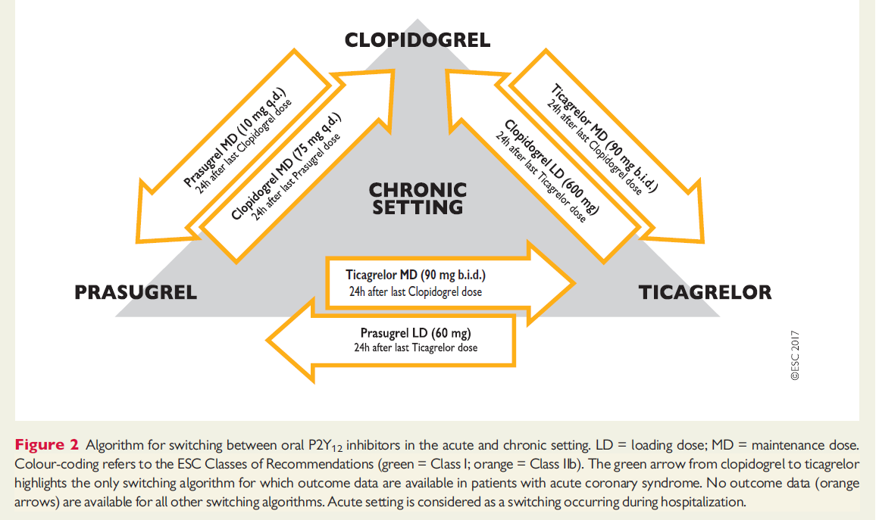
2017 ESC focused update on dual antiplatelet therapy in coronary artery disease developed in collaboration with EACTS
Switching between oral P2Y12 inhibitors
Valgimigli M et al. Eur Heart J 2017 doi:10.1093/eurheartj/ehx419; 2. Ibanez B et al. Eur Heart J 2017 doi:10.1093/eurheartj/ehx393;

Slide 55
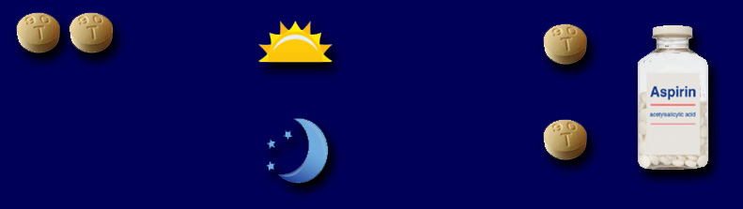
Dosing and Administration
LOADING
MAINTENANCE
Initial treatment: 180 mg
Continue treatment: 90 mg twice daily + Aspirin: 75–150 mg once daily
Morning – Take one
Two 90-mg tablets
Ticagrelor tablet
in the morning (AM)
Take aspirin
(either in the
morning or night)
Initiate Ticagrelor with a loading dose of aspirin.
Night – Take one
Ticagrelor tablet
in the evening (PM)
Ticagrelor treatment should be initiated with a single 180-mg loading
dose (two 90-mg tablets) and then continued at 90 mg twice daily with concomitant low dose ASA
Treatment with Ticagrelor is recommended for up to 12 months unless discontinuation is clinically indicated
Ticagrelor can be administered with or without food
Ticagrelor: Summary of Product Characteristics, 2010.
Notes:
Title:
Dosing and Administration
Key Points:
Ticagrelor can be used in patients with ACS irrespective of diagnosis (UA, NSTEMI, or STEMI), and without regard to management strategy, medical history, age, or body weight
Ticagrelor treatment should be initiated with a single 180-mg loading dose (two 90-mg tablets) and then continued at 90 mg twice daily with concomitant low dose ASA
Treatment with Ticagrelor is recommended for up to 12 months unless discontinuation is clinically indicated
Ticagrelor can be administered with or without food
Additional Information:
Ticagrelor should be used with low-dose aspirin (75–150 mg); coadministration of Ticagrelor and high maintenance-dose aspirin (>300 mg) is not recommended
Reference:
BRILIQUE: Summary of Product Characteristics, 2010.

Slide 56
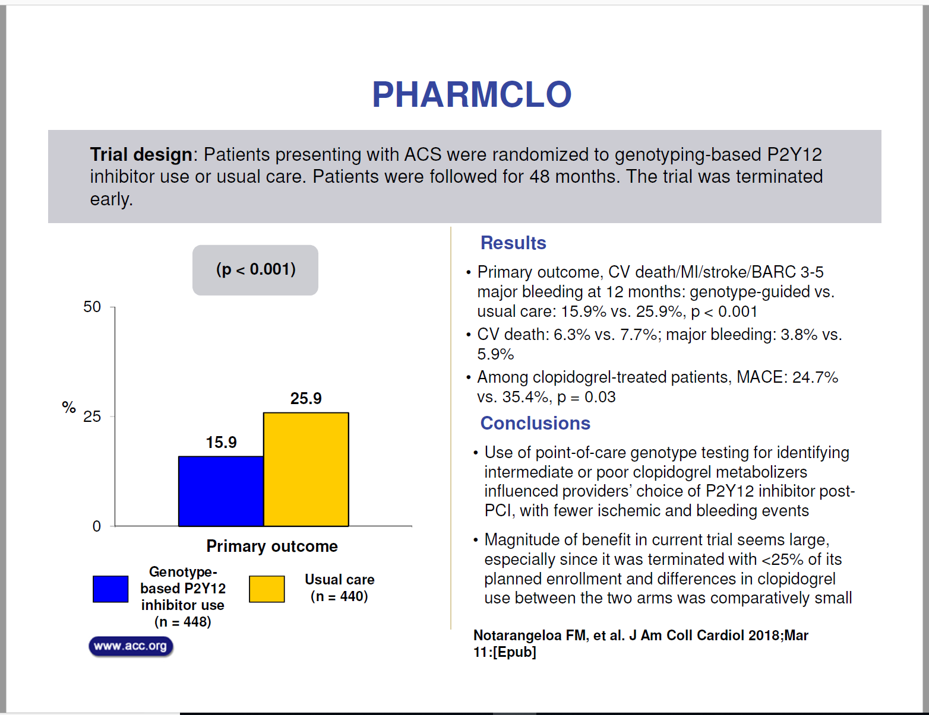

Slide 57
Pharmacogenomic Approach to Selecting Antiplatelet Therapy in Acute Coronary Syndromes: PHARMCLO trial
Background: Clopidogrel is still frequently used in patients with acute coronary syndromes (ACS), but its efficacy is hampered by interpatient response variability, due to genetic polymorphisms associated with clopidogrel metabolism.
Objective: To evaluate whether selecting antiplatelet therapy (clopidogrel, prasugrel or ticagrelor) on the basis of a patient’s genetic and clinical characteristics leads to better clinical outcomes in comparison with the standard of care, which bases the selection on clinical characteristics alone

Slide 58
Methods:
Patients hospitalized for ACS were randomly assigned to standard of care or pharmacogenomic arm, which included the genotyping of ABCB1, CYP2C19*2, CYP2C19*17 using an ST Q3 system that provide the data within 70 minutes at each patient’s bedside.
The patients were followed up for 12 ± 1 months for the primary composite endpoint of cardiovascular death and the first occurrence of non-fatal myocardial infarction, non-fatal stroke and BARC 3 to 5-defined major bleeding.

Slide 59
The primary endpoint was the composite of cardiovascular death and the first occurrence of non-fatal myocardial infarction, non-fatal stroke and 3 to 5-defined major bleeding within 12 months of randomization.
The secondary end-point was the composite of the primary endpoint plus the occurrence of definite or probable stent thrombosis.

Slide 60
Results:
After enrolling 888 patients, the study was prematurely stopped. Clopidogrel was used more frequently in the standard of care arm (50.7% vs 43.3%), ticagrelor in the pharmacogenomic arm (42.6% vs 32.7%; P=0.02), and prasugrel was equally used in both arms.
The primary endpoint occurred in 71 patients (15.9%) in the pharmacogenomic arm and in 114 (25.9%) in the standard of care arm (hazard ratio 0.58; 95% confidence interval [CI] 0.43 to0.78; P<0.001).

Slide 61
Conclusion:
A personalized approach to selecting antiplatelet therapy for ACS patients may reduce ischemic and bleeding events

Slide 62



