Slide 1


© 2017 EuroIntervention. All rights reserved.
EuroIntervention 2017;13-online publish-ahead-of-print August 2017
Clopidogrel or ticagrelor in acute coronary syndrome patients treated with newer-generation drug-eluting stents: CHANGE DAPT

Slide 2
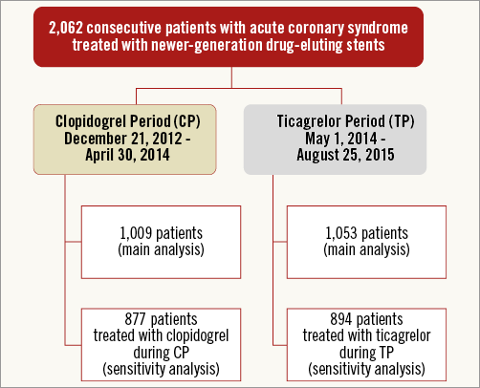
© 2017 EuroIntervention. All rights reserved.
EuroIntervention 2017;13-online publish-ahead-of-print August 2017
Clopidogrel or ticagrelor in acute coronary syndrome patients treated with newer-generation drug-eluting stents: CHANGE DAPT

Slide 3
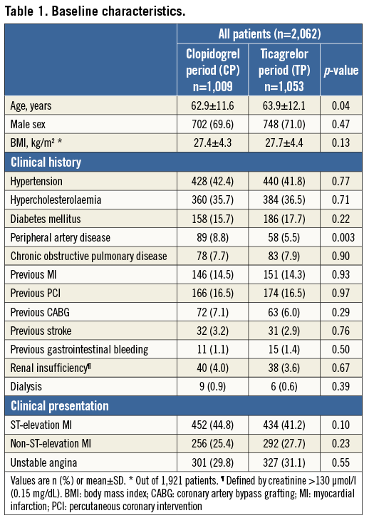
© 2017 EuroIntervention. All rights reserved.
EuroIntervention 2017;13-online publish-ahead-of-print August 2017
Clopidogrel or ticagrelor in acute coronary syndrome patients treated with newer-generation drug-eluting stents: CHANGE DAPT

Slide 4
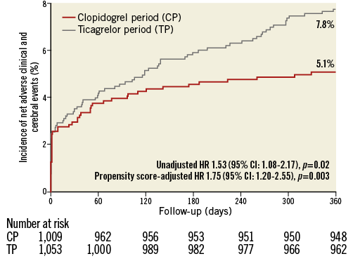
© 2017 EuroIntervention. All rights reserved.
EuroIntervention 2017;13-online publish-ahead-of-print August 2017
Clopidogrel or ticagrelor in acute coronary syndrome patients treated with newer-generation drug-eluting stents: CHANGE DAPT

Slide 5
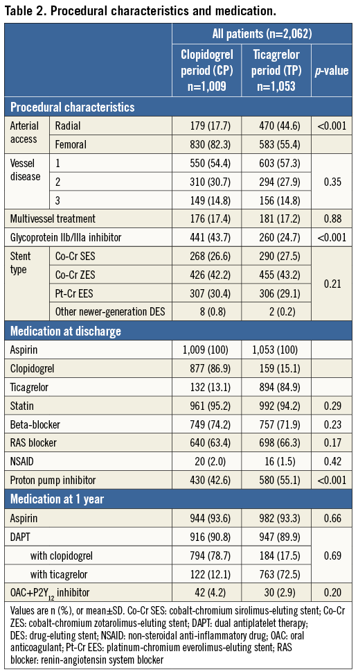
© 2017 EuroIntervention. All rights reserved.
EuroIntervention 2017;13-online publish-ahead-of-print August 2017
Clopidogrel or ticagrelor in acute coronary syndrome patients treated with newer-generation drug-eluting stents: CHANGE DAPT

Slide 6
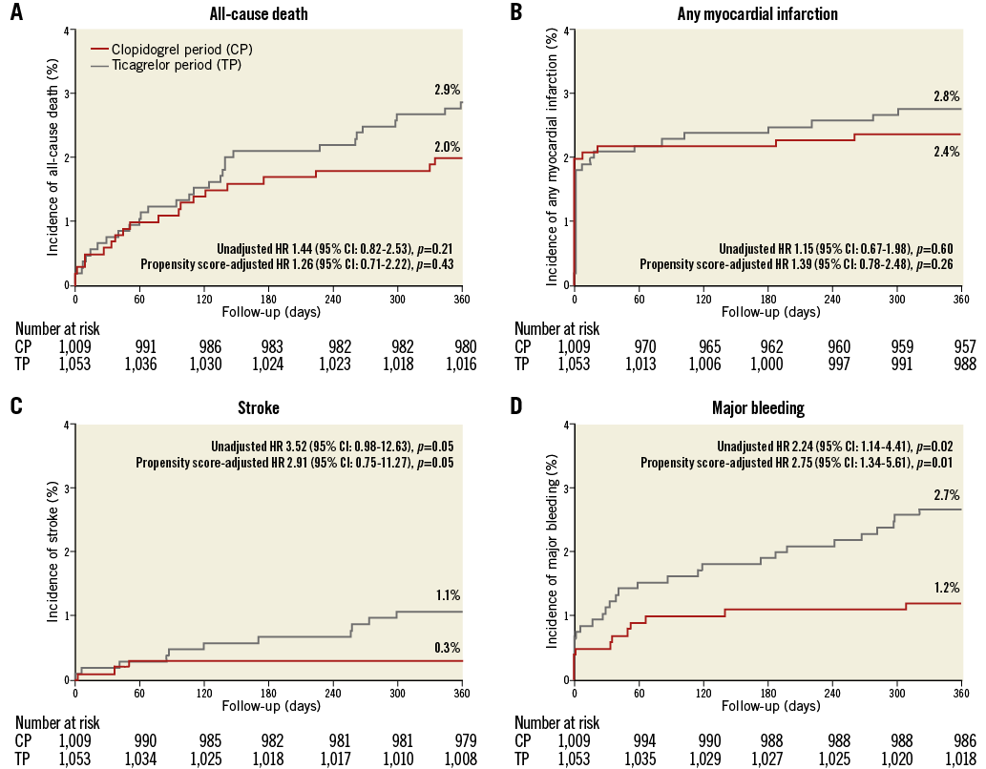
© 2017 EuroIntervention. All rights reserved.
EuroIntervention 2017;13-online publish-ahead-of-print August 2017
Clopidogrel or ticagrelor in acute coronary syndrome patients treated with newer-generation drug-eluting stents: CHANGE DAPT

Slide 7
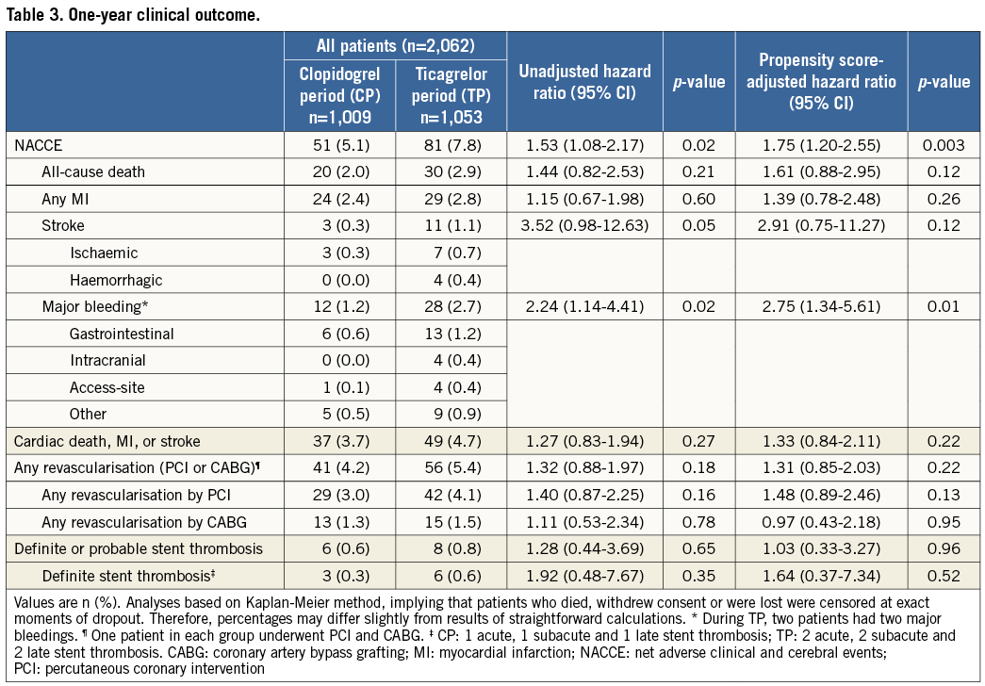
© 2017 EuroIntervention. All rights reserved.
EuroIntervention 2017;13-online publish-ahead-of-print August 2017
Clopidogrel or ticagrelor in acute coronary syndrome patients treated with newer-generation drug-eluting stents: CHANGE DAPT

Slide 8
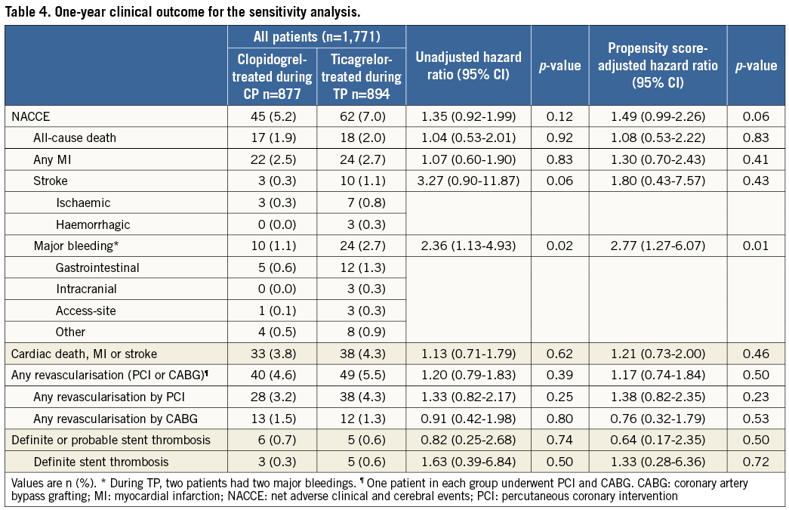
© 2017 EuroIntervention. All rights reserved.
EuroIntervention 2017;13-online publish-ahead-of-print August 2017
Clopidogrel or ticagrelor in acute coronary syndrome patients treated with newer-generation drug-eluting stents: CHANGE DAPT

Slide 9
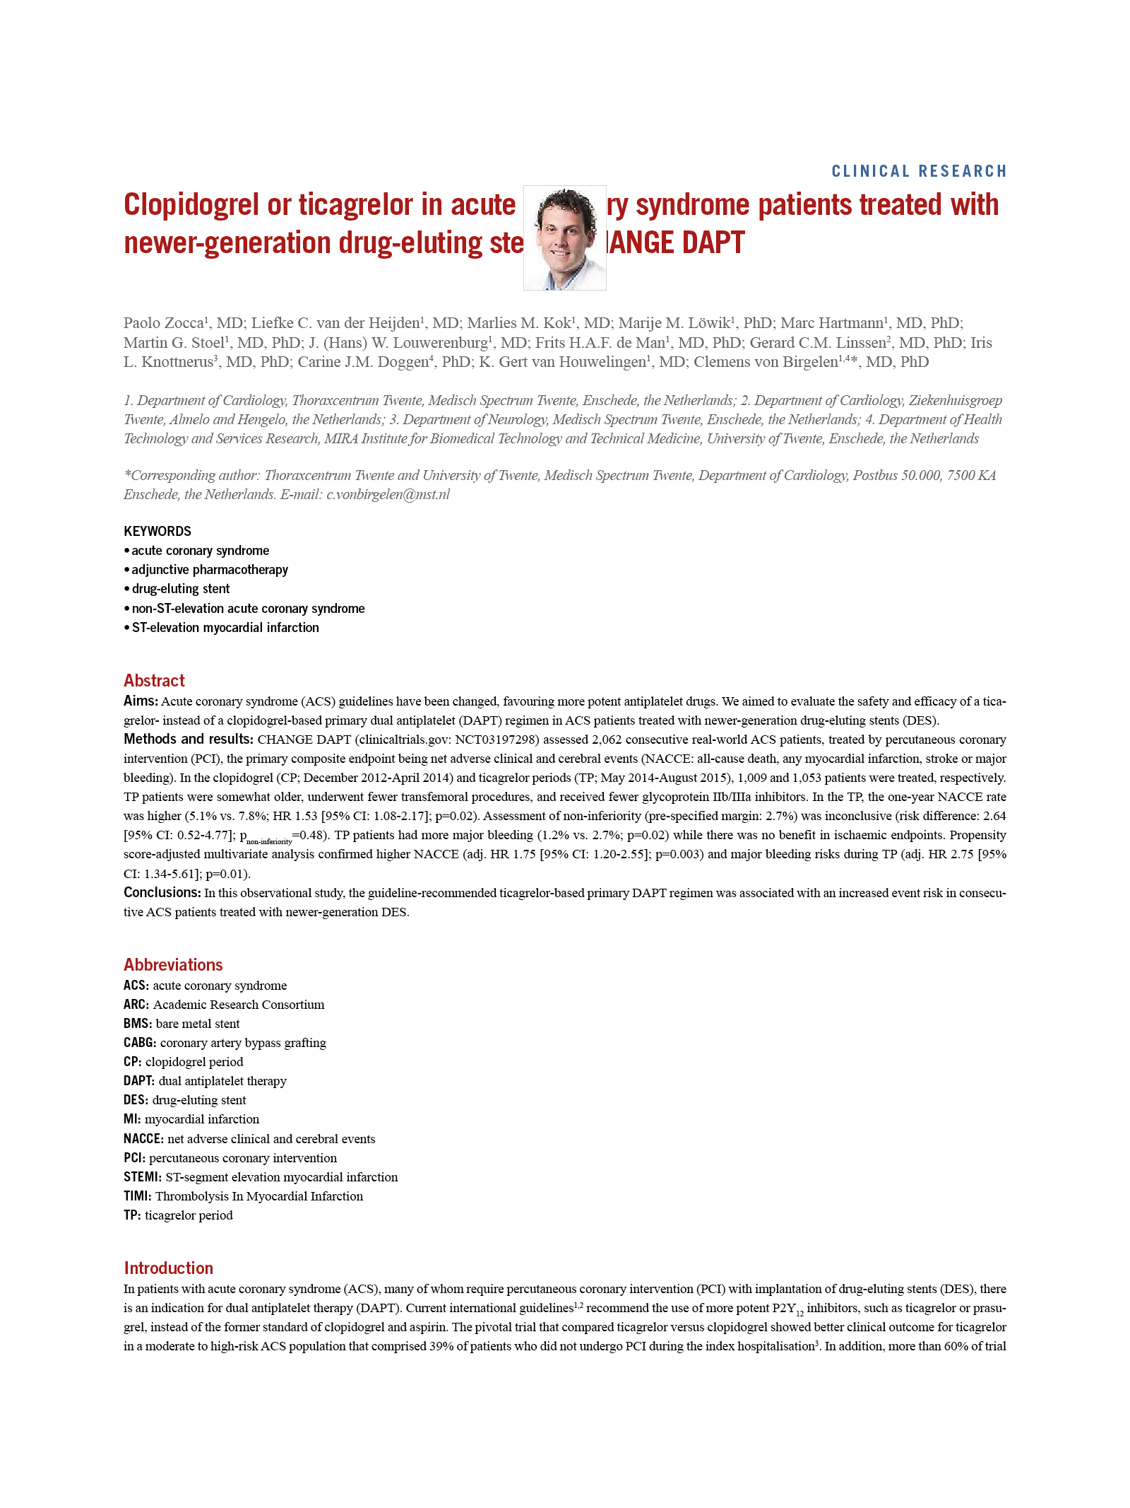
© 2017 EuroIntervention. All rights reserved.
EuroIntervention 2017;13-online publish-ahead-of-print August 2017
Clopidogrel or ticagrelor in acute coronary syndrome patients treated with newer-generation drug-eluting stents: CHANGE DAPT

Slide 10
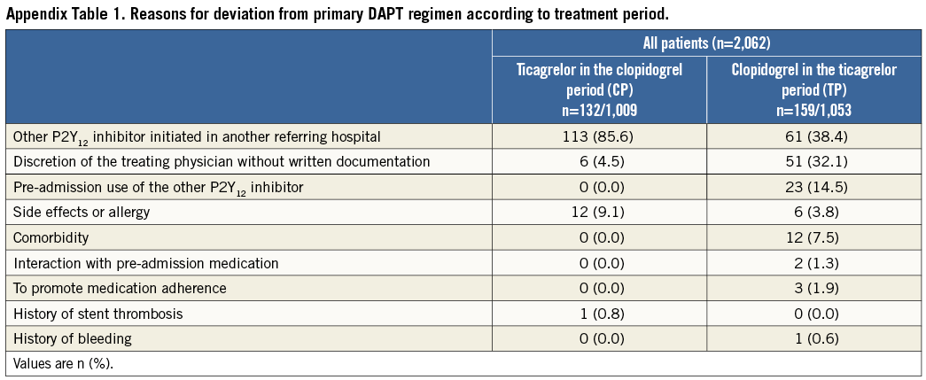
© 2017 EuroIntervention. All rights reserved.
EuroIntervention 2017;13-online publish-ahead-of-print August 2017
Clopidogrel or ticagrelor in acute coronary syndrome patients treated with newer-generation drug-eluting stents: CHANGE DAPT

Slide 11
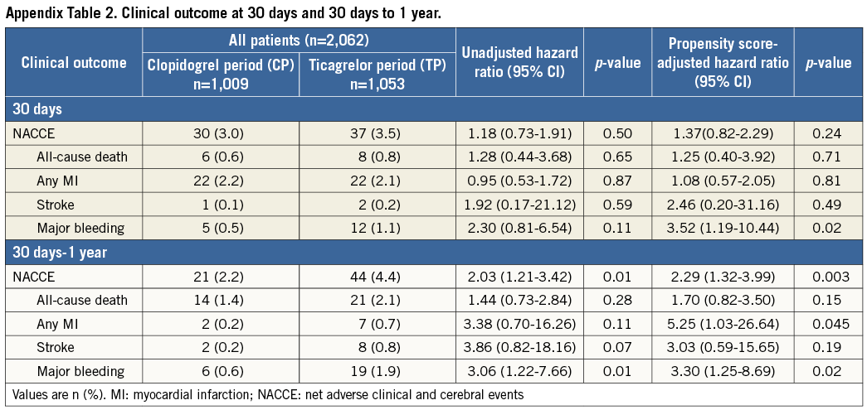
© 2017 EuroIntervention. All rights reserved.
EuroIntervention 2017;13-online publish-ahead-of-print August 2017
Clopidogrel or ticagrelor in acute coronary syndrome patients treated with newer-generation drug-eluting stents: CHANGE DAPT

Slide 12
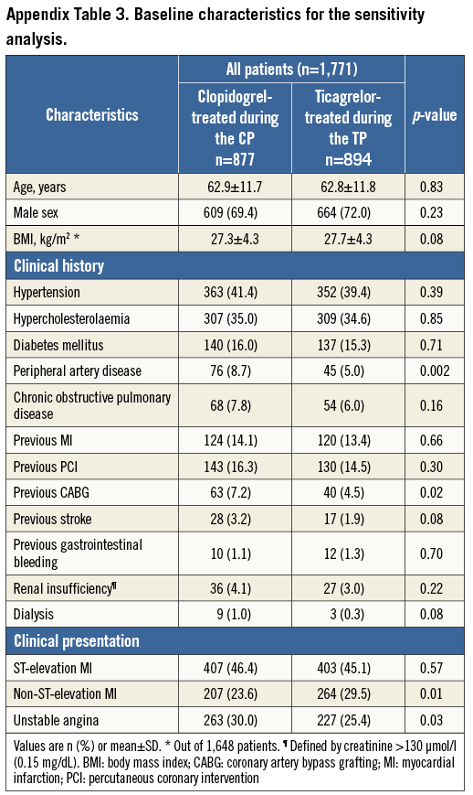
© 2017 EuroIntervention. All rights reserved.
EuroIntervention 2017;13-online publish-ahead-of-print August 2017
Clopidogrel or ticagrelor in acute coronary syndrome patients treated with newer-generation drug-eluting stents: CHANGE DAPT

Slide 13
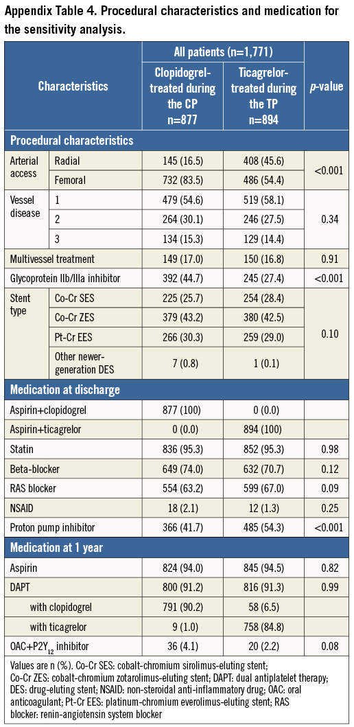
© 2017 EuroIntervention. All rights reserved.
EuroIntervention 2017;13-online publish-ahead-of-print August 2017
Clopidogrel or ticagrelor in acute coronary syndrome patients treated with newer-generation drug-eluting stents: CHANGE DAPT

