Slide 1

Long-Term Tolerability of Ticagrelor for Secondary Prevention:
Insights from PEGASUS-TIMI 54 Trial
Marc P. Bonaca, MD, MPH
on behalf of the PEGASUS-TIMI 54
Executive & Steering Committees and Investigators
NCT00526474

Slide 2
Disclosures
PEGASUS-TIMI 54 was funded through a research grant to Brigham and Women’s Hospital
Consulting for AstraZeneca, Merck, Bayer, Roche Diagnostics

Slide 3
Primary Endpoint
10
21,162 patients with MI 1-3 years prior and treated with low-dose aspirin
9
Placebo (9.0%)
8
Ticagrelor 90 (7.8%)
Ticagrelor 60 (7.8%)
7
6
CV Death, MI, or Stroke (%)
5
Ticagrelor 90 mg
HR 0.85 (95% CI 0.75 – 0.96)
P=0.008
4
3
Ticagrelor 60 mg
HR 0.84 (95% CI 0.74 – 0.95)
P=0.004
2
1
0
0
3
6
9
12
15
18
21
24
27
30
33
36
Months from Randomization
Bonaca MP et al. and Sabatine MS. NEJM 2015;372:1791-800

Slide 4
Background
Enrollment began in 2010; therefore few patients (<1%) had already been treated with ticagrelor
Premature discontinuation at 3 years was higher in those initiating ticagrelor (32% 90 mg BID, 29% 60 mg BID) vs. placebo (21%) with the majority due to adverse events
However, translation of PEGASUS-TIMI 54 into clinical practice would more likely be in the form of continuing in patients already tolerating ticagrelor for 1 year after their MI
We therefore investigated rates, reasons and timing of study drug discontinuation in PEGASUS-TIMI 54

Slide 5
Hypotheses
In outpatients with prior MI newly exposed to ticagrelor:
Treatment discontinuation overall, and due to AEs, would be higher early after initiation and would be low in patients tolerating therapy for at least one year
The efficacy of ticagrelor would be robust for events occurring on treatment, particularly for patients continuing on P2Y₁₂ inhibition from their index MI

Slide 6
Methods
The rate and reasons for discontinuation compared between treatment groups
Landmark evaluating discontinuation in those that tolerated 1 year of therapy
The efficacy and safety compared evaluating events that occurred through the last dose plus 7 days

Slide 7
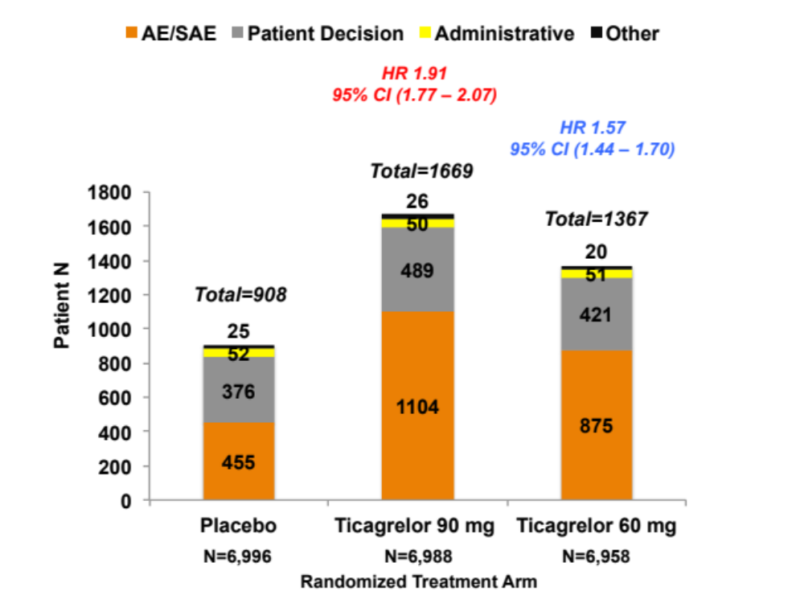
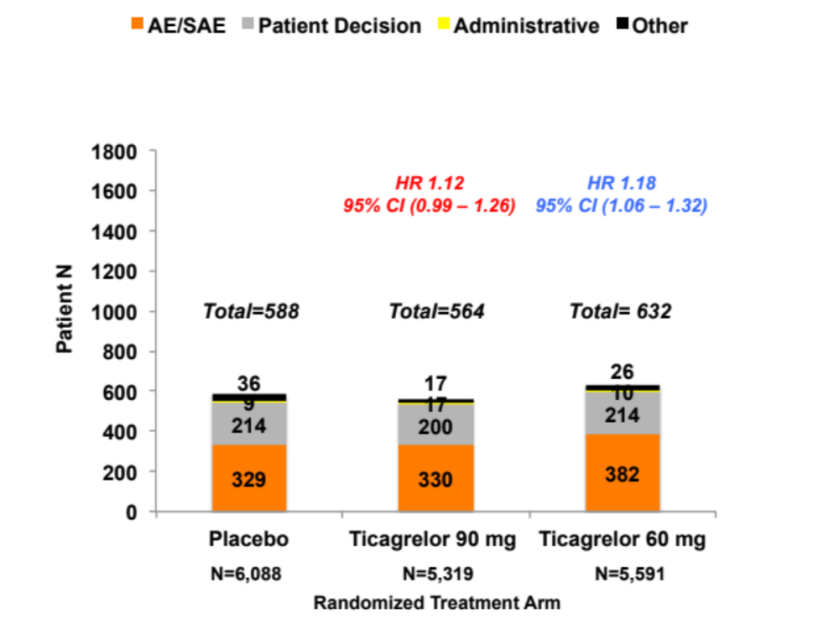
Drug discontinuation by Treatment Arm
First Year
Years 2 + 3

Slide 8
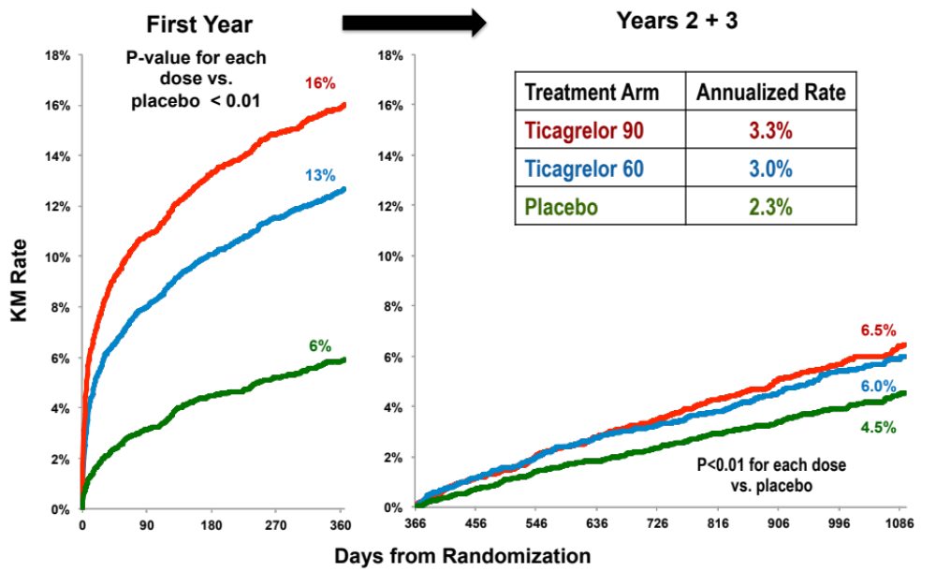
Drug discontinuation for AE by Treatment
Ticagarelor 90 mg twice daily
Ticagrelor 60 mg twice daily
Placebo

Slide 9
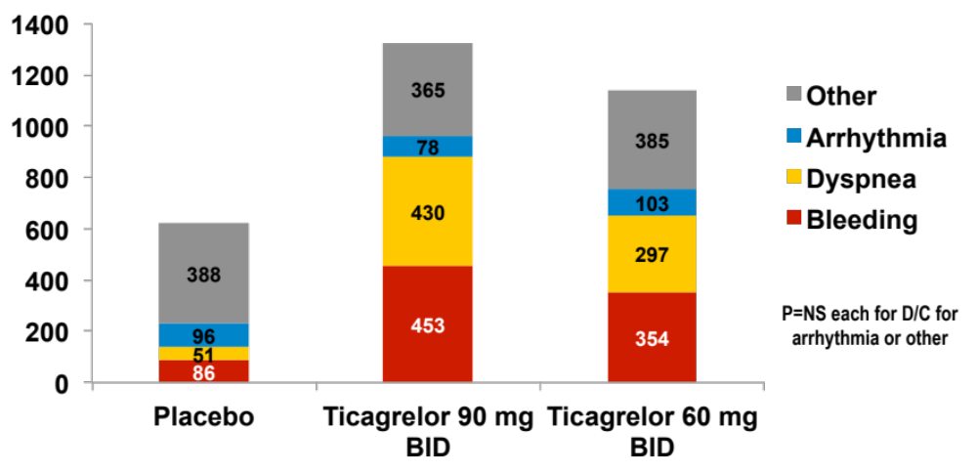
Adverse Events Leading to Discontinuation
3 Year KM Rate (%) – p-value for each dose vs. placebo <0.001
Treatment Arm | Any AE | Bleeding | Dyspnea
Ticagrelor 90 | 19.0% | 7.8% | 6.5%
Ticagrelor 60 | 16.4% | 6.2% | 4.6%
Placebo | 8.9% | 1.5% | 0.8%
Number of Patients

Slide 10
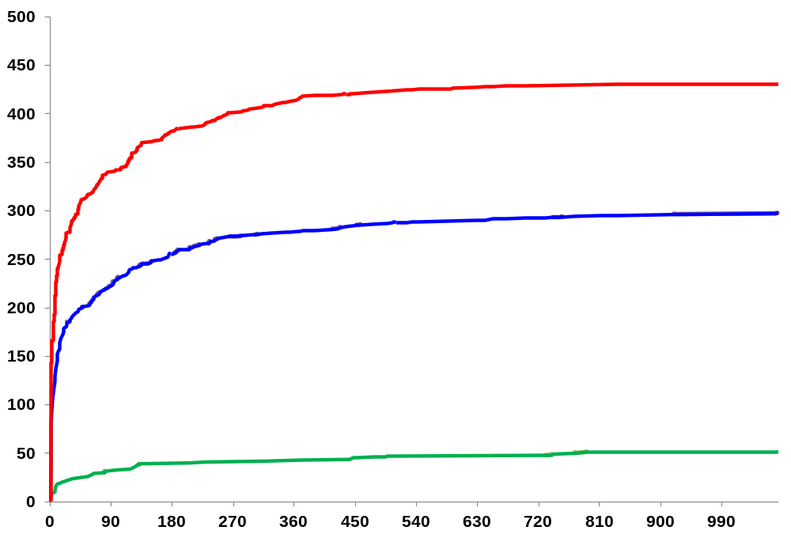
Discontinuation over time for Dyspnea by Randomization Group
Placebo
Ticagrelor 60 mg twice daily
Ticagrelor 90 mg twice daily
P<0.01 for each dose vs. placebo
Median Days to Discontinuation
8
Number of Patients Discontinued for Dyspnea
11
53
Days From Randomization

Slide 11
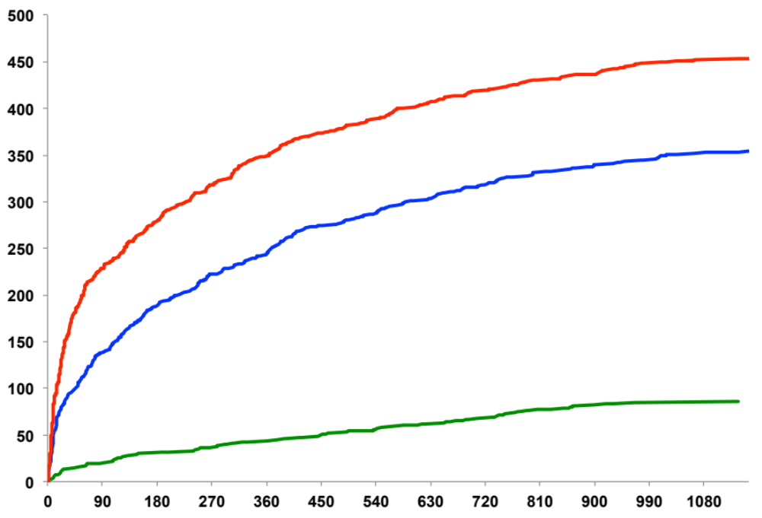
Discontinuation over time for Bleeding by Randomization Group
Placebo
Ticagrelor 60 mg twice daily
Ticagrelor 90 mg twice daily
P<0.01 for each dose vs. placebo
86
Number of Patients Discontinued for Bleeding
156
Median Days to Discontinuation
344
Days From Randomization

Slide 12
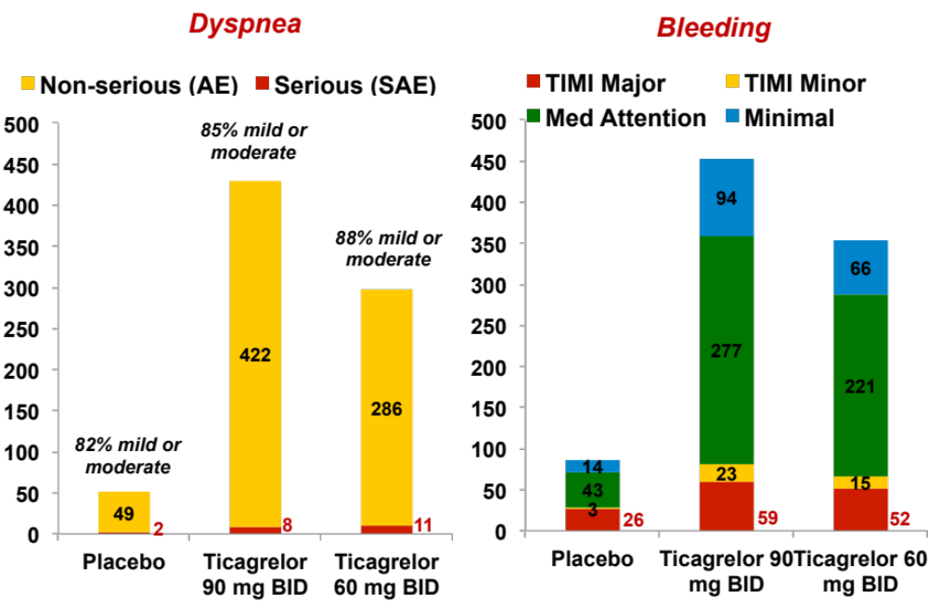
Dyspnea and Bleeding
Number of Patients

Slide 13
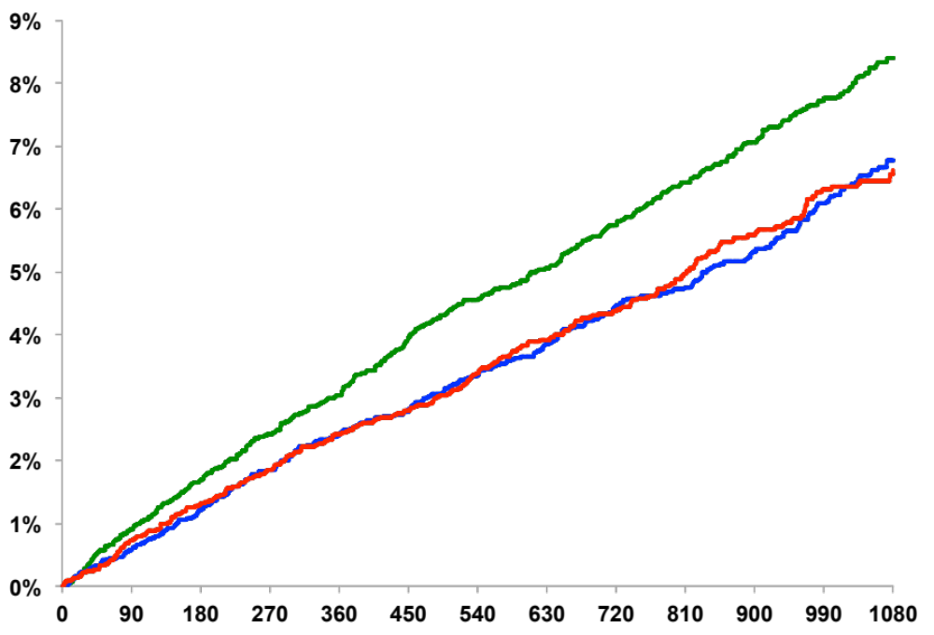
Cardiovascular Death, Myocardial Infarction or Stroke at 3 Years by Randomization Group in Patients On Treatment
Placebo
8.4%
Ticagrelor 60 mg BID
Ticagrelor 90 mg BID
HR 0.79
(95% CI 0.68 – 0.91)
P<0.001
HR 0.78
(95% CI 0.68 – 0.90)
P<0.001
6.8%
6.6%
KM Rate (%) at 3 Years
Days from Randomization

Slide 14
Efficacy of Ticagrelor – On Treatment*
3 Year KM Rate (%)
Ticagrelor Placebo
HR (95% CI)
P-value
6.6
8.4
0.79 (0.68 – 0.91)
<0.001
CVD / MI / Stroke
6.8
0.78 (0.68 – 0.90)
<0.001
6.7
0.78 (0.70 – 0.88)
<0.001
1.9
2.4
0.78 (0.60 – 1.03)
0.076
CV Death
1.8
0.74 (0.57 – 0.97)
0.031
1.9
0.76 (0.61 – 0.96)
0.019
1.3
1.6
0.75 (0.54 – 1.04)
0.087
Coronary Heart Disease Death
1.2
0.72 (0.52 – 1.00)
0.052
1.3
0.74 (0.56 – 0.97)
0.029
3.8
4.9
0.78 (0.65 – 0.94)
0.0080
Myocardial Infarction
4.1
0.81 (0.68 – 0.97)
0.0236
4.0
0.80 (0.68 – 0.93)
0.0036
1.4
1.8
0.77 (0.56 – 1.05)
0.094
Stroke
1.4
0.73 (0.53 – 1.00)
0.048
1.4
0.75 (0.58 – 0.97)
0.029
Ticagrelor 90 mg
Ticagrelor Better
Placebo Better
Ticagrelor 60 mg
1.0
Pooled
*N=20,942 patients who received at least one dose of study drug including events through 7 days from the last dose of study drug. Results consistent after propensity score adjustment

Slide 15
Summary
Discontinuation of newly started ticagrelor among stable outpatients with prior MI was driven by adverse events of bleeding and dyspnea
Although significant enough to prompt discontinuation, the majority of:
  Dyspnea was non-serious (>95%) and only mild-mod. in intensity (> 80%)
  Bleeds were minimal or medical attention
Among patients who remained on therapy
  Discontinuation for an AE after one year of exposure was low (~3%/y)
  Ischemic risk was robustly reduced, particularly in those continuing P2Y₁₂ inhibition or restarting after a brief interruption (≤ 30 days)

Slide 16
Conclusions
“Non-serious” bleeding and other AEs still have important consequences including discontinuation of therapy
These data underscore the need for patient counseling when initiating anti-thrombotic therapies in order to maximize adherence and improve outcomes

