Slide 1



Slide 2
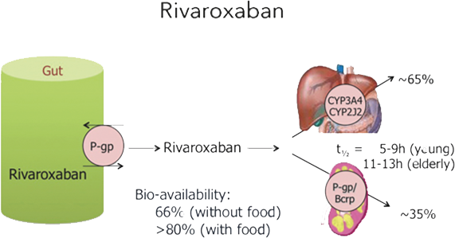

Absorption and Metabolism of Rivaroxaban

Slide 3
Mechanisms Underlying DDI in Rivaroxaban
P-glycoprotein transporter involved in absorption and renal clearance – plasma levels may be affected by P-gp inducers or inhibitors¹
Cytochrome P450 CYP3A4 involved in hepatic clearance of rivaroxaban and apixaban – plasma levels may be affected by CYP3A4 inducers of inhibitors²
1. Gnoth et al, J Pharmacol Exp Ther 2011;338:372-80 2. Mueck et al, Br J Clin Pharmacol 2013
Notes:
DDI: Drug-Drug interactions

Slide 4
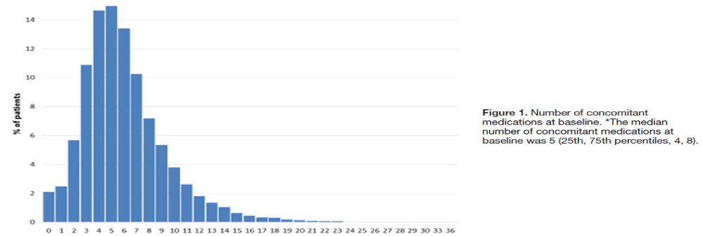
Poly pharmacy and DDI in cardiac patients
The median number of concomitant medications at base line is 5
Ann int med 1999

Slide 5
Possible Drug–Drug Interactions:
Effect on Rivaroxaban Plasma Levels (Part 1)
 |  | Rivaroxaban
Antiarrhythmic drugs
Amiodarone | moderate P-gp competition |  | Minor effect (use with caution if CrCl <50 mL/min)
Digoxin | P-gp competition |  | No effect
Diltiazem | P-gp competition and weak CYP3A4 inhibition |  | Minor effect (use with caution if CrCl 15–50 mL/min)
Dronedarone | P-gp competition and CYP3A4 inhibition |  | Moderate effect but no PK or PD data:caution and try to avoid
Quinidine | P-gp competition |  | Extent of increase unknown
Verapamil | P-gp competition (and weak CYP3A4 inhibition) |  | Minor effect*** (use with caution if CrCl 15–50 mL/min)
Notes:
Red – contraindicated/not recommended
orange – reduce dose
yellow – consider dose reduction if another yellow factor present
hatching – no PK data available

Slide 6
Possible Drug–Drug Interactions:
Effect on Rivaroxaban Plasma Levels (Part 2)
 |  | Rivaroxaban
Other cardiovascular drugs
Atorvastatin | P-gp competition and CYP3A4 inhibition |  | No effect
Antibiotics
Clarithromycin; Erythromycin | moderate P-gp competition and CYP3A4 inhibition |  | +30–54 %
Rifampicin*** | P-gp/ BCRP and CYP3A4/CYP2J 2 inducers |  | Up to -50 %
Antiviral drugs
HIV protease inhibitors (e.g. ritonavir) | P-gp and BCR competition or inducer; CYP3A4 inhibition |  | Up to +153 %
Fungostatics
Fluconazole | Moderate CYP3A4 inhibition |  | +42 % ( if systemically administered)
Itraconazole; Ketoconazole; Posaconazole; Voriconazole; | potent P-gp and BCRP competition; CYP3A4 inhibition |  | Up to +160 %
Notes:
Red – contraindicated/not recommended
orange – reduce dose
yellow – consider dose reduction if another yellow factor present
hatching – no PK data available

Slide 7
Possible Drug–Drug Interactions:
Effect on Rivaroxaban Plasma Levels (Part 3)
 |  | Rivaroxaban
Immunosupressive
Cyclosporin; Tacrolimus | P-gp competition |  | Extent of increase unknown
Antiphlogistics
Naproxen | P-gp competition |  | No data yet
Antacids
H2B; PPI; Al-Mg-hydroxide | GI absorption |  | No effect
Others
Carbamazepine***; Phenobarbital***; Phenytoin***; St John’s wort*** | P-gp/ BCRP and CYP3A4/CYP2J 2 inducers |  | Up to -50 %
Other factors
Age ≥80 years | Increased plasma level
Age ≥75 years | Increased plasma level
Notes:
Red – contraindicated/not recommended
orange – reduce dose
yellow – consider dose reduction if another yellow factor present
hatching – no PK data available

Slide 8
Possible Drug–Drug Interactions:
Effect on Rivaroxaban Plasma Levels (Part 4)
 |  |  | Rivaroxaban
Other factors
Weight≤60 kg | Increased plasma level
Renal function | Increased plasma level
Pharmacodynamic interactions – antiplatelet drugs, NSAIDs
Systemic steroid therapy Other anticoagulants
History of GI bleeding
Recent surgery on critical organ (brain; eye)
Thrombocytopenia (e.g. chemotherapy)
HAS-BLED ≥3
Other increased bleeding risk
Notes:
Red – contraindicated/not recommended
orange – reduce dose
yellow – consider dose reduction if another yellow factor present
hatching – no PK data available

Slide 9
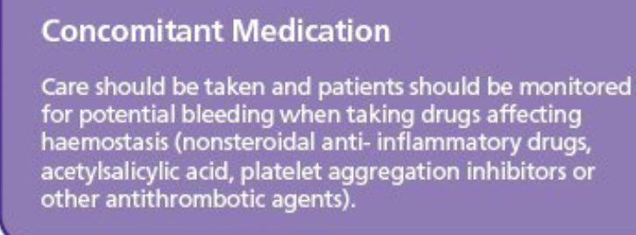
NSAIDs and Antiplatlates

Slide 10
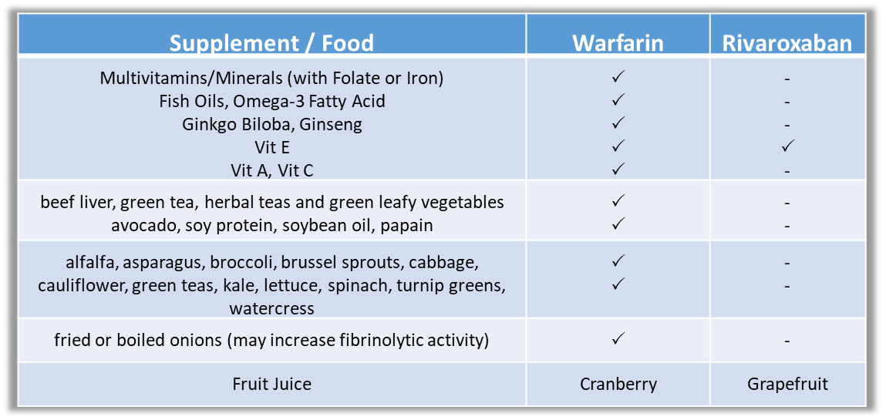
Drug-Food interactions
FDA lable

Slide 11
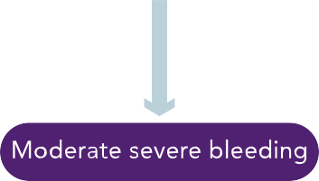

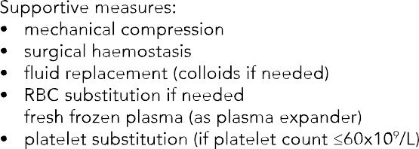

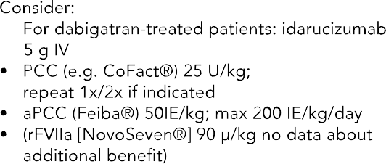
Possible measures to take in case of bleeding

Slide 12
Reversal of Rivaroxaban
Suggestions for Reversal of New Oral Anticoagulants
 | Rivaroxaban
Oral activated charcoal | Yes
Hemodialysis | No
Hemoperfusion with activated charcoal | Possible
Fresh frozen plasma(FFP) | No
Activated factor VIIa | Unclear
3-factor PCC | Unclear
4-factor PCC | Possible
Notes:
Charcoal use until 6h after ingestion

Slide 13
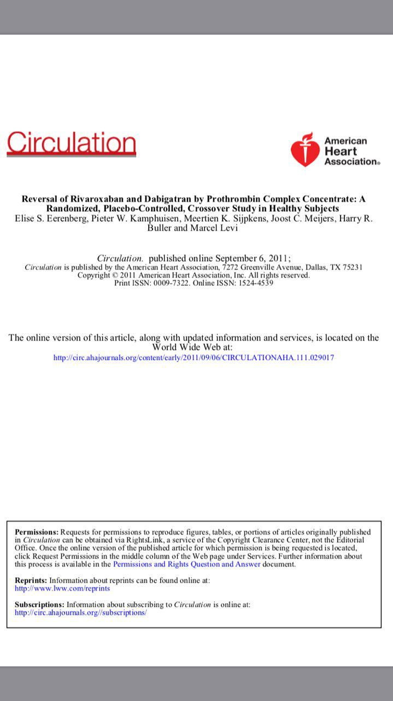

Slide 14
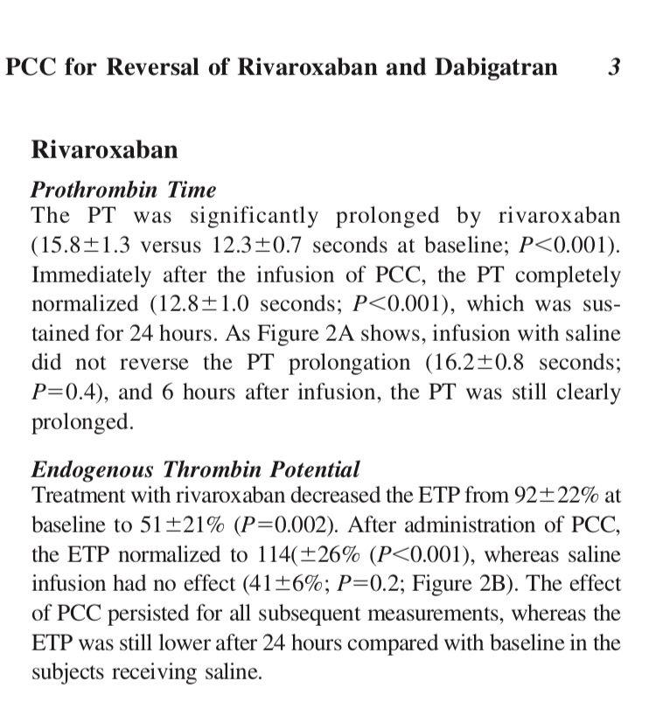

Slide 15
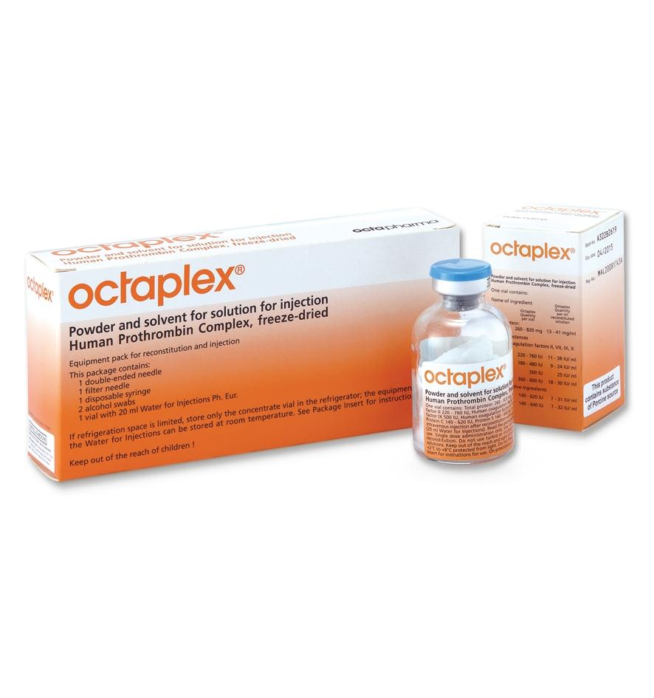
Reversal of Rivaroxaban
INR 2to<4 : 25 units/kg; not to exceed 2500 units
INR 4-6: 35 units/kg; not to exceed 3500 units
INR >6: 50 units/kg; not to exceed 5000 units
For 80 kg patient with INR 5.0:
35 units/kg * 80 kg = 2800 units

Slide 16
Administration of PCC
Infuse IV at rate of 0.12 mL/kg/min (~3 units/kg/min),
up to maximum rate of 8.4 mL/min (~210 units/min)
Reconstituted solution should be at room temperature before infusing
Do not mix with other medicinal products
Administer through a separate infusion line
No blood should enter the syringe, as there is a possibility of fibrin clot formation

Slide 17
Urgent Surgical Intervention
Discontinue NOAC.
Try to defer surgery at least 12 h and ideally 24 h after last dose.
For patients on FXa inhibitors:
  no specific reversal agents available yet (Andexanete Alpha), but under development.
  A strategy with PCC or aPCC pre-operatively has not been studied and cannot be recommended.

Slide 18
Warfarin OR Noacs

Slide 19
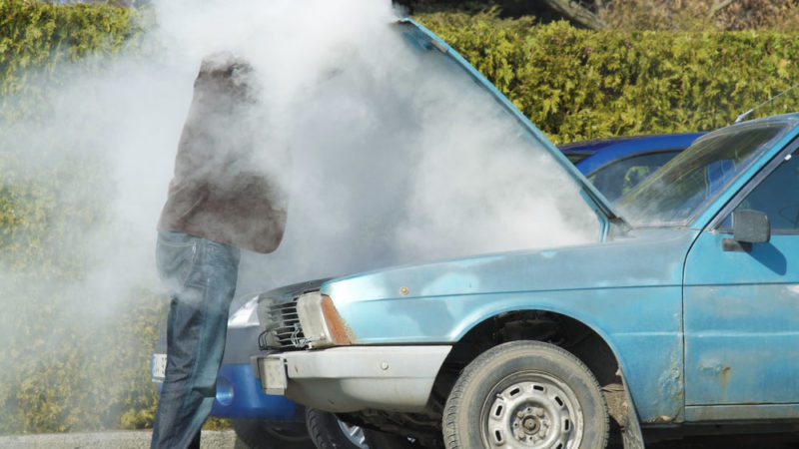
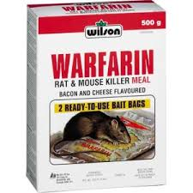
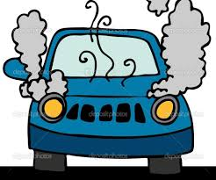

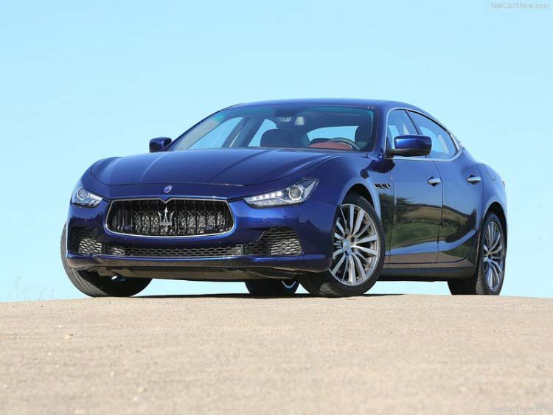
Major Bleeding and ICH

Slide 20

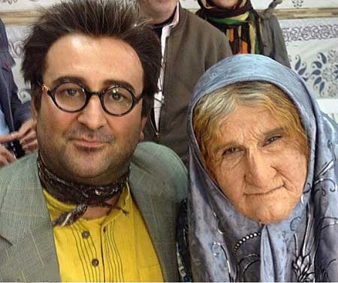
Monitoring and D.D , D.F interactions
OR

Slide 21
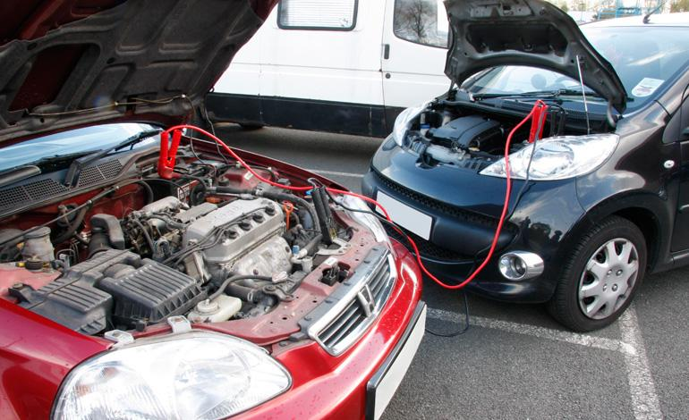
Noacs are Solution

Slide 22
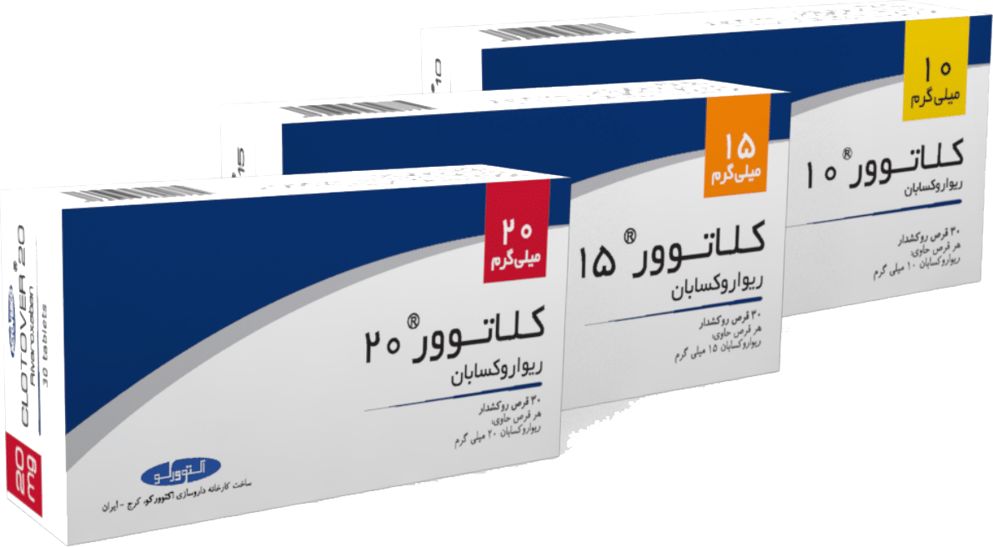
Dr. Amin ADILI
Cardiovascular team senior supervisor mail: amin.adili@actoverco.com cell phone: +989127194129

