Slide 1
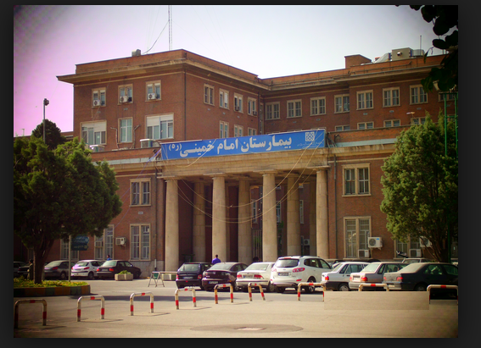
Triple therapy
Reza Mollazadeh, Associate professor of cardiology; Fellowship of interventional cardiac electrophysiology and pacemaker, Imam Khomeini medical center, Tehran University of medical sciences

Slide 2
Case 1
A 55 year-old man underwent Primary PCI on LAD with DES due to extensive anterior MI last week. Next day he developed AF and remained in AF rhythm throughout the hospital course. Past medical history was remarkable for hypertension and cigarette smoking for 5 and 30 years respectively. LVEF at discharge was 30%. He is been discharged with ASA, Clopidogrel, captopril and carvedilol, atorvastatin. What is your recommendation regarding anticoagulation in this patient?
1) Considering high risk of bleeding, there is no need for adding antithrombotics.
2) ASA and Clopidogrel long life is recommended
3) ASA, Clopidogrel and (N)OAC for 1 month is recommended.
4) ASA, Clopidogrel and (N)OAC for 6 months is recommended.
Notes:
CHADS-VASc=3
HAS-BLED score=2

Slide 3
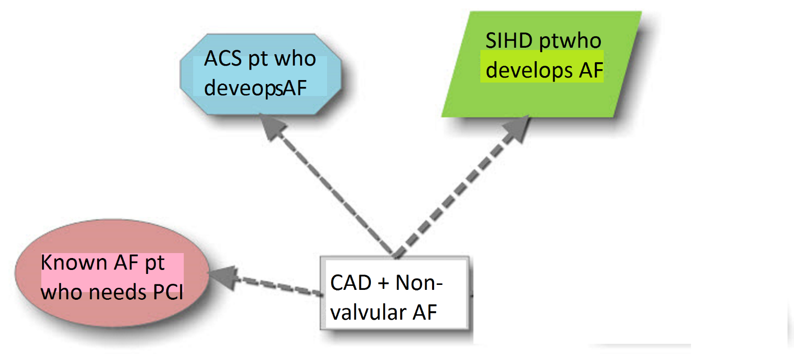
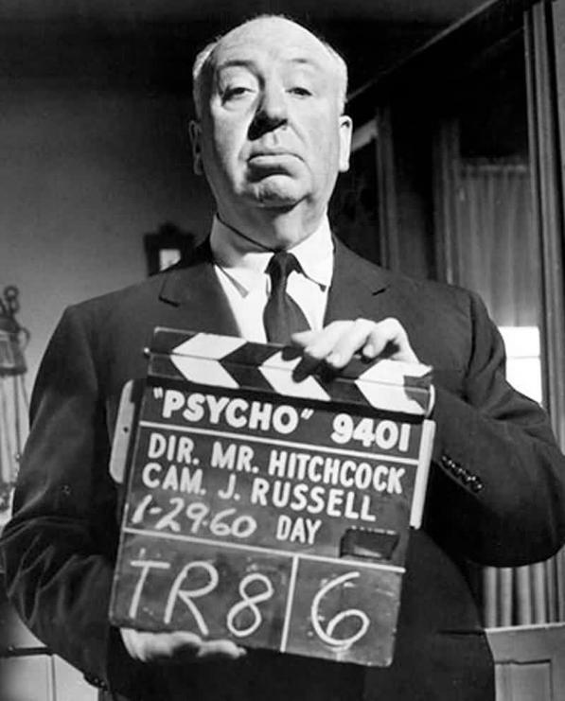
Scenario: CAD + Non- valvular AF

Slide 4
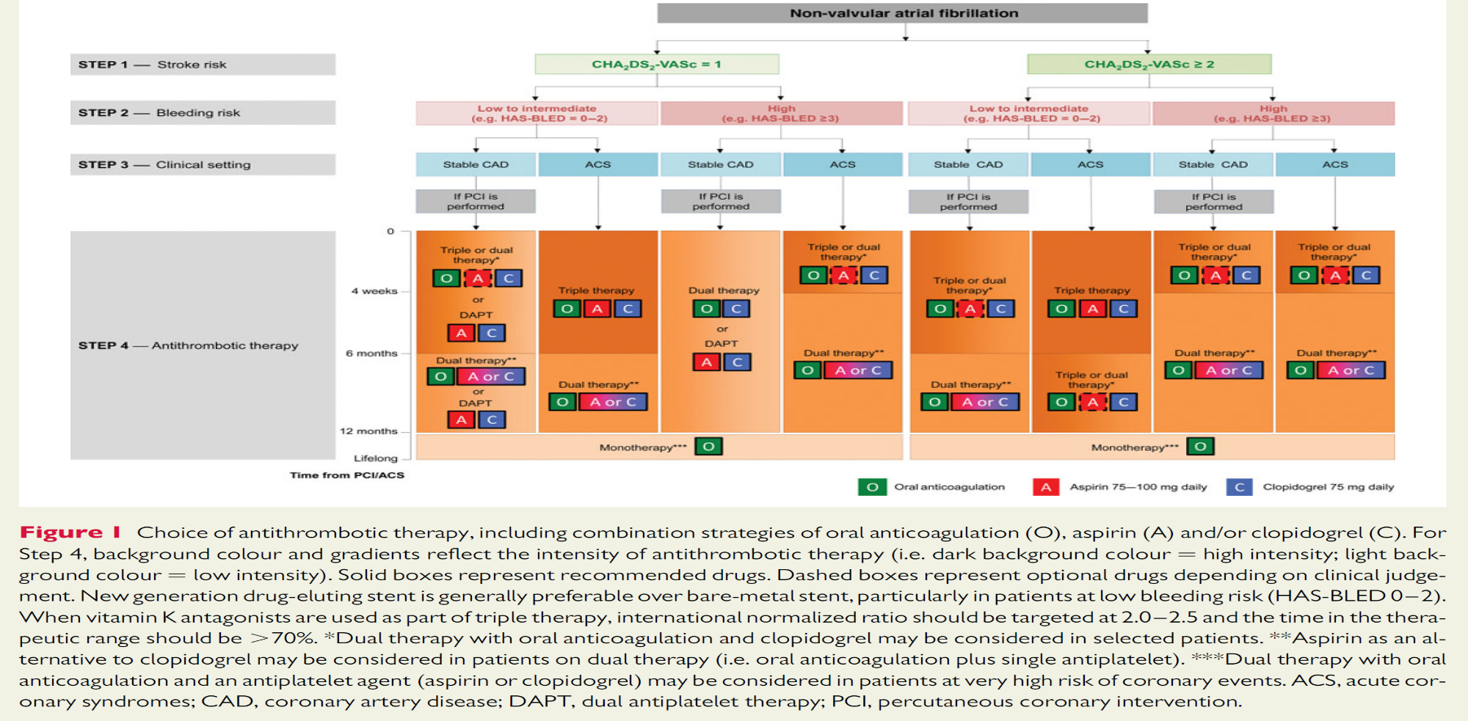

Slide 5
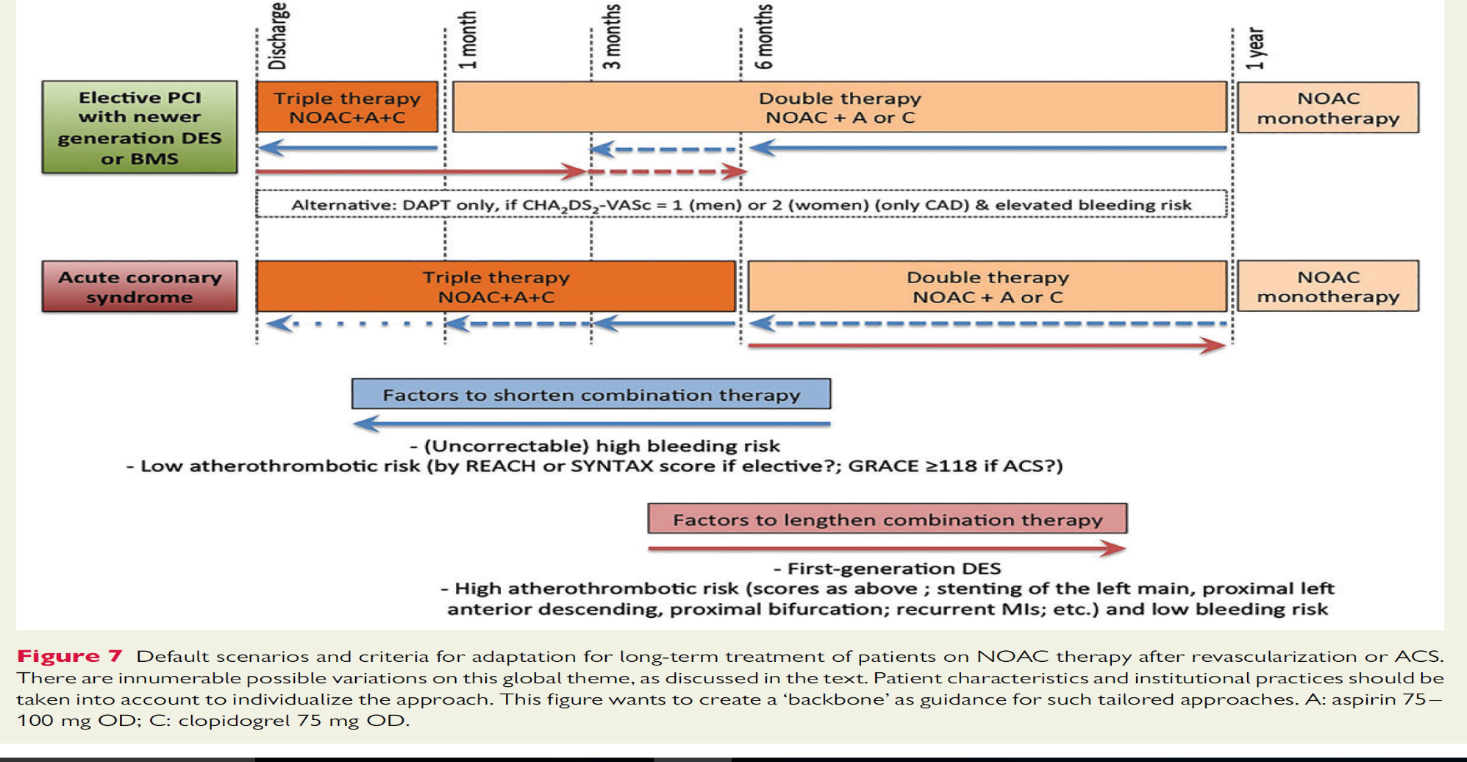

Slide 6
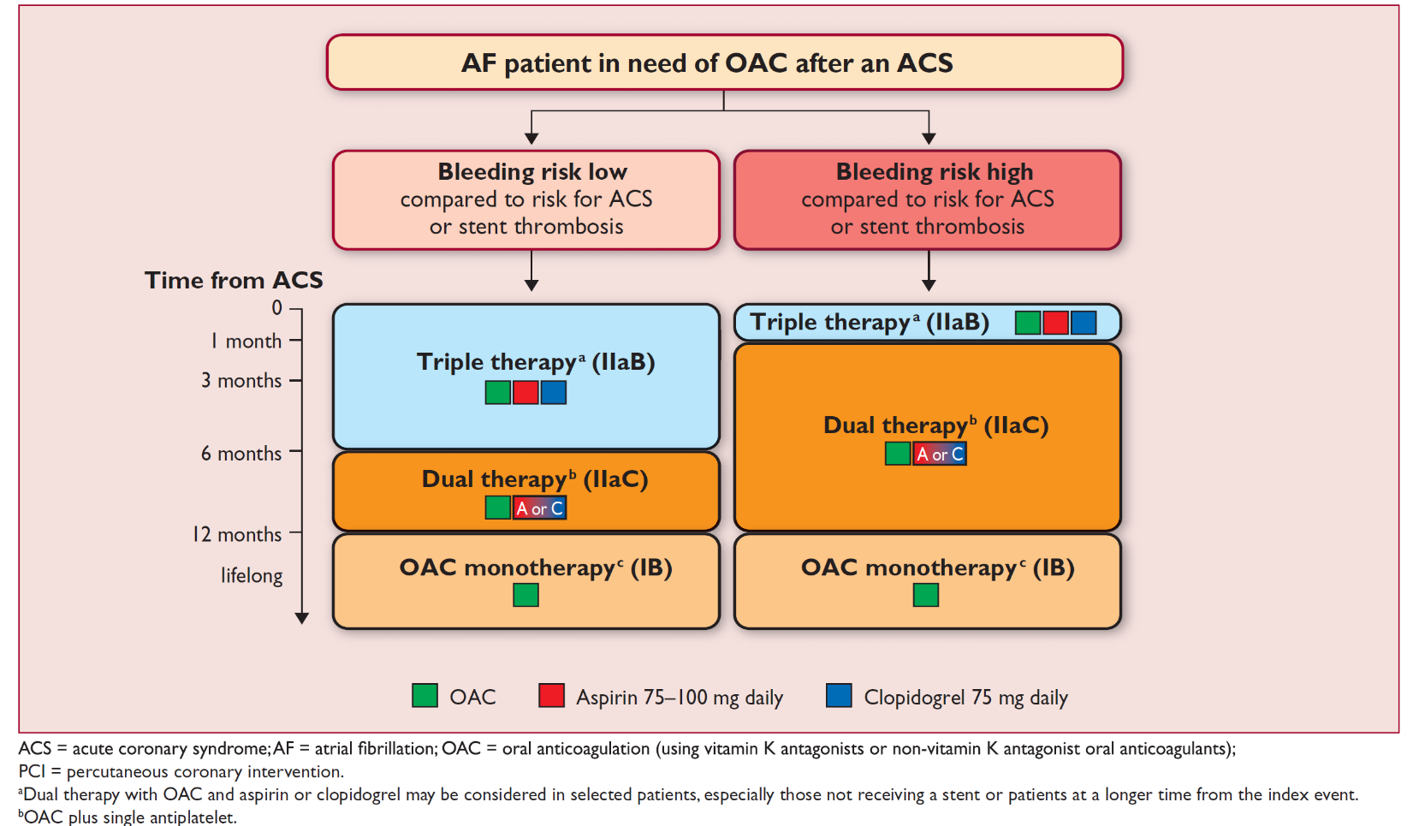

Slide 7
Case 1
A 55 year-old man underwent Primary PCI on LAD with DES due to extensive anterior MI last week. Next day he developed AF and remained in AF rhythm throughout the hospital course. Past medical history was remarkable for hypertension and cigarette smoking for 5 and 30 years respectively. LVEF at discharge was 30%. He is been discharged with ASA, Clopidogrel, captopril and carvedilol, atorvastatin. What is your recommendation regarding anticoagulation in this patient?
1) Considering high risk of bleeding, there is no need for adding antithrombotics.
2) ASA and Clopidogrel long life is recommended
3) ASA, Clopidogrel and (N)OAC for 1 month is recommended.
4) ASA, Clopidogrel and (N)OAC for 6 months is recommended.
CHADS-VASc=3
HAS-BLED score=2
Notes:
CHADS-VASc=3
HAS-BLED score=2

Slide 8
What should we do if patients bleed on NOAC
Reza Mollazadeh, Associate professor of cardiology; Fellowship of interventional cardiac electrophysiology and pacemaker, Imam Khomeini medical center, Tehran University of medical sciences
Notes:
I here in not just talk on the issue of bleeding, but also talk about the perioperative management of patients undergoing urgent surgery.
I tried to iranized my lecture.

Slide 9
Case presentation
A 76 – year old woman was brought to ER due to loss of consciousness. Brain CT scan showed massive ICH. Past medical history was remarkable for hypertension, CKD (Creatinine =1.8 mg/dl) and permanent AF. Pradaxa (Dabigatran) 150 mg bid was administered since 1 month ago for anticoagulation (CHADS- VASC=4, HAS BLED=3). Neurosurgery consultant suggested for urgent decompression. What is your pre-operative suggestion for this patient?
1) Surgery should be postponed for at least 24-48 hour
2) She can be operated after administering Vitamin K and FFP
3) She can be operated after administering cryoprecipitate
4) She can be operated soon after Activated prothrombin complex concentrate infusion

Slide 10
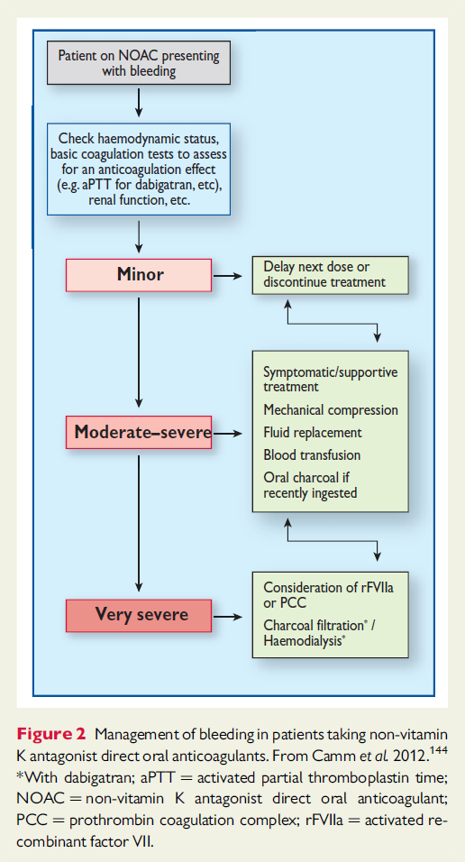

Reversal of anticoagulant therapy
Notes:
Antifibrinolytic agent (eg, tranexamic acid, epsilon-aminocaproic acid)
Oral activated charcoal (if last dose within prior two hours)

Slide 11
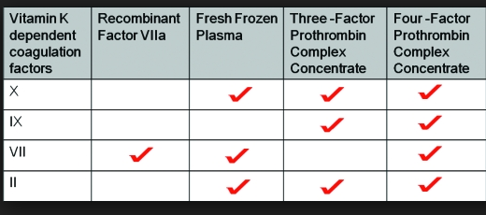
Notes:
4- factor PCC may be activated (Factor VII activated eg FEIBA o ) or simple (with simple Factor VII (eg, Kcentra).

Slide 12
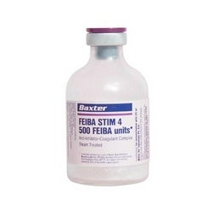
aPCC available in IRAN
اوین دارو | ACTIVATED PROTHROMBIN COMPLEX(CONCENTRATED) | Injection,Powder,Lyophilized 500 IU | BERIPLEX P/N | CSL BEHRING | GERMANY | 1219239916663072
پورا طب | ACTIVATED PROTHROMBIN COMPLEX(CONCENTRATED) | Injection,Powder,Lyophilized 500 IU | OCTAPLEX | OCTAPHARMA | AUSTRIA | 1228216428
کار و اندیشه | ACTIVATED PROTHROMBIN COMPLEX(CONCENTRATED) | Injection,Powder,Lyophilized 1000 IU | FEIBA | BAXTER | AUSTRIA | 1228025013
كار و انديشه | ACTIVATED PROTHROMBIN COMPLEX(CONCENTRATED) | Injection,Powder,Lyophilized 500 IU | FEIBA | BAXTER | AUSTRIA | 1228025020
بهستان دارو | ACTIVATED PROTHROMBIN COMPLEX(CONCENTRATED) | Injection,Powder,Lyophilized 500 IU | UMAN COMPLEX D.I. | KEDRION | ITALY | 1228119187
Notes:
PCC concentration of vitamin K-dependent clotting factors is approximately 25 times higher than plasma. In terms of clotting factor concentration, 2000 mL of FFP is comparable to a dose of PCC.

Slide 13
Indications
Reversal of warfarin therapy or vitamin K deficiency in patients exhibiting major bleeding manifestations.
Reversal of warfarin therapy or vitamin K deficiency in patients requiring urgent(< 6 hours) surgical procedures.
Contraindications
Elective reversal of oral anticoagulant therapy pre – invasive procedure.
Treatment of elevated INRs without bleeding or need for surgical intervention.
Massive transfusion
Coagulopathy associated with Liver dysfunction
Patients with recent history of thrombosis, myocardial infarction or Disseminated Intravascular Coagulation (DIC)
Notes:
Recommended in:
Reversal of warfarin therapy or vitamin K deficiency in patients exhibiting major bleeding manifestations.
Reversal of warfarin therapy or vitamin K deficiency in patients requiring urgent(< 6 hours) surgical procedures.
Not recommended for:
▫Elective reversal of oral anticoagulant therapy pre – invasive procedure.
▫Treatment of elevated INRs without bleeding or need for surgical intervention.
▫For management of vitamin K antagonist overdose with elevated INR but without bleeding
▫Massive transfusion
▫Coagulopathy associated with Liver dysfunction
▫Patients with recent history of thrombosis, myocardial infarction or Disseminated Intravascular Coagulation (DIC)

Slide 14
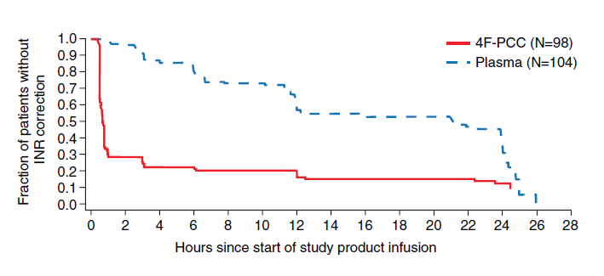
PCC vs FFP in patients treated with warfarin
Notes:
PCC provided more rapid and complete correction of INR as compared to FFP, however, it remains unclear if this led to improved clinical outcomes

Slide 15
Back to the case
A 76 – year old woman is brought to ER due to loss of consciousness. Brain CT scan showed massive ICH. Past medical history was remarkable for hypertension, CKD (Creatinine =1.8 mg/dl) and permanent AF. Pradaxa (Dabigatran) 150 mg bid was administered since 1 month ago for anticoagulation (CHADS- VASC=4, HAS BLED=3). Neurosurgery consultant suggested for urgent decompression. What is your pre-operative suggestion for this patient?
1) Surgery should be postponed for at least 24-48 hour
2) She can be operated after administering Vitamin K and FFP
3) She can be operated after administering cryoprecipitate
4) She can be operated soon after Activated prothrombin complex concentrate infusion

Slide 16
Patient quality of life on OACs
Reza Mollazadeh, Associate professor of cardiology; Fellowship of interventional cardiac electrophysiology and pacemaker, Imam Khomeini medical center, Tehran University of medical sciences

Slide 17
Case 3
A 75-year-old woman with new onset self terminating paroxysmal AF
Past medical history: CAD (2VD), MI two years ago,
Arterial hypertension
CRF: Cr-Clearance around 40ml/min
Otherwise good health condition

Slide 18
Question 1:
Does this patient need (long term) therapeutic anticoagulation?
1) Yes
2) No
Notes:
Role of CHA2DS2-VASc score
CHA2DS2-VASc score ==➔5
HAS-BLED score=➔3

Slide 20
Question 1:
Does this patient need (long term) therapeutic anticoagulation?
1) Yes
2) No
CHA2DS2-VASc score ==➔5
HAS-BLED score=➔3
Notes:
Role of CHA2DS2-VASc score
CHA2DS2-VASc score ==➔5
HAS-BLED score=➔3

Slide 21
Question 2:
What would be your agent of choice for prevention of thromboembolic events in this patient?
1) ASA
2) ASA + Clopidogrel
3) Warfarin (1.5<INR<2.5)
4) NOAC
Notes:
SaMe-TT2R2>2 so NOAC is a better option

Slide 22
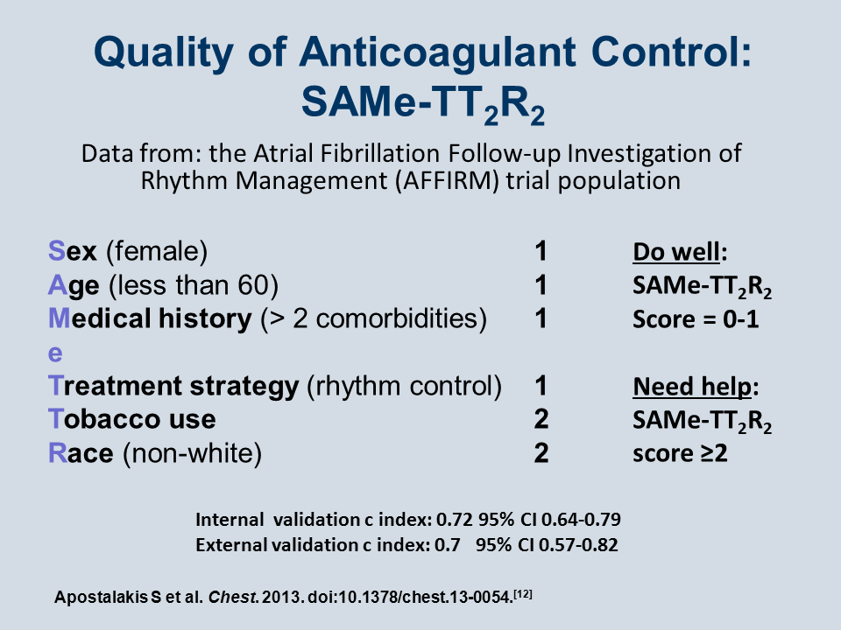
Notes:
Medical history (two of the following: hypertension, diabetes, MI, PAD, congestive heart failure, history of stroke, pulmonary disease, hepatic or renal disease)
Treatment (interacting medications e.g. amiodarone)

Slide 23
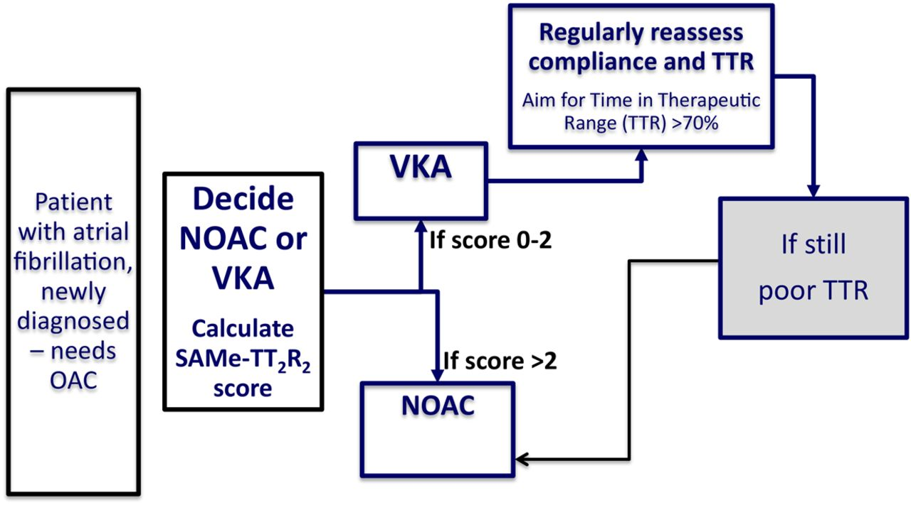

Slide 24
Question 2:
What would be your agent of choice for prevention of thromboembolic events in this patient?
1) ASA
2) ASA + Clopidogrel
3) Warfarin (1.5<INR<2.5)
4) NOAC
SaMe-TT2R2>2

Slide 25

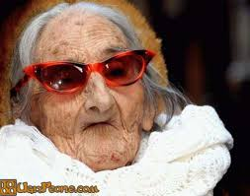
Sometimes choosing between NOAC vs. Warfarin is like
Take home message

Slide 26
Role of t-PA in STEMI
Reza Mollazadeh, Associate professor of cardiology; Fellowship of interventional cardiac electrophysiology and pacemaker, Imam Khomeini medical center, Tehran University of medical sciences

Slide 27
Case 4
You are working as a cardiology resident in Imam Khomeini hospital. Your Cath lab is open and primary PCI is performed from 6 AM up to 10 PM.
In which of the following scenarios you administer t-PA instead of transfer to another 24 hour PCI capable center for a patient with STEMI at 3 o'clock AM (the patient is in the ER)?
A 55 year-old man with chest pain since 6 hours ago if FMC-device is 90 min
A 60 year-old man with Ext anterior STEMI and ongoing chest pain since 18 hour ago and next Cath lab is occupied
A 70-year-old woman with chest pain and total ischemic time 100 minutes
A 80 year-old woman with BP=180/90 and ongoing chest pain since 1 hours ago

Slide 28
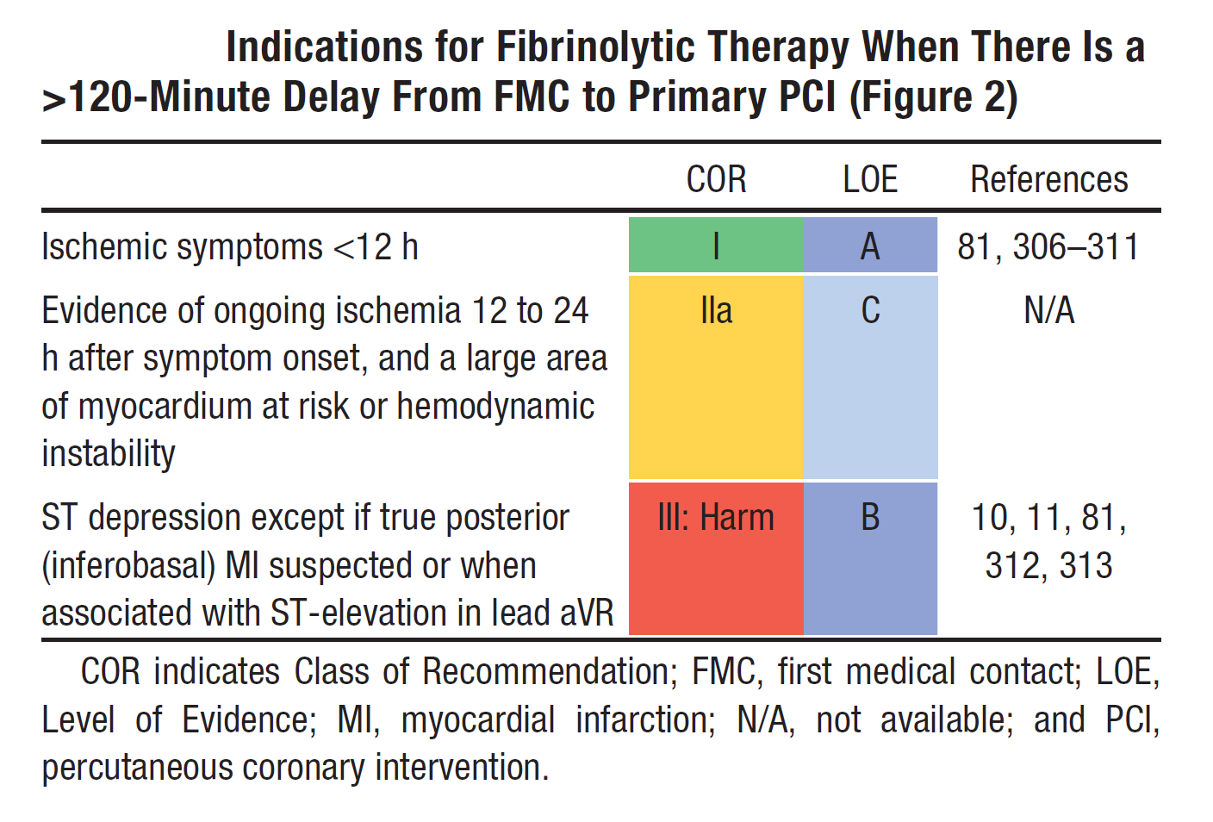

Slide 29
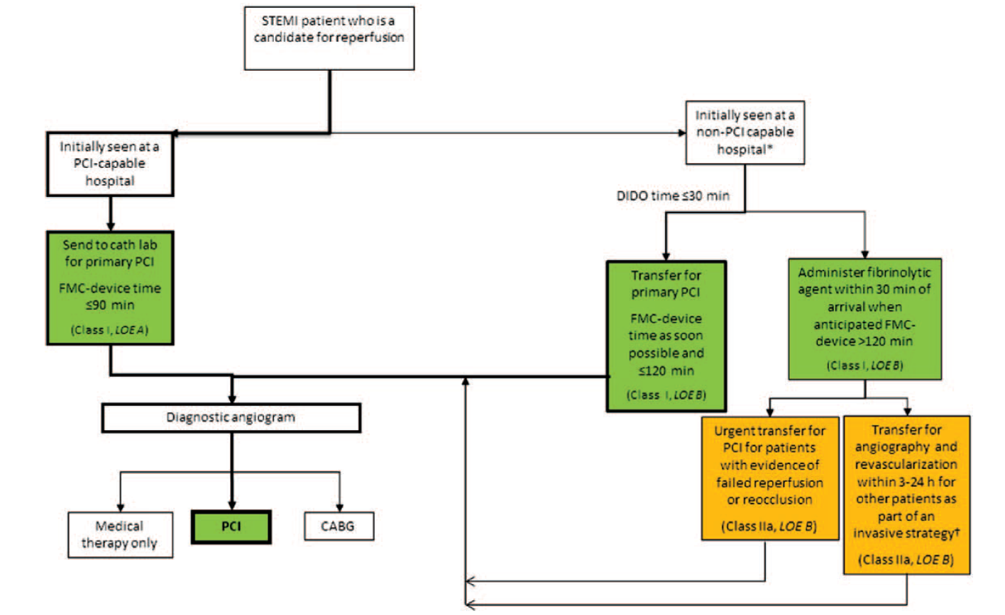

Slide 30
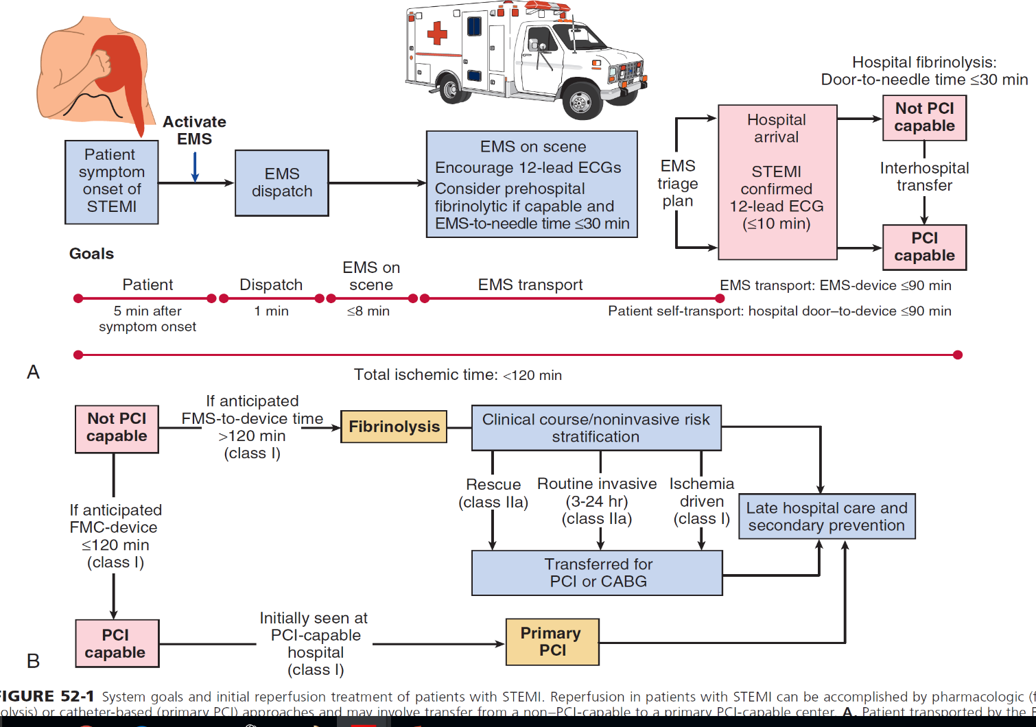

Slide 31
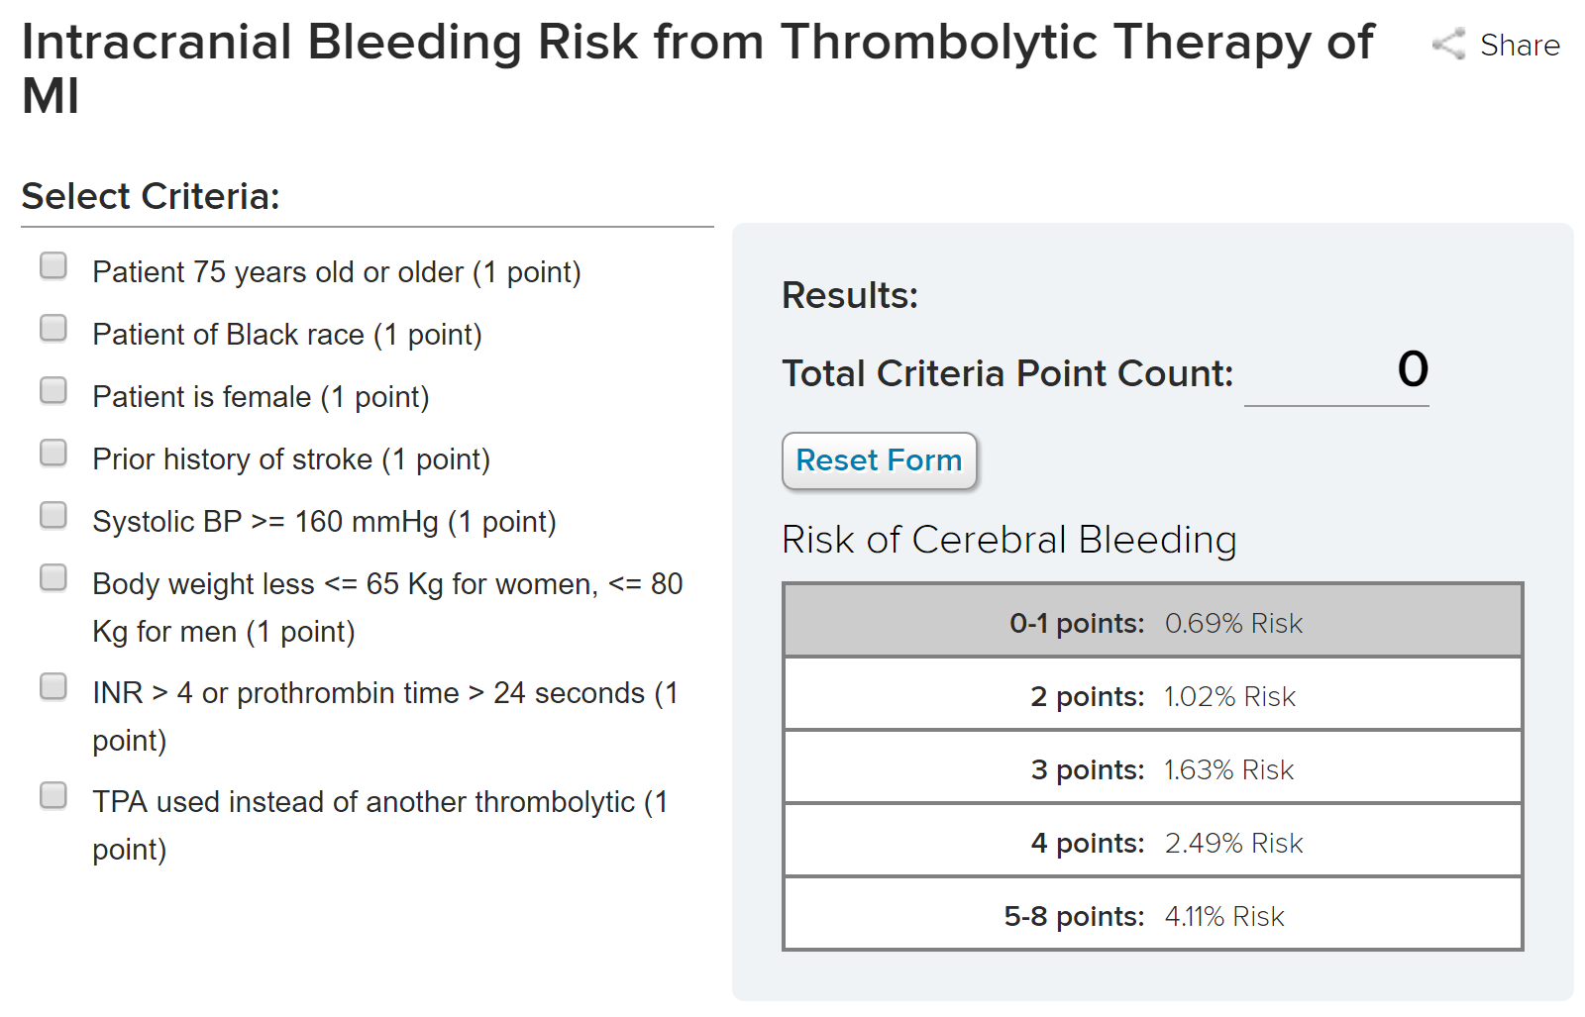

Slide 32
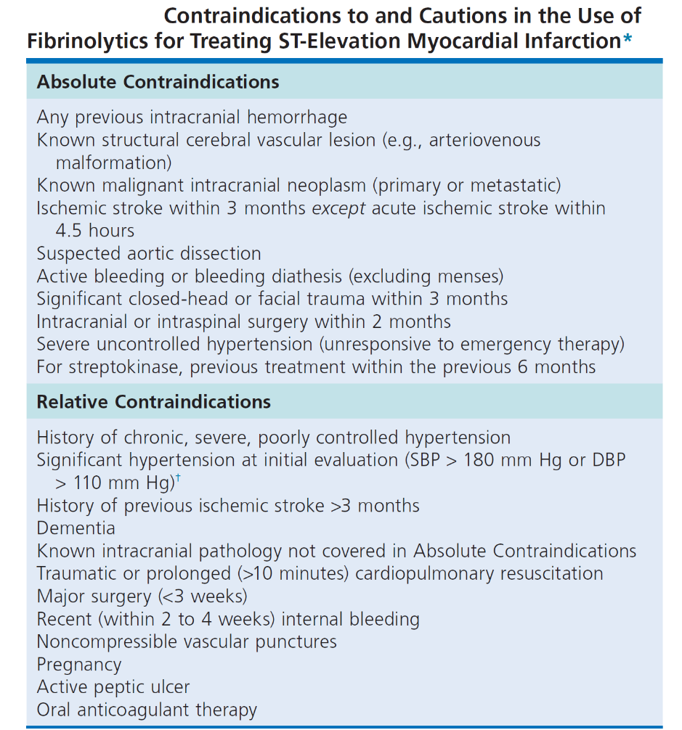

Slide 33
Case 4
You are working as a cardiology resident in Imam Khomeini hospital. Your Cath lab is open and primary PCI is performed from 6 AM up to 10 PM.
In which of the following scenarios you administer t-PA instead of transfer to another 24 hour PCI capable center for a patient with STEMI at 3 o'clock AM (the patient is in the ER)?
A 55 year-old man with chest pain since 6 hours ago if FMC-device is 90 min
A 60 year-old man with Ext anterior STEMI and ongoing chest pain since 18 hour ago and next Cath lab is occupied
A 70-year-old woman with chest pain and total ischemic time 100 minutes
A 80 year-old woman with BP=180/90 and ongoing chest pain since 1 hours ago

Slide 34
Case 4
You are working as a cardiology resident in Imam Khomeini hospital. Your Cath lab is open and primary PCI is performed from 6 AM up to 10 PM.
In which of the following scenarios you administer t-PA instead of transfer to another 24 hour PCI capable center for a patient with STEMI at 3 o'clock AM (the patient is in the ER)?
A 55 year-old man with chest pain since 6 hours ago if FMC-device is 90 min
A 60 year-old man with Ext anterior STEMI and ongoing chest pain since 18 hour ago and next Cath lab is occupied
A 70-year-old woman with chest pain and total ischemic time 100 minutes
A 80 year-old woman with BP=180/90 and ongoing chest pain since 1 hours ago

Slide 35
How to switch between NOAC and Warfarin
Reza Mollazadeh, Associate professor of cardiology; Fellowship of interventional cardiac electrophysiology and pacemaker, Imam Khomeini medical center, Tehran University of medical sciences

Slide 36
Case 5
A 75-year-old man with permanent AF for many years
Past medical history: Arterial hypertension, LVEF of 60%, Creatinine Clearance of 55 ml/min
On long-term Verapamil and warfarin therapy.
He has heard of Xarelto and wants to switch from warfarin to Rivaroxaban.
Notes:
CHADS-VASc =3
HAS-BLED=2

Slide 37
How can you switch from Warfarin to Xarelto?
1) Stop Warfarin and start Xarelto as soon as INR<1.5
2) Stop Warfarin and start Xarelto as soon as INR<3
3)Continue Warfarin and Xarelto concomitantly for 5 days and then D/C warfarin
4) Stop Warfarin 3-5 days and then start Xarelto

Slide 38
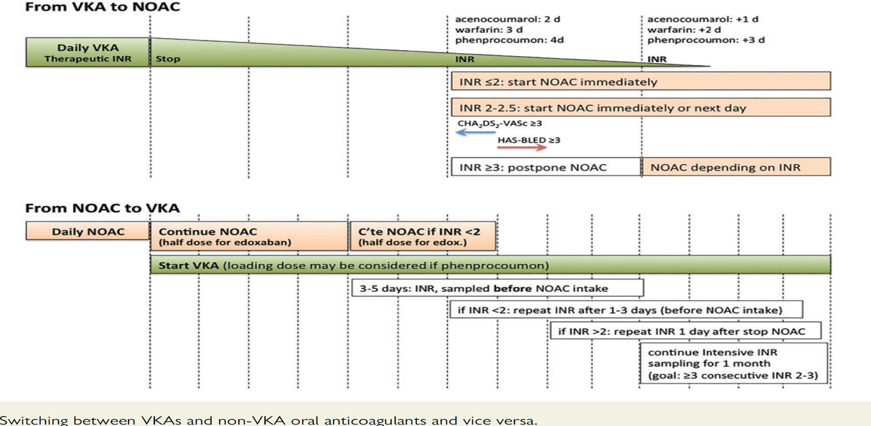
Switching between anticoagulant regimens
Notes:
The proposed scheme (also shown in Figure 4, top panel) tries to unify different specifications in the SmPCs, which state that NOAC can be started when INR is ≤3 for rivaroxaban, ≤2.5 for edoxaban, and ≤2 for apixaban and dabigatran

Slide 39
How can you switch from Warfarin to Xarelto?
How can you switch from Warfarin to Xarelto?
1) Stop Warfarin and start Xarelto as soon as INR<1.5
2) Stop Warfarin and start Xarelto as soon as INR<3
3)Continue Warfarin and Xarelto concomitantly for 5 days and then D/C warfarin
4) Stop Warfarin 3-5 days and then start Xarelto

Slide 40
Take home message
Before administering anticoagulant to a patient with AF, do not forget:
Patient’s CHA2DS2-VASc
Patient’s HAS-BLED
Dr Mollazadeh
Bayer company (Xarelto)

Slide 41
Which anticoagulants should we choose in the case of high bleeding risk?
Reza Mollazadeh, Associate professor of cardiology; Fellowship of interventional cardiac electrophysiology and pacemaker, Imam Khomeini medical center, Tehran University of medical sciences

Slide 42
A 83 year-old man had DVT and PTE after admission in hospital due to right knee septic arthritis. He has diabetes normal creatinine (1.3)(Cl creatinine=42 ml/min) (weight=70 kg). I treated him with Warfarin with INR goal of 2-2.5. In follow up His INR value was out of range in many times, so I switched to Rivaroxaban (Xarelto=15 mg qhs). Two weeks later he was admitted due to hematuria and INR=5???. What is your suggestion for him?
Dabigatran 110 mg bid
Dabigatran 75 mg bid
Rivaroxaban 10 mg qhs
Apixaban 2.5 mg bid
Apixaban 5 mg bid
Edoxaban 60 mg daily
Edoxaban 30 mg daily

Slide 43
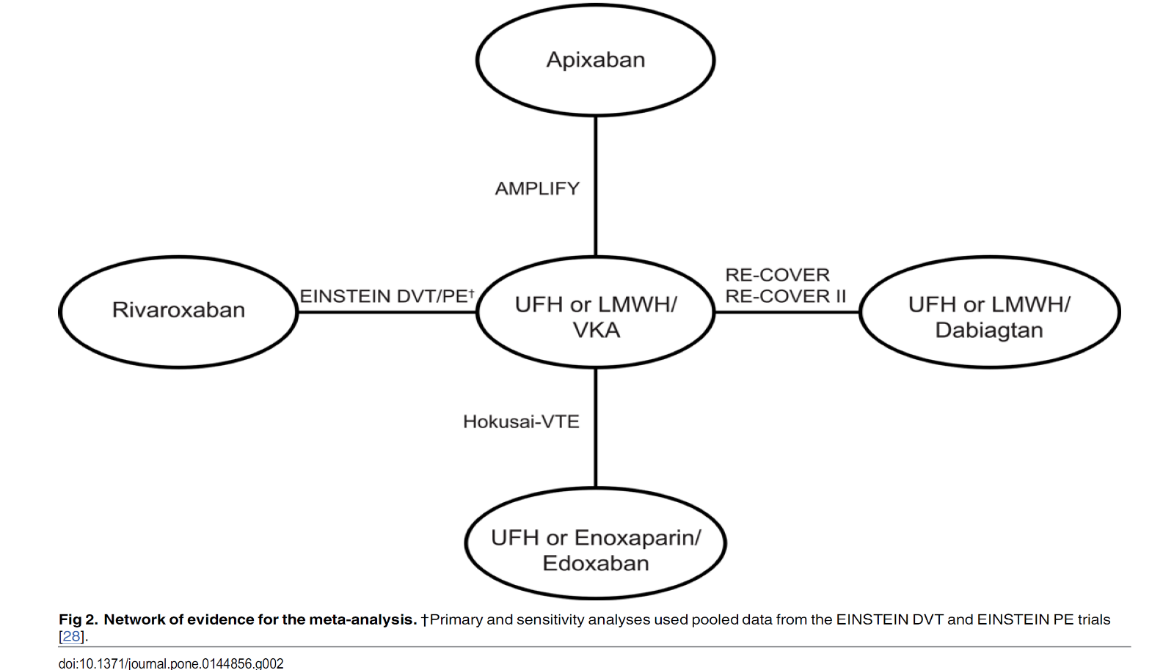

Slide 44
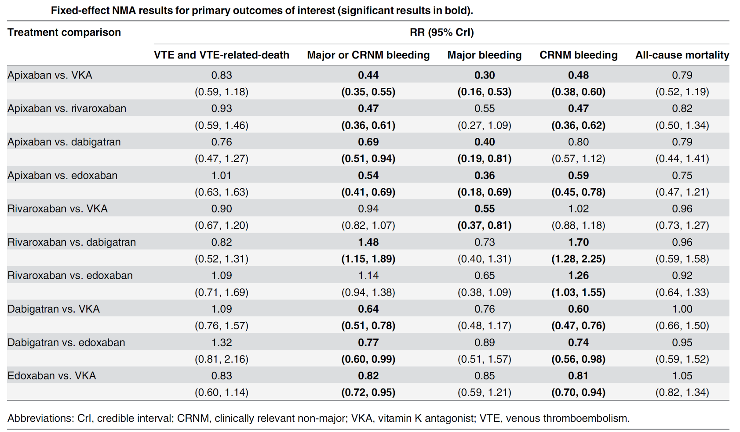

Slide 45
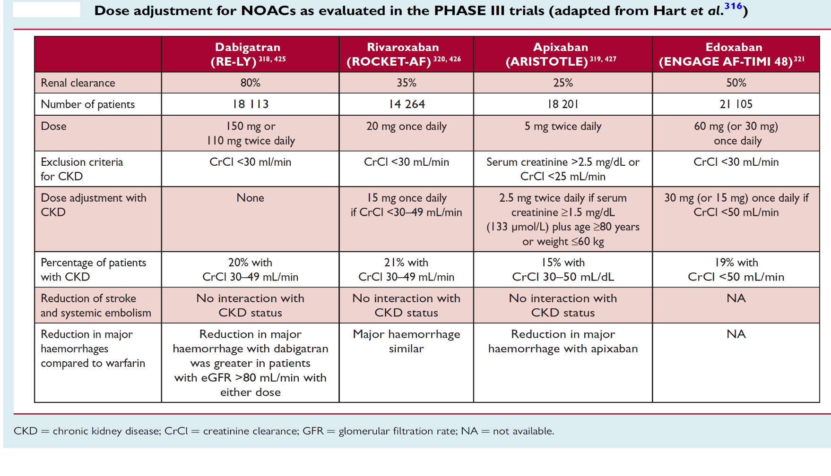

Slide 46
A 83 year-old man had DVT and PTE after admission in hospital due to right knee septic arthritis. He has diabetes normal creatinine (1.3)(Cl creatinine=42 ml/min) (weight=70 kg). I treated him with Warfarin with INR goal of 2-2.5. In follow up His INR value was out of range in many times, so I switched to Rivaroxaban (Xarelto=15 mg qhs). Two weeks later he was admitted due to hematuria and INR=5???. What is your suggestion for him?
Dabigatran 110 mg bid
Dabigatran 75 mg bid
Rivaroxaban 10 mg qhs
Apixaban 2.5 mg bid
Apixaban 5 mg bid
Edoxaban 60 mg daily
Edoxaban 30 mg daily

Slide 47
Take home message
Which NOAC needs more precaution in CKD?
Which NOAC is safer in CKD?
Which NOAC is associated with less chance of bleeding?
Which NOAC is administered once daily?

Slide 48
Marked variation in the efficacy of BB across cardiovascular health: Global systematic review
Reza Mollazadeh, Associate professor of cardiology; Fellowship of interventional cardiac electrophysiology and pacemaker, Imam Khomeini medical center, Tehran University of medical sciences

Slide 49
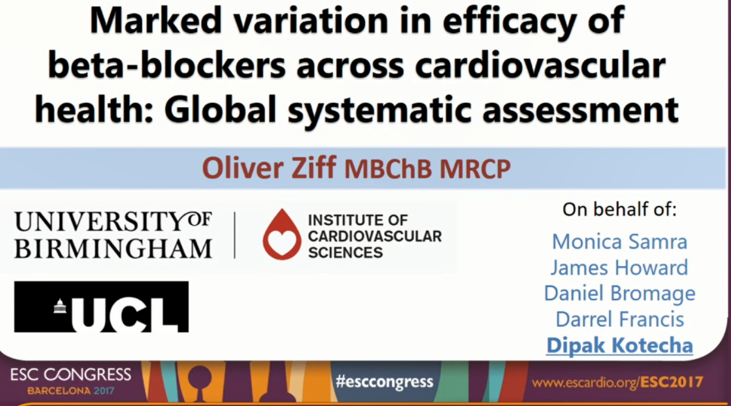

Slide 50
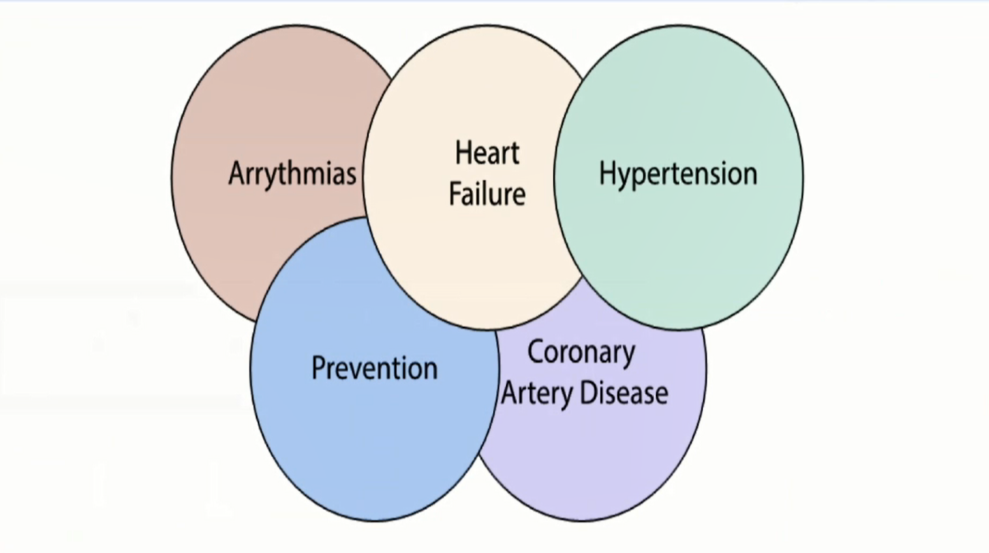

Slide 51
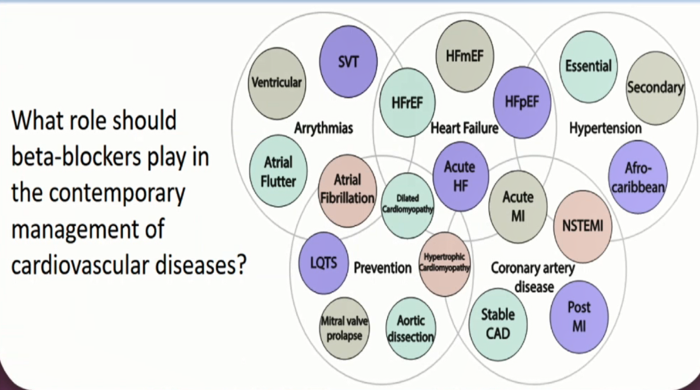

Slide 52
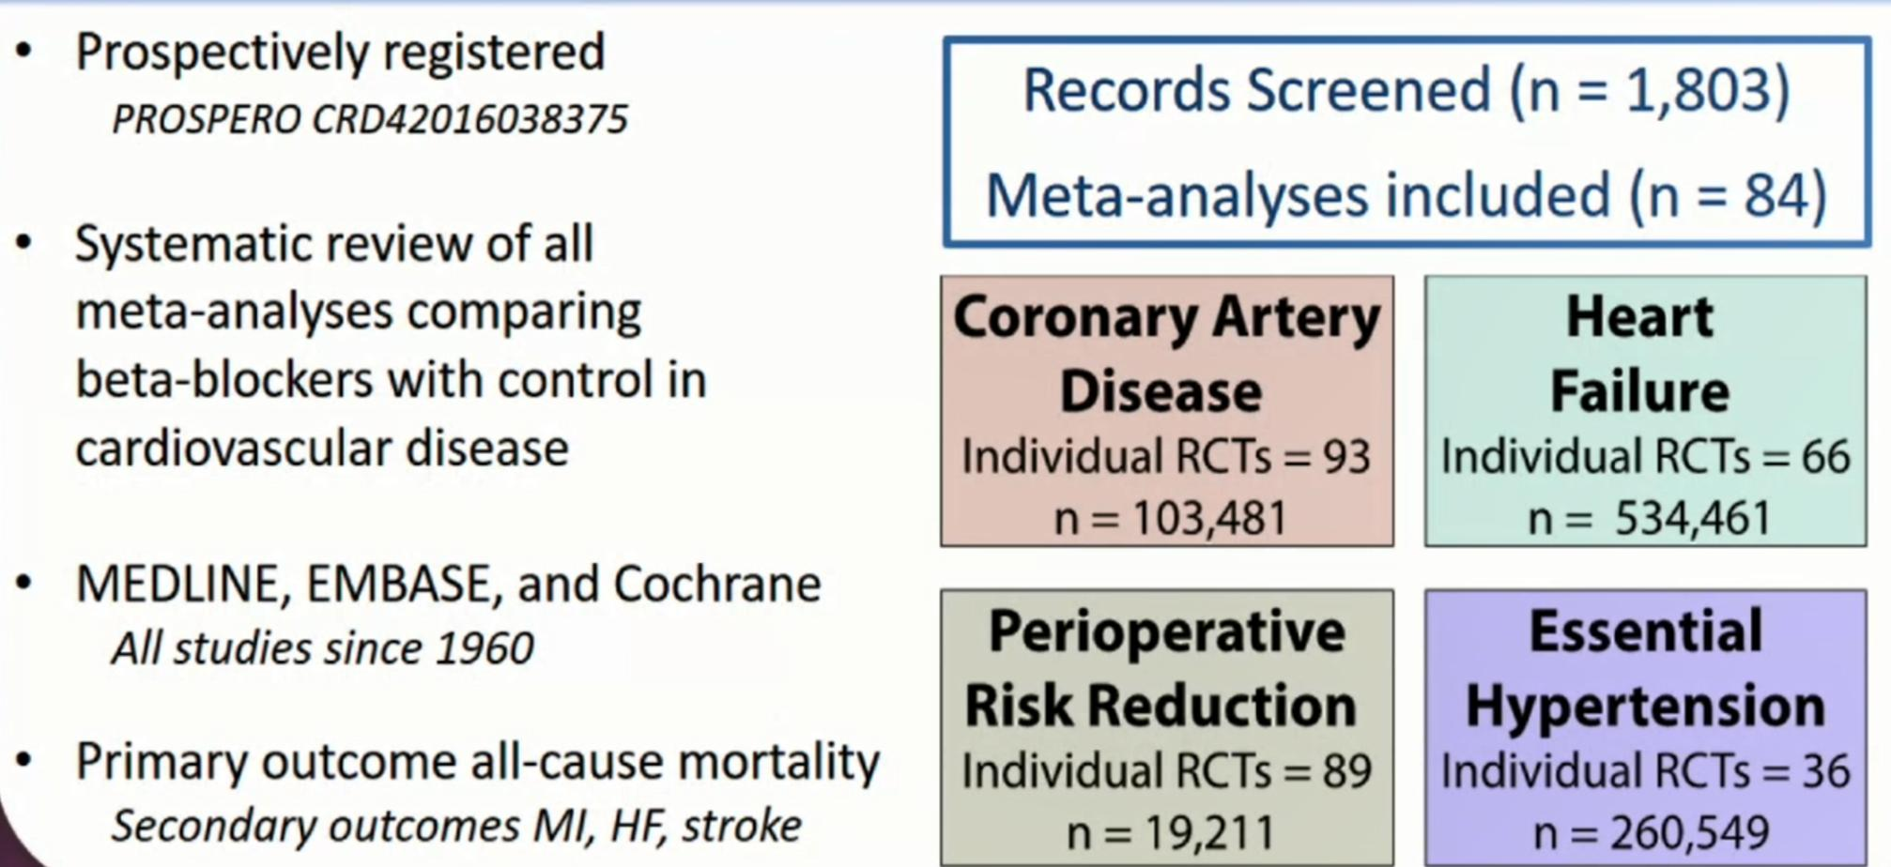

Slide 53
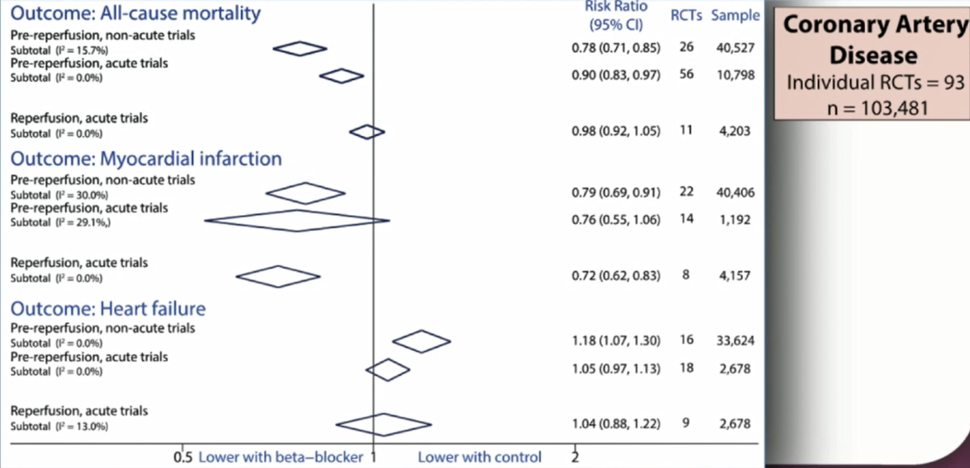

Slide 54
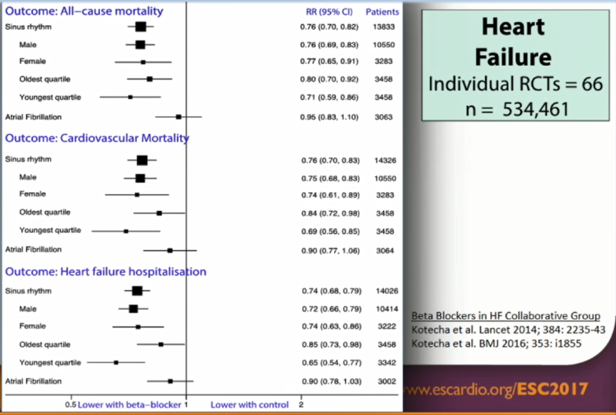

Slide 55
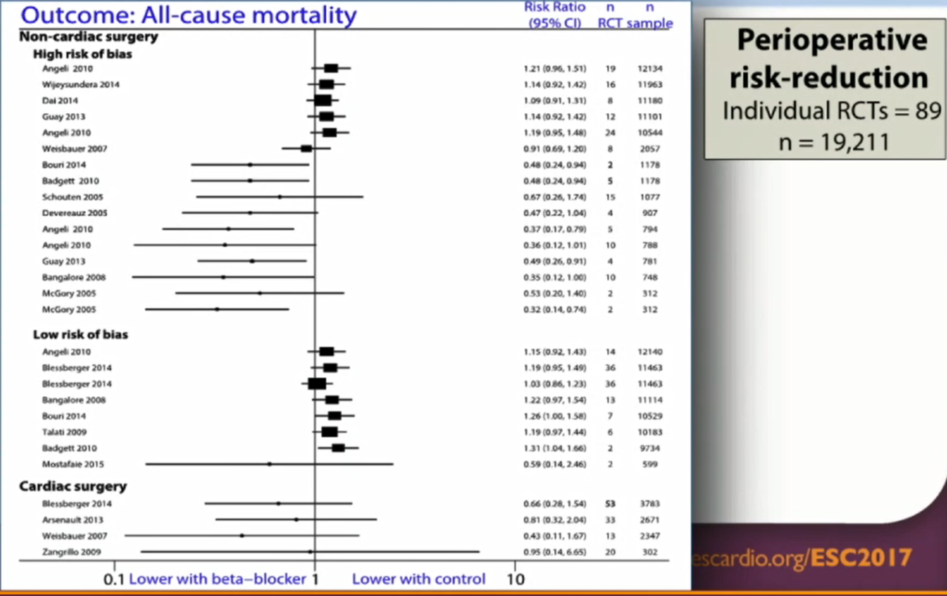

Slide 56
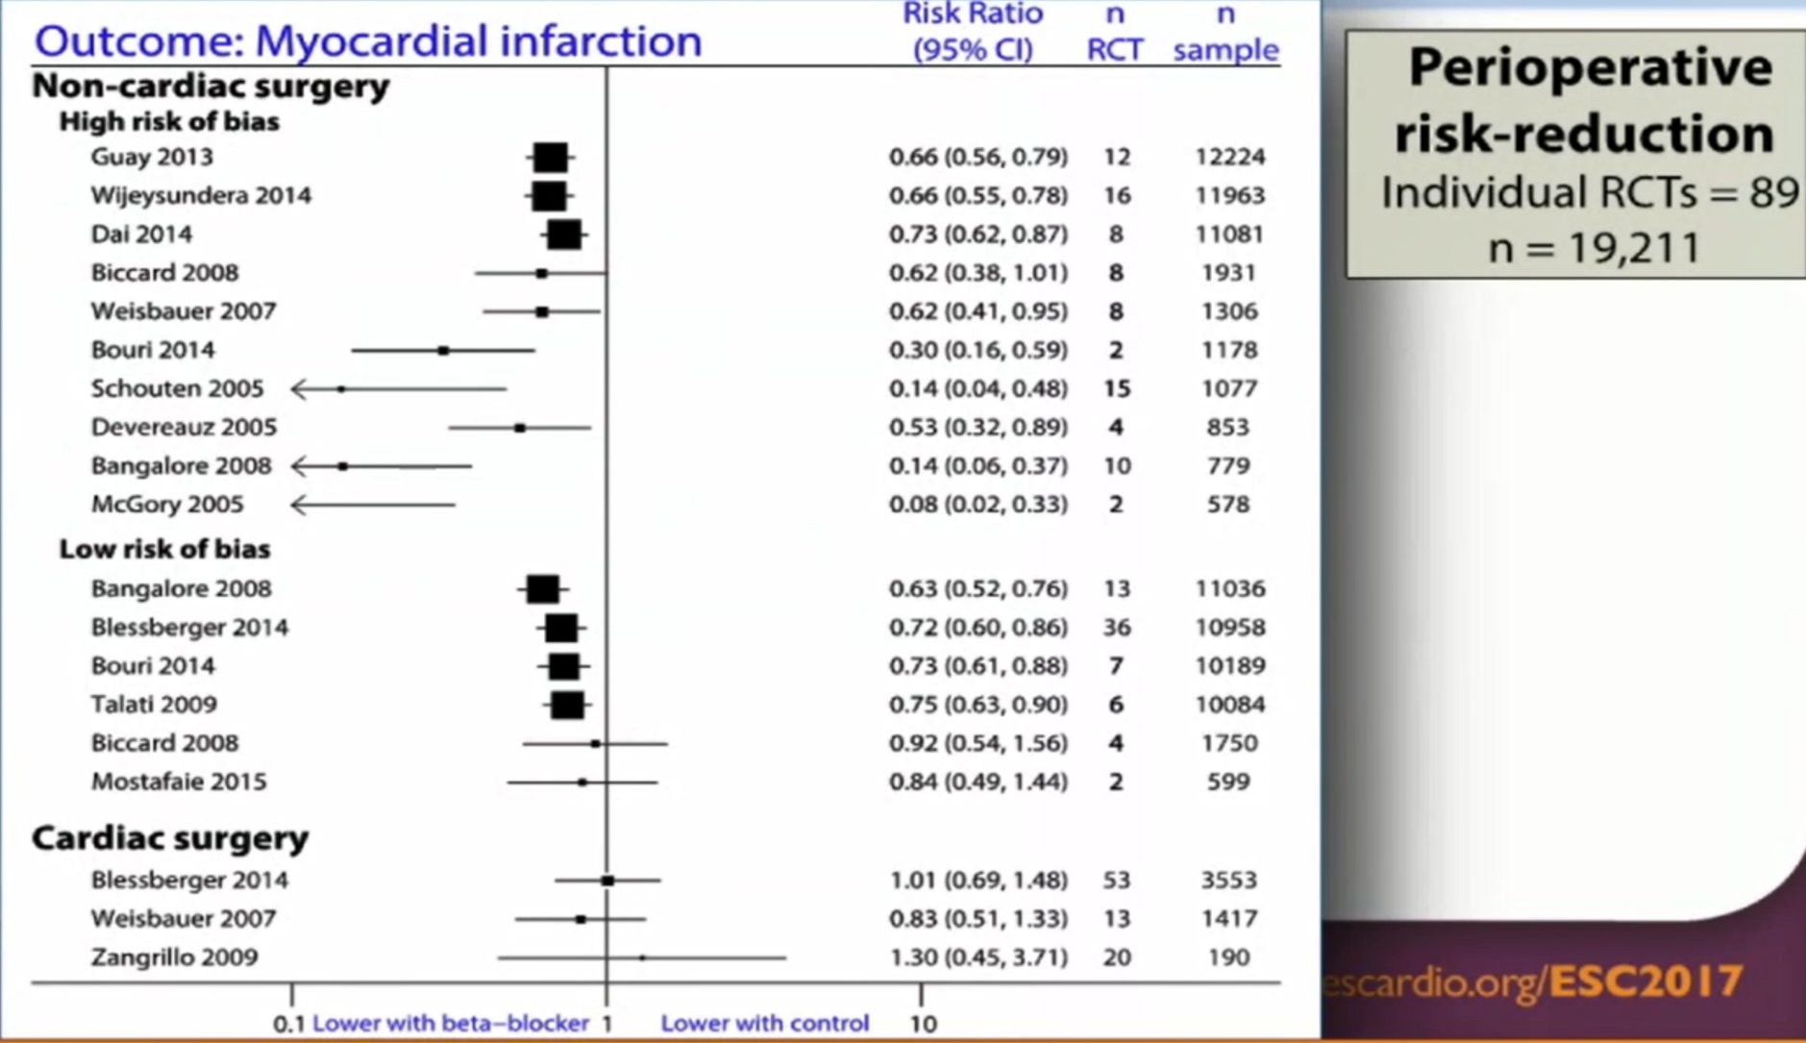

Slide 57
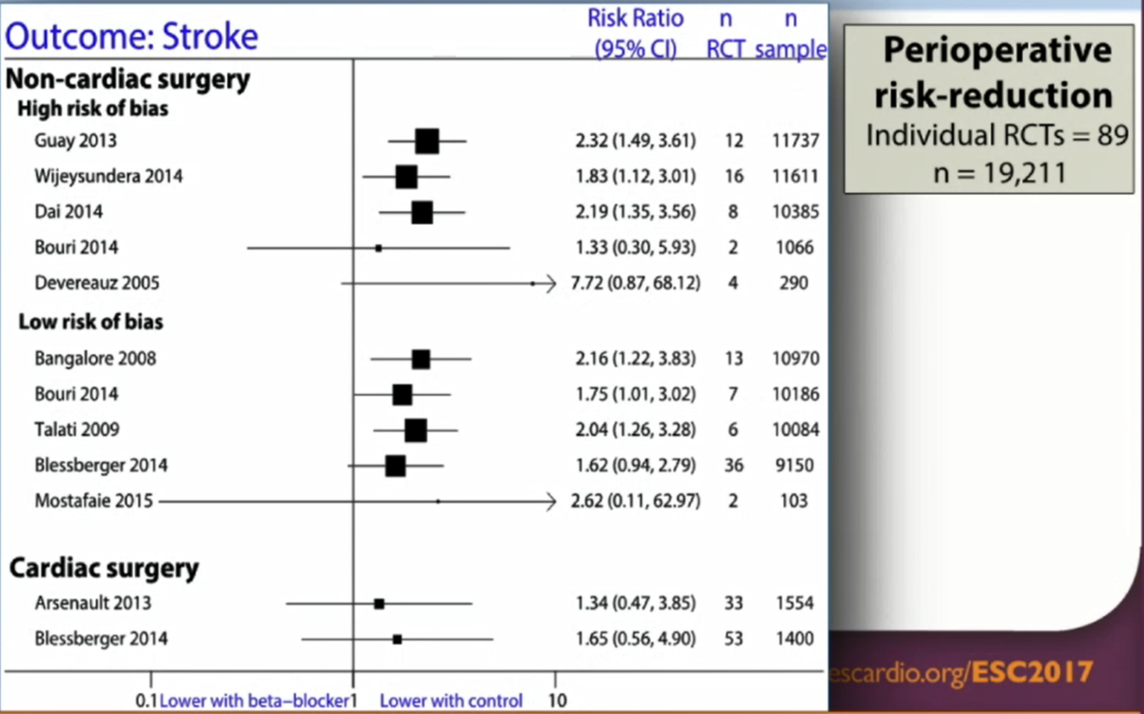

Slide 58
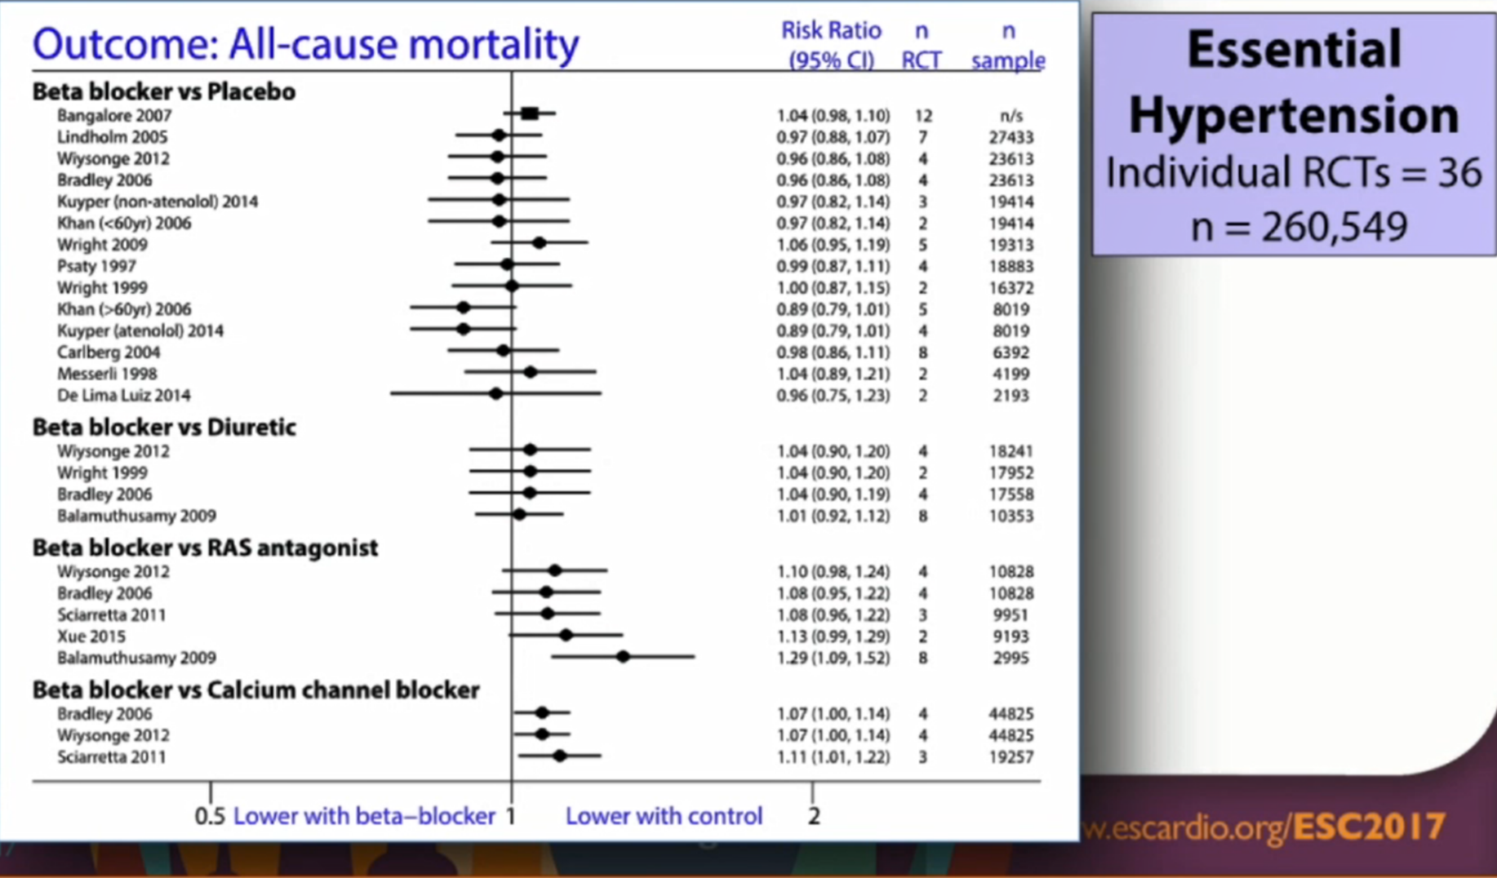

Slide 59
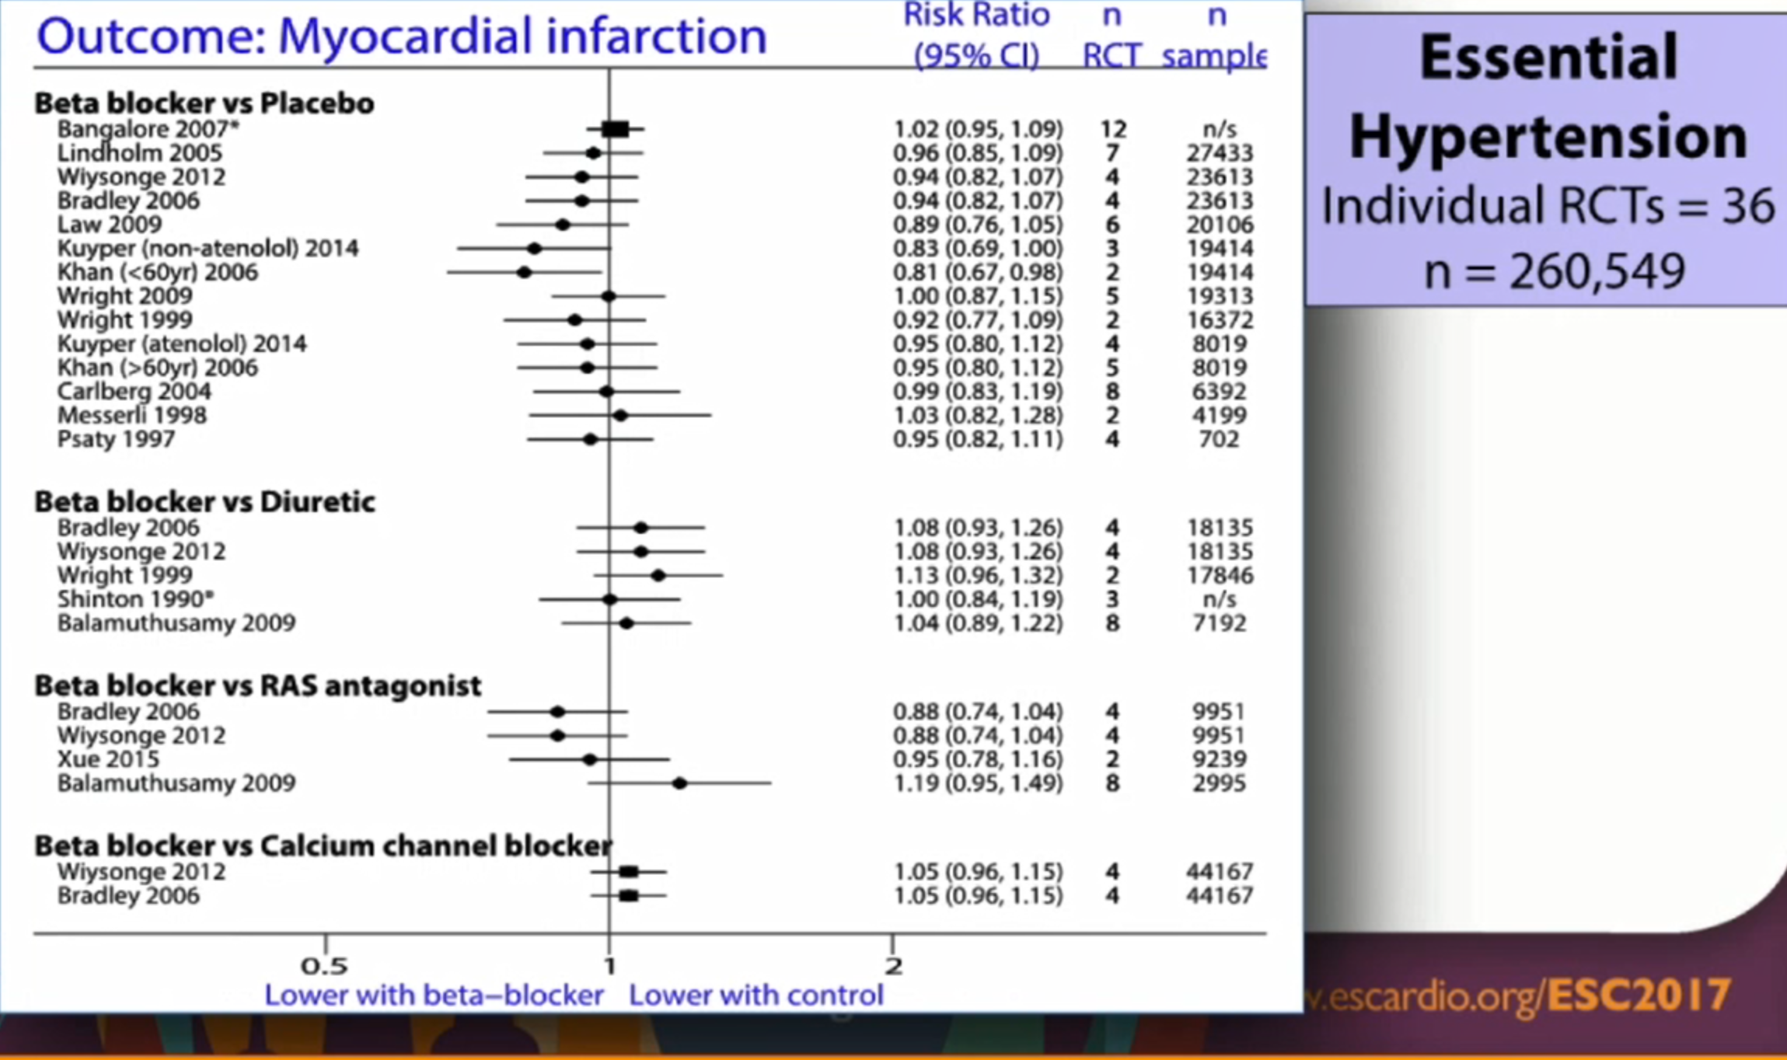

Slide 60
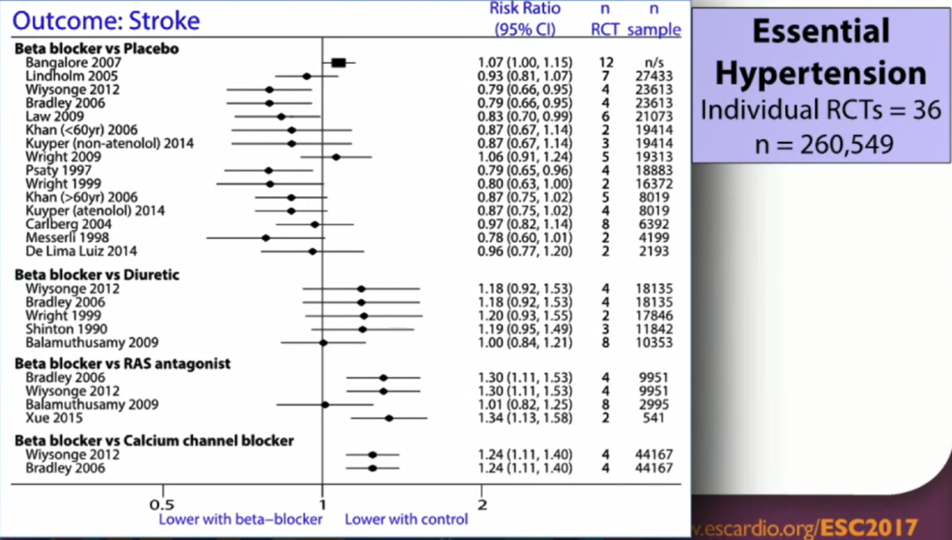

Slide 61
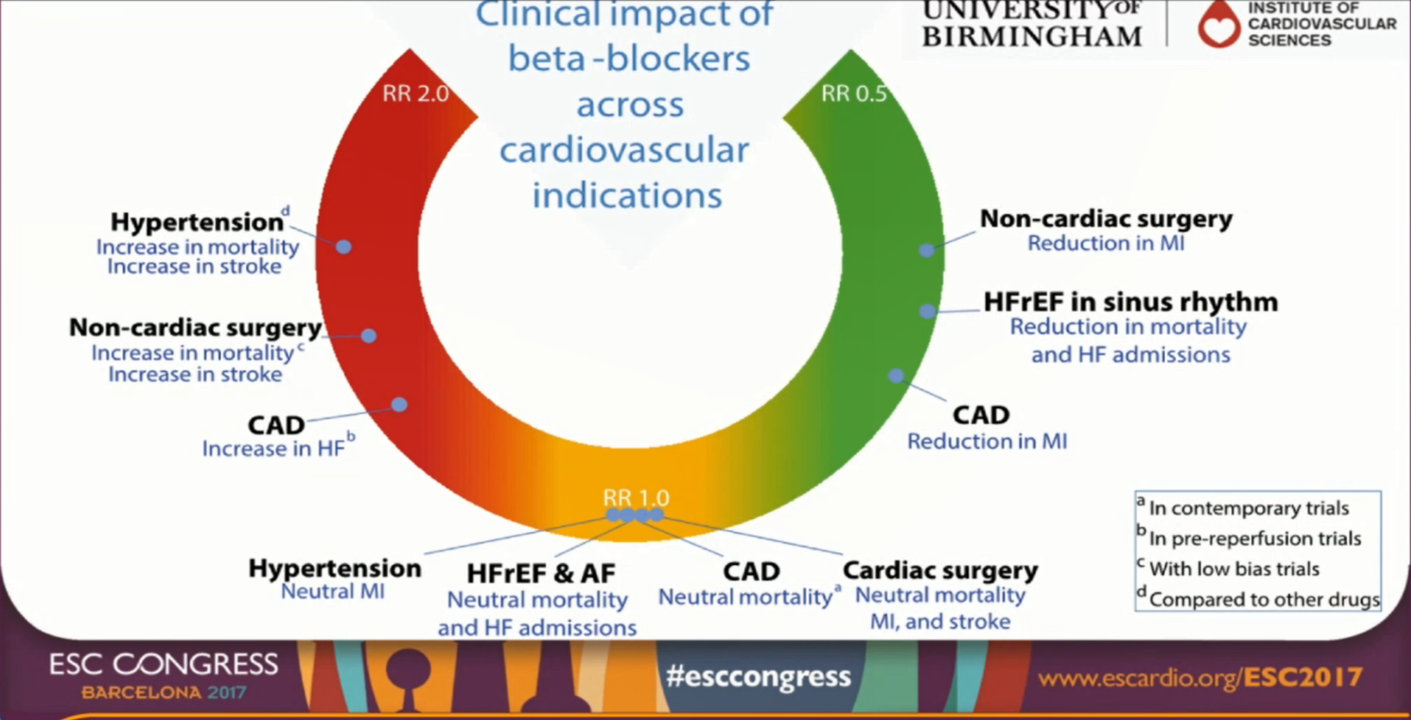
Take home message

Slide 62
Role of diuretics in HF (Based on 2016 ESC HF guidelines)

Slide 63
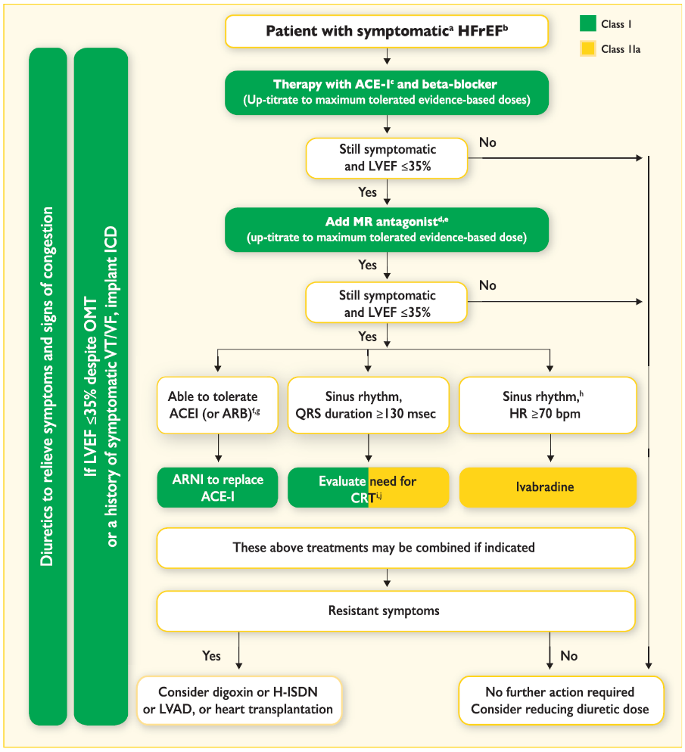
Role of diuretics in HF management

Slide 64
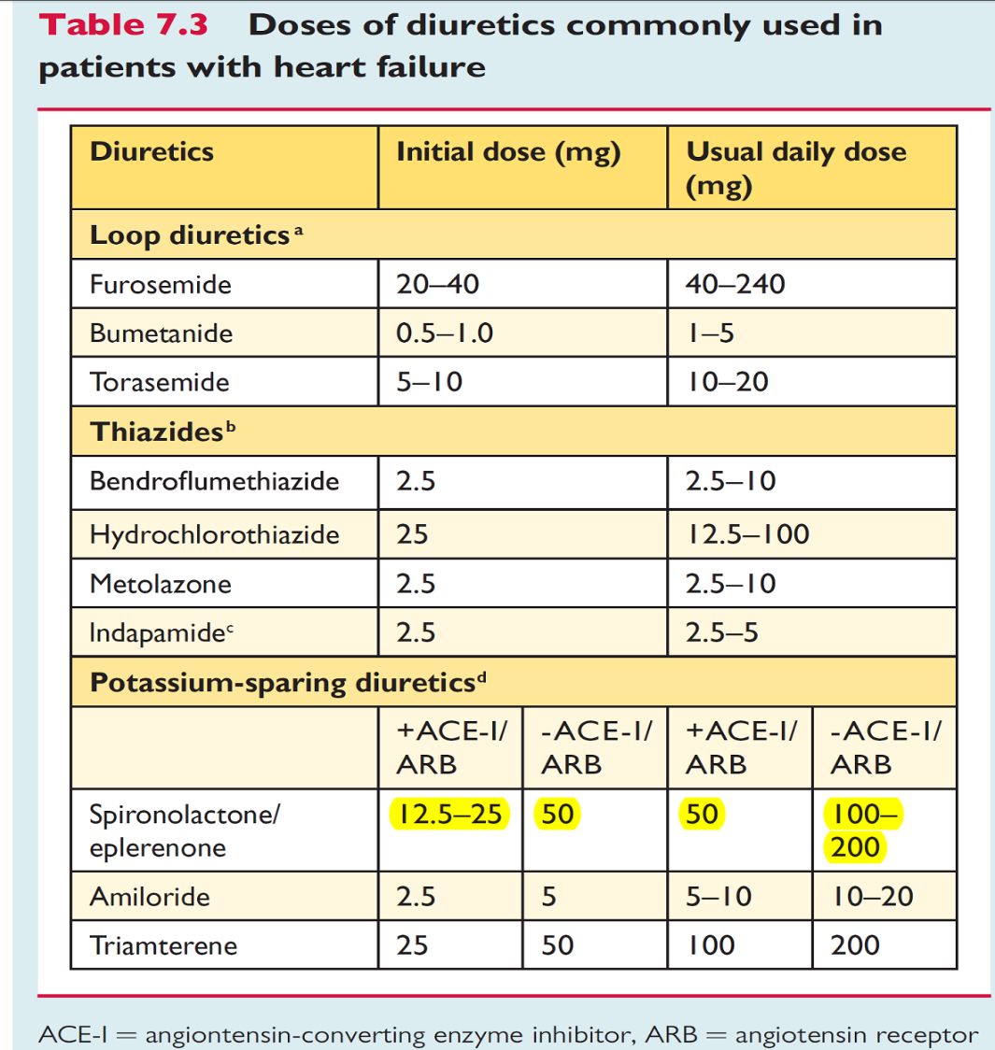

Slide 65
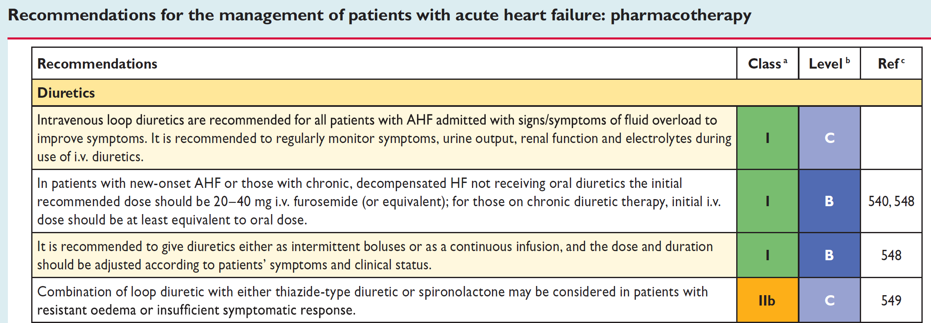

Slide 66
How to prevent stroke?
Pharmacologically or non pharmacologically?
NOAC vs Warfarin
Reza Mollazadeh, Associate professor of cardiology; Fellowship of interventional cardiac electrophysiology and pacemaker, Imam Khomeini medical center, Tehran University of medical sciences

Slide 67
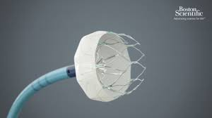
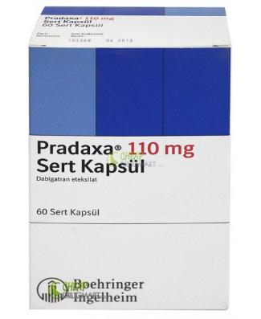
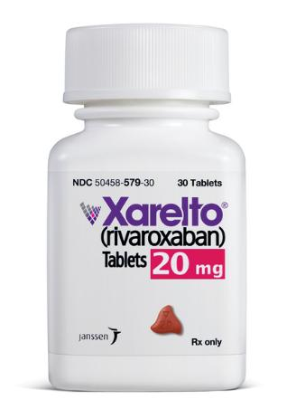
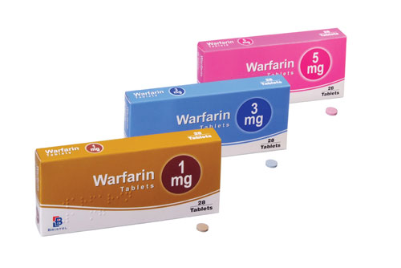
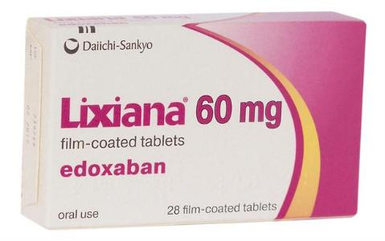
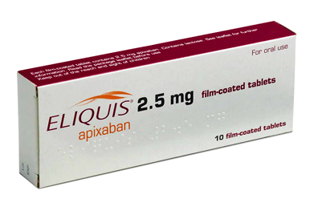
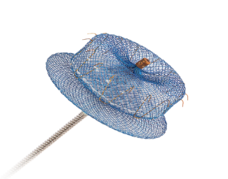
Notes:
Dabigatran (Pradaxa ; Boehringer)
rivaroxaban (Xarelto; Bayer and Johnson & Johnson)
Apixaban (Eliquis; Pfizer and Bristol-Myers Squibb)
Edoxaban (Daiichi-Sankyo)

Slide 68
Case 1: A 58 –year-old man was referred to our clinic due to AF rhythm. Previous medical history was remarkable for Hypertension, CRF (Cr=1.8, Cl cr=28cc/min) and non ischemic cardiomyopathy (LVEF=25% and so ICD-VR was implanted for him). Two months ago the patient had TIA. He was on ASA, Losartan, Atorvastatin, Carvedilol, Spironolactone and furosemide. What is your suggestion for this patient regarding reducing risk of thromboembolism?
Adding Dabigatran 75 mg bid to his medications
Dabigatran 150 mg bid as a substitute for ASA
Adding Warfarin to his medications (1.5<INR goal <2.5)
Warfarin as a substitute for ASA (2<INR goal <3)
LAA occlusion
Notes:
CHADS2=============➔4
CHADS- VASc=1-1-0-0-2-0-0-0=====➔4
HAS-BLED= 1-0-1-0-0-0-0 ====➔2

Slide 71
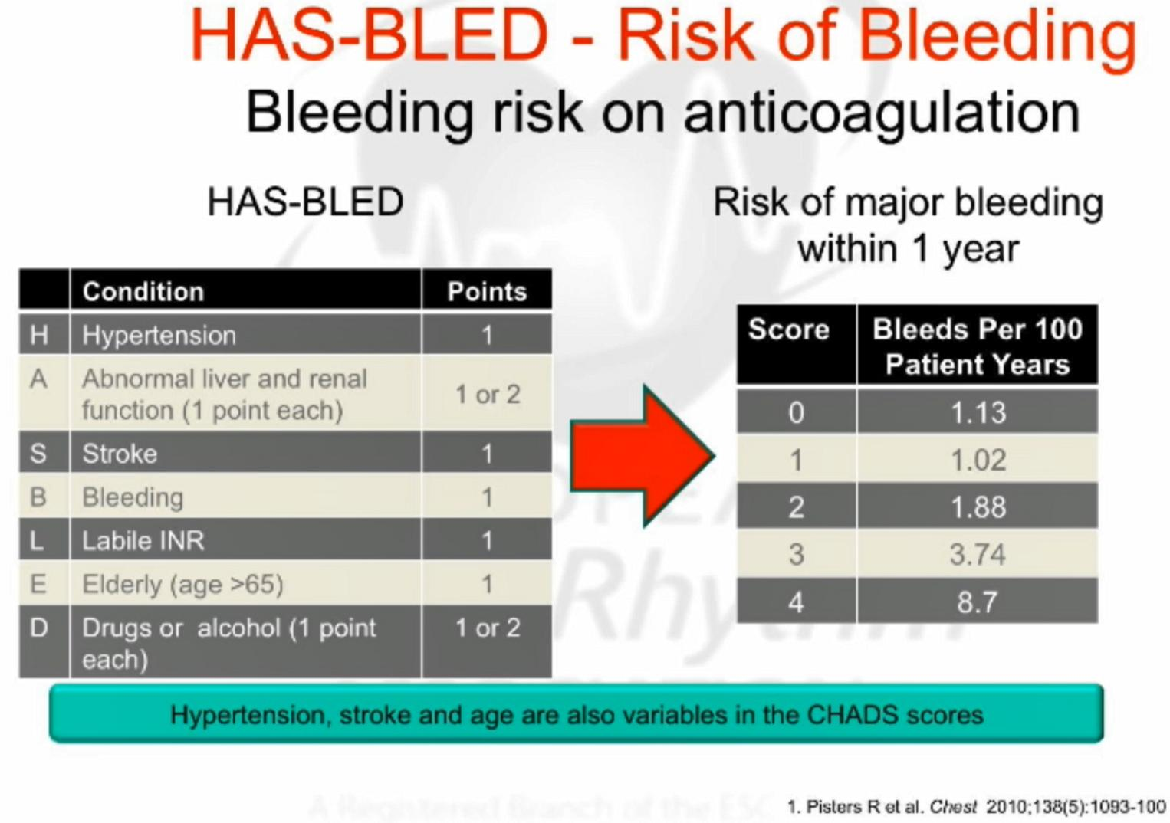

Slide 72
Notes:
Cr>2.6 gains 1 point

Slide 73
A 58 –years-old man was referred to our clinic due to AF rhythm. Previous medical history was remarkable for Hypertension, CRF (Cr=1.8, Cl cr=28cc/min) and non ischemic cardiomyopathy (LVEF=25%). Two months ago the patient had TIA. He was on ASA, Losartan, Atorvastatin, Carvedilol, spironolactone and furosemide. What is your suggestion for this patient regarding reducing risk of thromboembolism?
Adding Dabigatran 75 mg bid to his medications
Dabigatran 150 mg bid as a substitute for ASA
Adding Warfarin to his medications (1.5<INR goal <2.5)
Warfarin as a substitute for ASA (2<INR goal <3)
LAA occlusion
Notes:
CHADS- VASc=1-1-0-0-2-0-0-0=====➔4
HAS-BLED= 1-0-1-0-0-0-0 ====➔2

Slide 74
During follow-up, INR was not in the therapeutic range (majority of the times<1.8 or >3). What is your suggestion regarding reducing risk of thromboembolism?
Continuation of warfarin
Changing warfarin to ASA + Clopidogrel
LAA occlusion
Dabigatran

Slide 75
INR Control in Routine Practice Is Suboptimal
Many patients on VKAs have INR outside of the therapeutic range
Retrospective, multicentre cohort study (ISAM)
100
Time in therapeutic range
INR <2
INR 2–3
80
INR >3
60
% INRs
40
20
0
US
Canada
France
Italy
Spain
Ansell J et al. J Thromb Thrombolysis. 2007;23(2):83–91.
Notes:
INR control in routine practice is suboptimal – results from the ISAM study (1)
The ISAM study found that anticoagulation care varied from country to country and suggested that better INR control may be achieved in the anticoagulation clinic setting compared with routine care¹
Patients were treated in routine medical care in the US, Canada and France, and in anticoagulation clinics in Italy and Spain
Overall, in the real-life setting, INR control in many patients is far from optimal
Reference
Ansell J et al. J Thromb Thrombolysis 2007;23:83–91

Slide 78
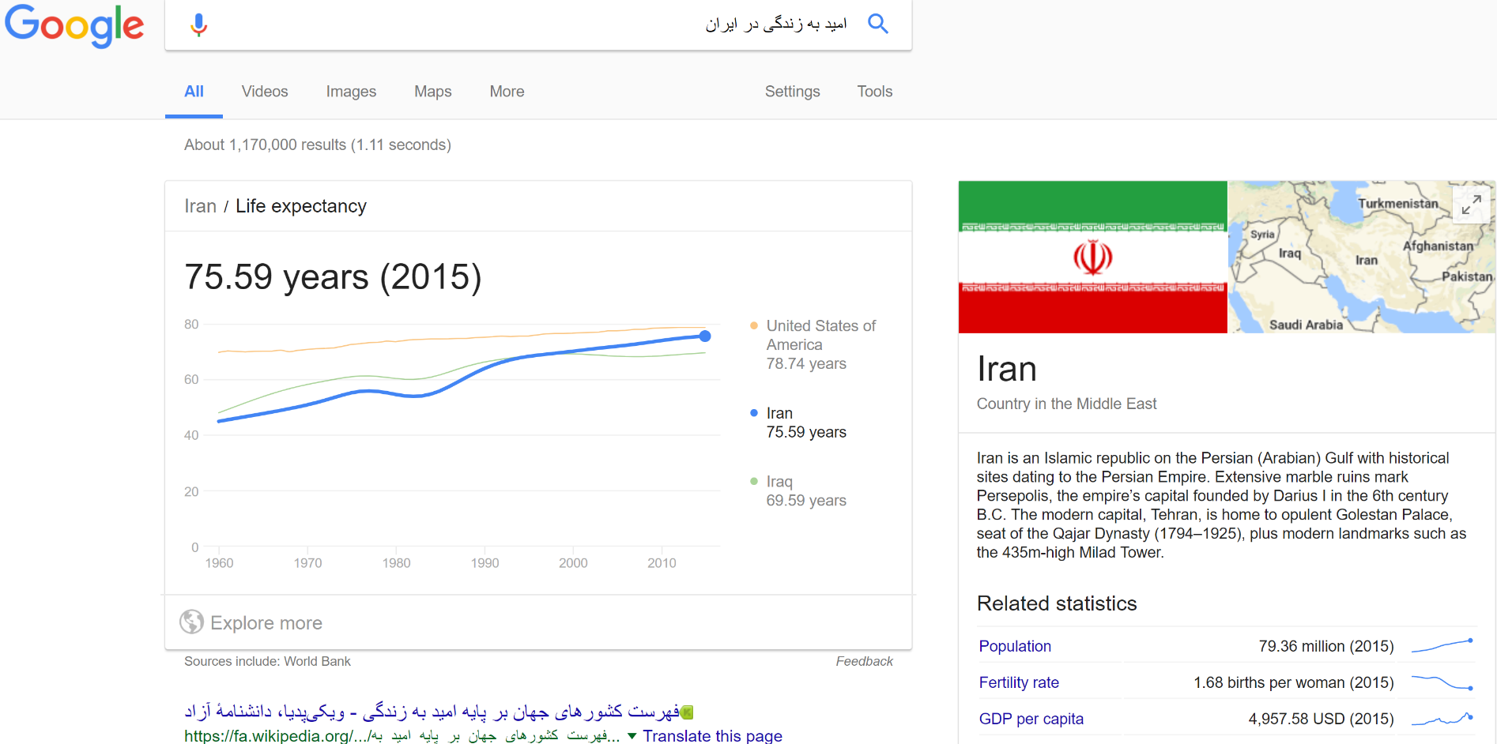
72% life time risk of TE
54% life time risk of bleeding

Slide 79
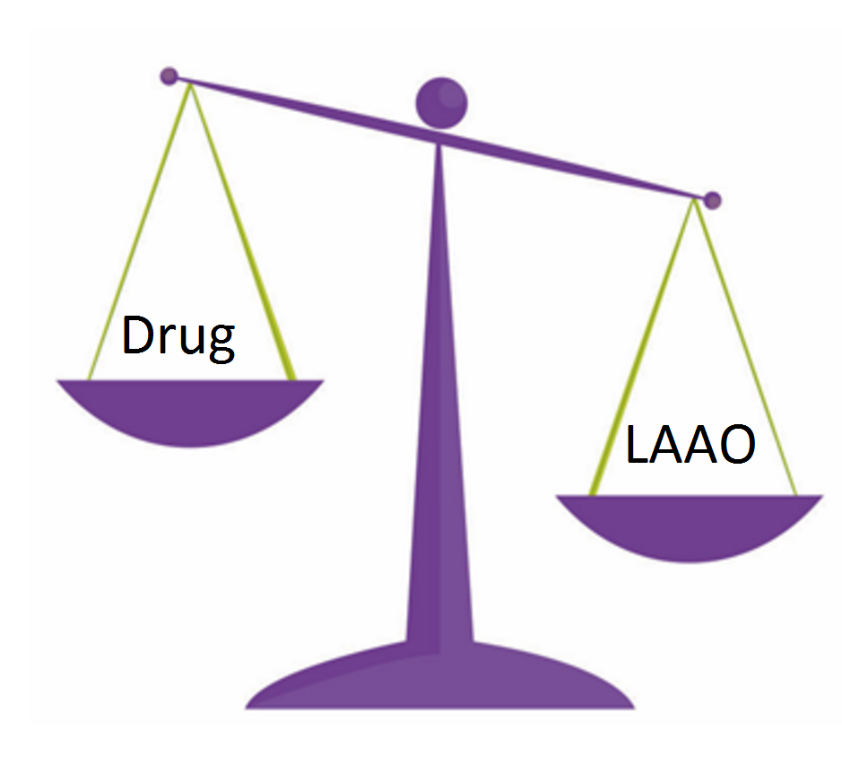

Slide 80
During follow-up, INR was not in the therapeutic range (majority of the times<1.8 or >3). What is your suggestion regarding reducing risk of thromboembolism?
Continuation of warfarin
Changing warfarin to ASA + Clopidogrel
LAA occlusion
Dabigatran

Slide 81
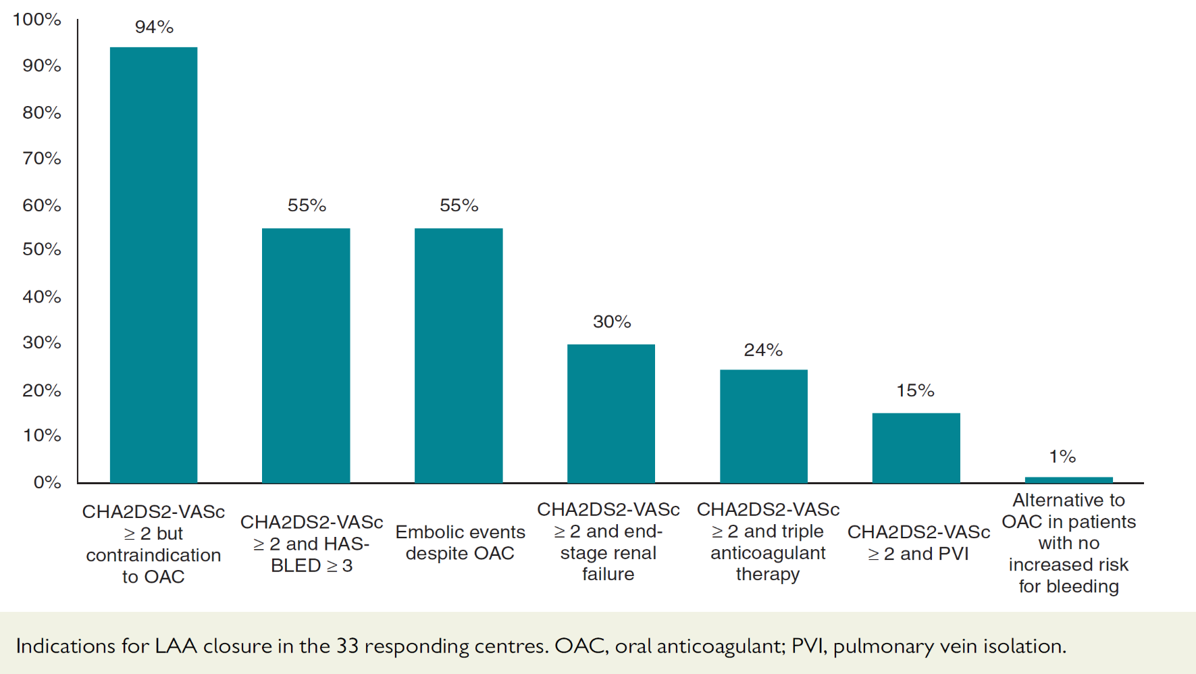
Indications for LAA
Notes:
The purpose of this EPWirewas to assess the indications, techniques, and outcomes of left atrial appendage occlusion (LAAO) in Europe. Thirty three European centers, all members of the European Heart Rhythm Association electrophysiology (EP) research network, responded to this survey by completing the questionnaire. The major indication for LAAO (94%) was the prevention of stroke in patients at high thromboembolic risk (CHA2DS2-VASc ≥ 2) and contraindications to oral anticoagulants (OACs). Twenty-one (64%) of the responding centers perform LAAO in their own institution and 80% implanted 30 or less LAAO devices in 2014. Two-dimensional trans esophageal echocardiography was the preferred imaging technique to visualize LAA before, during, and after LAAO in 79, 58, and 62% of the participating centres, respectively. Following LAAO, 49% of the centres prescribe vitamin K antagonists or novel OACs. Twenty-five per cent of the centres combine LAAO with pulmonary vein isolation. The periprocedural complications included death (range, 0–3%), ischemic or hemorrhagic stroke (0–25%), tamponade (0–25%), and device embolization (0–20%). In conclusion, this EP Wire has demonstrated that LAAO is most commonly employed in patients at high thrombo-embolic risk in whom OAC is contraindicated. The technique is not yet very widespread and the complication rates remain significant.

Slide 82
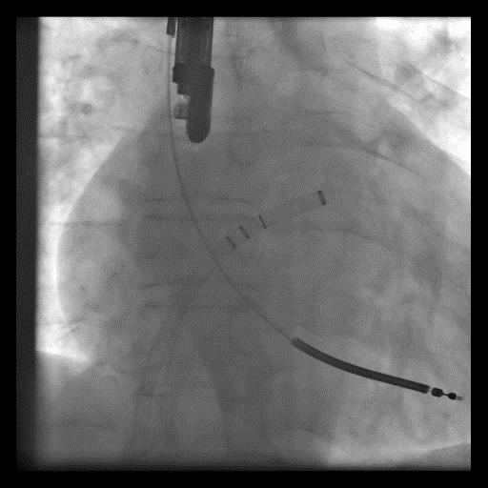

Slide 83


Slide 84


Slide 85


Slide 86



Slide 87

Take home message

Slide 88


Triple therapy
Reza Mollazadeh, Associate professor of cardiology; Fellowship of interventional cardiac electrophysiology and pacemaker, Imam Khomeini medical center, Tehran University of medical sciences

Slide 89
Scenario: CAD + Non- valvular AF

Slide 90
The current understanding is that DAPT is necessary to prevent stent thrombosis but not sufficient for stroke prevention.
(N)OAC are essential for stroke prevention but on their own not suitable for preventing new coronary events, especially in the acute/subacute setting

Slide 91
A 67-year-old man was admitted in B.A. hospital due to recent onset increase in dyspnea on exertion (10.2017) .

Slide 92
Past medical history: Hypertension since ?, CVA (probably ischemic) in 2014 leading to hemiparesis
Normal renal function
Drug history: ASA, captopril and atorvastatin
Irregular pulse rate and tachycardia (120-130/min)

Slide 93

ECG

Slide 94
Echocardiography
Top normal LV size (LVEF:25%), global LV Hypokinesia

Slide 95
Coronary angiography was performed. LAD and LCX had significant lesion. Percutaneous coronary intervention for mid part of LAD was performed successfully with Drug eluting stent. LCX stenting deferred for 1 month later.

Slide 96
Is there any need for anticoagulation/Thromboembolism prevention in this patient?
Yes
No

Slide 97
Notes:
January CT,Wann LS, Alpert JS, Calkins H, Cigarroa JE, Cleveland JC Jr et al. 2014
AHA/ACC/HRS guideline for the management of patients with atrial fibrillation: a
report of the American College of Cardiology/American Heart Association Task
Force on practice guidelines and the Heart Rhythm Society. Circulation 2014;130:
e199–267.

Slide 98
Is there any need for anticoagulation in this patient considering consumption of ASA and Clopidogrel?
Yes
No

Slide 99
Is there any risk for bleeding in this patient?
Yes
No

Slide 100


Slide 101
The physician in charge prescribed Clopidogrel 75 mg, ASA 80 mg, warfarin, pantoprazole 40 mg and bisoprolol 2.5 daily and discharged the patient with OPD follow-up.

Slide 102
Now the patient is on triple therapy. If you were in charge of this patient, What would be your suggestion?
Triple therapy with warfarin + DAPT (Already the patient uses this regimen)
Triple therapy with NOAC + DAPT
Dual therapy (NOAC+ single antiplatelet therapy)

Slide 103


Slide 104


Slide 105


Slide 106


Slide 107


Slide 108


Slide 109


Slide 110


Slide 111


Slide 112


Slide 113


Slide 114


Slide 115


Slide 116


Slide 117


Slide 118
If you decide to prescribe a NOAC for this patient, which one is your first choice?
Rivaroxaban
Dabigatran
Apixaban (not yet available in Iran)

Slide 119


Slide 120
In dual therapy strategy(NOAC + single antiplatelet therapy), do you prefer to use
ASA
P2 Y12 inhibitor

Slide 121
Among all P2y12 inhibitors available in Iran, which one do you suggest in this patient?
Clopidogrel
Prasugrel
Ticagrelor

Slide 122
3 weeks later, the patient was brought by his relatives to ER (F. hospital) due to agitation, weakness and abnormal behavior.

Slide 123


Follow-up 3 weeks later

Slide 124
The physician in charge discontinued all his antithrombotic medications. After several days the patient was discharged with clonazepam, ASA and Clopidogrel. He was completely debilitated and spoked with difficulty.

Slide 125

Triple vs. dual antithrombotic therapy
24 Oct 2018

Slide 126


Slide 127


Slide 128


Slide 129


Slide 130


Slide 131


Slide 132


Slide 133


Slide 134
Take home message

Slide 135


